Slide 1
Mock-Ups for Visualization Test

Slide 2
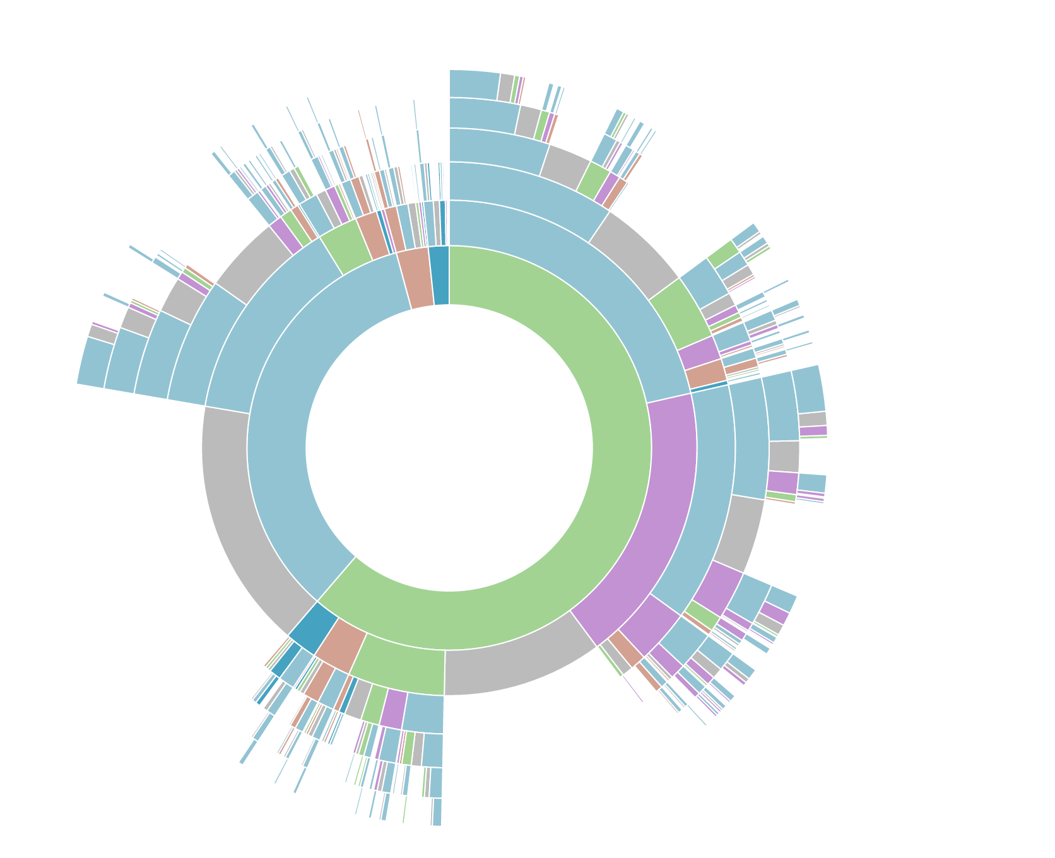
Automotive
Hybrids
Toyota Prius
Total hits to this part of the site structure is 1039. Coverage rate is 0.0003, 65% below the minimum coverage threshold
Click Here

Slide 3
Automotive
Hybrids
Total hits to this part of the site structure is 8650. Coverage rate is 0.003, 88% the above the minimum coverage threshold
Click Here

