Slide 1
Presidential Campaign Finance Map
Sleepless @ Pulitzer

Slide 2
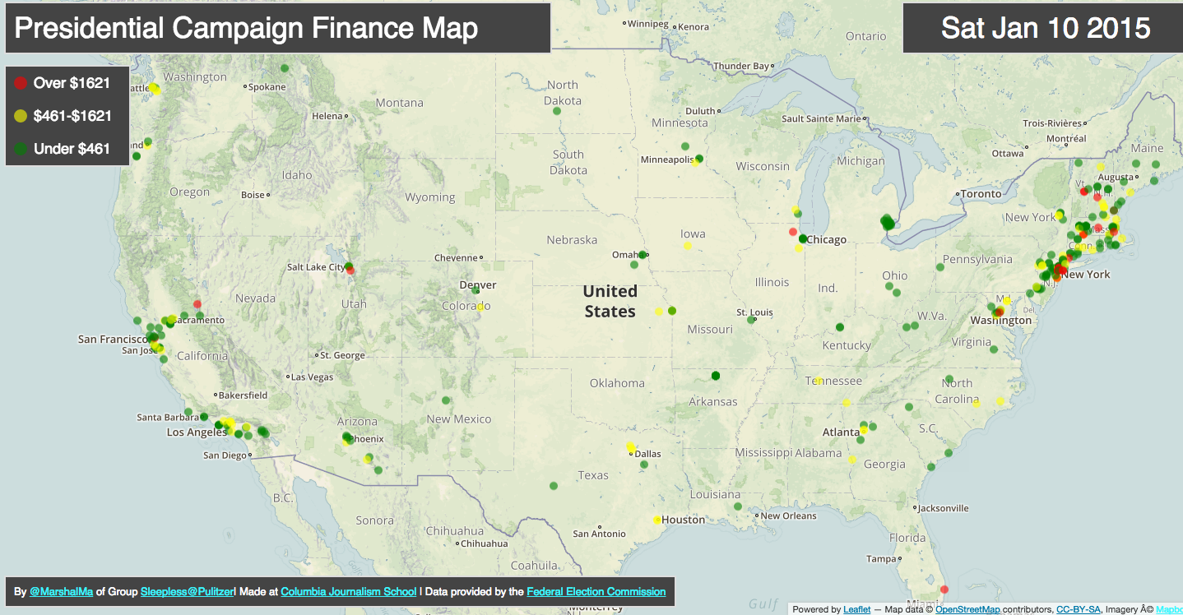

Slide 3
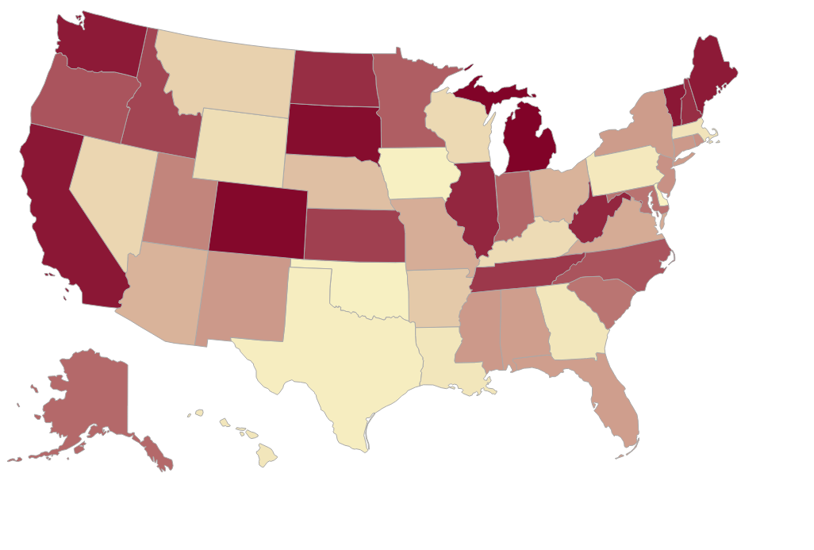
Monthly Transaction

Slide 4
Monthly Transaction

Slide 5
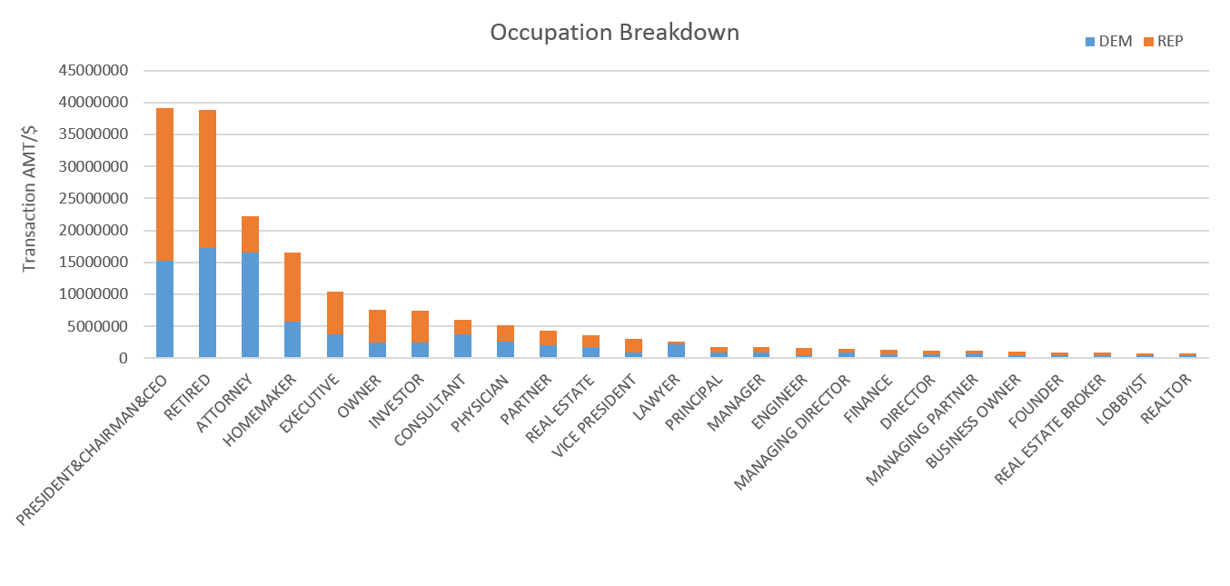
Transaction Amount & Occupation

Slide 6
Transaction Amount for individual

Slide 7
Transaction Amount & Employer - Republican

Slide 8


Transaction Amount & Employer - Republican
Finance & Insurance
Business & Information
Natural Resources &
Environmental
Others

Slide 9
Transaction Amount & Employer - Democratic

Slide 10
Transaction Amount & Employer - Democratic
Legal & Security
Finance & Insurance
Business & Information
Others

Slide 11
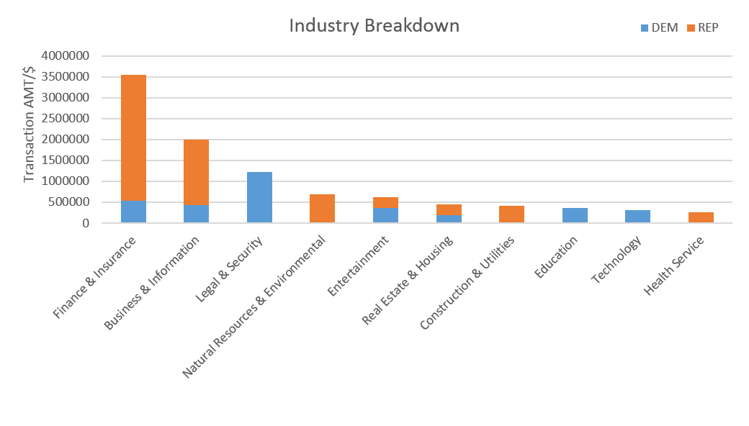
Transaction Amount & Employer

