Slide 1
PYTHON Lessons 51-61
By yours truly

Slide 2
Table of Contents
Grouping Conditionals
‘Switch’
Verifying the Blockchain & Blockchain Theory
Using Conditions in a loop
Using ‘else’ in loops
‘Range’ function
Module Intro
Understanding data required for a Blockchain

Slide 3
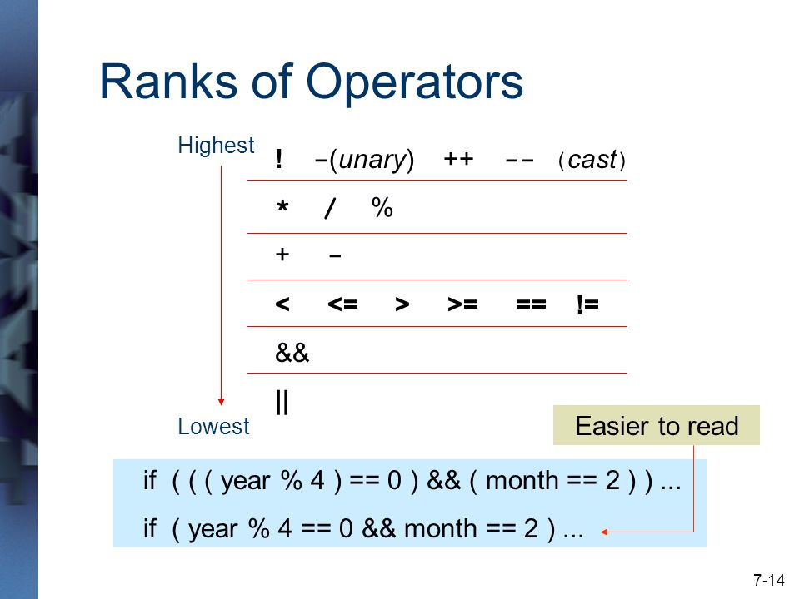
Grouping Conditionals
Pretty simple, all you do is use parentheses.
Not sure if there’s a rank of conditionals like in Java.
That’s for java >>

Slide 4
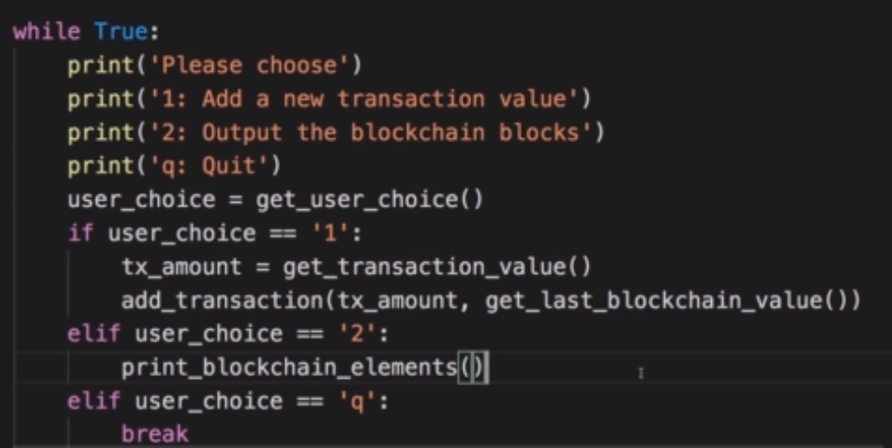
‘Switch’
THERE IS NO SWITCH CASEEEEEEEE!

Slide 5

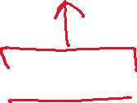
Verifying the Blockchain
[[1], 3.5]
[[[1], 3.5], 8.0]
[[[[1], 3.5], 8.0], 10.0]
Well, what if your blockchain gets hacked?
‘h’ option for hack.
We can check!
Also, +=

Slide 6


Using Conditionals in a loop
Setting a variable instead of hardcoding something
Waiting_for_input instead of rightout True or False

Slide 7


Using ‘else’ in loops
Baaaaasically an else for a while loop. For loops, too.
(Haven’t seen this in java before)

Slide 8
‘range’ function
No worries, we have range()!
We’ve gone over range() before.
Starts at first param, ends right before second param, third param is step. Ye know, the basics.
No longer is there a need to manually increment and keep count of iterations.
The function goes as thus:
range(start, end, step)
NO FLOATSSSSS, ONLY INTS
Question: Is there a for(i = 0, I <=5, i++)?
…Hahaha No.

Slide 9
Module Intro
Tuples, sets, and Dictionaries
Iterable functions and behaviours
List comprehensions ^
By reference vs by value (we know what that means, is vs ==)
Modules – Stuff beyond simple numbers, conditionals, stuff

Slide 10
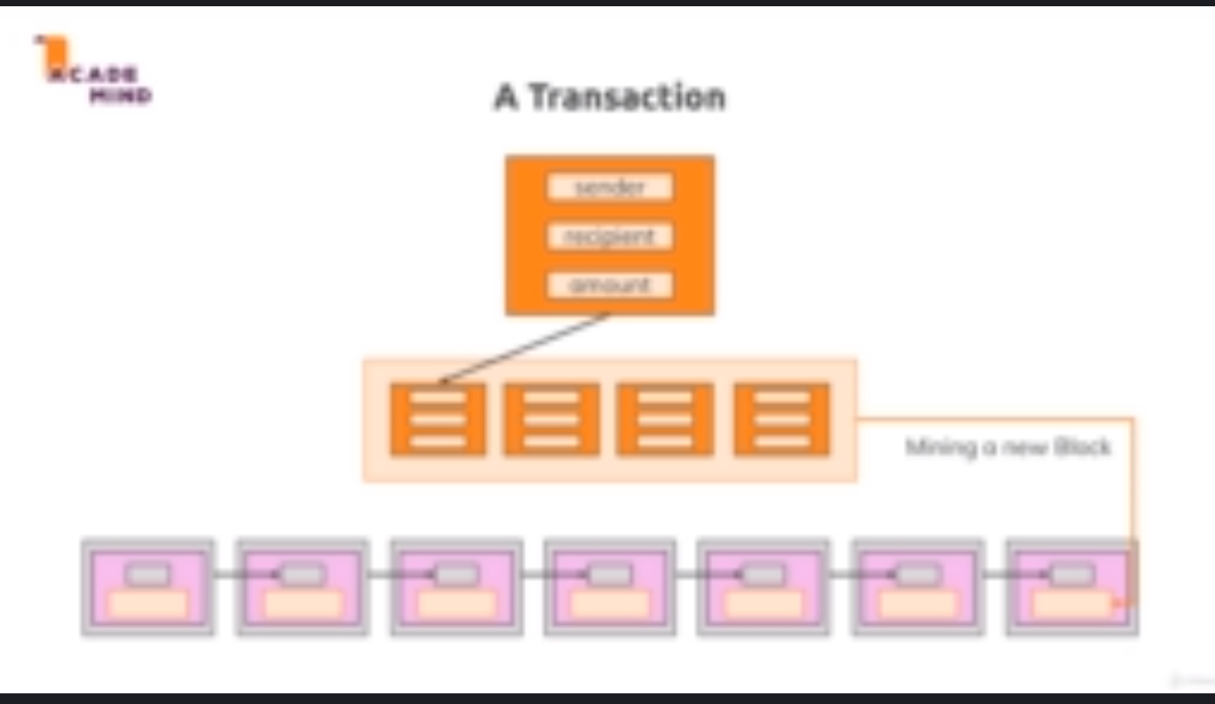
So what’s next, then?
It’s a mystery, of course, because My VPN/Wifi decides to be terrible for the last lesson, and it’s all blurry.
☺
Thank goodness I can still read the transcript and listen to him talk – I hear stuff about mining, senders, values, and receivers. Also stuff about information, but all that’s things in the future.
We need stuff like hashes and indexes and transactions. We could also get a list of participants!
I’ll tell ya what’s next:
Look there >>>

