Slide 1
Python Stuff
By: Me

Slide 2
Topics for Today
Formatting strings
Using f
Adding formatting to the blockchain
The map function
Lambda
Reducing Lists
Unpacking format functions
Lessons 99&100

Slide 3
Formatting Strings
A STRING IS NOT A LIST!
Fun stuff
‘This is a {} string because {}’.format([insert whatever], [insert whatever])
Endless formatting! No length limit (that we know of)

Slide 4
The ‘f’ thing
Fun stuff, can be used to format numbers.
:6.2f means six spaces before the decimal (including number) and two decimal points afterwards
F will round for you!
Symbols are fun too!
< means align to the left, default
> means align to the right
^ means align to the centre
In the blockchain we just align things to look nicer. Two decimal places.

Slide 5
The map function
Example:
Randomstuff = [1,2,3,4]
Def timestwo(el):
… return el * 2
list(map(timestwo, randomstuff)
Will give you
[2,4,6,8]
Map repeats a function for all elements in an iterable
Returns a list, but you need to wrap it or else you’re just getting the address
Alternative to list comprehensions

Slide 6
Lambda
Why use lambda?
It’s fast!
It’s simple!
It’s concise!
No need to reuse function. (One-time calculation for a list
When not to use lambda:
When your functions are too complex
Pretty much just that
HAHAHAHHAHAHAHAHHAHAHAHAHAHAHAAHHAHAHAAHAHAAAHAHAHAHHAHAHAHAHHAHAHAHAHAHAHAAHHAHAHAAHAHAAAHAHAHAHHAHAHAHAHHAHAHAHAHAHAHAAHHAHAHAAHAHAAAHAHAHAHHAHAHAHAHHAHAHAHAHAHAHAAHHAHAHAAHAHAAA

Slide 7
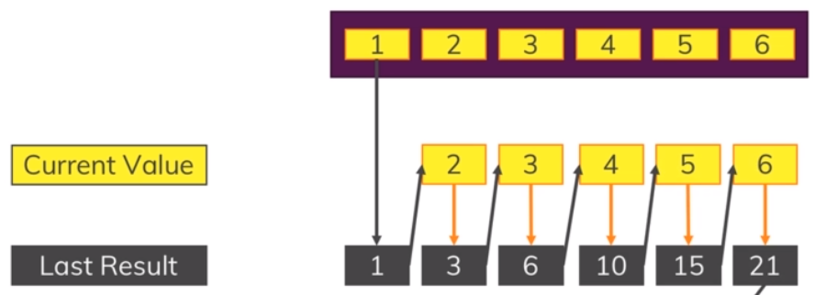
Reducing Lists
Basically, you do something to the whole list
It becomes something that is not a list
At first, two results. Current Value and Last Result
P.s. it’s basically how we do math
Functools
Reduce function
Similar to a map function, but now for reducing things like addition/subtraction/multiplication/division
3 lines into one!

Slide 8
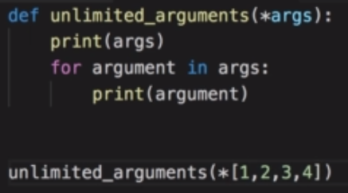

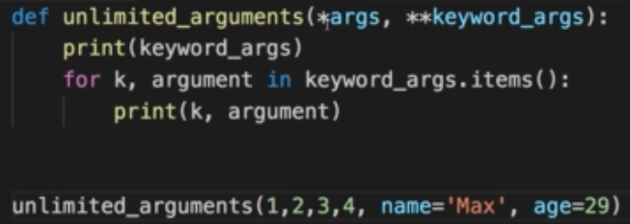
Unpacking format functions
Endless parameters, endless possibilities!!!
In professional terms, ‘unlimited positional arguments’
The MAGICAL STAR!
**********
It’ll come out as a tuple
Stars can also unpack lists
Two stars unpack a dictionary

Slide 9
Lessons 99 & 100
Introduction to the next units;
Python Standard Library (everything built in)
Importing/Exporting stuff! (functools, math)
Oh, and, we’re finally getting an actual HASH instead of checking back

