Slide 1



Adnoc Taxi
Driving Growth with
Sustainable Solutions
A Forward-thinking Initiative Aligned With UAE's Sustainable Transportation
©2024-2025 ADNOC Distribution

Slide 2




Executive Summary
Purpose
Financial Impact
Launching Adnoc Taxis for growth and sustainability.
AED XX million projected revenue and XX% operational savings.
Request
Growth Opportunity
Approval for rollout and required budget allocation.
Untapped markets, tourism hubs, and premium services.

Slide 3
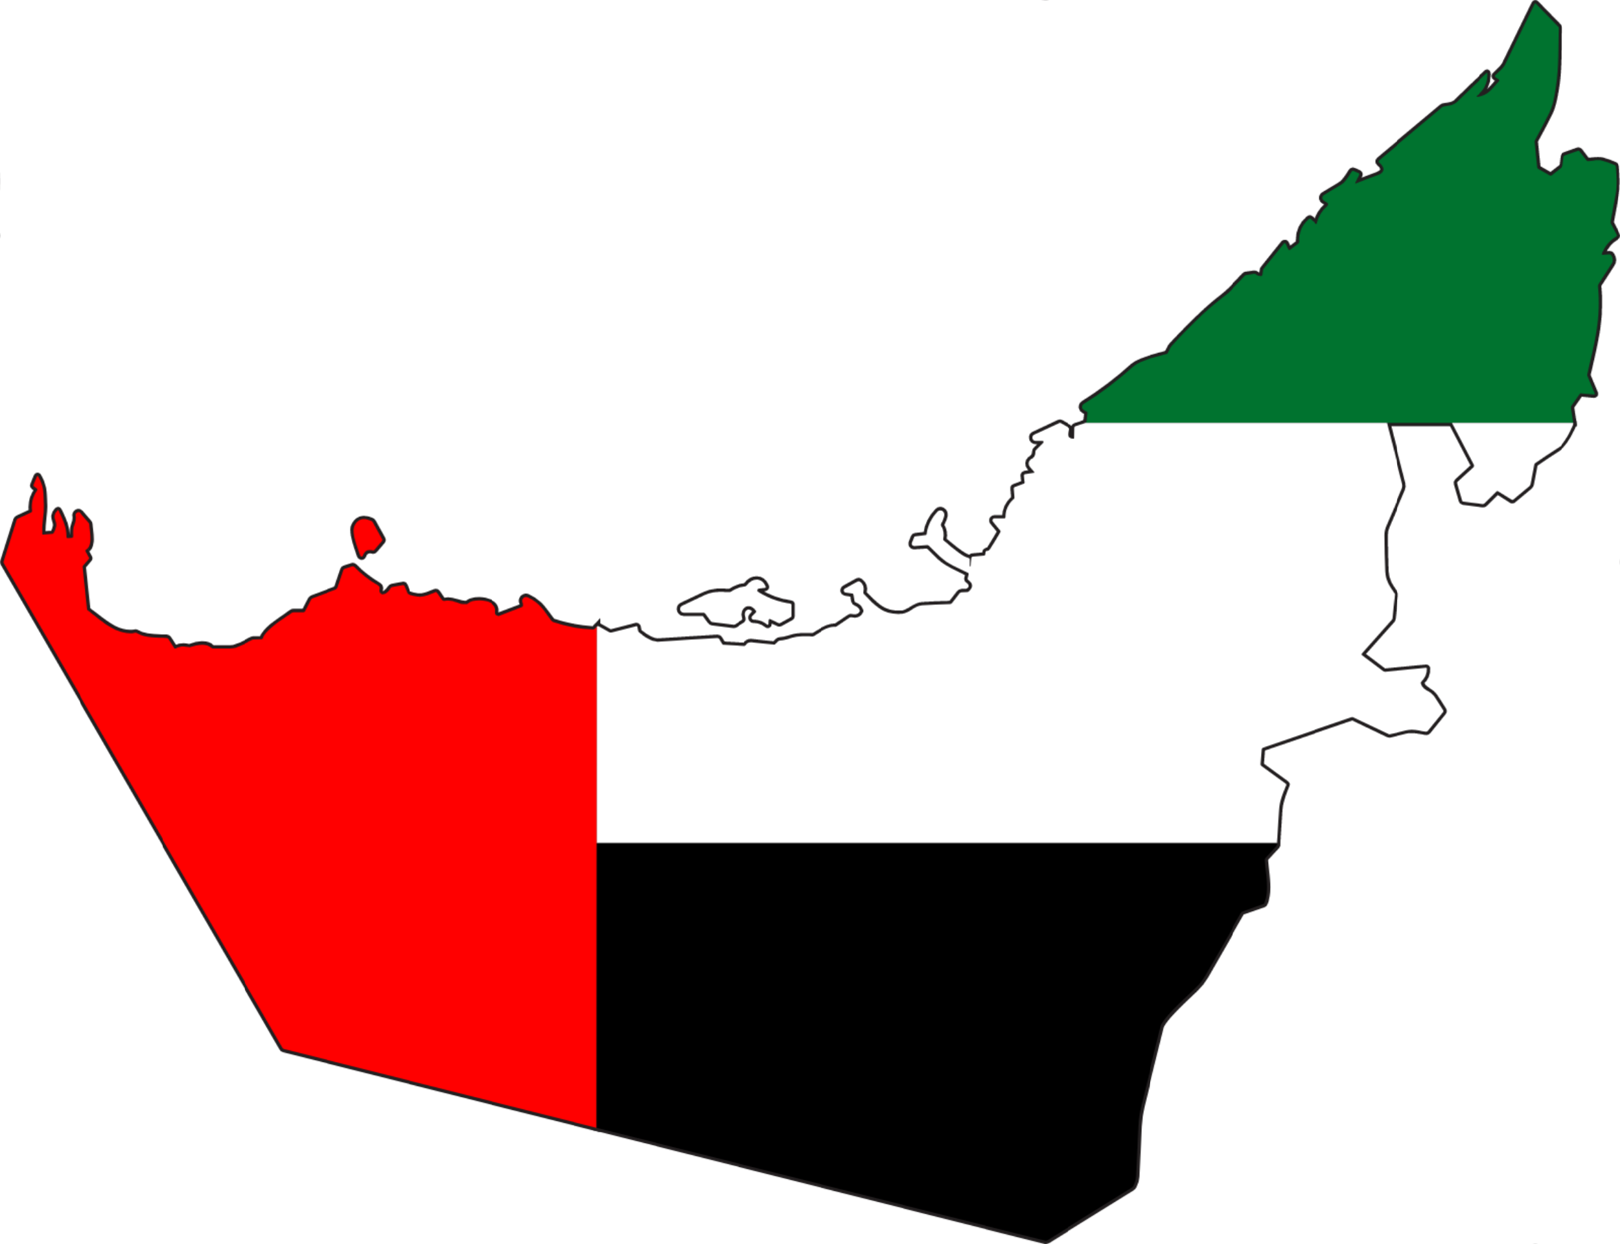
Problem And
Opportunity Statement
01
Growing demand for sustainable transport options in UAE.
02
Enhance Customer Experience
03
Integrated Ecosystem

Slide 4




Strategy Pillars
02
Leverage partnerships (BYD & Al-Futtaim).
Vision & Strategy
Vision Statement
01
To become the UAE’s leading provider of sustainable taxi services.
Transition to EVs (electric vehicles).
03
Enhance customer experience with smart technology.

Slide 5


Fare Structure &
Investment Breakdown
Revenue Model
Fare Details
Revenue Streams
01
Base fare: 10 AED
01
Passenger fares.
02
Per km rate: 3.10
02
Subscriptions.
03
Subscription tiers: Blue, Gold, Platinum for frequent riders.
03
Ad revenue from branded taxis.

Slide 6
Financial Overview
ROI: Break-even by Year 3.

Slide 7
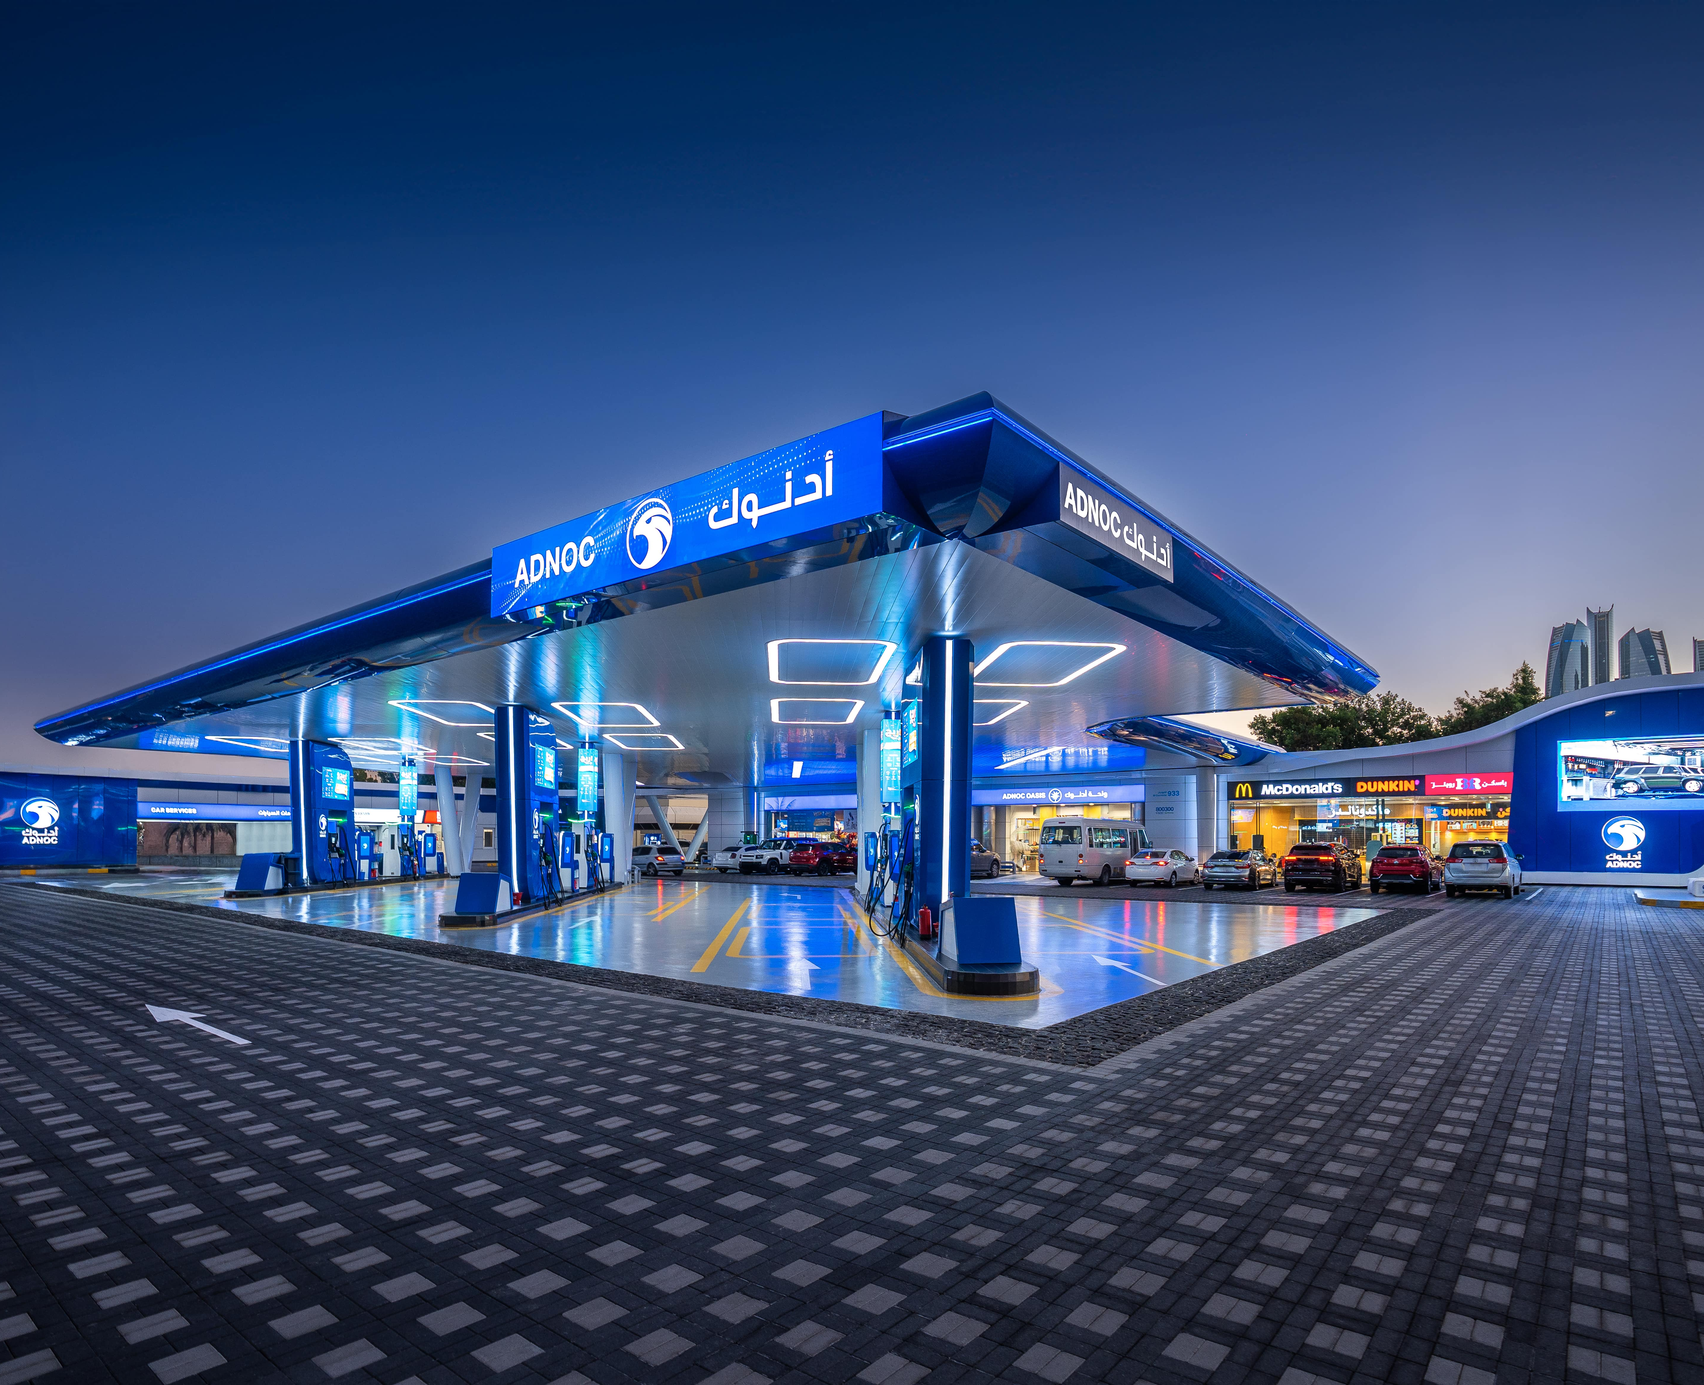



Growth
Opportunities
Expansion into underserved markets and tourism hubs.
Loyalty-based premium ride options.
Long-term partnership opportunities (e.g., BYD for maintenance contracts).

Slide 8



Risks & Mitigation
Risks
Mitigation Strategies
01
High initial investment in EV fleet.
01
Use of cost savings to offset investment.
02
Competition from established ride-hailing services.
02
Adnoc brand loyalty and innovative subscription services for differentiation.

Slide 9
Finalize partnerships with BYD and Al-Futtaim.
Implementation Plan
Launch pilot phase in key regions.
Q1 2025.
Pilot
Rollout full-
scale fleet and subscription models.
Q3 2025
Full launch

Slide 10
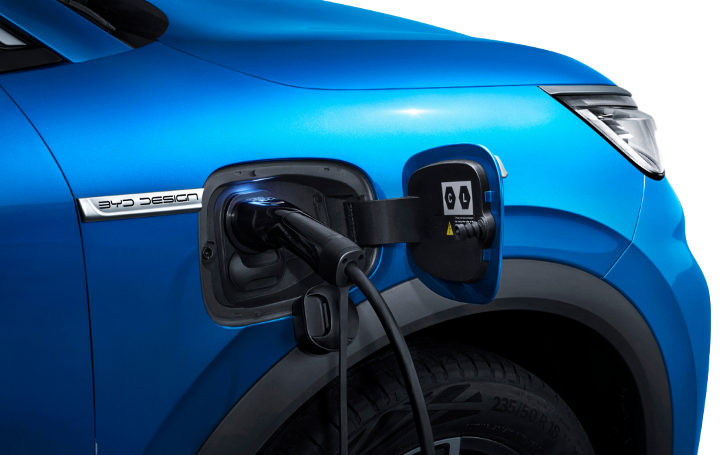




Next Steps
Decision Required
for Approval
Approval of budget and implementation plan.
Website
www.adnocdistribution.ae
Email
Khalid.marzouqi@adnocdistribution.ae
Phone
009718003000
Location
NE

Slide 11
Thank You!

