Slide 1

Horse Health Monitoring System
MID-SEMESTER PRESENTATION
Senior Design I – Spring 2017

Slide 2
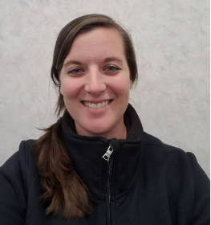
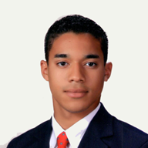
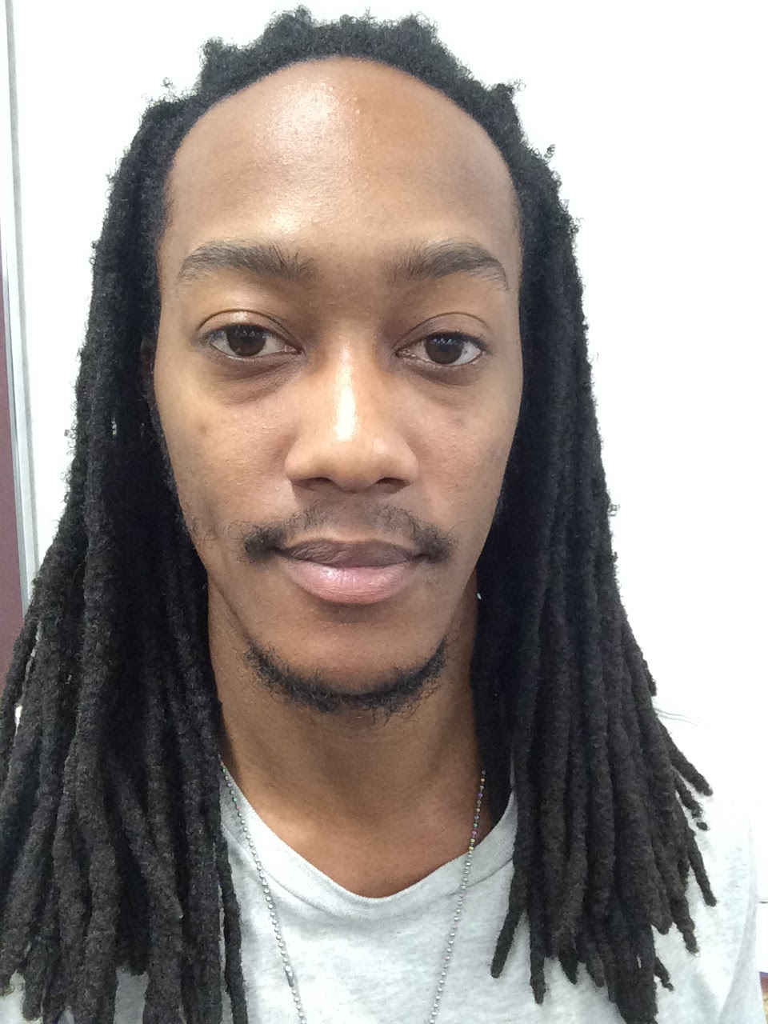
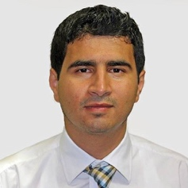
TEAM MEMBERS
Casandra Sasser
Electrical Engineering
Team Leader
Pulse Sensor Design/Testing
Austin Heath
Computer Engineering
GSM/ Communications
Jeremy Brown
Electrical Engineering
Temperature Sensor Design/Testing
Hussein Alsabbahi
Electrical Engineering
Microcontroller/Enclosure Design
Notes:
Pull up team charter and edit responsibilities

Slide 3
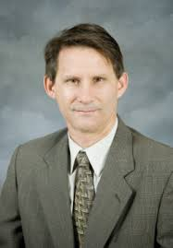
ADVISOR
Dr. Robert B. (Bob) Reese
Associate Professor and Robert D. Guyton Chair for Teaching Excellence
Education
Ph.D., Texas A&M University, 1985
M.S., Texas A&M University, 1982
B.S., Louisiana Tech University, 1979
Academic/Research and Fields of Interest
Asychronous Design
VLSI CAD Frameworks
High-Level System Synthesis
Research/Organization Affiliations
Engineering Research Center (ERC)
Microsystems Prototyping Laboratory (MPL)

Slide 4

AGENDA
Problem
Solution
System Overview
Constraints
Technical
Practical
Approach
Timeline
Questions

Slide 5
PROBLEM
Horse owners and veterinarians need an affordable, efficient, and safer system to monitor the key vitals of a horse.
Responding to any signs of illness a horse may exhibit in a timely fashion is paramount to reducing the likelihood of a horse’s injury or death.

Slide 6
SOLUTION
Horse Health Monitoring System will do the following:
Provide Horse accurate and timely measurement of a horse’s temperature.
Measure a horse’s pulse rate.
The system will acquire a horse’s vitals every 30 minutes or upon user command and transmit the data via the Global System for Mobile communication technology (GSM) to the user.

Slide 7
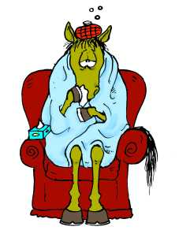
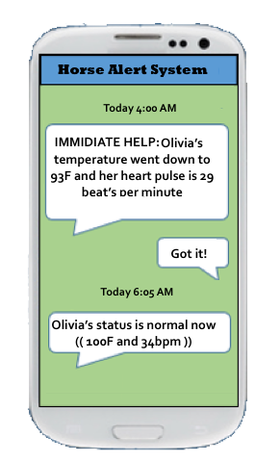

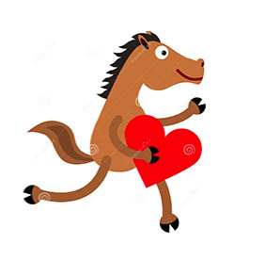
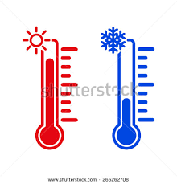
PROCESS

Slide 8
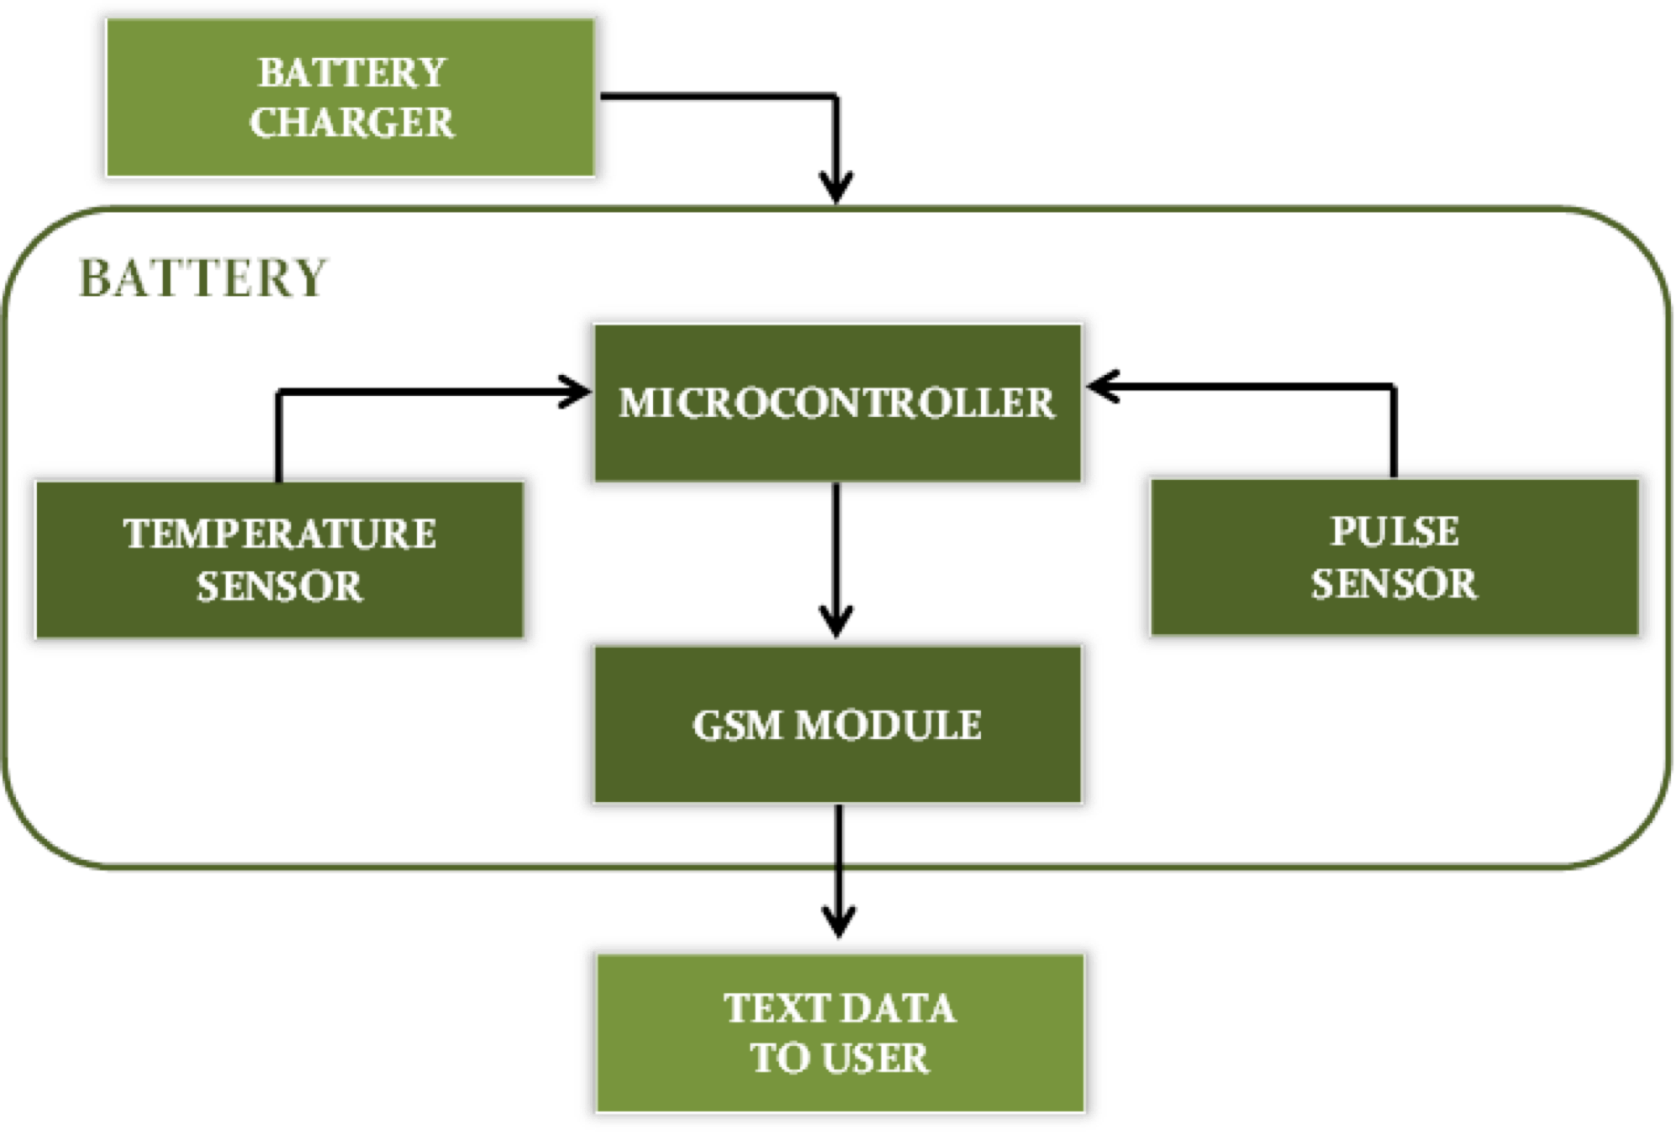
SYSTEM OVERVIEW

Slide 9
CONSTRAINTS

Slide 10
TECHNICAL CONSTRAINTS
Constraint | Description
Temperature Sensor Accuracy | The temperature sensor must measure the horse’s temperature within a tenth of a degree Fahrenheit between the range of 90˚F and 110˚F.
Pulse Sensor Accuracy | The pulse sensor must be able to give an accurate heart rate between the range of 25 and 200 beats per minute (bpm).

Slide 11
TECHNICAL CONSTRAINTS
Constraint | Description
Ingress Protection | The device must adhere to Ingress Protection Rating IP56.
Battery Life | The device battery must maintain device operation for a minimum of 12 hours.
User Notifications | The device must update the user via text message at certain intervals based upon the user’s discretion as well as alert the user to unusual horse health activity.

Slide 12
PRACTICAL CONSTRAINTS
Type | Name | Description
Health | Safety | The Horse Health Monitoring system must not be hazardous or dangerous to horses.
Economical | Cost | The system must stay at a low cost for consumers because horses are already costly.
Durability | Damage | The system must be installed somewhere on the horse, where it will not get damaged by the horse.

Slide 13
PRACTICAL CONSTRAINTS
Type | Name | Description
Ethical | Reliability | The system must satisfy the goal of saving horse’s lives.
Manufacturability | Size | The system must be able to fit on varies sizes of horses.

Slide 14
APPROACH

Slide 15
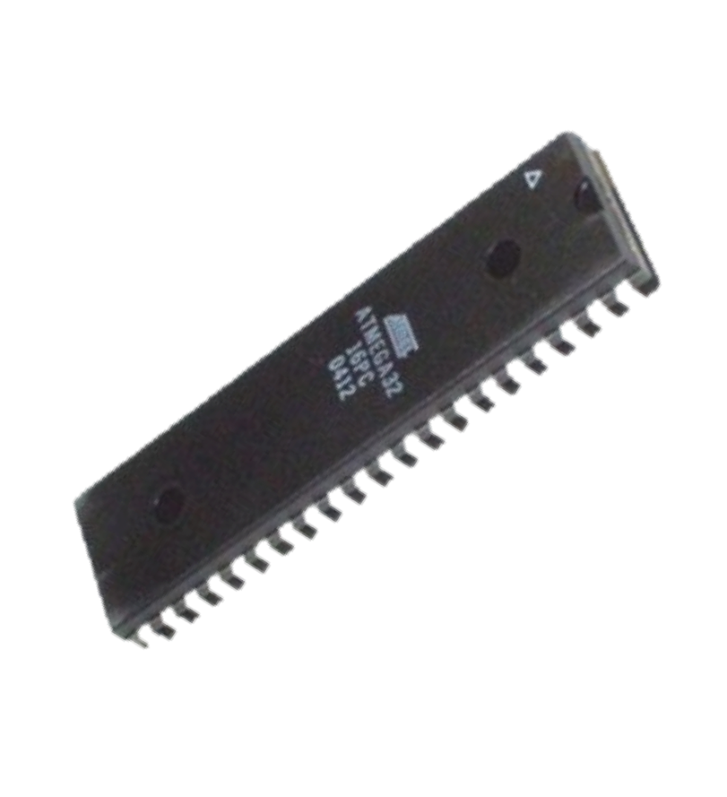

MICROCONTROLLER
dsPIC33EP128GP502 (dsPIC33)
Satisfies pin-out criteria to accomodate sensors and GSM module
Operates at 3.3V source which corresponds to voltage ratings of other HHM devices
All members of the team are familiar with sofware and programmming

Slide 16
TEMPERATURE SENSOR
Model | Style | Supply Voltage | Measurement Range | Accuracy | Cost
SEN-12871 | Analog Probe, Thermistor | N/A | -40◦F to 257◦F | 32◦F: ± 0.36◦F 212◦F: ± 0.9◦F | $28.95
MLX90614 | Non-Contact IR Sensor | 2.6 to 3.6V | -40◦F to 257◦F | 32◦F to 122◦F: ± 0.9◦F | $19.95
DS18B20 | Digital Probe | 3.0 to 5.5V | -67◦F to 257◦F | 14◦F to 185◦F: ± 0.9◦F -67◦F to 257◦F: ± 5.6◦F | $9.95

Slide 17
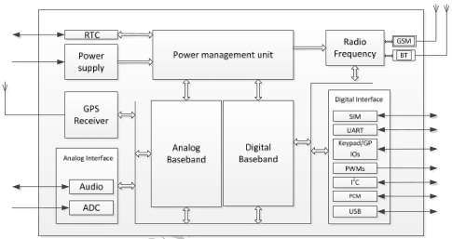
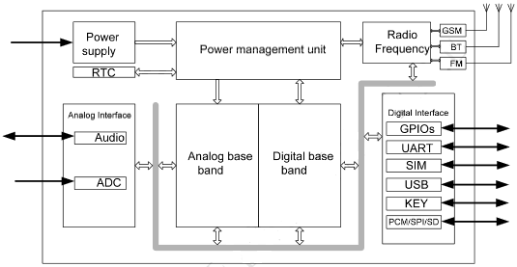
GSM MODULE
SIM808
1.75"x1.60"
$49.95
SIM800H
1.75"x1.25"
$39.95

Slide 18
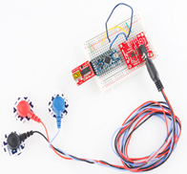
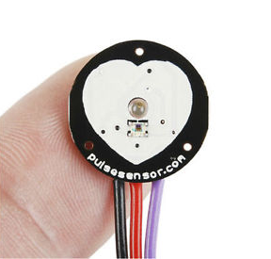
PULSE SENSOR
Electrocardiogram Sensors (ECG)
Very accurate and have a very low current draw (≈170µA)
Impractical for use on a horse:
-electronics incorporated in an ECG sensor are very sensitive
-must be used with biomedical sensor pads, designed for human skin
Infrared (IR) Pulse Sensor (ECG)
Higher than desired current draw at 0.39mA with a 3.3V source
Range of 0 to 200 bpm
Will allow for placement in multiple locations on the horse
Simple analog voltage interface which will make programming and interpreting measurements user-friendly

Slide 19
PROGRESS
Researched parts and best capabilities
Ordered parts
Testing
Currently in programming stage

Slide 20
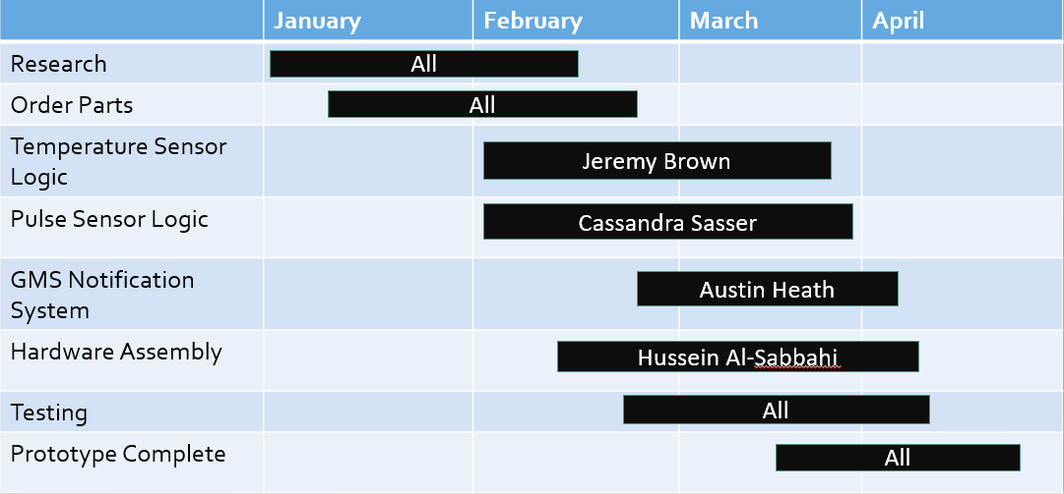
TIMELINE

Slide 21
REFERENCES
[1] Vernier, “Stainless Steel Temperature Probe,” TMP-BTA datasheet, [Revised Dec. 2012].
[2] Melexis, “MLX90614 family: Single and Dual Zone Infrared Thermometer in TO-39,” 3901090614 datasheet, Feb. 2007 [Revised May 2009].
[3] Dallas Semiconductor, “DS18B20: Programmable Resolution 1-Wire Digital Thermometer,” 050400 datasheet.
[4] Analog Devices, “Single-Lead, Heart Rate Monitor Front End,” AD8232 datasheet, [Revision A].
[5] Murphy, J. “Pulse Sensor Amplified,” schematic, Spring 2012. Access URL: https://cdn.shopify.com/s/files/1/0100/6632/files/PulseSensorAmpd_-_Schematic.pdf?1862089645030619491
[6] SIMCom, “SIM808_Hardware Design_V1.02,” SIM808_Hardware Design Manual, Mar. 2015 [Revision 1.02].
[7] SIMCom, “SIM800H_Hardware_Design,” SIM808_Hardware_Design_V1.00 Manual, Aug. 2013 [Revision 1.00].
[8] Brett D. Scott, Ph.D. and Mike Martin, DVM, Understanding Vital Life Signs in Horses [Online]. Available: http://texashelp.tamu.edu/005-agriculture/pdf/understanding-vital-life-signs-in-horses.pdf [Accessed: February 1, 2017]
[9] DSMT.com, “IP Rating Chart | DSMT.com”, 2017. [Online]. Available: http://www.dsmt.com/resources/ip-rating-chart/ [Accessed: February 1, 2017]

Slide 22
REFERENCES
[10] searchmobilecomputing.com, “GSM (Global System for Mobile communication)”, 2007. [Online]. Available: http://searchmobilecomputing.techtarget.com/definition/GSM [Accessed: February 1, 2017]
[11] Kahn Academy. A Little Big History of Horses. [Online]. Available: https://www.khanacademy.org/partner-content/big-history-project/expansion-interconnection/other-materials8/a/a-little-big-history-of-horses
[12] Sushil Dulai Wenholz. (2000 January 1). 100 Years of Horse Health Care. [Online]. Available: http://www.thehorse.com/articles/10234/100-years-of-horse-health-care
[13] Pet MD. Colic in Horses. [Online]. Available: http://www.petmd.com/horse/conditions/digestive/c_hr_equine_colic
[14] American Veterinary Medical Association. (2013, April 16). 2013 U.S. Veterinary Workforce Study: Modeling Capacity Utilization. [Online]. Available: https://www.avma.org/KB/Resources/Reports/Documents/Veterinarian-Workforce-Final-Report-LowRes.pdf
[15] Cost Helper. How Much Does a Horse Cost? [Online]. Available: http://pets.costhelper.com/pet-horse.html
[16] Tom Lenz. (2008, July 29). Horse Health: The "Unwanted" Horse in the U.S. [Online]. Available: http://www.aaep.org/info/horse-health?publication=942
[17] Trackener, Act Sooner. Trackener: Detect. Prevent. Learn. [Online]. Available: http://www.trackener.com/index.html
[18]Nightwatch: Equine Distress & Wellness Monitor. You’ve Got Questions, We’ve Got Answers. [Online]. Available: http://www.nightwatch24.com/faq/

Slide 23
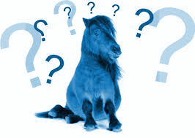
QUESTIONS?

