Slide 1

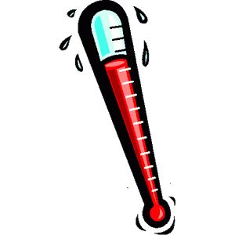
Horse Health Monitoring
Applications
Monitor horse’s core temperature
Monitor horse’s heartrate/pulse rate
Features
Measures vitals every 30 minutes
Measures vitals on user command
Monitored on user friendly app
Specifications
Measures temperature within 0.2° accuracy
Bluetooth GPS ranges to 450ft

