Slide 1
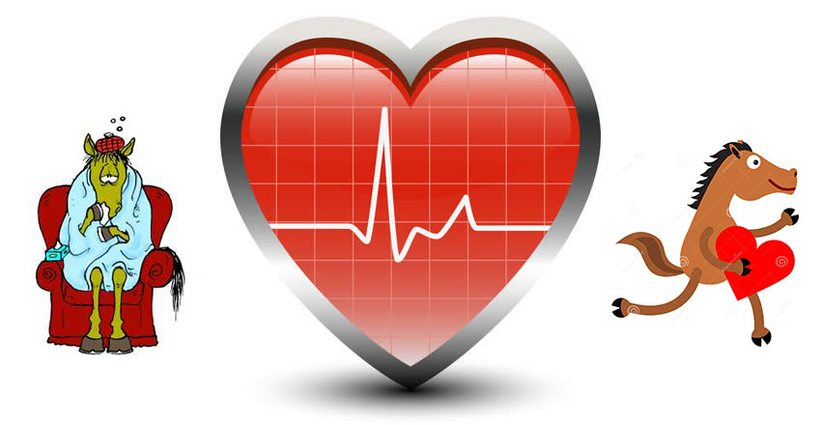
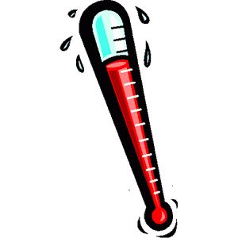
Horse Health Monitoring
Applications
Monitor horse’s temperature and pulse rate.
Allows owner to be alerted to abnormal horse vitality.
Features
Notifications through text message on user cell phone.
Compatible with standard cell phone network.
Includes non invasive neck strap for horse’s comfort.
User defined notification rate (instantaneous, every 30mins, 1hr, etc.)
Specifications
Measures temperature within 0.1° accuracy
Measure heart rate within ranges of 25 – 200 beats per minute.
12 hour minimum battery life.

