Slide 1
MAFS 5013 Course Project Instruction

Slide 2
Overview
Description
Evaluation
Grading
Timeline
Programming
Submission

Slide 3
1. Description
You need to use data of past matches (from 2007-09-09 to 2019-01-06) to build a prediction model to predict upcoming matches from 2019 Oct.
We encourage you to collect any useful external data to expand the training dataset and you will get bonus for this.

Slide 4
1. Description
Input: HKJC racing information of 1 upcoming match
Your prediction model
Output: 1. a vector of predicted probabilities of each horse to be the winner,
2. a vector of predicted probabilities of each horse to finish within top three places,
3. a vector of win betting ratios of bankroll on horses,
4. a vector of place betting ratios of bankroll on horses,

Slide 5
1. Description
You need to submit the prediction model program weekly. Deadline is usually Monday 11pm. Then we will test your predictions using matches of that week.
You don’t need to submit a totally new prediction model every week. You can make minor modifications or submit the old model directly.
You can choose either Python 3.X or R as your programming language.

Slide 6

2. Evaluation
The evaluation metric of prediction performance is RMSE (root-mean-square error).
For example, for a match of 10 horses,
given a vector of predicted probability for each horse to be the winner, $\vec{x}= \left(x_{1}, x_{2}, x_{3}…, x_{10}\right)$,
if horse 2 got the winner, then the outcome vector is $\left(0, 1, 0, …, 0\right)$.
So RMSE of this prediction will be computed as
$$\sqrt{\frac{{(x_{1}−0)}^{2}+{(x_{2}−1)}^{2}+{(x_{3}−0)}^{2}+…+{{(x}_{10}−0)}^{2}}{10}}$$

Slide 7
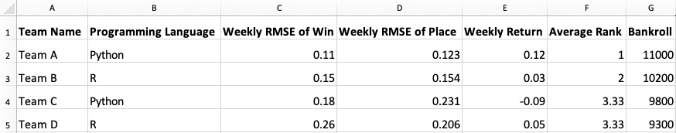
2.1 Leaderboard
The leaderboard is decided by average rank of your
weekly RMSE of predicted winner,
weekly RMSE of predicted top three places,
bankroll (We will calculate results by ‘fair’ odds)
Positive return by real odds will get bonus!
Initial bankroll is 10,000 HKD.

Slide 8
3. Grading
There are 10 chances for you to submit your prediction (from 2019.10.07 to 2019.12.15, the deadline is Monday 11 pm for each week)
A leaderboard will be published every week since 2019.10.07
The final score of this project is based on
70%: average of best 6 weekly ranks of your team
30%: final presentation and report

Slide 9
4. Timeline
Preparation Period | Regular Season | Final Presentation
Now ~ Oct 07 | Oct 07 ~ Dec 15 (10 weeks) | Around Dec 19
Team up (up to 2 persons per group) Download the historical data as the training set You can upload an experimental model before Sep 30 (Monday) midnight. We will test your prediction but the performance will not count for grading | For each week: Teams can upload the model before this week starts (Monday 11 pm). We will test prediction performance using upcoming matches of this week (matches of Wed and Sat/Sun) The leaderboard will be updated on next Monday afternoon New data of this week will also be shared with you on next Monday afternoon | You need to write a report (pdf) and prepare a presentation about your prediction model, including the method, rationality, data analysis, main results etc. We will grade your presentation and report.

Slide 10
5. Programming
Suggested working environment:
R: R (https://www.r-project.org/) + RStudio (https://www.rstudio.com/)
Python: Anaconda (https://www.anaconda.com/download/, which includes an IDE called Spyder and most necessary Python packages for data science, such as numpy, pandas, scipy, etc.)
There are many online tutorials for Python and R. Try to search and learn about them if you are not familiar with them. For example, book Python for Data Analysis and R for Data Science (https://r4ds.had.co.nz/).

Slide 11
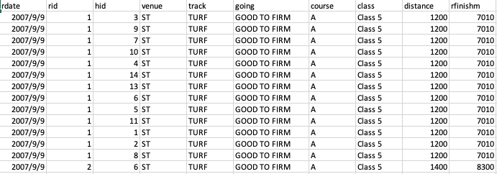
5.1 Data
Each row represents a horse in a match.
There is a document explaining column meanings. You should get familiar with the data and do explanatory analysis at first.

Slide 12
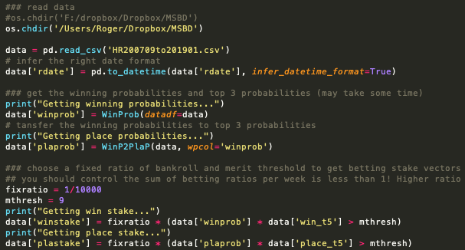
5.2 Prediction
Please add comments to make your program easy to understand. Check demo1.py in the shared python folder.

Slide 13
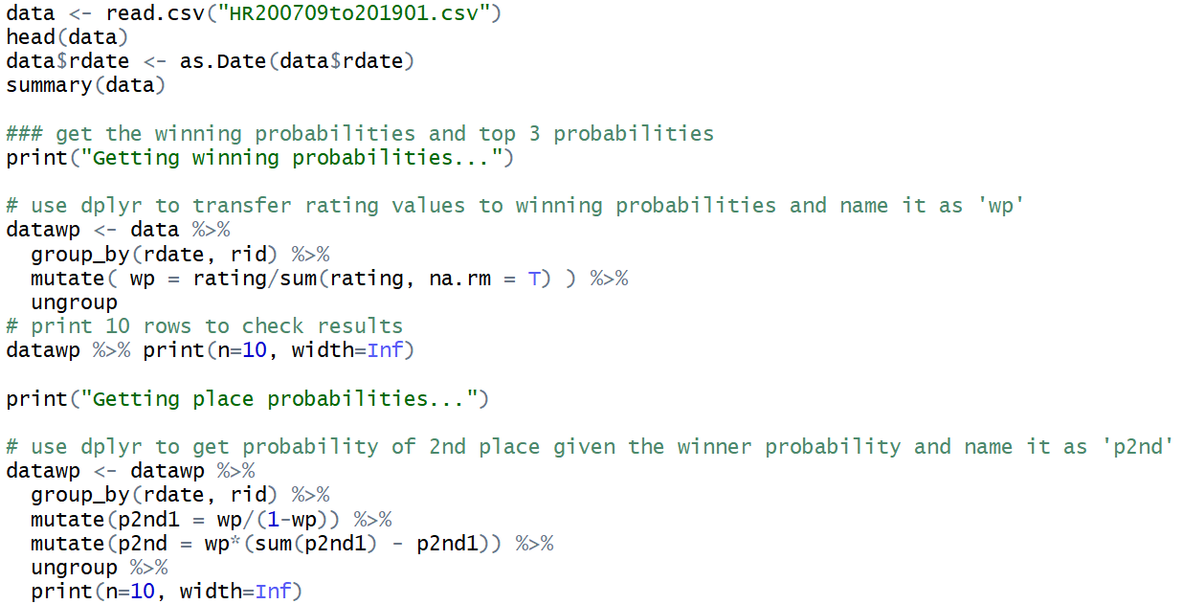
5.2 Prediction
Please add comments to make your program easy to understand. Check demo1.R in the shared R folder.

Slide 14
5.2 Prediction
Build your prediction model based on your observation, experience, data analysis, papers etc.
Split the historical data into training set & test set.
Your prediction should output a data frame including 4 new columns: winning probabilities of horses, top-three probabilities of horses, betting ratios of horses to be winners and betting ratios of horses to finish within top three places.
Check your program by running the back testing program (backtesting.py or backtesting.R) and upload the summary of the back testing.

Slide 15
6. Submission
Create a folder whose name is your team name (avoid special characters)
In this folder, you need to put a “prediction.py” or “prediction.R” file and summary of results of back testing. You can also add other files such as trained models, engineered features and extra data in this folder. Check the comments in demos for more information.
Then compress your folder in a single .zip file. Submit it to the following webpage before the deadline: https://forms.gle/VcFhr2rKAD3CGi998

Slide 16
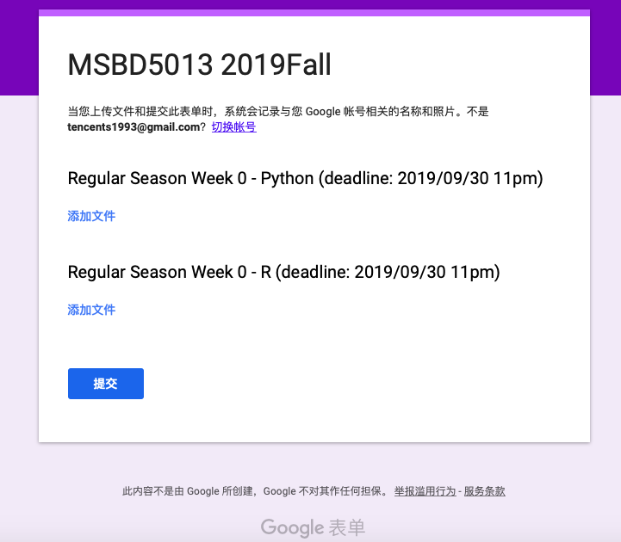
6. Submission
Submit your folder to the question of corresponding programming language

Slide 17
6. Links
Data download & leaderboard & code examples, instruction
https://www.dropbox.com/sh/wwhrwcdd1gjy8de/AADsKn2s5wUFgcLWaRy1VJ93a?dl=0
Submission link
https://forms.gle/VcFhr2rKAD3CGi998

