Slide 1
USE DIVIDE AND CONQUER TO COMPUTE X^1+X^2+X^3…
KALPANA IIB2019019
DEVANG IIB2019020
HITIKA IIB2019021

Slide 2
INTRODUCTION
For ﬁnding the sum of this gp series it can be solved using recursion.
Recursion is the process of repeating items in a self-similar way. In programming languages, if a program allows you to call a function inside the same function, then it is called a recursive call of the function.

Slide 3
APPROACH
Using divide and conquer method the array is being divided simultaneously and recursion have been called at array to divide it into smaller fragments till the base case is not reached.
After the base case is triggered the recursive function will return the sum of array.

Slide 4
ALGORITHM DESIGN
1) Take input of integers n and x in variables n and x respectively.
2) Call for the GeometricSequenceSum function with parameters as a(array) and n(size of array) which will give the answer.
3) GeometricSequenceSum function is using a recursive approach to ﬁnd the answer.
4)Base conditon :
Return 0 if size=0
else if size=1 then return a[0] element

Slide 5
5)Create two variables middle and rightSize.
6)Initialize middle=size/2 and rightSize = size-middle.
7)Create two variables leftSum and rightSum.
8)Call for the GeometricSequenceSum function with parameters as a(array) and middle(size of array) which will return its computed sum in leftSum variable.
9) Call for the GeometricSequenceSum function with parameters as (a+ middle)(array passed from a+middle index) and rightSize(size of array) which will return its computed sum in rightSum variable.
10)After receiving values in leftSum and rightSum , these values are being added and final computed sum will be returned.
11) Sum of the geometric sequence will be the required output and after performing the above stated actions the requirement will be satisfied.

Slide 6
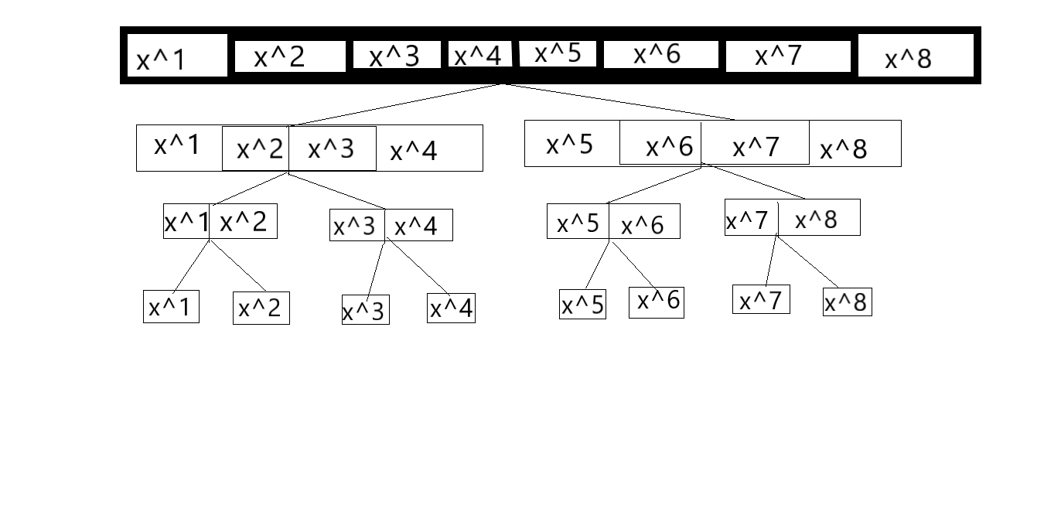
illustration

Slide 7
CONCLUSION
Time complexity : O(n)
Space complexity:O(n)

