Slide 1
KNIGHT’S TOUR CHESS PROBLEM!!
KALPANA IIB2019019
DEVANG IIB2019020
HITIKA IIB2019021

Slide 2
INTRODUCTION
A KNIGHT IS INITIALLY PLACED AT ANY POSITION OF AN EMPTY CHESS BOARD .
IT MOVES ACCORDING TO THE RULES OF CHESS i.e. TAKING TWO AND HALF STEPS.
BASICALLY THE KNIGHT HAVE TO TRAVEL THE CHESS BOARD AND VISIT EACH SQUARE EXACTLY ONCE( i.e. cannot visit the same block again if already traversed)

Slide 3
APPROACH
Warnsdorff’s Rule:
THE KNIGHT CAN START FROM ANY INITIAL POSITION ON THE CHESSBOARD.
THE KNIGHT IS MOVED SO THAT IT ALWAYS PROCEEDS TO THE SQUARE FROM WHICH THE KNIGHT WILL HAVE MINUMUM ONWARD MOVES.
THIS IS BASICALLY THE MODIFIED VERSION OF BACKTRACKING PROBLEM OF KNIGHT’S TOUR.
THE TIME NEEDED FOR THIS ALGORITHM GROWS ROUGHLY LINERALY WITH THE NUMBER OF SQUARES OF THE CHESSBOARD.

Slide 4
ALGORITHM DESIGN
A BLOCK OF THE CHESS ‘B’ CAN BE TAKEN INTO FURTHER MOVE OF THE KNIGHT FROM BLOCK ‘A’ IF:
‘B’ IS UNVISITED.
‘B’ CAN BE REACHED BY A SINGLE MOVE OF THE KNIGHT.

Slide 5
ASSUME ‘A’ TO BE THE RANDOM INITIAL POSITION FROM WHERE THE KNIGHT STARTS IT TRAVEL.
SINCE ‘A’ IS VISTED IT IS NEEDED TO MARK IT WITH “1”.
TO MOVE TO ANY POSITION ‘B’ FROM ‘A’
->LET A SET ‘S’ HAVE ALL THE POSSIBLE POSITIONS WHICH CAN BE REACHED FROM ‘A’.
->FROM THIS SET ‘S’ CHOOSE THE PATH WHICH IS HAVING MINIMUM ONWARD MOVES.
->AFTER BEING CHOSEN MARK IT ‘2’ .
THIS IS THE MAIN LOGIC BEHIND THIS PROBLEM AND THIS GOES ON FURTHER ….

Slide 6
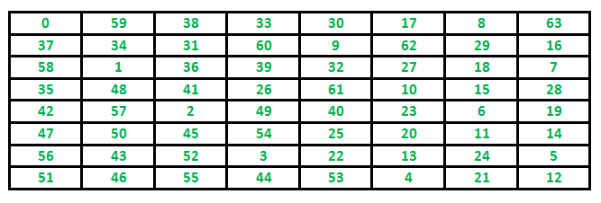
Illustration

Slide 7
CONCLUSION
Time complexity :
THE TIME NEEDED FOR THIS ALGORITHM GROWS ROUGHLY LINEARALY WITH THE NUMBER OF SQUARES OF THE CHESSBOARD.
Space complexity:
Array of size 8*8

Slide 8
refrences
Wikipedia –
https://en.wikipedia.org/wiki/Knight%27s_tour
Gfg –
https://www.geeksforgeeks.org/warnsdorffs-algorithm-knights-tour-problem/
Stack Overflow-
https://stackoverflow.com/questions/19214109/how-to-optimize-knights-tour-algorithm

