Slide 1
DataMining —— BlackFriday
TJU
Project
2019
Group members:
Planning
Liang ZheLin , Huo XinZhi , He YuXuan , Ma Li

Slide 2
01
Background
02
Difficulty
CONTENTS
03
GUI
04
Diagram
05
Global Architecture

Slide 3
Background
/01

Slide 4
Background
Thanksgiving Day is the fourth Thursday in November.So its second day, the fourth Friday in November, is the first day of the American shopping season.On this day, American shopping malls will launch a large number of discounts and preferential activities, in order to carry out the last large-scale promotion at the end of the year.Stores in the United States usually record deficits in red pens and profits in black pens. Therefore, this Friday after Thanksgiving Day is called Black Friday because people rush to buy goods to increase the profits of the stores
Q1.
How was the sales on Black Friday ?
Q2.
.
What can we do for the next day ?

Slide 5
01
Find out the sales of Black Friday
Apr-Jun
02
Explore the relationship between customers’ basic attributes and consumption
Analysis Goal
Jul-Sep
03
Provide forecast based on data.
Oct-Des
04
Provide advice to businesses.

Slide 6
Data On Show
Best sellers and categories
Best consumers and their personal information
Comparison of purchasing power of people with different attributes
Analysis of purchasing power correlation coefficient
.

Slide 7
Difficulty Of The Project
/02
.

Slide 8
Difficulty
The function
The standard to classify the customer to low, middle and high
The technique
An appropriate method viewing the data generally to find some internal relation
A method to solve the problem of lacking data, add it or ignore it.
An efficient method for this project to calculate the data.
A combination of classification, clustering and association rule discovery.
Compare algorithms and models to choose the most appropriate one.

Slide 9
Graphical User Interface
/03
.

Slide 10

Entrance Module

Slide 11
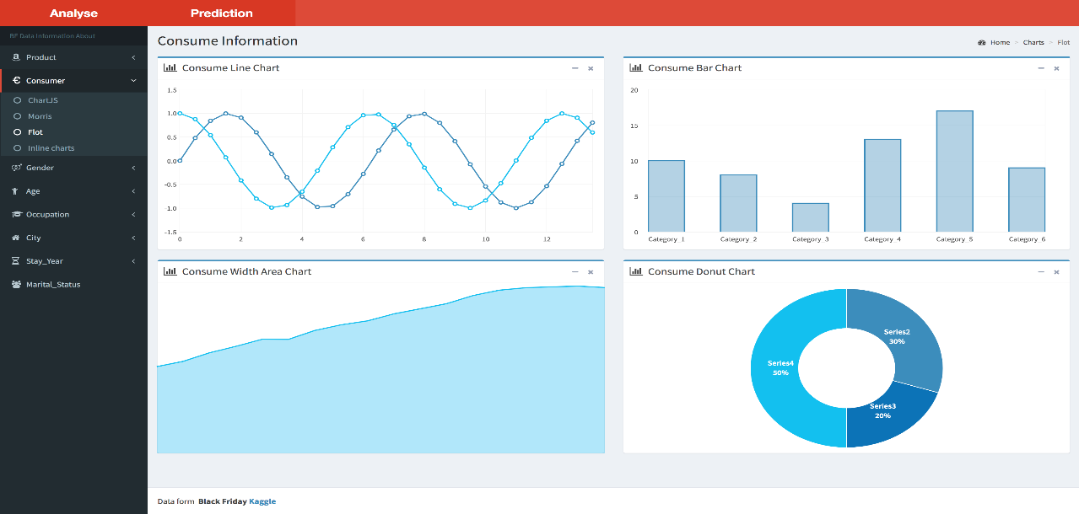
Analyse Module

Slide 12
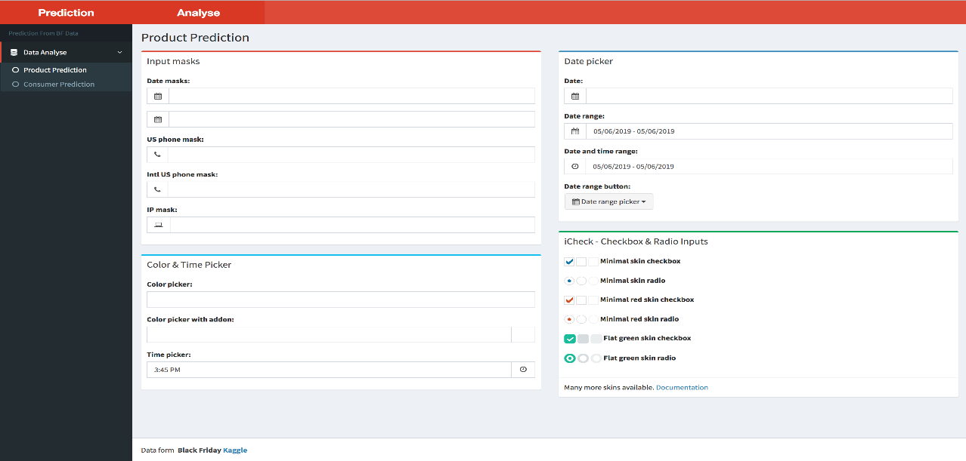
Predict Module

Slide 13
Diagram
/04
.

Slide 14

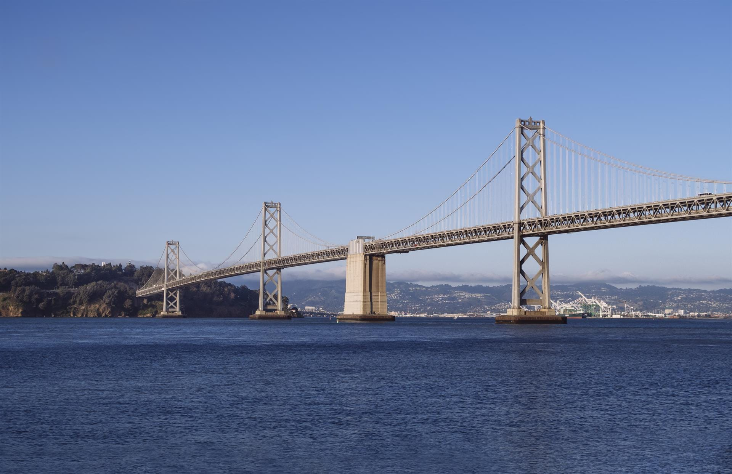

Use Case Diagram
Class Diagram
Use Case Diagram
Sequence Diagram
……
……
……

Slide 15
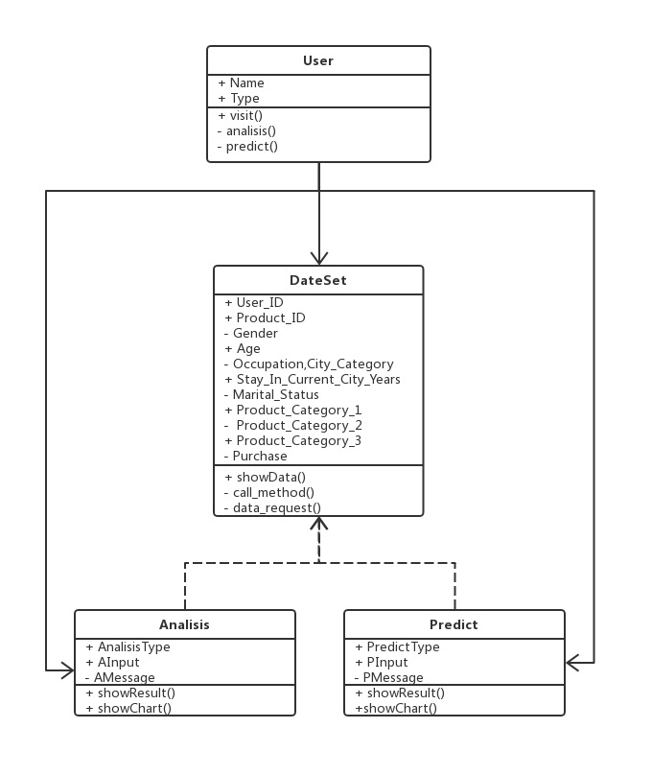
Class Diagram
Four class
User class:
DataSet class:
Analisis:
Predict:
Connection
User use data set to analyse and predict
Analisis class and Predict class use
DataSet class to machine learning and data maining

Slide 16
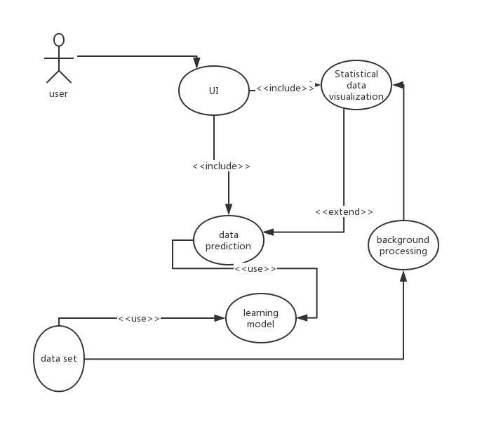
Use Case Diagram
Actor and Use Case
Actor: user
Use Case: UI, data prediction, learning model, data set, background processing, statistical data visualization
Connection
Data prediction is an extend to statistical date
We use data set to learn model
UI include date prediction and statistical data visualization

Slide 17
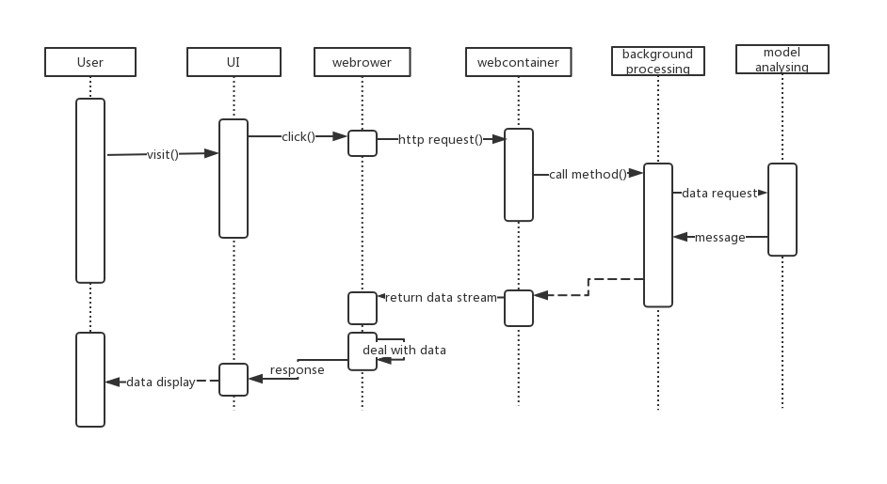
Sequence Diagram
Four class
User class:
DataSet class:
Analisis:
Predict:
Connection
User use data set to analisis and predict
Analisis class and Predict class use DataSet class to work.

Slide 18
Global Architecture
/05
.

Slide 19
