Slide 1
ML Experiment Optimization via Intelligent Caching
Bachelor Thesis | Lennart Gorzel | IMC FH Krems
Three storytelling strategies • 5×5 rule • 7 minutes
Strategy A
Strategy B
Strategy C
The Researcher's Day
The Trust Problem
Numbers-First
Notes:
• Pick ONE strategy for the actual defense; do not present all three.
• All three strategies are 7 minutes total and follow the same outline.
• Speaker notes for each slide live in this notes pane.

Slide 2
Strategy A — The Researcher's Day
First-person pain → unified idea → relief
Motivation 1:30 • SOTA 0:45 • Model 1:00 • Implementation 1:15 • Results 1:30 • Conclusion 1:00
7 min • CS committee • English • 5×5 rule
2

Slide 3
Strategy A — — The Researcher's Day | Motivation
1:30
Nine Hours. Again.
• 128 subjects, 2,304 runs
• One run: 9–12 hours
• Change one parameter, restart
• 80% redundant recomputation
• Bottleneck: pipeline, not model
3
Notes:
• Open verbatim: 'I run an experiment. Nine hours. I change one number. Another nine hours.'
• Let the 2,304 number land. Pause.
• Don't define LOSO yet — say 'standard cross-validation'.
• Close: 'This isn't a model problem. It's a pipeline problem.'

Slide 4
Strategy A — — The Researcher's Day | State of the Art
0:45
The Parts Exist
• SHA-256 hashing exists
• Caching libraries exist
• Model serialization exists
• None covers cross-validation
• Gap: assembling them safely
4
Notes:
• Three lines, one per tool. Then the gap.
• Do NOT mention your combination. Just point at the gap.
• Transition: 'The parts exist. Assembling them safely doesn't.'

Slide 5
Strategy A — — The Researcher's Day | Model
1:00
Identity of a Computation
• All inputs → hash → key
• Same inputs, same key
• Different inputs, recompute
• Stages chained hierarchically
• Partial invalidation possible
5
Notes:
• Anchor word: 'identity'. Return to it.
• Say 'fingerprint' instead of 'hash function' for the non-crypto folks.
• Transition: 'That's the concept. Now the wiring.'

Slide 6
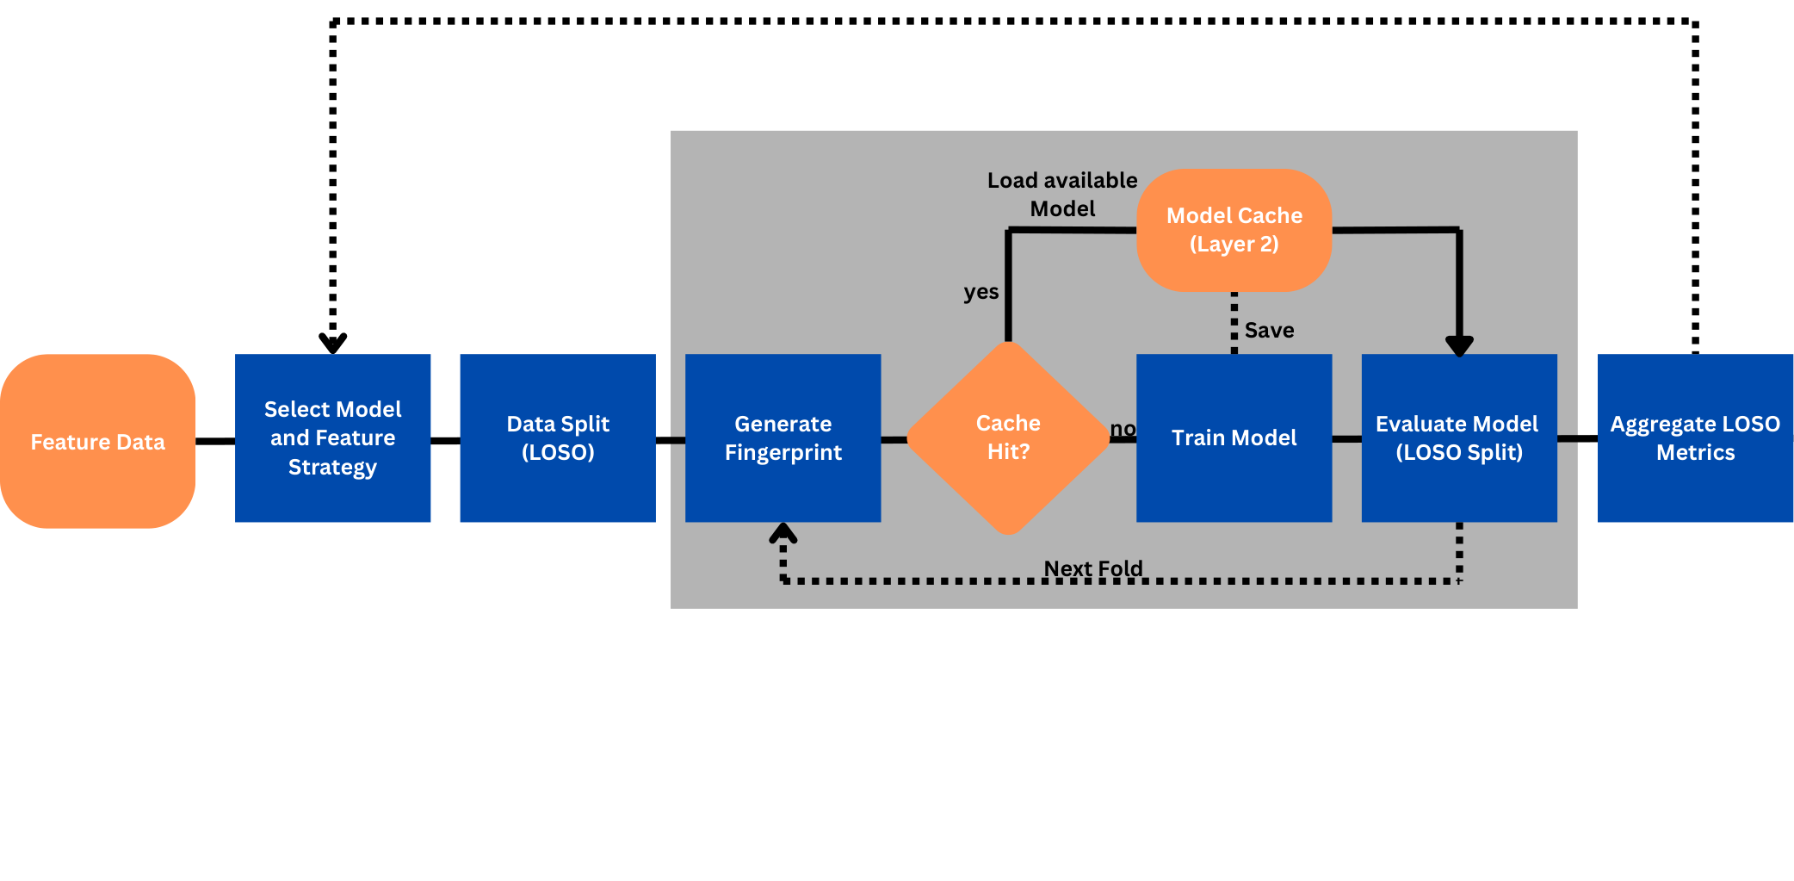
Strategy A — — The Researcher's Day | Implementation
1:15
Four-Stage Pipeline
• Feature data feeds strategy
• LOSO split per subject
• Fingerprint decides cache hit
• Subject ID guards leakage
• Hierarchical, partial invalidation
Pipeline with fingerprint-based cache lookup
6
Notes:
• Walk through the figure left to right.
• Stop at 'Generate Fingerprint' — that's the novelty.
• Mention: change Stage 3 config → only 3+4 recompute.
• No code, no file tree. Stay on the diagram.

Slide 7
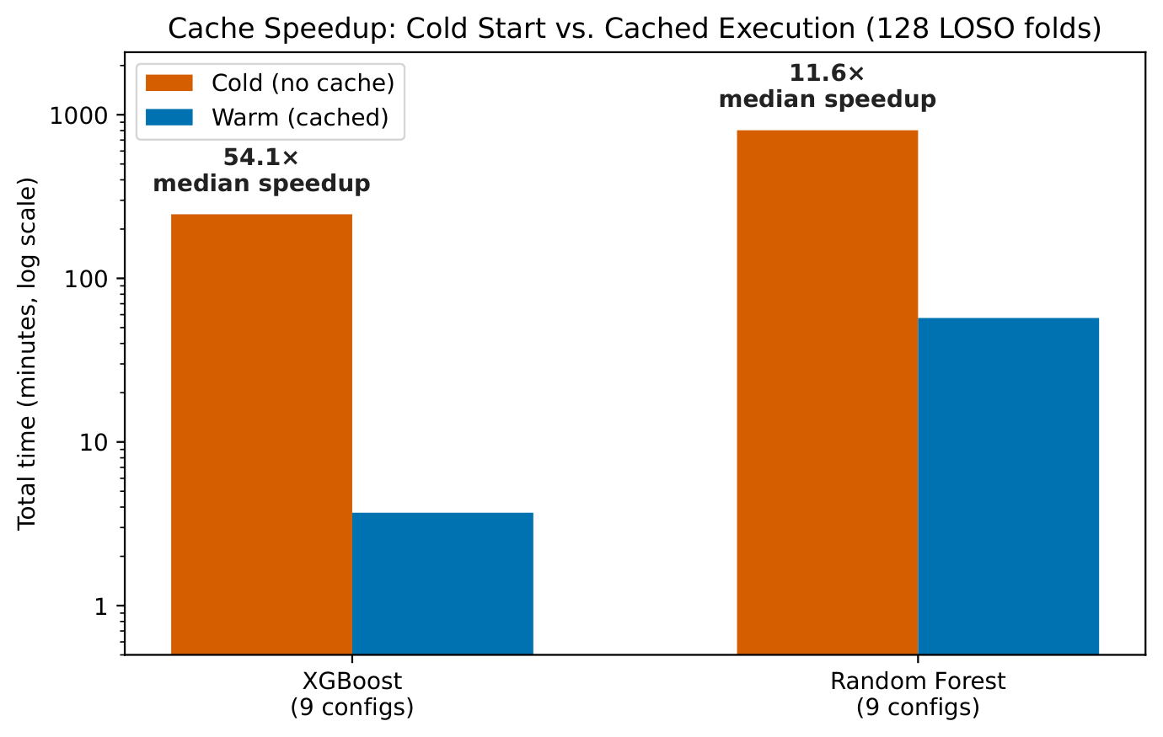
Strategy A — — The Researcher's Day | Results
1:30
Cold vs Warm Run
• XGBoost: 54× median speedup
• Random Forest: 12× speedup
• 128 LOSO folds tested
• 100% cache hit rate
• Zero leakage detected
Cold vs warm execution, 128 LOSO folds
7
Notes:
• Read the speedups off the chart. Pause after 54×.
• Lead with speed, then correctness.
• Reframe: 'Nine experiments a day, not one.'

Slide 8
Strategy A — — The Researcher's Day | Conclusion
1:00
The Bottleneck Is Gone
• Fingerprint every computation
• Cache the stable parts
• Recompute only what changed
• Nine hours to one
• Iteration is unlocked
8
Notes:
• Closing line: 'Iteration cost was the bottleneck. It isn't anymore.'
• Mention generalization in one breath: any LOSO/k-fold pipeline.
• Stop. Pause. Wait for questions.

Slide 9
Strategy B — The Trust Problem
Correctness framing → gap → fast AND safe
Motivation 1:00 • SOTA 0:45 • Model 1:15 • Implementation 1:15 • Results 1:45 • Conclusion 1:00
7 min • CS committee • English • 5×5 rule
9

Slide 10
Strategy B — — The Trust Problem | Motivation
1:00
Speed Easy. Safety Hard.
• 2,304 runs per experiment
• 9 hours each, 80% redundant
• LOSO demands data isolation
• Wrong cache: silent leakage
• Real problem: safe caching
10
Notes:
• Open with the hook: 'Cross-validation has a rule: don't touch the held-out subject. Caching has a habit: it remembers everything.'
• Frame as a TRUST problem, not a SPEED problem.
• Transition: 'Can we cache safely?'

Slide 11
Strategy B — — The Trust Problem | State of the Art
0:45
Building Blocks, No Glue
• SHA-256 hashing exists
• Caching libraries exist
• Model serialization exists
• None encodes fold identity
• Gap: cross-validation boundary
11
Notes:
• Keep fast. The gap is the payoff.
• Last two bullets are the contribution shape. Don't say more yet.
• Transition: 'The boundary between them under cross-validation is missing.'

Slide 12
Strategy B — — The Trust Problem | Model
1:15
Identity Includes the Fold
• Hash of all inputs
• Subject ID inside the hash
• Each fold: unique key
• Leakage prevented by construction
• Guarantee, not runtime check
12
Notes:
• Emphasize 'by construction' — mathematically guaranteed.
• Slow down here. This is the insight.
• Transition: 'Now the wiring.'

Slide 13
Strategy B — — The Trust Problem | Implementation
1:15
Four Stages, Each Fingerprinted
• Stage 1 hashes raw signals
• Stage 2 hashes features
• Stage 3 hashes selection config
• Stage 4 adds subject ID
• Partial invalidation cascades
Stage
Fingerprint includes
1. Preprocess
Raw EEG + filter config
2. Features
Preprocessed + extraction config
3. Selection
Features + threshold + top-K
4. Model
Above + params + subject ID
Subject ID in Stage 4 → fold identity guards the cache
13
Notes:
• Read the table left column, then right.
• Stop at Stage 4. Say 'this is where safety lives.'
• The caption line summarizes the entire thesis contribution.

Slide 14
Strategy B — — The Trust Problem | Results
1:45
Fast AND Correct
• XGBoost: 54× median speedup
• Random Forest: 12× speedup
• 100% cache hit rate
• Zero leakage cases confirmed
• Both claims hold together
Speed gains, with correctness preserved across all 128 folds
14
Notes:
• Present speed first, then correctness — that's the pair this strategy promises.
• 'Zero leakage' is the payoff for the trust framing. Land it.
• Don't rush. This slide proves two things at once.

Slide 15
Strategy B — — The Trust Problem | Conclusion
1:00
Safe Caching, Under Cross-Validation
• Caching: well understood
• Safe caching under LOSO: not
• Fold ID in the fingerprint
• Zero correctness compromise
• Generalizes to k-fold pipelines
15
Notes:
• Open with the contrast — that's the contribution.
• Closing line, slowly: 'Caching, safely, under cross-validation.'
• Stop. Don't summarize the summary.

Slide 16
Strategy C — Numbers-First
Open with the number → backfill → close the loop
Motivation 1:15 • SOTA 0:45 • Model 1:00 • Implementation 1:15 • Results 1:30 • Conclusion 1:15
7 min • CS committee • English • 5×5 rule
16

Slide 17
Strategy C — — Numbers-First | Motivation
1:15
Nine Hours. Then One.
• 128 subjects, 2,304 runs
• Each run: 9–12 hours
• 80% identical recomputation
• Question: cache without errors?
• Answer: one design choice
17
Notes:
• Open with the hook: 'Nine hours. Then one. Same data, same model, same correctness.'
• Plant the question early — every following slide answers it.
• Numbers-first: result is already on the table.

Slide 18
Strategy C — — Numbers-First | State of the Art
0:45
Close, But Not Quite
• Hashing exists
• Caching frameworks exist
• Model serialization exists
• No unified LOSO scheme
• Stale fold reads unprotected
18
Notes:
• Fast slide, 45 seconds.
• Don't linger — the audience knows an answer is coming.

Slide 19
Strategy C — — Numbers-First | Model
1:00
Fingerprint Every Computation
• Hash of all inputs
• Same key, cache hit
• Different key, recompute
• Stages chained downstream
• Partial invalidation cascades
19
Notes:
• Tight, conceptual. No implementation details yet.
• Transition: 'That's the idea. Here's the wiring.'

Slide 20
Strategy C — — Numbers-First | Implementation
1:15
Four-Stage Hierarchical Cache
• Pipeline split into four
• Each stage hashed separately
• Subject ID at training
• Each fold: distinct entry
• Threshold change: stages three, four
Hierarchical cache with fold-aware fingerprints
20
Notes:
• Walk through the diagram briefly.
• Highlight Stage 4 = safety guarantee.
• Transition: 'Does it deliver on the promise?'

Slide 21
Strategy C — — Numbers-First | Results
1:30
The Numbers Hold Up
• XGBoost: 54× median speedup
• Random Forest: 12× speedup
• 100% cache hit rate
• Zero leakage events
• Promise from slide one delivered
Median speedup across 128 LOSO folds, two model families
21
Notes:
• Echo the hook: 'Remember slide one — nine hours, then one.'
• The last bullet closes the story loop.

Slide 22
Strategy C — — Numbers-First | Conclusion
1:15
One Design Choice
• Fingerprint every computation
• Include fold ID inside
• Four cascading stages
• 12–54× measured speedup
• Generalizes to k-fold pipelines
22
Notes:
• Echo opening line as closing line.
• Then stop. Pause. Wait for questions.

