Slide 1
Fingerprint-Based Caching for Leave-One-Subject-Out Cross-Validation (Eliminating Redundant Computation in Iterative ML Experimentation on EEG Sleep Staging)
▸ Post-hoc per-fold model inspection
▸ ML specialist + clinician: outlier review at zero extra cost
Lennart Gorzel 52418474
Bachelor Thesis
Notes:
Open with the hook (~0:30). Two concrete payoffs of this work, in plain terms. First: because every fold's model is cached and preserved, you can inspect any single subject's model after the fact — open the box, not just read the score. Second: that enables a workflow where a clinician flags an unusual subject and an ML specialist pulls that exact model to check its feature weights — at zero extra compute, because it is already cached. Keep it brief here; I deliver the proof at the end. Then move to the agenda.

Slide 2
Outline
Motivation & Research Questions
State of the Art
Model — The Fingerprint
Implementation
Results
Conclusion
Notes:
30 seconds. Six sections, ten minutes. The contribution is the caching framework; sleep staging is just the test vehicle.

Slide 3
Motivation
18 models × 128 subjects = 2,304 trainings → ~21 h / sweep
Why it's hard
Sleep EEG · BOAS dataset · 128 subjects
LOSO = gold standard in medical ML
Subject-independent → 1 model per held-out subject
Change one parameter → recompute all folds
Research Questions
RQ1 — Speedup & hit rate?
RQ2 — Bitwise-identical?
RQ3 — Scaling with N?
RQ4 — Storage-efficient (η)?
Notes:
Lead with the number on the band: 18 model configurations across 128 subjects is 2,304 trainings, about 21 hours per sweep — and almost all of it is recomputing byte-for-byte identical models. Why so many folds? Because LOSO is not just one option — in clinical and medical ML it is the preferred protocol, since it enforces true subject independence: one model per held-out subject. The pain is that changing a single parameter throws the whole sweep away. That motivates four research questions — read each in full: RQ1, what speedup and hit rates does caching achieve; RQ2, are the cached results bitwise-identical to retraining; RQ3, does the benefit scale as the subject count N grows; RQ4, when is caching storage-efficient, measured by eta. I answer all four explicitly in the conclusion. (~2:00)

Slide 4
State of the Art
Every ingredient already exists — nobody combines them.
Capability | Tools
Experiment tracking | MLflow, W&B
Pipeline caching | DVC, ZenML
Config fingerprinting | DVC (MD5), ZenML (SHA-256)
LOSO splitting | scikit-learn
Combination + held-out subject | — none —
D. Kreuzberger, N. Kühl, S. Hirschl, “Machine Learning Operations (MLOps): Overview, Definition, and Architecture,” IEEE Access, vol. 11, 2023.
Notes:
Every ingredient already exists — tracking, caching, fingerprinting, cross-validation. What no tool does is the bottom row: combine them AND put the held-out subject into the cache key. Without that, a cache hit can silently hand you a model trained on the wrong people — no error, just an invalid result. That's the gap I close. (~1:00)

Slide 5
Model — The Fingerprint
Idea: every computation gets an identity
Fingerprint = SHA-256(all inputs)
Inputs: seed, code, params, features
Plus the held-out subject ID
Behaviour
Same config → same key → reuse
Change anything → new key → recompute
Why not generic caching?
No fold identity → wrong-subject hit is silent
cache_key = SHA-256(seed, code, params, features) + held_out_subject
Notes:
The mechanism is one idea: give every computation an identity. I take the full configuration — seed, code version, hyperparameters, feature set — serialize it to canonical JSON, and hash it with SHA-256. Same inputs always give the same key; change one thing and the key changes, forcing a recompute. The decisive part, and the reason generic tools cannot do this, is adding the held-out subject ID into the hash. That makes fold isolation structural, not a convention: a model trained with subject A out cannot be retrieved when subject B is the test subject. Any caching library can store a file by key — what makes this fingerprint-based is that the key is derived from ALL inputs including the held-out subject ID. Without that, a cache hit could silently return a model trained on the wrong 127 people with no error raised. (~1:30)

Slide 6
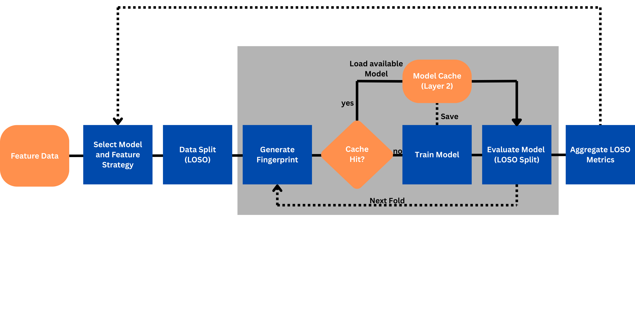
Implementation
Two-layer cache
Layer 1: features — always valid
Layer 2: models — fingerprint-keyed
Flow
Miss → train → store → reuse
Validated: zero hash collisions
LOSO experiment loop: fingerprint → cache check → train only on miss
Notes:
Here's the whole pipeline — and this diagram is the method on one slide. Two cache layers. Layer 1 holds the extracted features; they depend only on the raw signal, so they're computed once and stay valid. Layer 2 is the fingerprint-keyed model cache — that's where the speedup lives. The inner loop runs 128 times per configuration: fingerprint, check cache, train only on a miss. The outer loop sweeps all 18 configurations, and configurations that share folds reuse each other's cached models automatically. I verified it with deliberate invalidation tests — change a hyperparameter, a feature count, a subject — each produces a distinct fingerprint and the correct miss. Zero collisions. (~1:30)

Slide 7
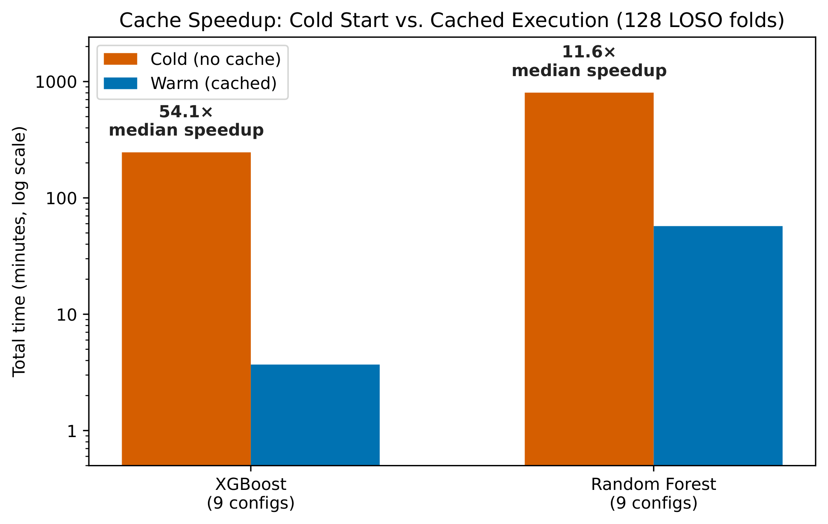
Results — Speed & Trust
Speed
XGBoost: median 54×, peak 202×
3,816 s → 18.9 s
Feature cache: 227×
Trust
100% hit rate — 2,304 / 2,304
100% identical predictions
85.5% accuracy, κ = 0.74
Cold vs. warm wall-clock per configuration (log scale)
Notes:
The headline: for XGBoost, a median 54x speedup, and the best configuration went from a 64-minute cold run to 19 seconds — 202x. Feature extraction alone is 227x faster. Two numbers I want to state explicitly, because they're the scientific claims, not just speed: every one of the 2,304 warm operations was a hit — a 100% hit rate — and every cached model produced bitwise-identical predictions to retraining. And the cached models still reach 85.5% accuracy, kappa 0.74 — so this is faster AND provably the same result, at no cost to quality. (~1:30)

Slide 8
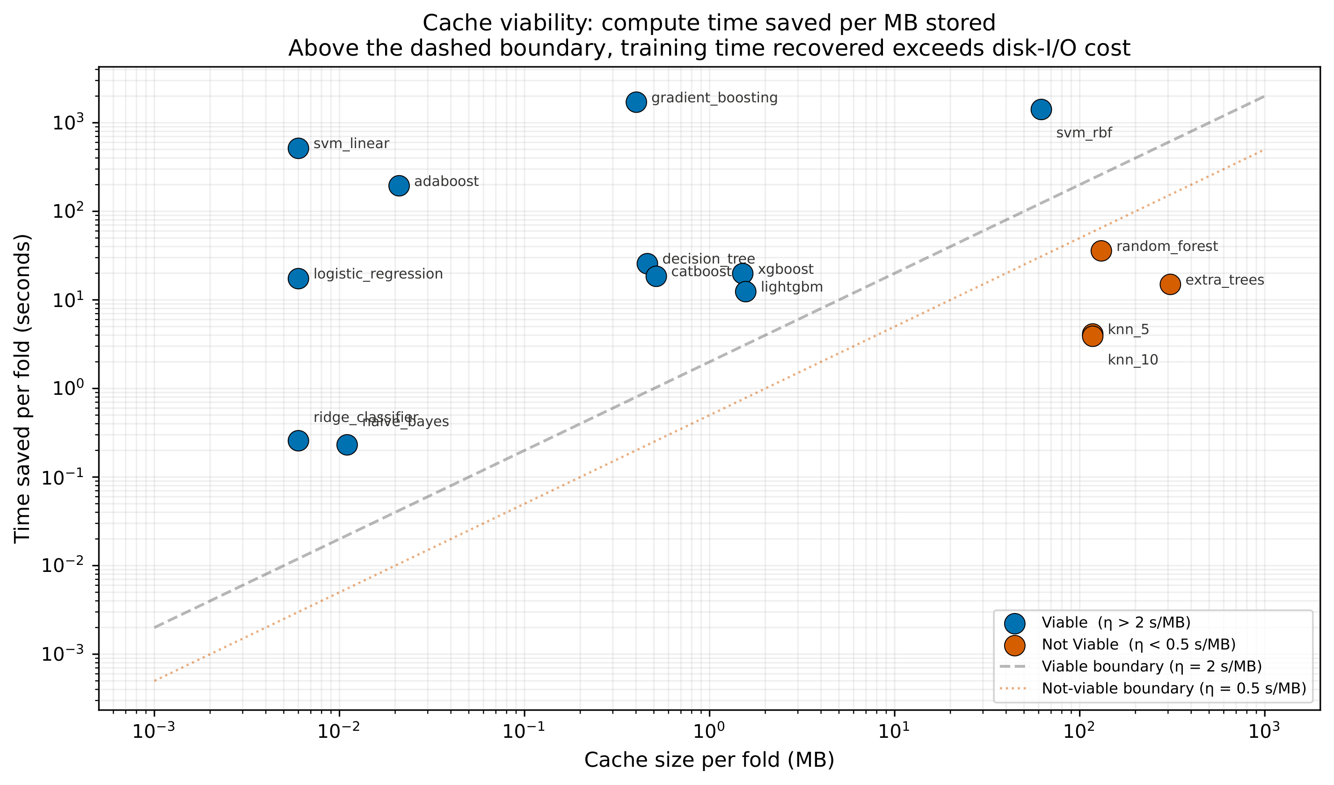
Results — Viability & Scaling
Viability
15 models: 11 viable, 4 not
η (eta) = seconds saved / MB
Threshold from empirical gap — not arbitrary
Above the line → worth caching
Cost & Scaling
XGBoost 1.5 MB (viable)
RF 18.5 GB (not viable)
SVM-RBF: 9× → 201× with scale
Compute saved vs. storage cost; dashed line = viability boundary
Notes:
Caching isn't free for every model, so I built a metric — eta, the same symbol physics uses for efficiency — seconds of compute saved per megabyte stored. I tested 15 models. Everything above this diagonal recovers more compute than it spends on storage I/O: 11 pass, 4 fail. The failures cluster bottom-right — Random Forest, Extra Trees, kNN — big files, little saved. The threshold wasn't picked arbitrarily: after measuring all 15 models, the viable cluster landed between 4 and 2,500 s/MB; the not-viable cluster between 0.19 and 0.4 s/MB — a near-decade gap on a log scale. The threshold just needs to sit inside that gap; the exact value doesn't change any verdict. And the scaling result is the general takeaway: SVM went from 9x at ten subjects to 201x at 128. Caching gets MORE valuable as the study grows, not less. (~1:20)

Slide 9
Conclusion
Contributions
Fold-aware fingerprint → no contamination
Order-of-magnitude speedup, reproducible
Every fold's model preserved → inspect post-hoc
Outlier flagged → pull model, inspect feature weights
Research Questions — Answered
RQ1 ✓ median 54×, 100% hit rate, 2,304/2,304
RQ2 ✓ 100% bitwise-identical, zero collisions
RQ3 ✓ speedup grows: SVM 9× → 201×
RQ4 ✓ 11/15 viable; η separates clusters by ~3 orders
Notes:
To close: the fingerprint makes fold-safe caching structural, the speedups are order-of-magnitude, and reproducibility is guaranteed by construction — that answers all four research questions: efficiency, reproducibility, scalability, and the storage trade-off. There's also a second win beyond speed: because I persist every fold's model, not just the metrics, a clinician can flag an outlier subject and an ML specialist can pull that subject's exact model and inspect its feature importances — for free. Model evaluation meeting domain knowledge. The honest caveat: the specific numbers depend on hardware and model choice — but the method, the fingerprint and the eta metric, transfers to any subject-level cross-validation domain. (~1:20)

Slide 10
THANK YOU
Any Questions?
Notes:
Thank you — I'm happy to take questions. Advance to backup slides as needed (full results table, eta ranking, confusion matrix, global-vs-fold leakage).

Slide 11
Backup — Material
The following slides support likely questions
B1 — Full 9-config cache results (XGB + RF)
B2 — η ranking, all 15 models
B3 — Confusion matrix (N1 weakness)
B4 — Global vs. per-fold selection (leakage)
Notes:
Optional index. Pull the relevant slide up only if asked.

Slide 12
Backup — Full Cache Results (128-fold LOSO)
XGBoost — median 54×, ~185 MB (best: 202×, 3816 s → 18.9 s)
Config | Cold (s) | Warm (s) | Speedup | Cache
corr=0.75, k=30 | 1053.4 | 26.4 | 39.9× | 186 MB
corr=0.75, k=50 | 1447.4 | 27.2 | 53.3× | 189 MB
corr=0.75, k=None | 1440.3 | 26.6 | 54.2× | 189 MB
corr=0.90, k=30 | 964.1 | 25.7 | 37.5× | 176 MB
corr=0.90, k=50 | 1453.8 | 26.4 | 55.1× | 187 MB
corr=0.90, k=None | 2223.6 | 28.2 | 78.8× | 189 MB
corr=None, k=30 | 1003.6 | 21.1 | 47.7× | 177 MB
corr=None, k=50 | 1385.9 | 21.2 | 65.3× | 178 MB
corr=None, k=None | 3816.1 | 18.9 | 202× | 188 MB
Random Forest — median 11.6×, ~18.5 GB (borderline viable)
Config | Cold (s) | Warm (s) | Speedup | Cache
corr=0.75, k=30 | 4341.3 | 391.8 | 11.1× | 19.2 GB
corr=0.75, k=50 | 4638.0 | 402.8 | 11.5× | 19.9 GB
corr=0.75, k=None | 4648.3 | 401.3 | 11.6× | 19.9 GB
corr=0.90, k=30 | 4342.7 | 392.2 | 11.1× | 19.1 GB
corr=0.90, k=50 | 5794.2 | 375.3 | 15.4× | 17.0 GB
corr=0.90, k=None | 6315.9 | 359.0 | 17.6× | 17.4 GB
corr=None, k=30 | 4567.2 | 415.6 | 11.0× | 20.4 GB
corr=None, k=50 | 5602.4 | 356.7 | 15.7× | 17.5 GB
corr=None, k=None | 7962.4 | 339.4 | 23.5× | 16.3 GB
Notes:
Per-configuration cache results, 128-fold LOSO. XGBoost: median 54×, ~185 MB, best config corr=None/k=None at 202×. Random Forest: median 11.6×, ~18.5 GB — meaningful speedup but GB-scale storage. All 2,304 warm operations were cache hits.

Slide 13
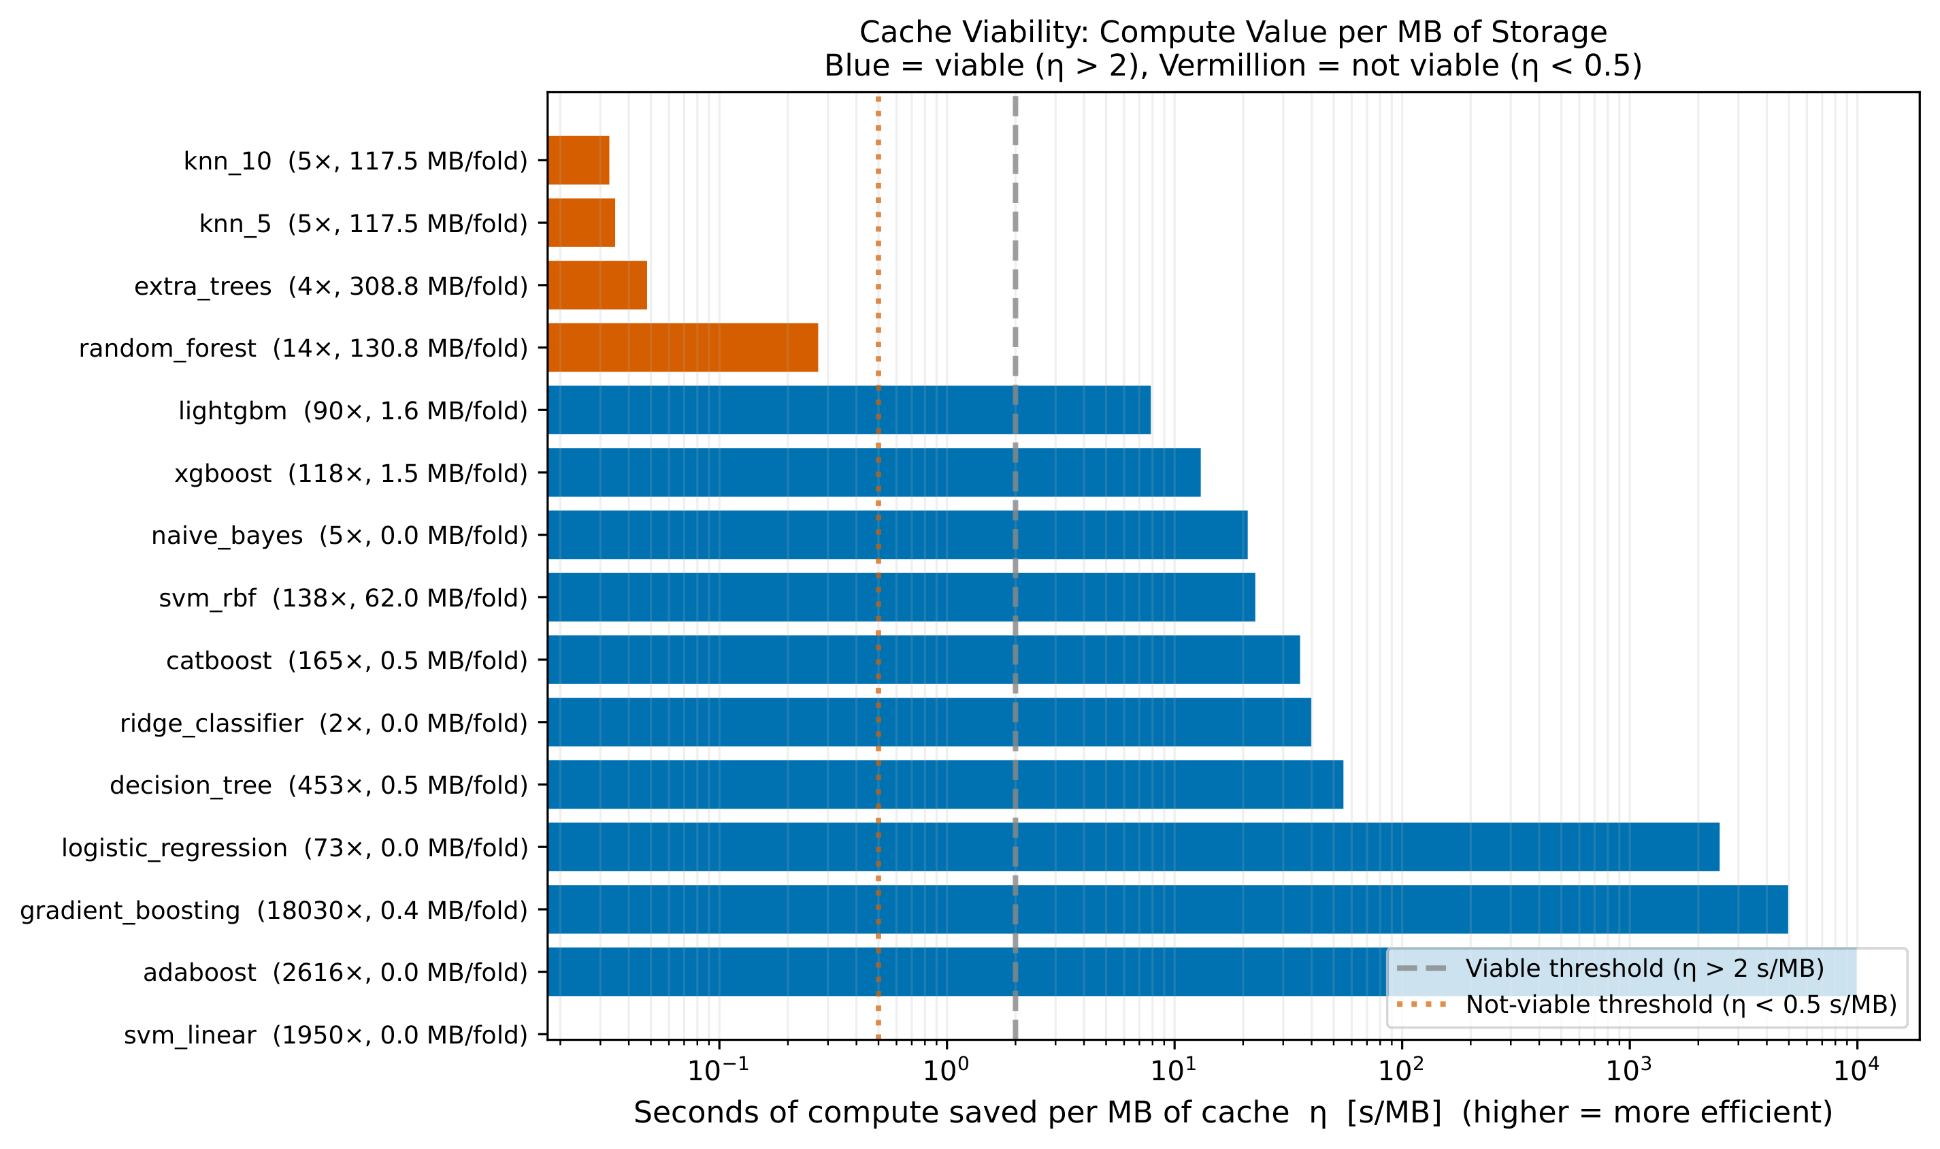
Backup — Cache Viability Ranking (η, 15 models)
η = seconds of compute saved per MB stored. Blue viable (η > 2), orange not viable (η < 0.5).
Notes:
η ranking of all 15 model types. Eleven viable, four not (Random Forest, Extra Trees, kNN k=5/k=10). Caveat if asked: the tiny-cache models (gradient boosting, AdaBoost, SVM-linear) show very large η because their cache size rounds toward zero — read this alongside the two-axis scatter on the main Results slide, which also shows absolute time saved.

Slide 14
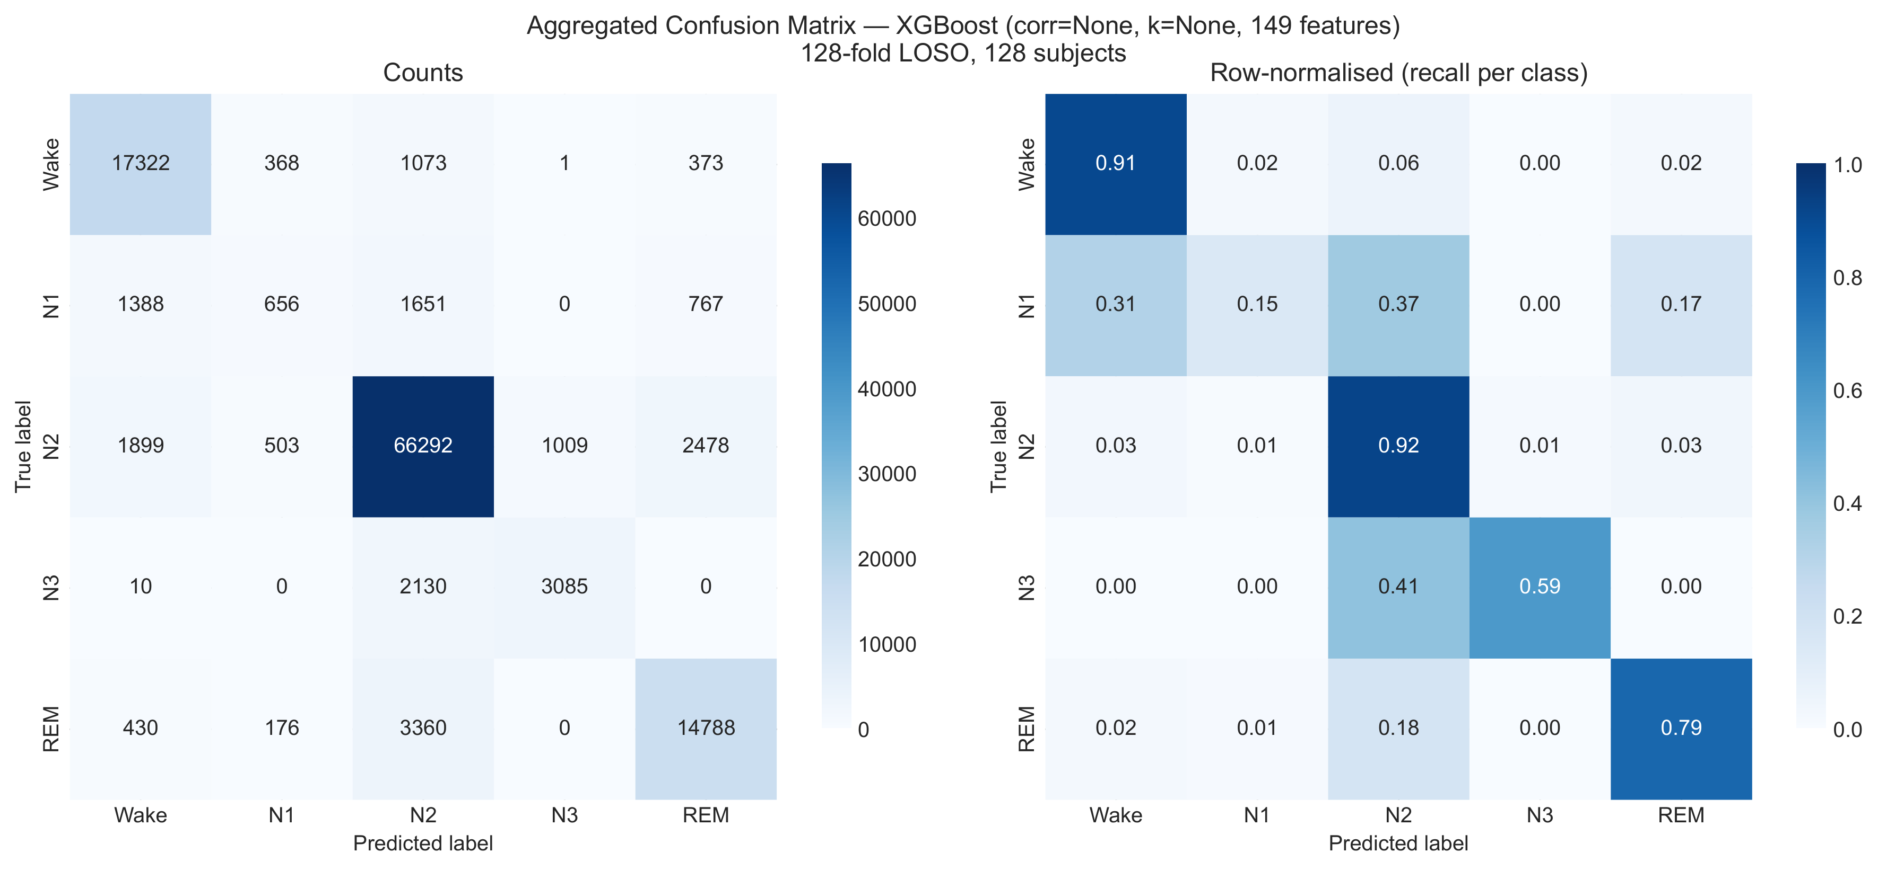
Backup — Confusion Matrix (best XGBoost)
Aggregated 5×5 confusion across all 128 LOSO folds; right panel row-normalised (recall).
Notes:
Aggregated confusion matrix, best XGBoost configuration, all 128 folds. N1 has the lowest recall — it is a transitional stage, only 3.7% of all epochs, and is most often confused with Wake and N2. This is the standard hard class in AASM sleep staging, not a caching artefact.

Slide 15
Backup — Global vs. Per-Fold Feature Selection
Aspect | Global (chosen) | Per-Fold
Selection fitted on | All subjects (once) | Training fold only
Label leakage | 1/128 ≈ 0.8% | None
Accuracy difference | ±0.4% mean, ≤1.1% max | Baseline
XGBoost warm speedup | 14–23× | 4–9×
RF warm speedup | 3–5× | 2.5–2.8×
Degrades with N? | No (fingerprint stable) | Yes (re-select/fold)
Cache key | One per config | One per fold
Global selection retains the cache speedup; measured accuracy impact ≤1.1% with no consistent direction.
Notes:
Global vs per-fold feature selection. Per-fold is statistically stricter — it removes the 0.8% label leakage — but it re-runs ANOVA on every warm load, collapsing XGBoost speedup from 14–23× to 4–9×. Global was chosen with the supervisor's approval; the empirical accuracy impact is ≤1.1% with no consistent direction. This slide directly addresses the train-set leakage point in the assessment.

