Slide 1

DeepRemaster: Temporal Source-Reference Attention
Networks for Comprehensive Video Enhancement
学生姓名：张明君-6319000359
松良-6318000433
唐琳-6319000411
那迪-6319000346

Slide 2
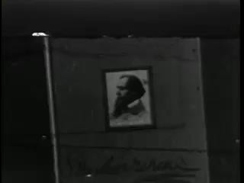
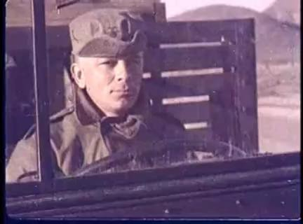
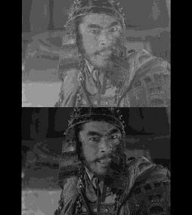
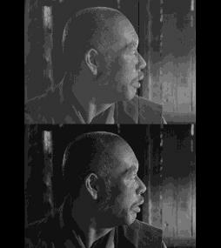
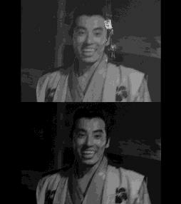
Background
Vintage film is deteriorated
Noise, blur, and low contrast
Black and white or low quality colors
Digital remastering is a challenging task
Conducted manually by experts
Requires a significant amount of
both time and money
“Oliver Twist”
(1933)
“A-Bomb Blast Effects”
(1952)
Seven Samurai (1954)

Slide 3
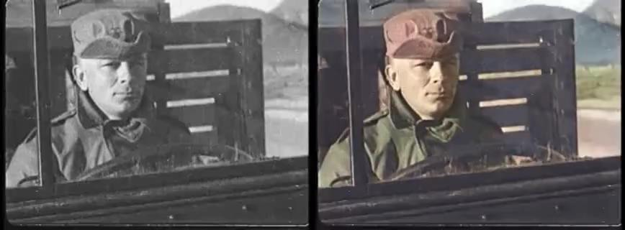
Our Goal
Semi-automatically remastering of vintage films
This includes restoration, enhancement, and colorization

Slide 4
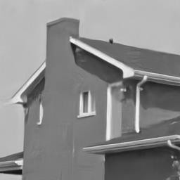
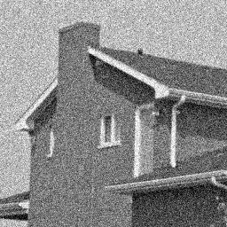
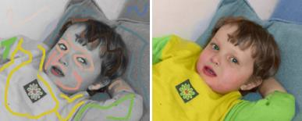
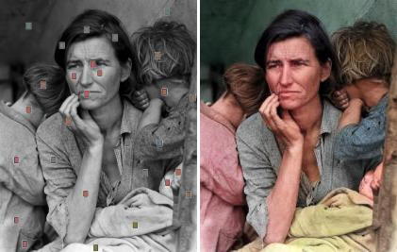
Related Work
Image/video restoration
Gaussian noise [Dabov+ ’07, Maggioni+ ’12 ’14, Lefkimmiatis ’18]
JPEG noise [Zhang+ ’17]
Blur [Shi+ ’16]
Gaussian Noise
Image Colorization
Scribble-based [Levin+ 2004; Yatziv+ ’04;
An+ ’09; Xu+ ’13; Endo+ ’16; Zhang+ ’17]
Reference-based [Chia+ ’11; Gupta+ ’12; He+ ’18]
Automatic [Iizuka+ ’16; Larsson+ ’16; Zhang+ ’16]
[Levin+ ’04]
[Zhang+ ’17]

Slide 5
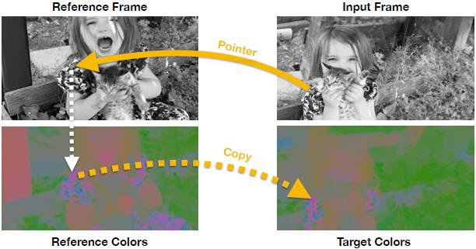
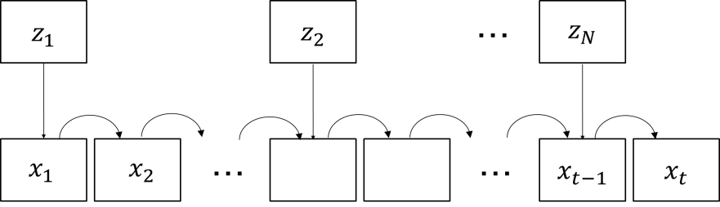
Related Work
Reference-based video colorization
Recurrent neural networks [Liu+ ’18; Vondrick+ ’18]
Processes a video by propagating color frame-by-frame
Cannot propagate between scene changes
Continues amplifying errors

Slide 6
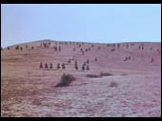
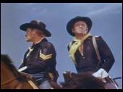
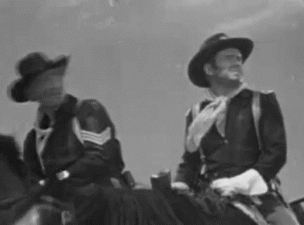
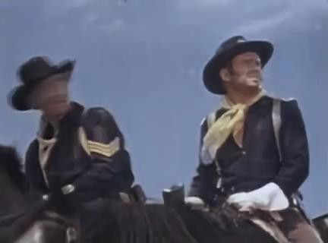


Our Method
Model based on spatial and temporal convolutions
Automatic noise removal, super-resolution, and contrast adjustment
Semi-automatic colorization source-reference attention
Can colorize a video using an arbitrary number of reference images
References
Remastering
Net

Slide 7
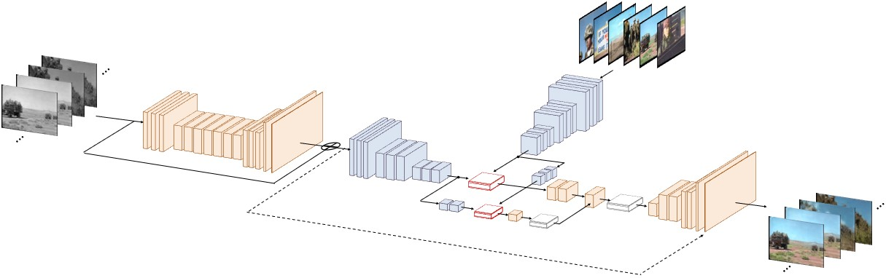
Our Network
Reference images
Temporal source-reference attention
Input
Pre-processing Network
Source-reference Network
Output

Slide 8
Our Network
Reference images
Temporal source-reference attention
Input
Pre-processing Network
Source-reference Network
Output

Slide 9
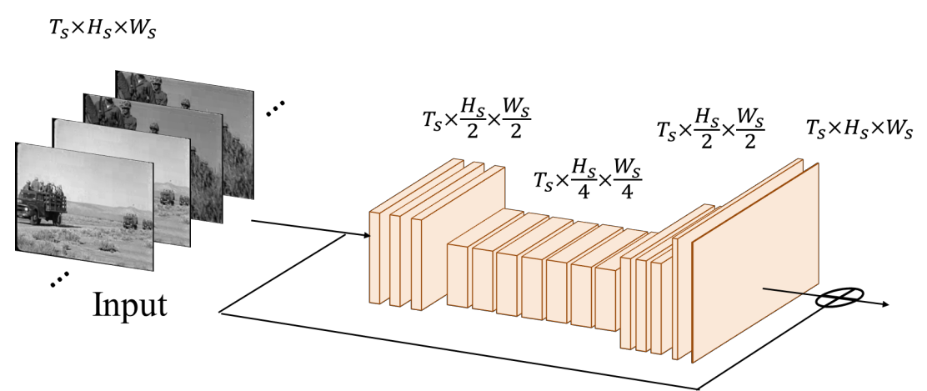
Pre-processing Network
Removes artifacts and noise from the input grayscale video
Formed exclusively by temporal convolutions
Temporal conv.
Input
Pre-processing Network

Slide 10
Our Network
Reference images
Temporal source-reference attention
Input
Pre-processing Network
Source-reference Network
Output

Slide 11
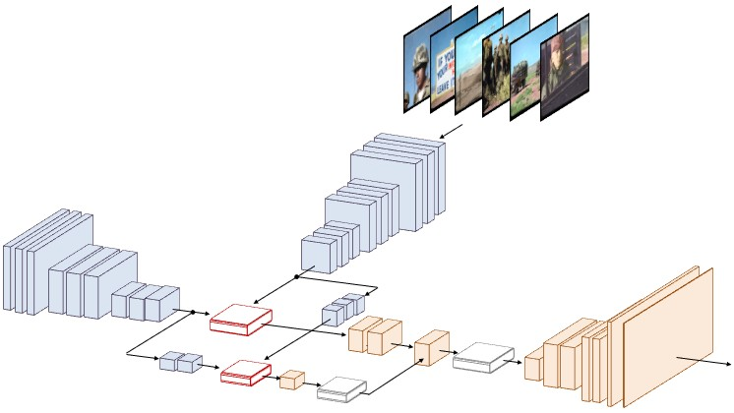
Source-reference Network
Takes the output of the pre-processing network along with an arbitrary number
of reference color images
Reference images
Colorizes the frames based on the reference images by using source-reference attention
Source-reference attention
Temporal conv.
Spatial conv.

Slide 12
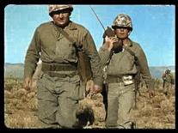
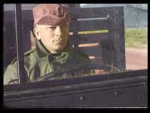
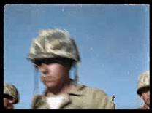
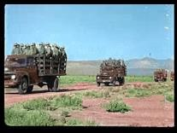
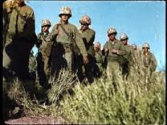
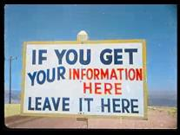
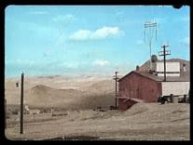
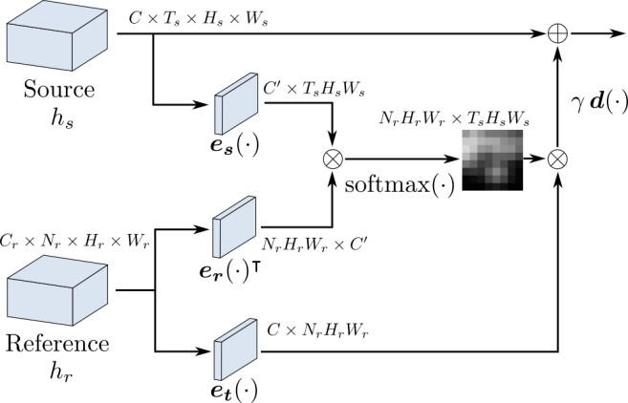
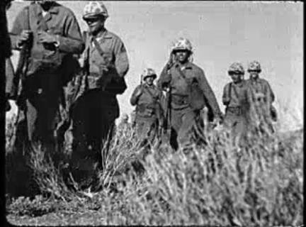
Temporal Source-reference Attention
Compute similarity between the source images and reference images
Actually computed on feature maps
References
Feature map
Input frame
source-reference attention

Slide 13
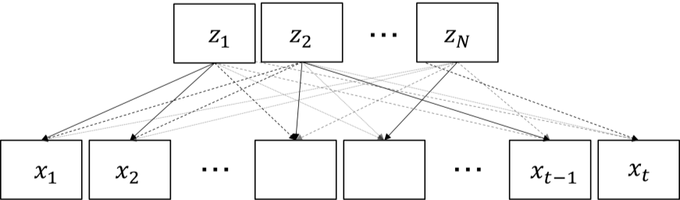
Advantages of Source-Reference Attention
Cannot form long-term dependencies
Temporal consistency is lost when a new reference is used
Require precise scene segmentation
Recursion-based network
Can use all the color reference information for colorization
Our temporal source-reference attention

Slide 14
Optimization
Combination of two L1 losses
Fully supervised learning
Uses ADADELTA[Zeiler ’12] for optimization
Objective function:
Output of
source-reference network
Ground truth
chrominance
Output of
pre-processing network
Ground truth luminance

Slide 15
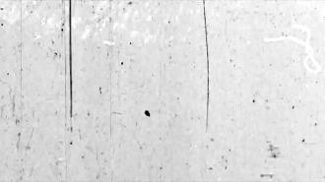

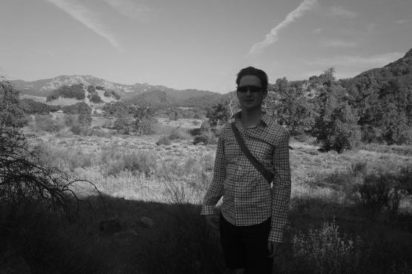
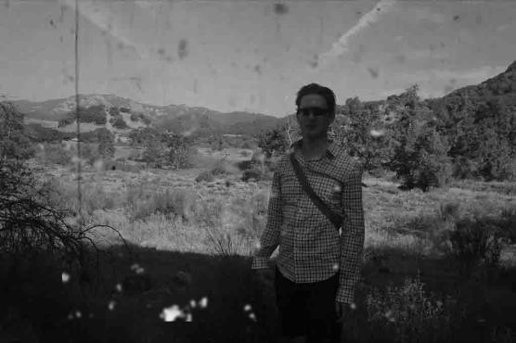



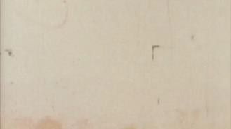
Training Data Generation
Example-based and algorithm-based deterioration
Example-based: scratch noise, fractal noise, dust noise, …
Algorithm-based: Gaussian noise, blur, low contrast
1200 videos from Youtube8M[Abu-El-Haji+ ’16] for training
Examples of noise data
Original
Deteriorated

Slide 16
Results

Slide 17
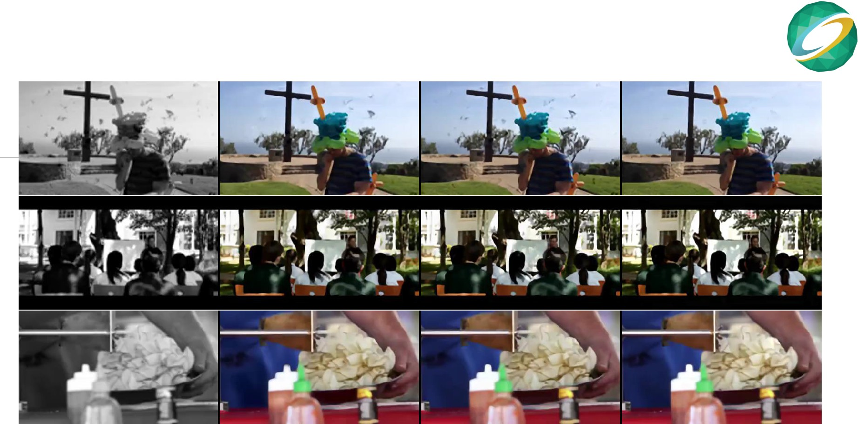
Comparisons
Input
[Yu+ '18]&[Zhang+ '17a]
[Zhang+ '17b]&[Vondrick+ '18]
Ours

Slide 18
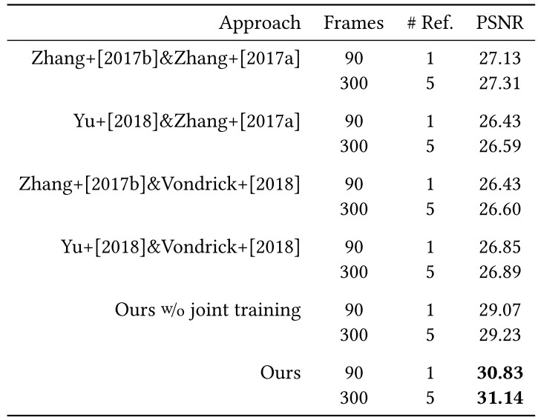
Quantitative Result
Remastering results

Slide 19
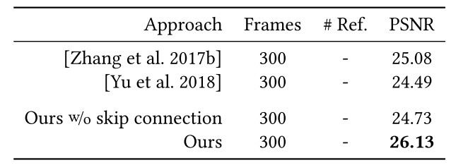
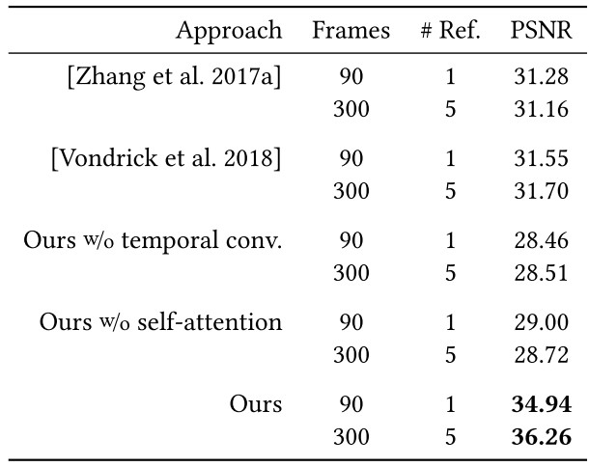
Quantitative Results
Restoration results
Colorization results

Slide 20
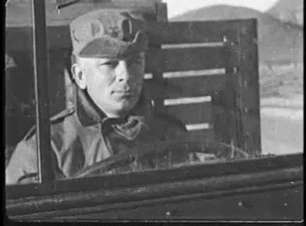
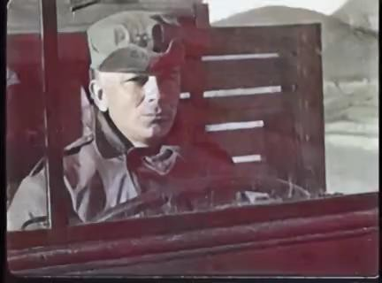
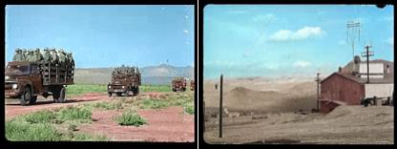
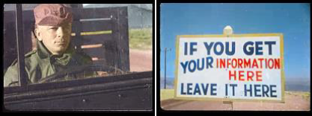
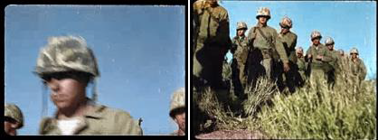
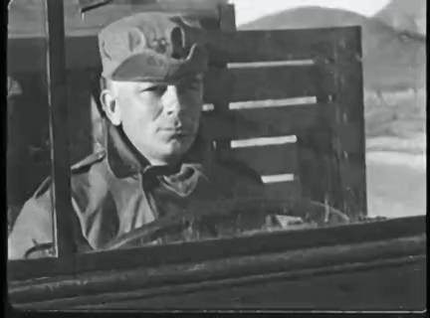
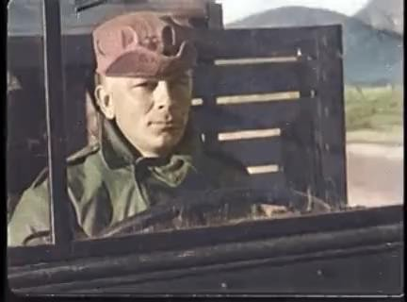
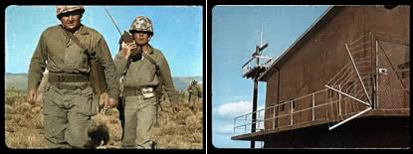
Comparisons
Input
[Yu+ ’18]&[Zhang+ ’17a]
Reference images
(manually created)
[Zhang+ ’17b]&[Vondrick+ ’18]
Ours

Slide 21
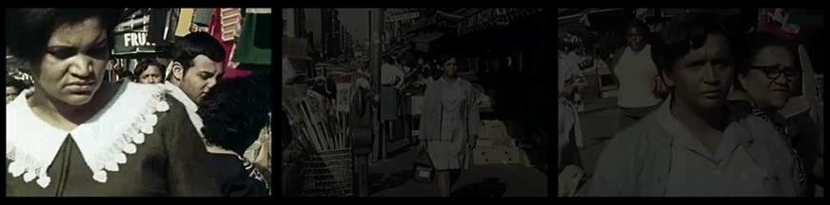
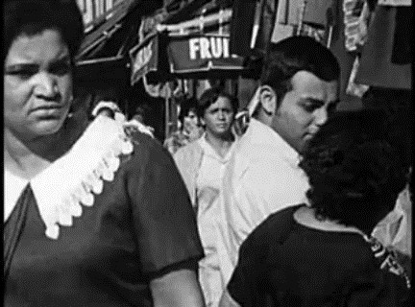
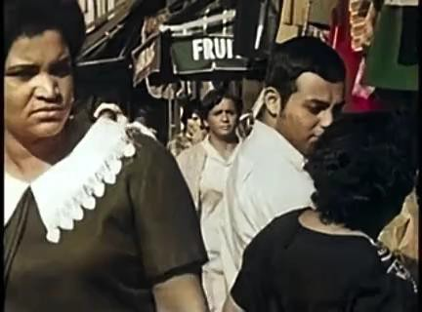
Results
Reference images
Attention
Input
Output

Slide 22
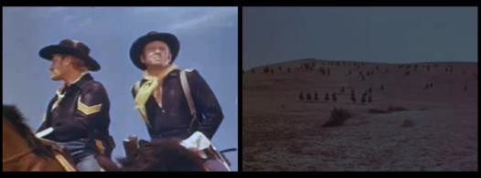
Results
Reference images
Attention
Input
Output

Slide 23
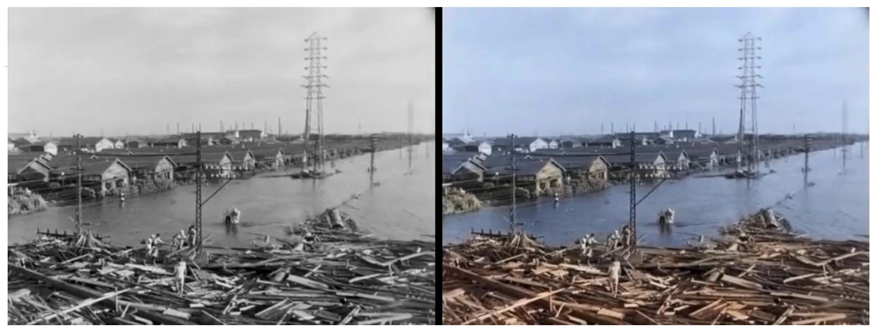
Results
"lsewan typhoon" (1959), the original film is provided by CBC Television Co.

Slide 24






Restoration Results
Large noise removal
Input
[Zhang et al. 2017b]
Ours

Slide 25




Limitations
Severely deteriorated film is difficult to remaster
Cannot fill large missing regions
Scene with intense motion
Input
Output
Input
Output

Slide 26
Conclusion
Novel single framework to tackle entire remastering task
Automatic noise removal, super-resolution, and contrast adjustment
Reference-based colorization via temporal source-reference attention
Significant improvement with respect to existing methods
Applicable to other reference-based image/video processing

