Slide 1
MIMO ANTENNAS
Tutorial

Slide 2
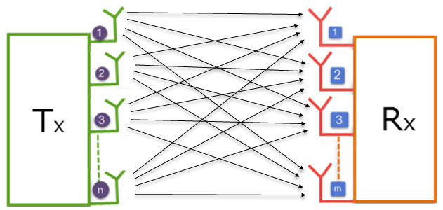
What is MIMO ?
MIMO (Multiple input, Multiple output) : an antenna technology for wireless communications in which multiple inputs are used at both the transmitter and receiver.

Slide 3
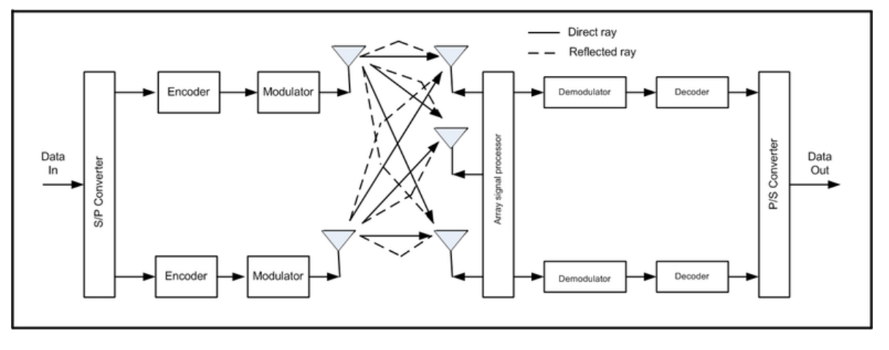
MIMO communication system high level diagram

Slide 4
Why using MIMO?
Minimize errors.
Optimize data speed. (Spatial multiplexing)
Improve capacity by enabling data to travel over many signal baths at the same time.
Create more stable connection and less congestion.

Slide 5
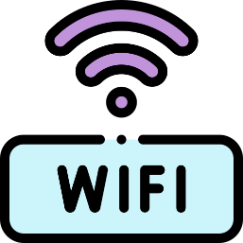
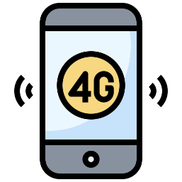
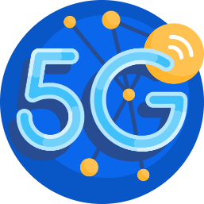

The importance of MIMO for users

Slide 6
LTE applications of MIMO
LTE uses MIMO and (OFDM) to increase speeds up to 100 megabits per second (mbps) and beyond.
These rates are double 802.11a Wi-Fi.
It separates the data into individual streams before transmission.

Slide 7
MIMO and 5G massive systems
These massive 5G MIMO systems use numerous small antennas to boost bandwidth to users and support more users per antenna.
Unlike 4G MIMO, which uses a frequency division duplex (FDD) system for supporting multiple devices, 5G massive MIMO uses a different setup called time division duplex (TDD).

Slide 8
MIMO and beamforming
Beamforming is an RF management technique that maximizes the signal power at the receiver by focusing broadcast data to specific users instead of a large area.
These can reach devices even if they're at the top of a high-rise, for example.
The beams prevent interference with other wireless signals and stay with users as they move throughout a given area.

Slide 9
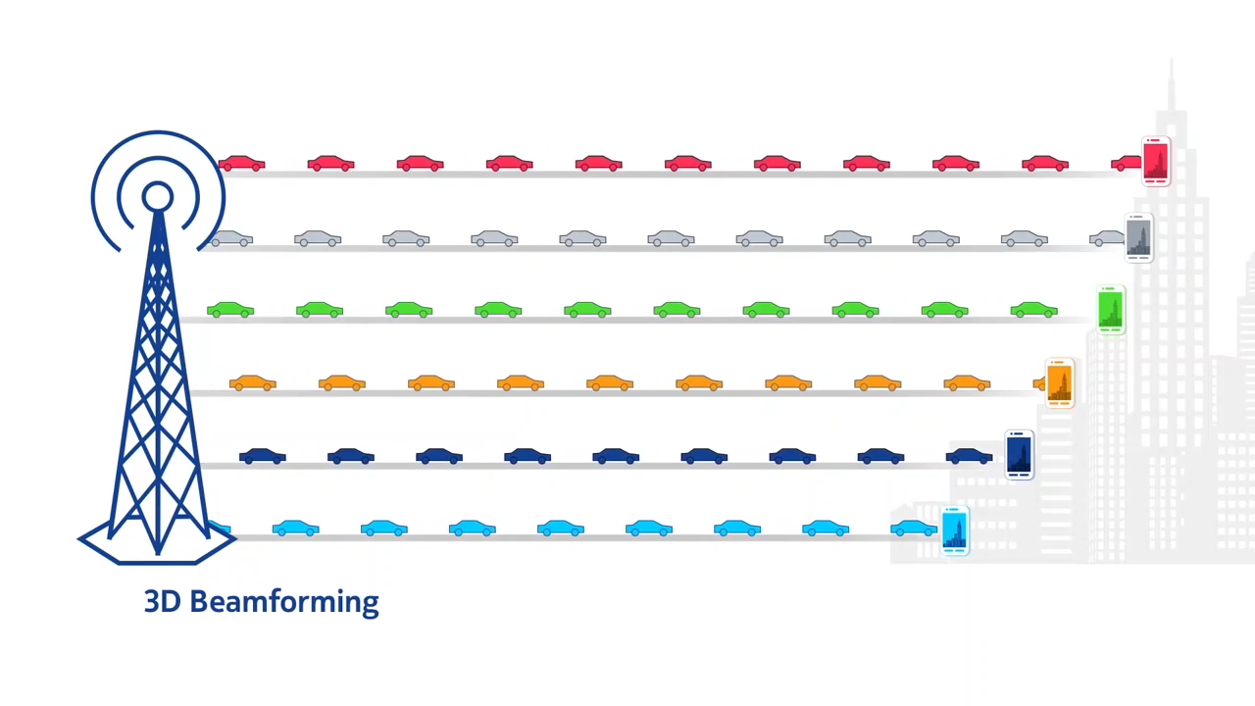
MIMO and beamforming

Slide 10
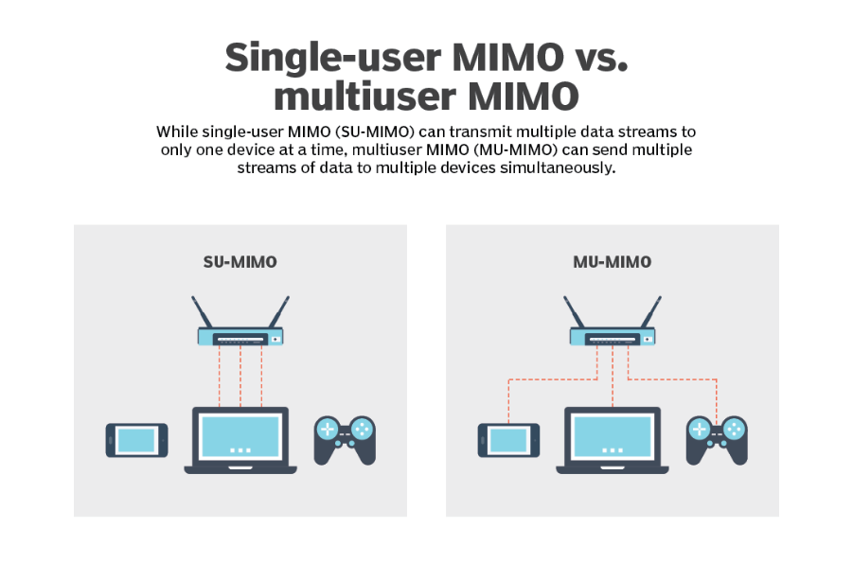
SU-MIMO vs. MU-MIMO

Slide 11
MIMO's primary advantages
MIMO enables stronger signals. It bounces and reflects signals so a user device doesn't need to be in a clear line of sight.
Video and other large-scale content can travel over a network in large quantities. This content travels more quickly because MIMO supports greater throughput.
Many data streams improve visual and auditory quality. They also decrease the chance of lost data packets.

Slide 12
How massive MIMO systems are influencing the future
High network capacities. Data travels to more users through the deployment of 5G New Radio (5G NR). MU-MIMO and 5G NR enable more users to access data at the same frequency and time rates.
More coverage. Users can soon expect high-speed data wherever they are, even at the edge of service areas. Using 3D beamforming, the coverage adapts to the user's movement and location.
Better user experience (UX). Watching videos and uploading content is easier and faster. Massive MIMO and 5G technology transform UX.

Slide 13
References
What is MIMO (multiple input, multiple output)? (techtarget.com)
https://youtu.be/g84f4mP0u30
(PDF) MIMO: Wireless Communications (researchgate.net)

