Slide 1
OoD Spurious Robustness with Foundation Models
Hosein Hasani
Reihaneh Zohrabi

Slide 2
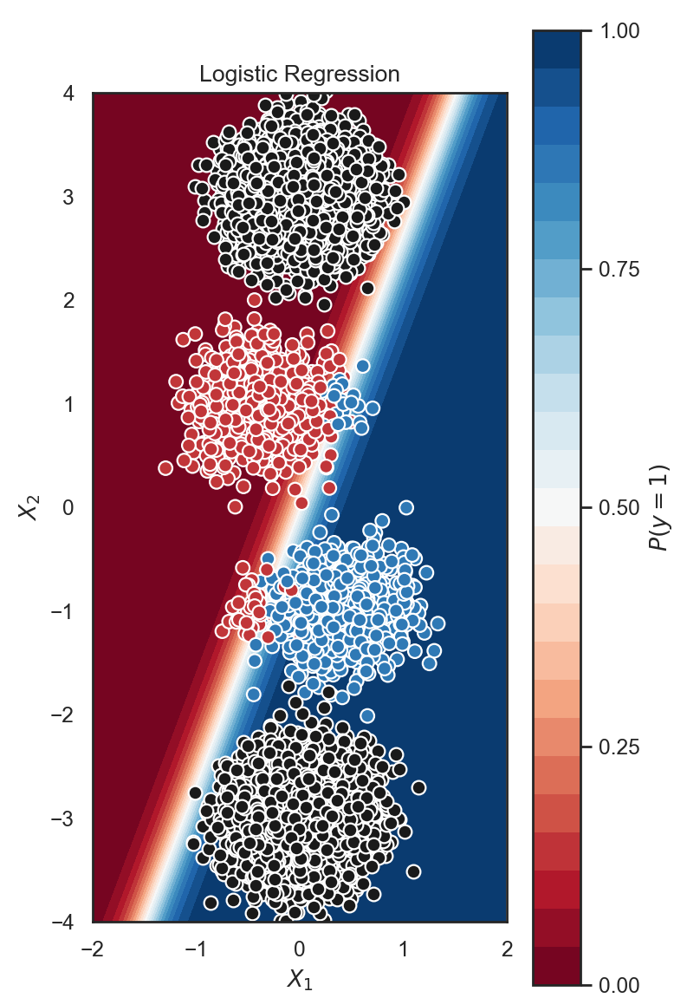
Motivation
Problem with discriminative approaches
Sp. feature
OoD samples
Core feature

Slide 3
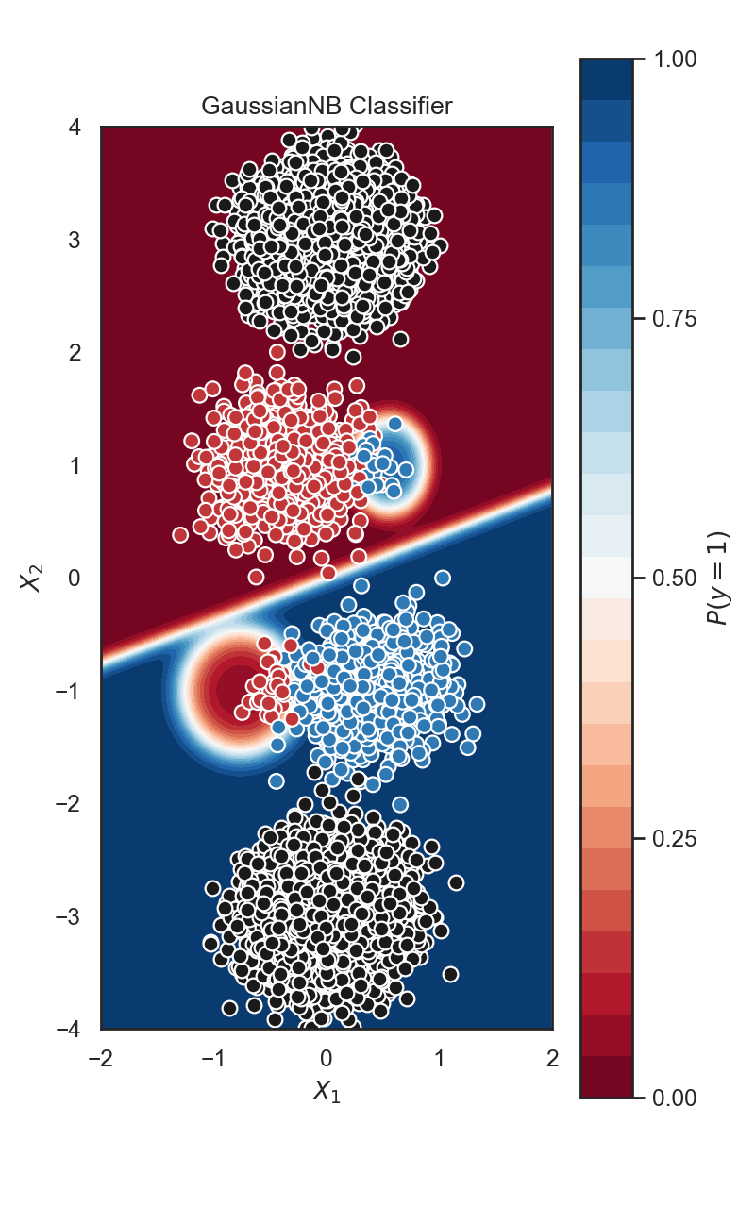
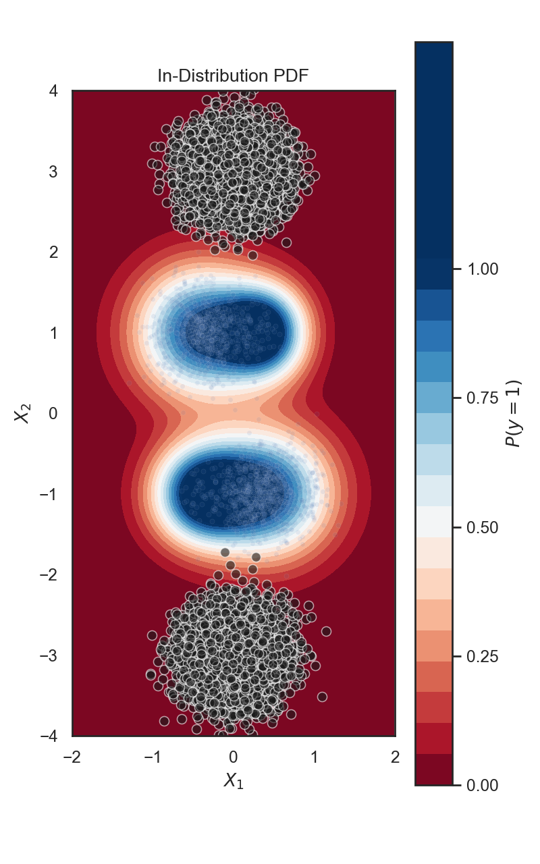
Generative vs. Discriminative
Sp. feature
Sp. feature
fitted distributions
Core feature
Core feature

Slide 4
Foundation Models
Build generative models upon large foundation models (e.g. DINO, CLIP, …)
VLM features are more robust (e.g. attribute correlation)
Can be utilized in few-shot settings

Slide 5

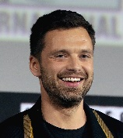

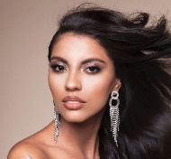


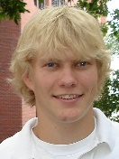
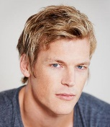


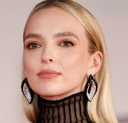

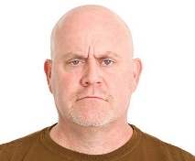

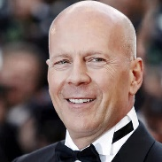
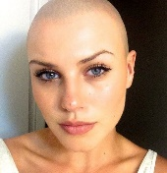
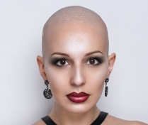
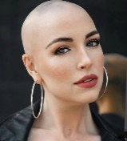
Proof of Concept
Few-shot face dataset
core feat.
sp. feat.
black
man
black
woman
blond
man
blond
woman
-
man
-
woman

Slide 6
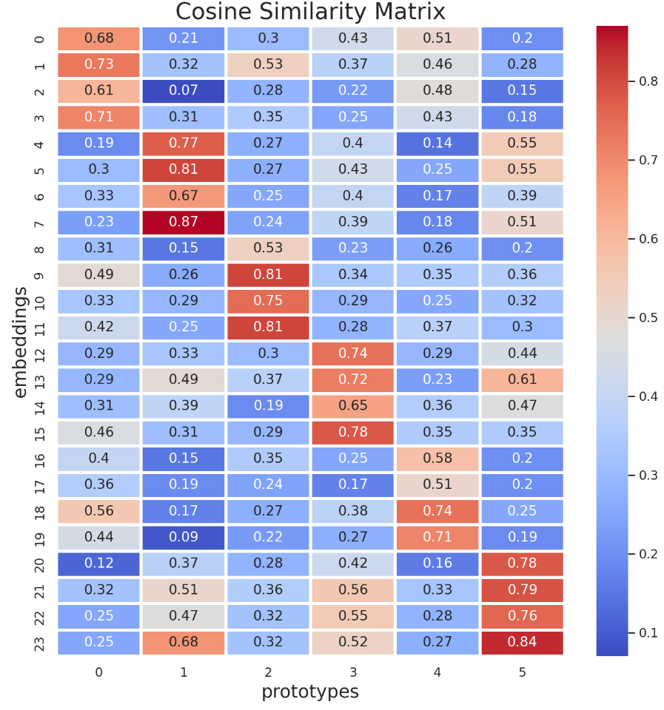
Proof of Concept: Face Dataset
Cosine distance with group prototypes in DINO space
black man
black woman
blond man
blond woman
bald man
bald woman

Slide 7
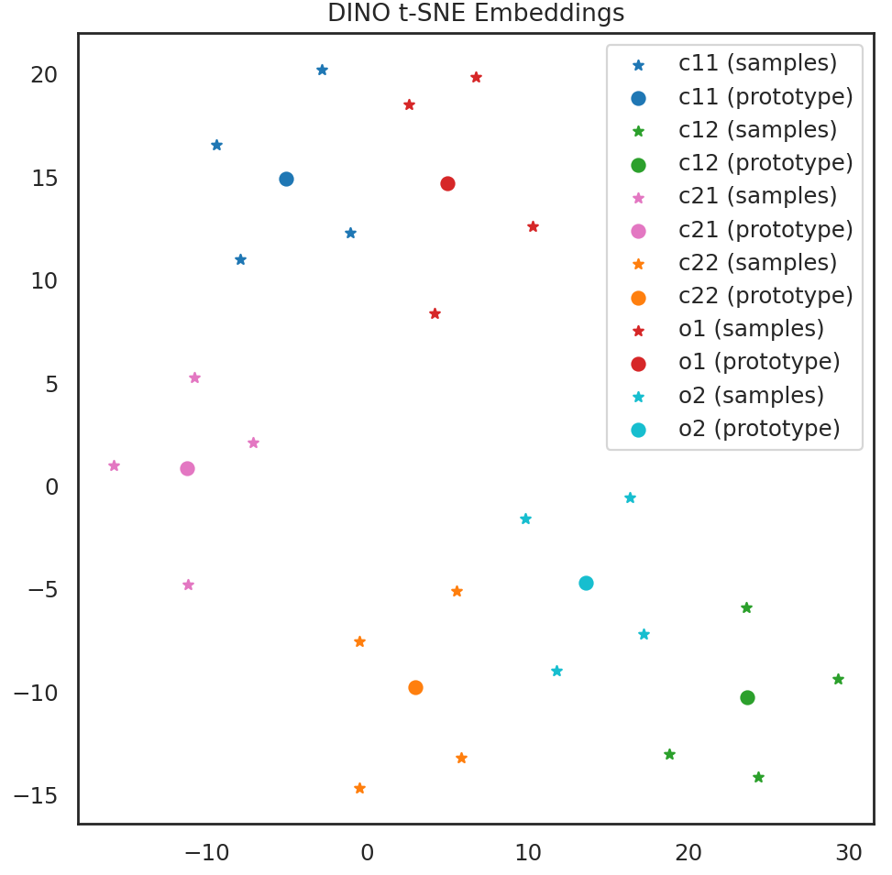
Proof of Concept: Face Dataset
Visualized DINO embeddings

Slide 8
Proof of Concept: Face Dataset
Groups are almost disjoint without any feature refinement!
black man
blond man
bald man
bald woman
black woman
blond woman

Slide 9
Proposed Procedure
Extract embeddings with FMs
Confidence-aware group discovery
Feature refinement
Metric-based classification

Slide 10
Group Discovery
We just need few samples for each group.
Use classification probability to find most confident minority / majority groups.
Group labels are used in the next stages.

Slide 11
Feature Refinement
Feature selection:
Finding predictive features for core/spurious features
A simple logistic regression classifier with lasso regularization is good
Hold most predictive core features and remove most predictive spurious features

Slide 12
Feature Refinement
Axis correction:
Using basic operation from linear algebra to achieve new sub-space (like PCA)
Remove alignments with spurious vectors
normalized data vector
spurious attribute vector
feature space
core attribute vector
alignment with sp. attr.

Slide 13
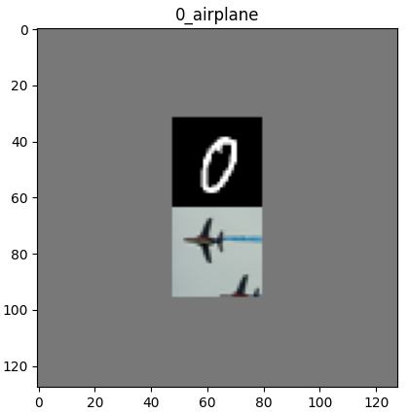
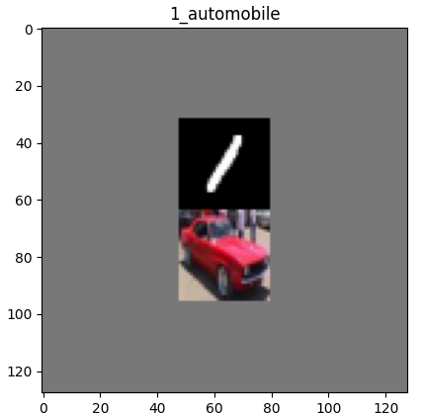
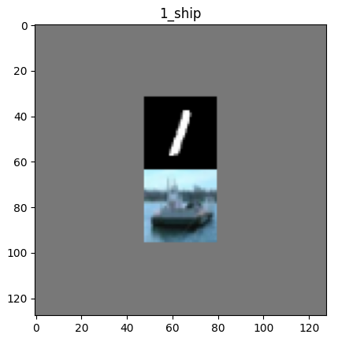
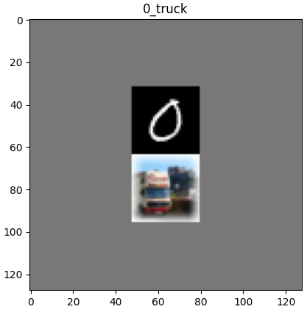
Case Study
Dominoes dataset
Main classes:
OoD classes:

Slide 14
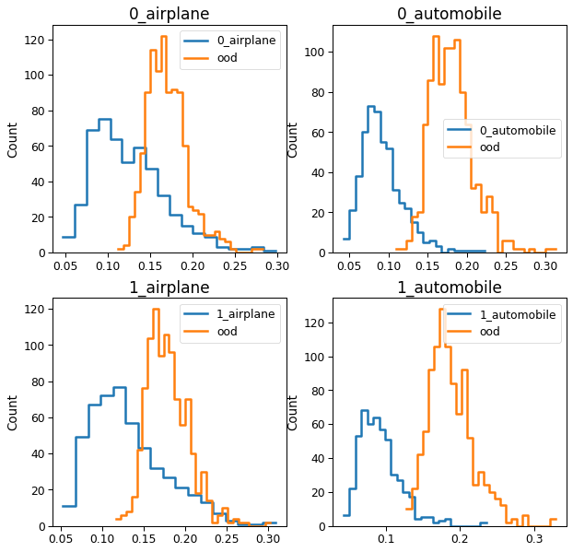
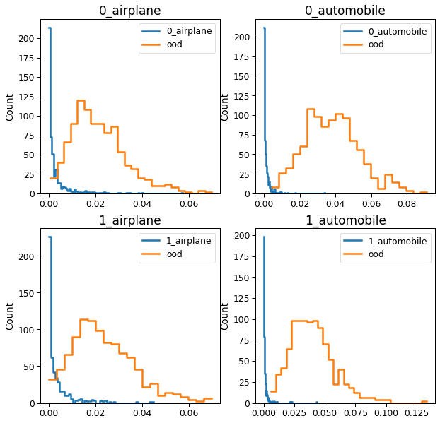
Histogram of Distances
Main classes: [airplane, automobile]
Spurious classes: [0, 1]
Hard OoD class: ship
Before refinement
After refinement

Slide 15
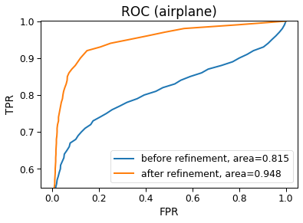
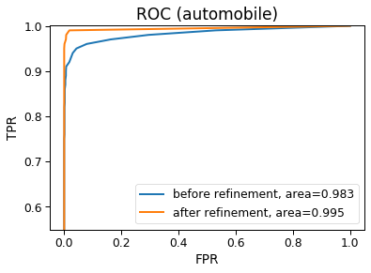
Accuracy
FPR with 95% threshold:
OoD: ship | Before refinement | After refinement
airplane | 0.94 | 0.32
automobile | 0.05 | 0.00

Slide 16
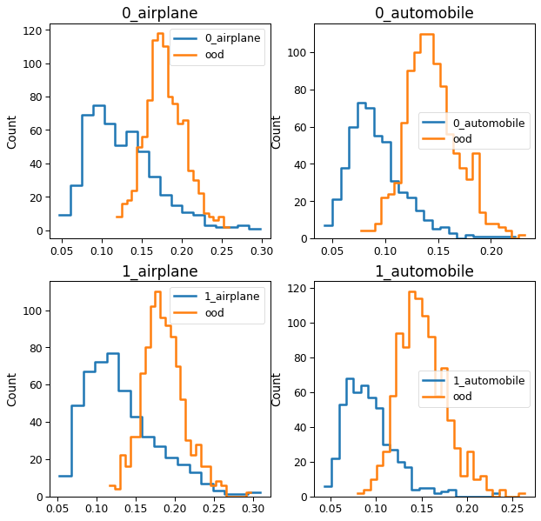
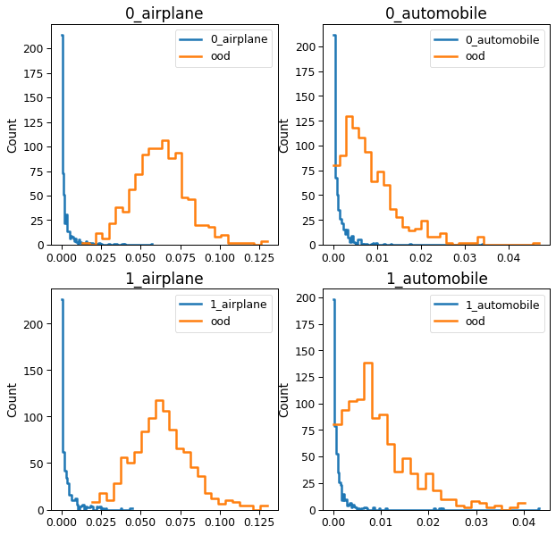
Histogram of Distances
Main classes: [airplane, automobile]
Spurious classes: [0, 1]
Hard OoD class: truck
Before refinement
After refinement

Slide 17
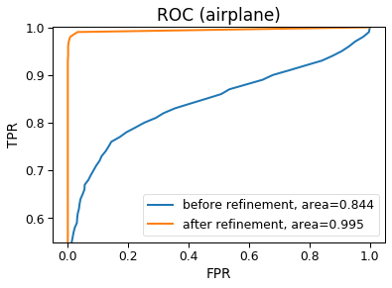
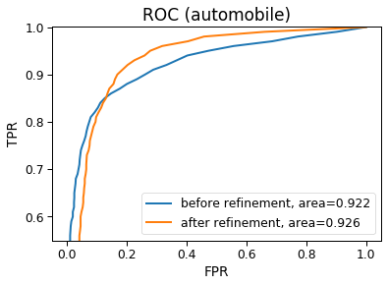
Accuracy
FPR with 95% threshold:
OoD: truck | Before refinement | After refinement
airplane | 0.91 | 0.01
automobile | 0.47 | 0.27

