Slide 1

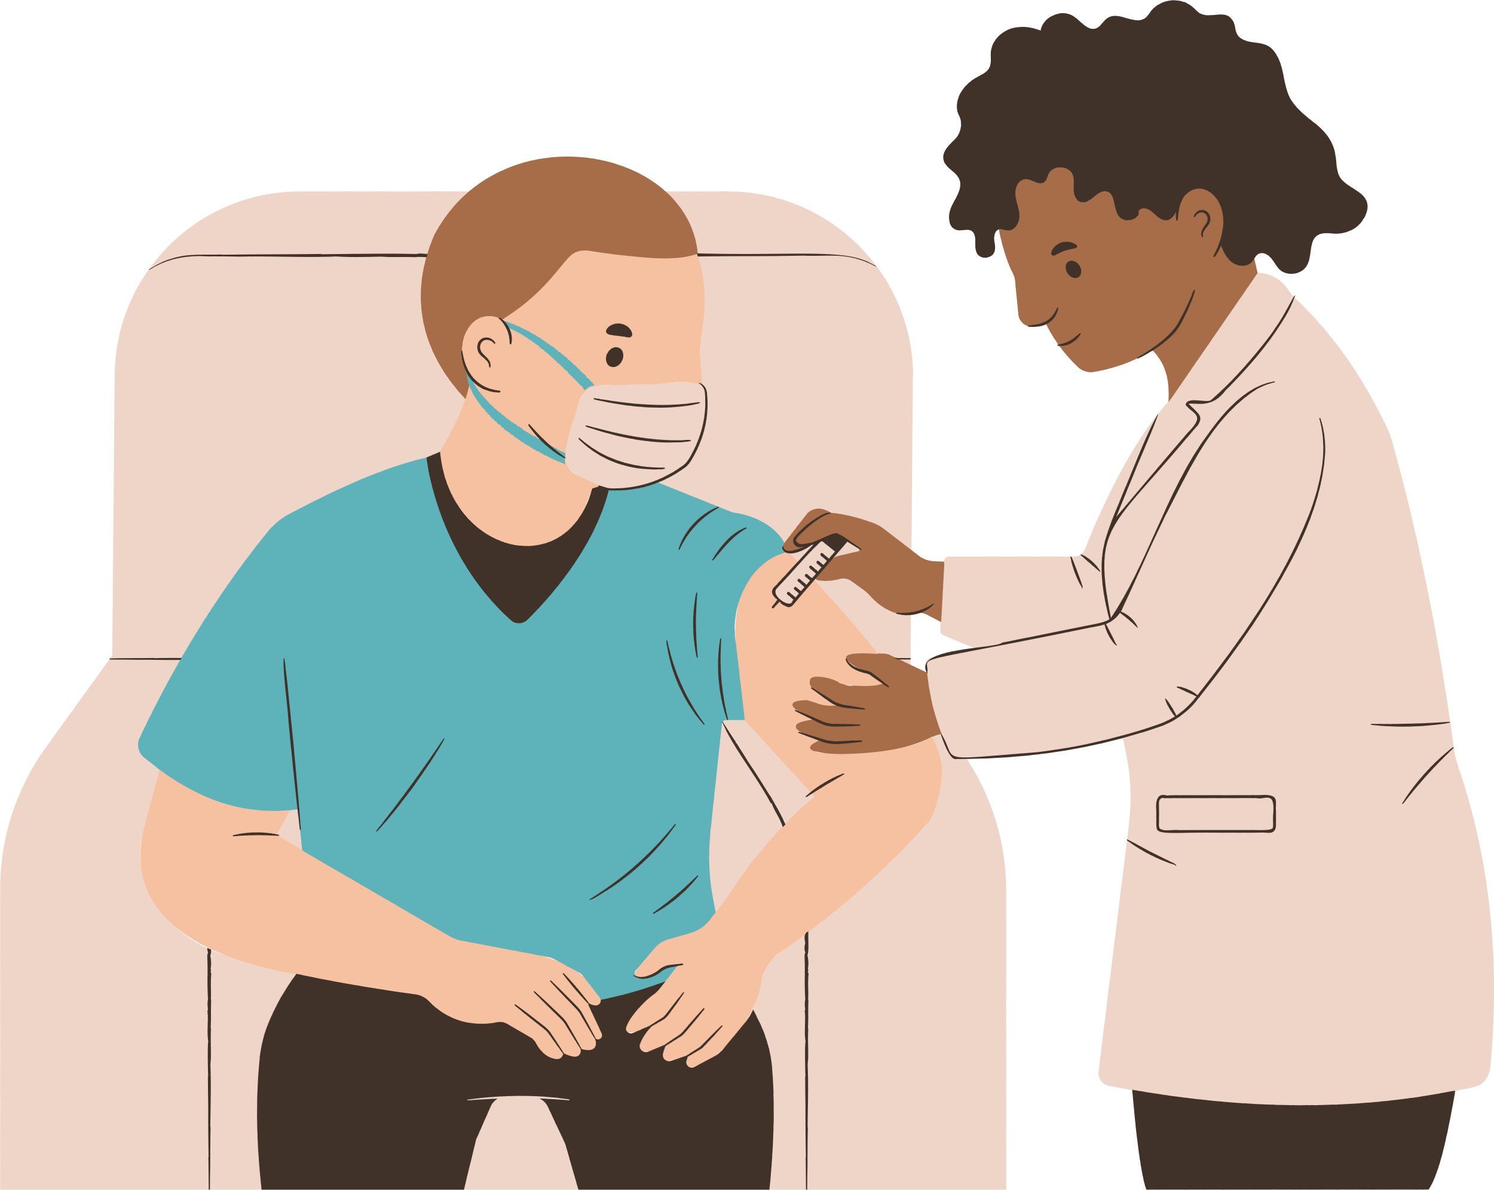
Group7
HEAL
HEALTHCARE EMPOWERMENT through AI Linguistic

Slide 2
Function
Features using large language models
問診 Medical consultation
翻訳 Translation
医療用語の解説 Explanation of medical terms

Slide 3
Social significance of the system
Background and issues
医師の質問や治療の説明を理解できないことによる不安
Anxiety due to not understanding the doctor's questions and explanations of treatments
翻訳アプリのみでの対処には限界がある
There are limitations to relying solely on translation apps
Advantages of the System
問診、診察、セカンドオピニオンまでを全て母国語で行うことが可能
Conduct consultations, examinations, and seek second opinions all in one's native language
医療用語をAIが判別し、医療用語データベースから解説を提示することで不安を解消
AI identifies medical terms and alleviates anxiety by presenting explanations from a medical terminology database
医療用語データベースは医師が監修し、信頼性を確保
The medical terms database is supervised by doctors to ensure reliability

Slide 4
Novelty of the system
Similar services
web問診システム Web-based medical consultation system
対応言語が少ない Limited languages supported
多言語対応医療翻訳/問診システム Multilingual medical translation/consultation system
医療機関が導入し、患者に提供 Adopted by medical institutions and provided to patients
大学病院などで導入するも、身近ではない
Innovative Features of HEAL
LLMを用いることで全言語間の翻訳に対応, 全世界で利用可能
Using LLMs allows for translation between all languages, Available worldwide
AIによる医療用語解説機能
AI-powered medical terminology explanation feature
患者自身がインストールし利用する身近なサービス
A convenient service installed and used by patients themselves

Slide 5
Use Case
Patient
Upon registration, select "primary care physician (hospital name)."
First, input symptoms into the AI consultation system.
Wait for a response from the "primary care physician" who reviews the consultation.
If unresolved by the response, visit the hospital for a face-to-face examination
Use HEAL's translation features during the examination: communicate using smartphones and PCs.
If the issue remains unresolved after the examination, create a report using AI.
Carry the report to another hospital or post it on HEAL and wait for a response from a doctor in your home country.

Slide 6
Use Case
Doctor
Review and respond to consultation results of assigned patients.
Conduct face-to-face examinations or refer to other hospitals.
Check and update the medical terminology database (compensation provided).
Review and respond to report posts from patients of your country (@abroad) for second opinions.

Slide 7
Technology Language
Frondend
Designing
Language: Typescript
Framework/Libraries: React Native, Redux, Socket.IO, axios
Deployment: Expo
Backend API: Postman
Database: Valentina Studio
Version Control
Git, GitHub
Backend
Language: Python
Framework: Flask, Socket.IO
Database: SQLite, peewee
AI: OpenAI API
Deployment: AWS, Docker
Deployment
AWS
Docker
Nginx

Slide 8
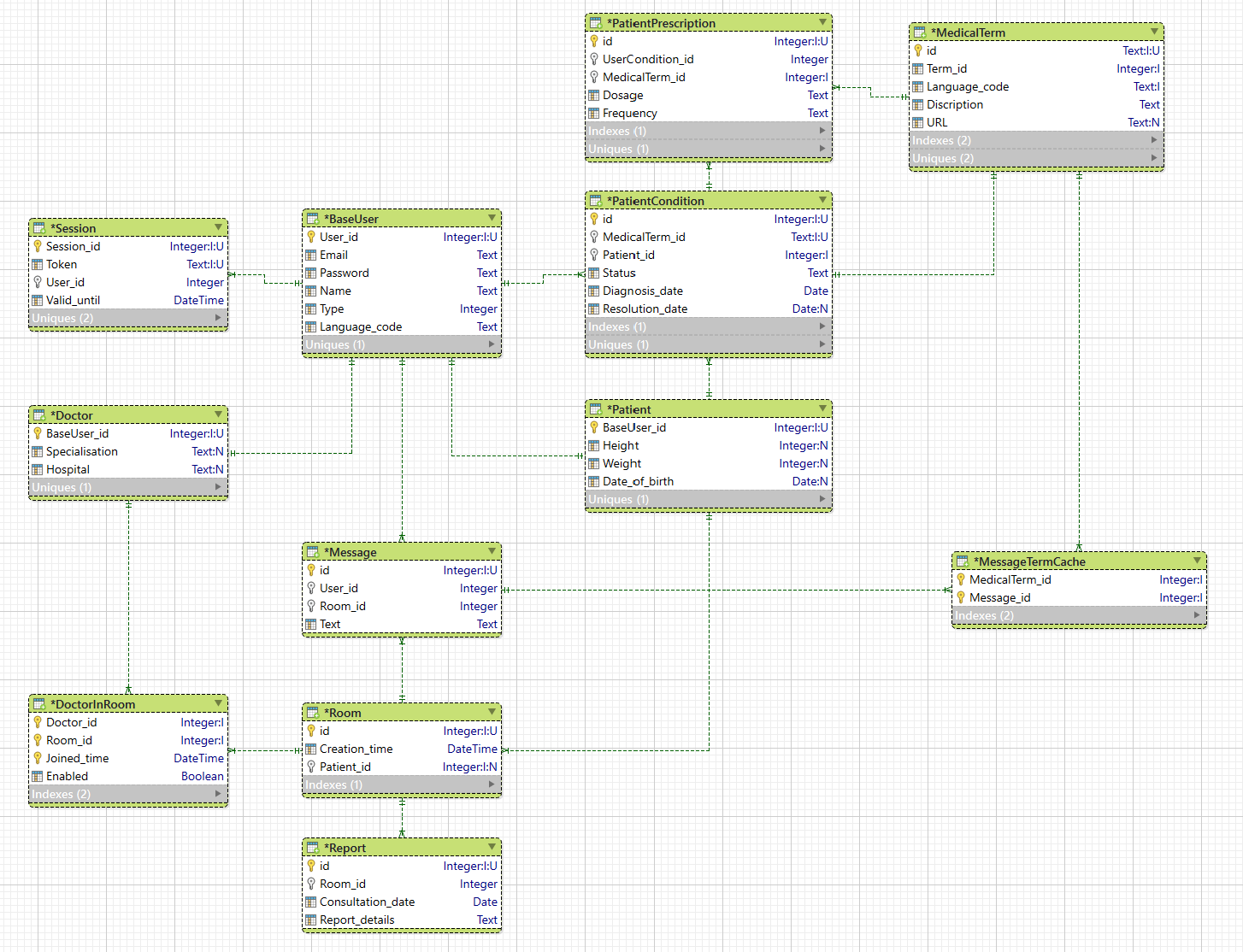
Database Design(ERD)

Slide 9
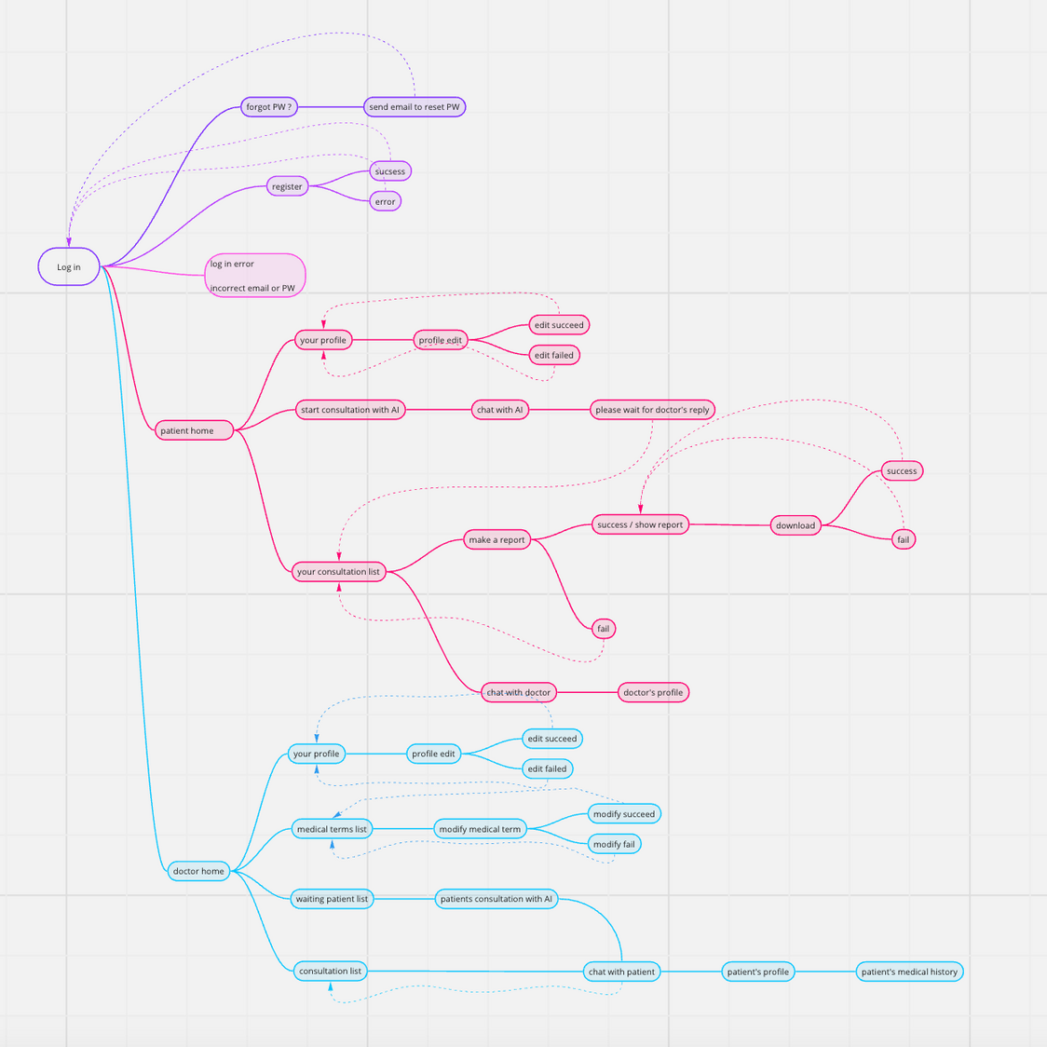
Screen Transition Diagram
(Storyboard)

Slide 10
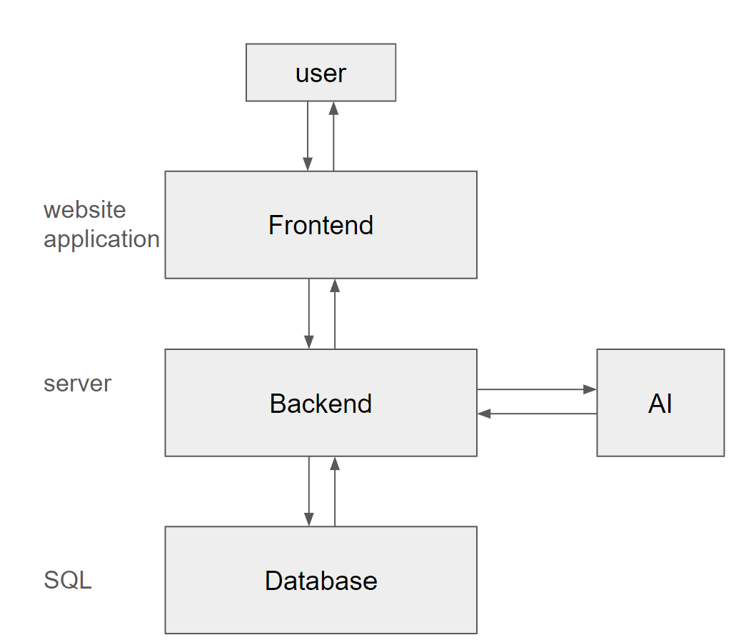
Shimizu: Story Boards/UX Design
Chris: React Native App + Website, Architecture, Front-Back communication, UX/UI Design, Database Design
Li: Architecture, Front-Back com, Docker, Database Design
Nishida: AI, Front-Back com, database operations
Baba : database operations, utilities functions
Roles

Slide 11
Functions
Patient
Login
Profile Edit
Chat with AI(Consultation: 問診)
Chat with Doctor
View Medical History
Doctor
Log in
Profile Edit
Chat with Patient
View and Edit Patient’s Medical History

Slide 12
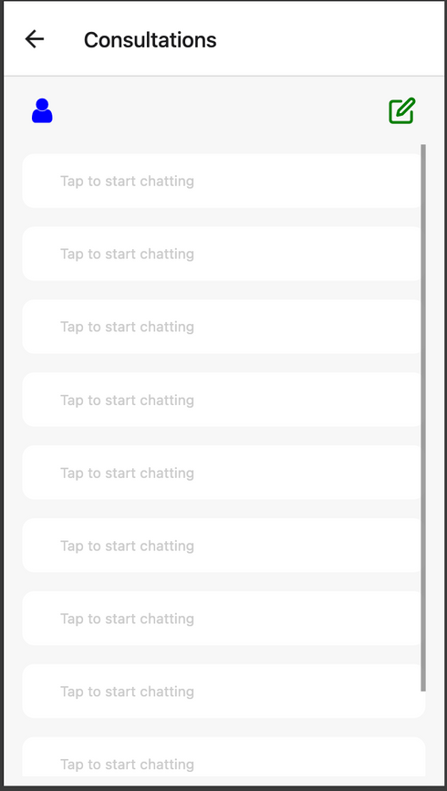
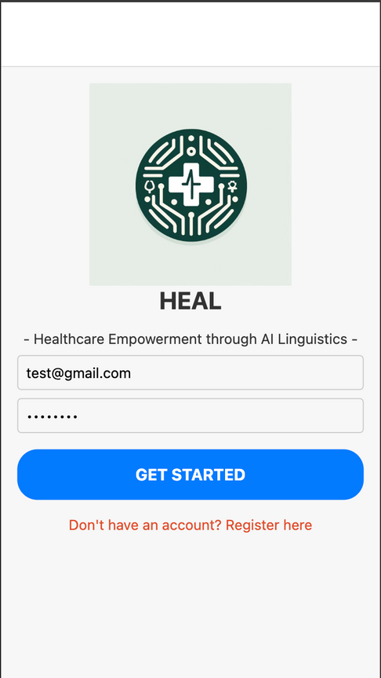
Demonstration
Login, HOME(patient:EN)

Slide 13
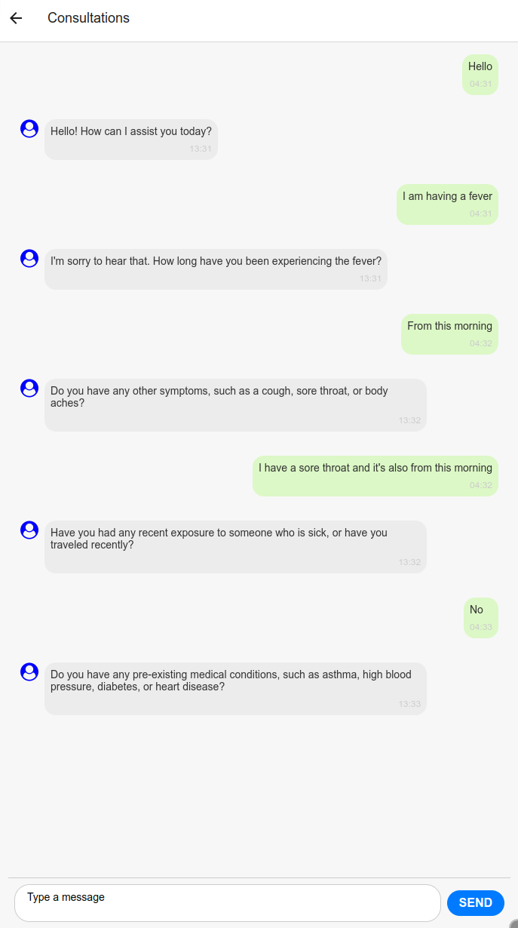
Demonstration
Consultation with AI
プロンプトに従ってAIが問診を行う
基本的には特定の質問を投げかける
問診に必要な質問を1つずつ順に投げかける
患者からの返事（質問）にも対応可能
The AI conducts the consultation by following prompts
Primarily, it asks specific questions.
It sequentially asks questions necessary for the consultation.
It can also respond to answers (questions) from the patient.

Slide 14
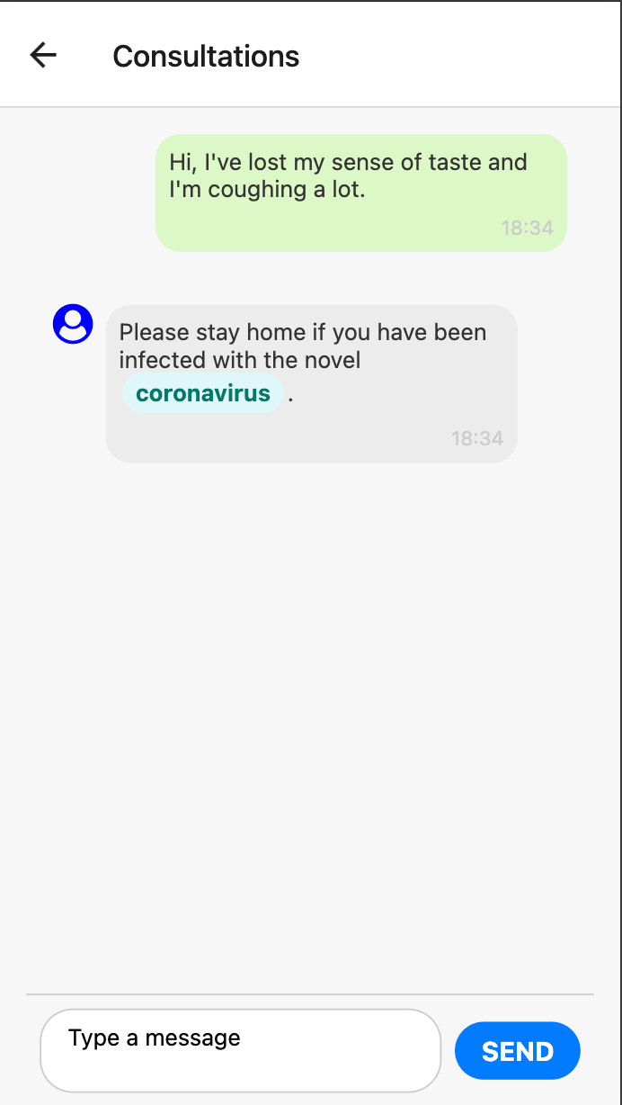
Demonstration
Consultation with Doctor
in patient’s native language

Slide 15
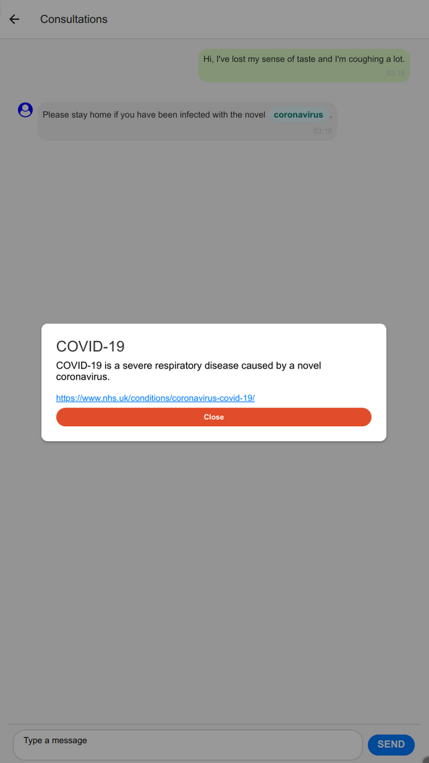
Demonstration
Highlight medical terms by AI

Slide 16
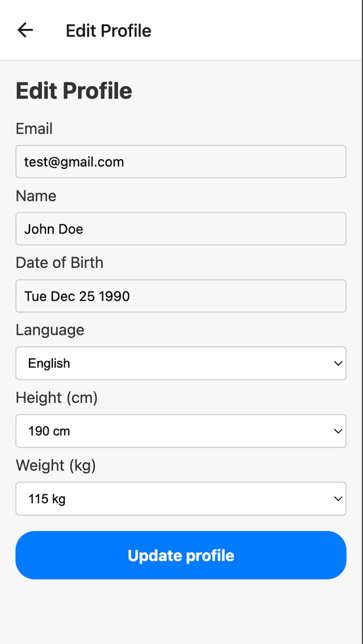
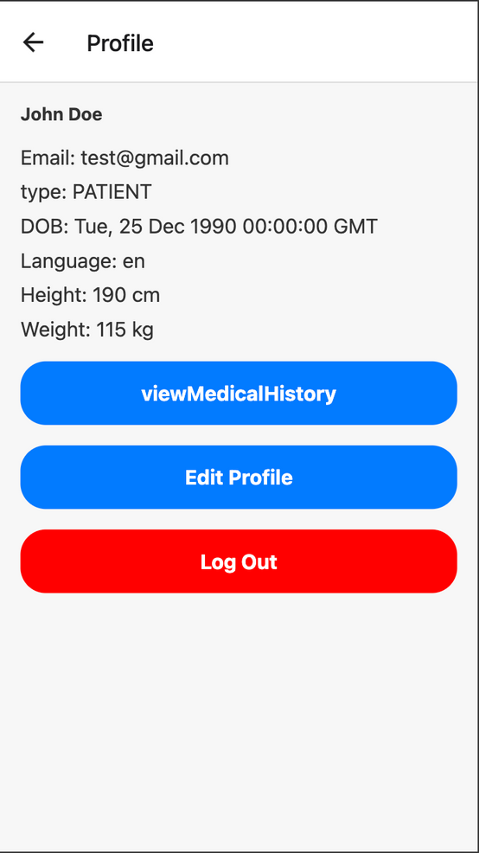
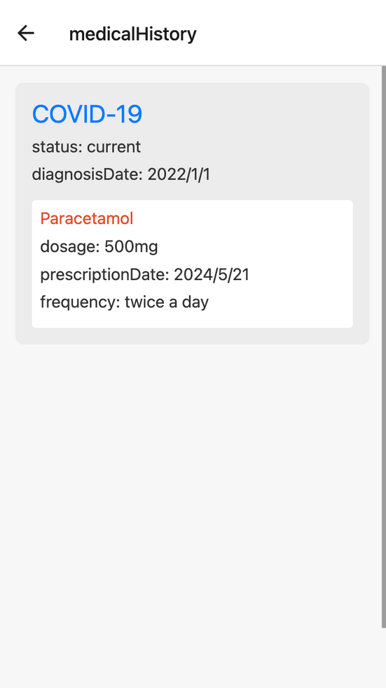
Demonstration
UserPlofile, MedicalHistory, EditProfile

Slide 17
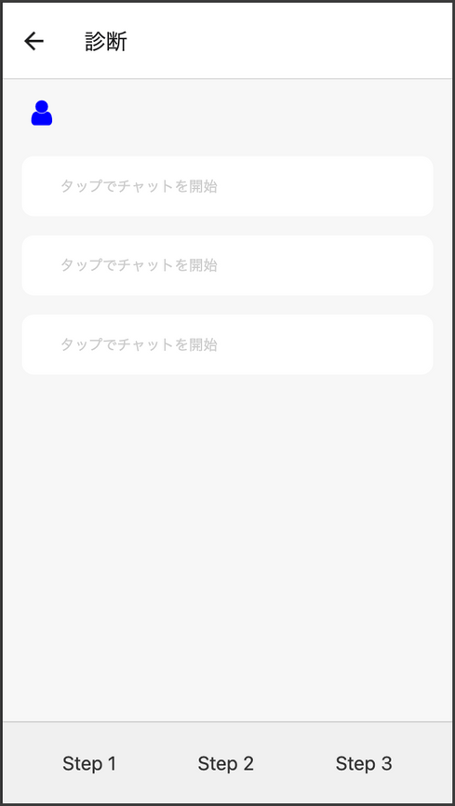
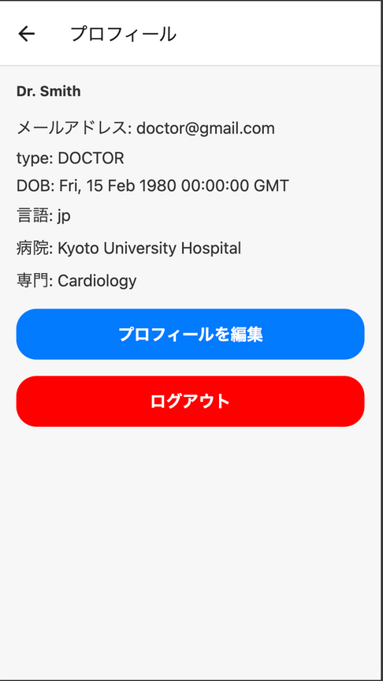
Demonstration
HOME(Doctor:JP), Profile

Slide 18
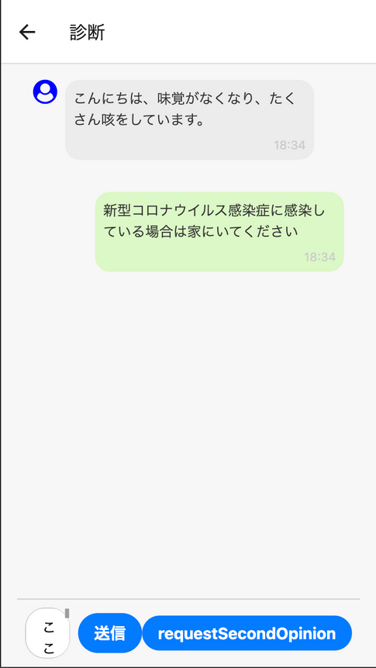
Demonstration
chat with a patient(consultation) in doctor’s native language

Slide 19
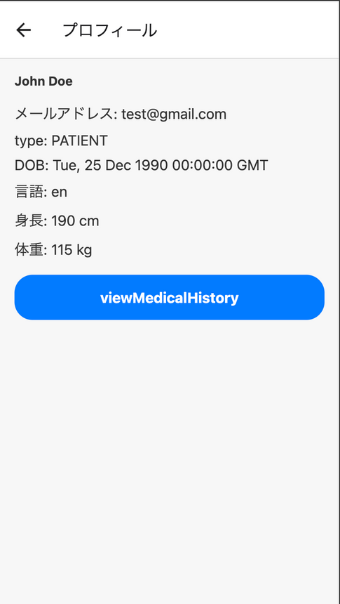
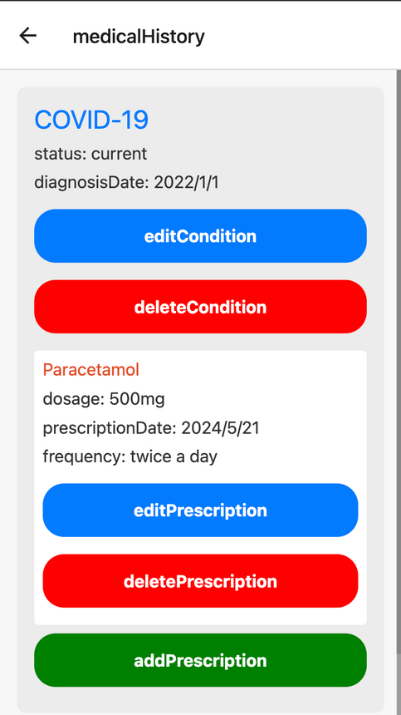
Demonstration
View & Edit Patient’s medical history

Slide 20
Future Prospects
診断書作成機能 Creating report
セカンドオピニオン推薦機能 Second opinion
医師による医療用語の審査機能 Review medical term by doctors

