Slide 1
A. R. I. M. A

Slide 2
A. R. I. M. A
Auto. Regressive. Integrated. Moving. Average

Slide 3
What is that for ?

Slide 4
In statistics, and in particular in time series analysis, an auto regressive integrated moving average (ARIMA) model is a generalization of an autoregressive moving average (ARMA) model. Both of these models are fitted to time series data either to better understand the data or to predict future points in the series.
Thanks for Wikipedia

Slide 5
ARIMA is actually a class of models that ‘explains’ a given time series based on its own past values, that is, its own lags and the lagged forecast errors, so that equation can be used to forecast future values.
Thanks for Machine Learning Plus

Slide 6
A.R.I.M.A is for forecasting!

Slide 7
But!!
What is Time Series Forecasting?

Slide 8
What is Time Series
A time series is a sequence where a metric is recorded over regular time intervals.
Depending on the frequency, a time series can be of yearly (ex: annual budget), quarterly (ex: expenses), monthly (ex: air traffic), weekly (ex: sales qty), daily (ex: weather), hourly (ex: stocks price), minutes (ex: inbound calls in a call canter) and even seconds wise (ex: web traffic).
Thanks for Machine Learning Plus

Slide 9
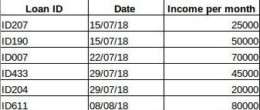
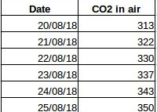
What is Time Series
Data about information of employee
Data about C02 for each day

Slide 10
Why do we need to Forecast?
For most manufacturing companies, any errors in the forecasts will ripple down throughout the supply chain or any business context for that matter. So it’s important to get the forecasts accurate in order to save on costs and is critical to success.
Thanks for Machine Learning Plus

Slide 11
Why do we need to Forecast?
$$$$$$$$$$$$$

Slide 12
One particular type of Time Series Forecasting method
A. R. I. M. A

Slide 13
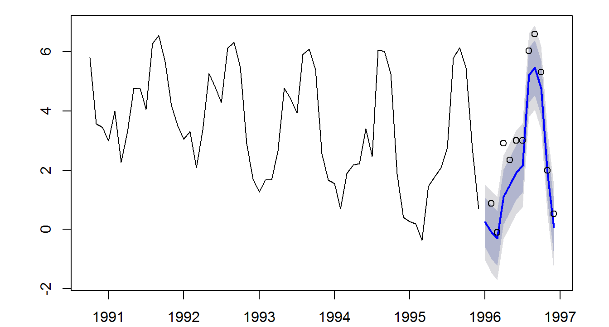
A. R. I. M. A
past values
forecast
$$$$$$

Slide 14
ARIMA-MECHANISM

Slide 15
Mechanism – differencing and stationarity
ARIMA models are applied in some cases where data show evidence of non-stationarity, where an initial differencing step can be applied one or more times to eliminate the non-stationarity
Thanks for Thanks for Wikipedia
differencing step
stationarity
forecast
correlation

Slide 16
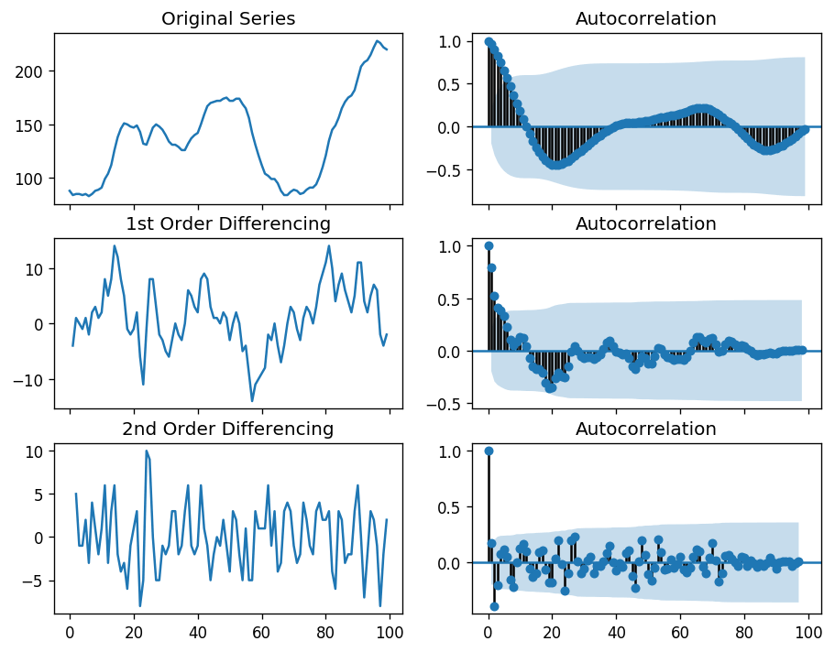
Mechanism – differencing and stationarity
Non-stationarity
Differencing Step
(e.g. subtracting an observation from an observation at the previous time step)
Stationarity
(correlation exist)
The analysis of autocorrelation is a mathematical tool for finding repeating patterns

Slide 17
Mechanism-ARIMA(p,d,q)
An ARIMA model is characterized by 3 terms: p, d, q
A. R. I. M. A
p d q

Slide 18
A. R. I. M. A
（p） (d) (q)
A.R. (Autoregression):
Autoregression is a time series model that uses observations from previous time steps as input to a regression equation to predict the value at the next time step.
P -> number of time lags
p is the order (number of time lags) of the autoregressive model
I. (Integrated):
The use of differencing of raw observations (e.g. subtracting an observation from an observation at the previous time step) in order to make the time series stationary
d -> number of differencing required
d is the number of differencing required to make the time series stationary
M.A.(Moving Average):
Lags of the forecast errors are called "moving average" terms
q -> lagged forecast errors
q is the number of lagged forecast errors in the prediction equation.

Slide 19
Forecast Y when X=13
T | Y
1 | 20
2 | 25
3 | 30
4 | 25
5 | 35
6 | 45
7 | 35
8 | 55
9 | 75
10 | 55
11 | 80
12 | 105
13 | ？

Slide 20
Forecast Y when X=13
STEP1:
Autoregression
STEP2:
Integrated(differencing)
STEP3:
Moving average
X | Y | X_1 | X_2
1 | 20
2 | 25 | 20
3 | 30 | 25 | 20
4 | 25 | 30 | 25
5 | 35 | 25 | 30
6 | 45 | 35 | 25
7 | 35 | 45 | 35
8 | 55 | 35 | 45
9 | 75 | 55 | 35
10 | 55 | 75 | 55
11 | 80 | 55 | 75
12 | 105 | 80 | 55
13 |  | 105 | 80
X | Y | X_1 | X_2
1
2 | 5
3 | 5 | 5
4 | -5 | 5 | 5
5 | 10 | -5 | 5
6 | 10 | 10 | -5
7 | -10 | 10 | 10
8 | 20 | -10 | 10
9 | 20 | 20 | -10
10 | -20 | 20 | 20
11 | 25 | -20 | 20
12 | 25 | 25 | -20
13 |  | 25 | 25
X | Y | X_1 | X_2
1
2
3 | 5
4 | 0 | 5
5 | 2.5 | 0 | 5
6 | 10 | 2.5 | 0
7 | 0 | 10 | 2.5
8 | 5 | 0 | 10
9 | 20 | 5 | 0
10 | 0 | 20 | 5
11 | 2.5 | 0 | 20
12 | 25 | 2.5 | 0
13 |  | 25 | 2.5
25-20=5
(5+5)/2=5
p = 2 (x_1 and x_2)
P -> number of time lags
d=1
Subtracting an observation from an observation at the previous time
q=1
Calculating the average of an observation and an observation at the previous time.
Just for understand the concept of ARIMA

Slide 21
Forecast Y when X=13
Autoregression
Integrated(differencing)
Moving average
X | Y | X_1 | X_2
1 | 20
2 | 25 | 20
3 | 30 | 25 | 20
4 | 25 | 30 | 25
5 | 35 | 25 | 30
6 | 45 | 35 | 25
7 | 35 | 45 | 35
8 | 55 | 35 | 45
9 | 75 | 55 | 35
10 | 55 | 75 | 55
11 | 80 | 55 | 75
12 | 105 | 80 | 55
13 |  | 105 | 80
X | Y | X_1 | X_2
1
2 | 5
3 | 5 | 5
4 | -5 | 5 | 5
5 | 10 | -5 | 5
6 | 10 | 10 | -5
7 | -10 | 10 | 10
8 | 20 | -10 | 10
9 | 20 | 20 | -10
10 | -20 | 20 | 20
11 | 25 | -20 | 20
12 | 25 | 25 | -20
13 |  | 25 | 25
X | Y | X_1 | X_2
1
2
3 | 5
4 | 0 | 5
5 | 2.5 | 0 | 5
6 | 10 | 2.5 | 0
7 | 0 | 10 | 2.5
8 | 5 | 0 | 10
9 | 20 | 5 | 0
10 | 0 | 20 | 5
11 | 2.5 | 0 | 20
12 | 25 | 2.5 | 0
13 | 2.5~25 | 25 | 2.5
25-20=5
(5+5)/2=5
p = 2 (x_1 and x_2)
P -> number of time lags
d=1
Subtracting an observation from an observation at the previous time
q=1
Calculating the average of an observation and an observation at the previous time.
Just for understand the concept of ARIMA

Slide 22
Forecast Y when X=13
Autoregression
Integrated(differencing)
Moving average
X | Y | X_1 | X_2
1 | 20
2 | 25 | 20
3 | 30 | 25 | 20
4 | 25 | 30 | 25
5 | 35 | 25 | 30
6 | 45 | 35 | 25
7 | 35 | 45 | 35
8 | 55 | 35 | 45
9 | 75 | 55 | 35
10 | 55 | 75 | 55
11 | 80 | 55 | 75
12 | 105 | 80 | 55
13 | 85 | 105 | 80
X | Y | X_1 | X_2
1
2 | 5
3 | 5 | 5
4 | -5 | 5 | 5
5 | 10 | -5 | 5
6 | 10 | 10 | -5
7 | -10 | 10 | 10
8 | 20 | -10 | 10
9 | 20 | 20 | -10
10 | -20 | 20 | 20
11 | 25 | -20 | 20
12 | 25 | 25 | -20
13 | -20 | 25 | 25
X | Y | X_1 | X_2
1
2
3 | 5
4 | 0 | 5
5 | 2.5 | 0 | 5
6 | 10 | 2.5 | 0
7 | 0 | 10 | 2.5
8 | 5 | 0 | 10
9 | 20 | 5 | 0
10 | 0 | 20 | 5
11 | 2.5 | 0 | 20
12 | 25 | 2.5 | 0
13 | 2.5 | 25 | 2.5
25-20=5
(5+5)/2=5
p = 2 (x_1 and x_2)
P -> number of time lags
d=1
Subtracting an observation from an observation at the previous time
q=1
Calculating the average of an observation and an observation at the previous time.
Just for understand the concept of ARIMA

Slide 23
Forecast Y when X=13
Autoregression
Integrated(differencing)
Moving average
X | Y | X_1 | X_2
1 | 20
2 | 25 | 20
3 | 30 | 25 | 20
4 | 25 | 30 | 25
5 | 35 | 25 | 30
6 | 45 | 35 | 25
7 | 35 | 45 | 35
8 | 55 | 35 | 45
9 | 75 | 55 | 35
10 | 55 | 75 | 55
11 | 80 | 55 | 75
12 | 105 | 80 | 55
13 | 130 | 105 | 80
X | Y | X_1 | X_2
1
2 | 5
3 | 5 | 5
4 | -5 | 5 | 5
5 | 10 | -5 | 5
6 | 10 | 10 | -5
7 | -10 | 10 | 10
8 | 20 | -10 | 10
9 | 20 | 20 | -10
10 | -20 | 20 | 20
11 | 25 | -20 | 20
12 | 25 | 25 | -20
13 | 25 | 25 | 25
X | Y | X_1 | X_2
1
2
3 | 5
4 | 0 | 5
5 | 2.5 | 0 | 5
6 | 10 | 2.5 | 0
7 | 0 | 10 | 2.5
8 | 5 | 0 | 10
9 | 20 | 5 | 0
10 | 0 | 20 | 5
11 | 2.5 | 0 | 20
12 | 25 | 2.5 | 0
13 | 25 | 25 | 2.5
25-20=5
(5+5)/2=5
p = 2 (x_1 and x_2)
P -> number of time lags
d=1
Subtracting an observation from an observation at the previous time
q=1
Calculating the average of an observation and an observation at the previous time.
Just for understand the concept of ARIMA

Slide 24
Forecast Y when X=13
T | Y
1 | 20
2 | 25
3 | 30
4 | 25
5 | 35
6 | 45
7 | 35
8 | 55
9 | 75
10 | 55
11 | 80
12 | 105
13 | 85 ~130

