Slide 1
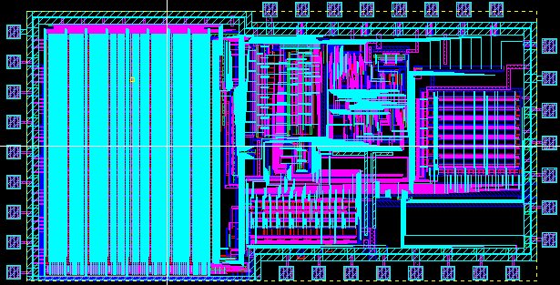
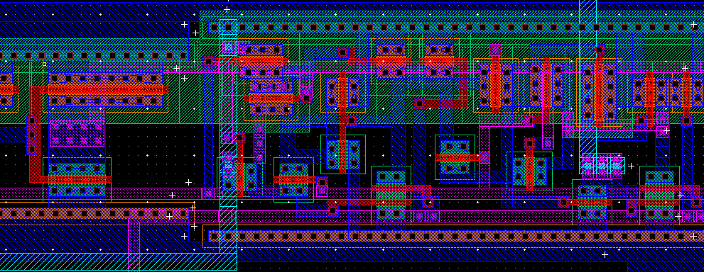
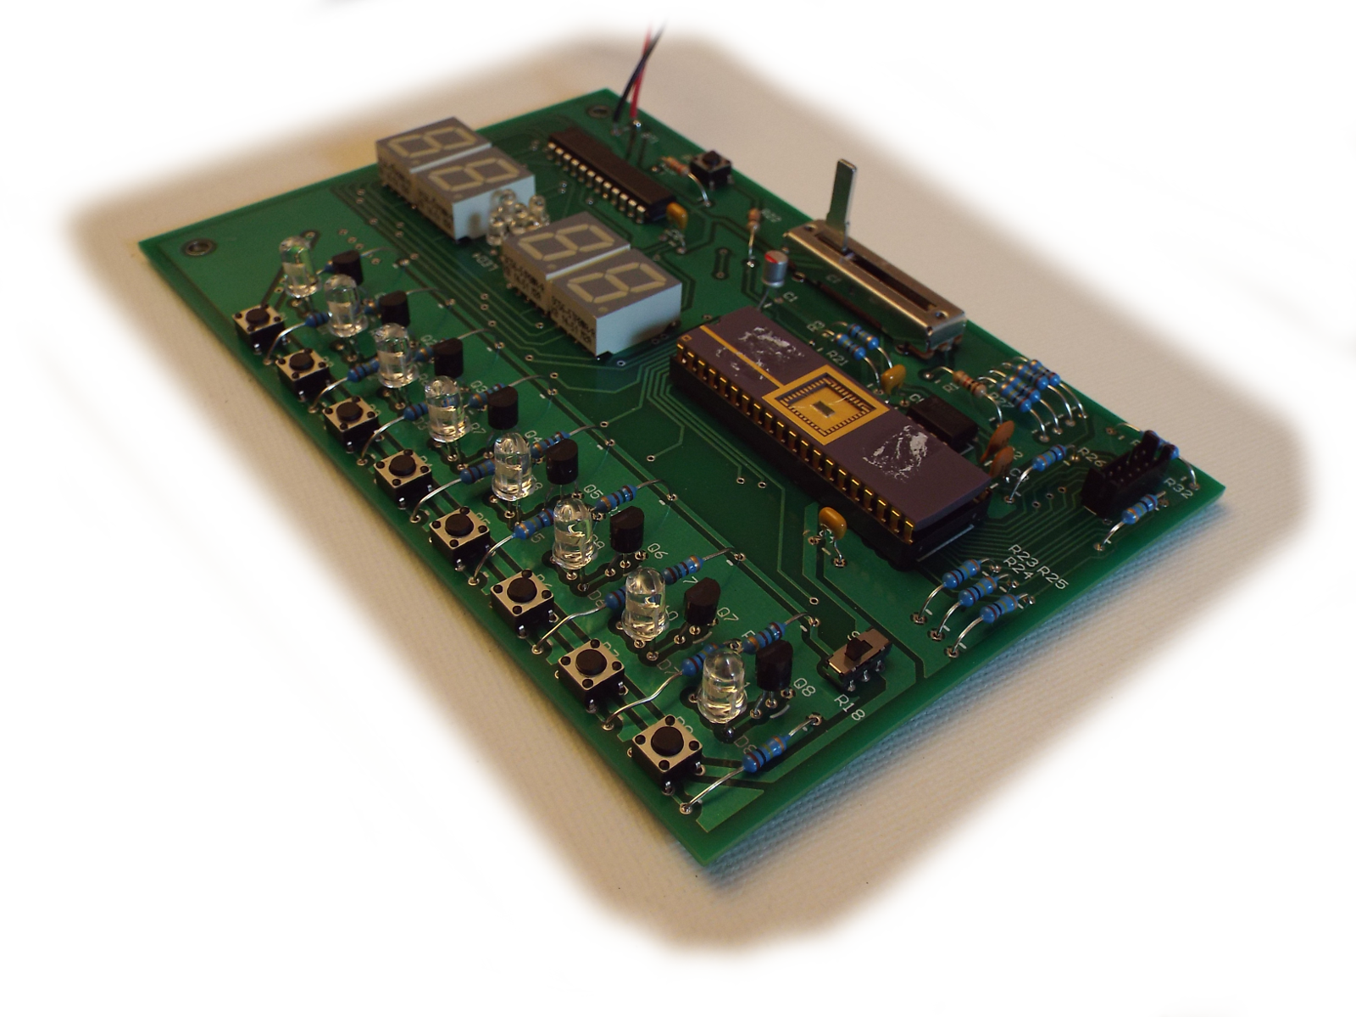
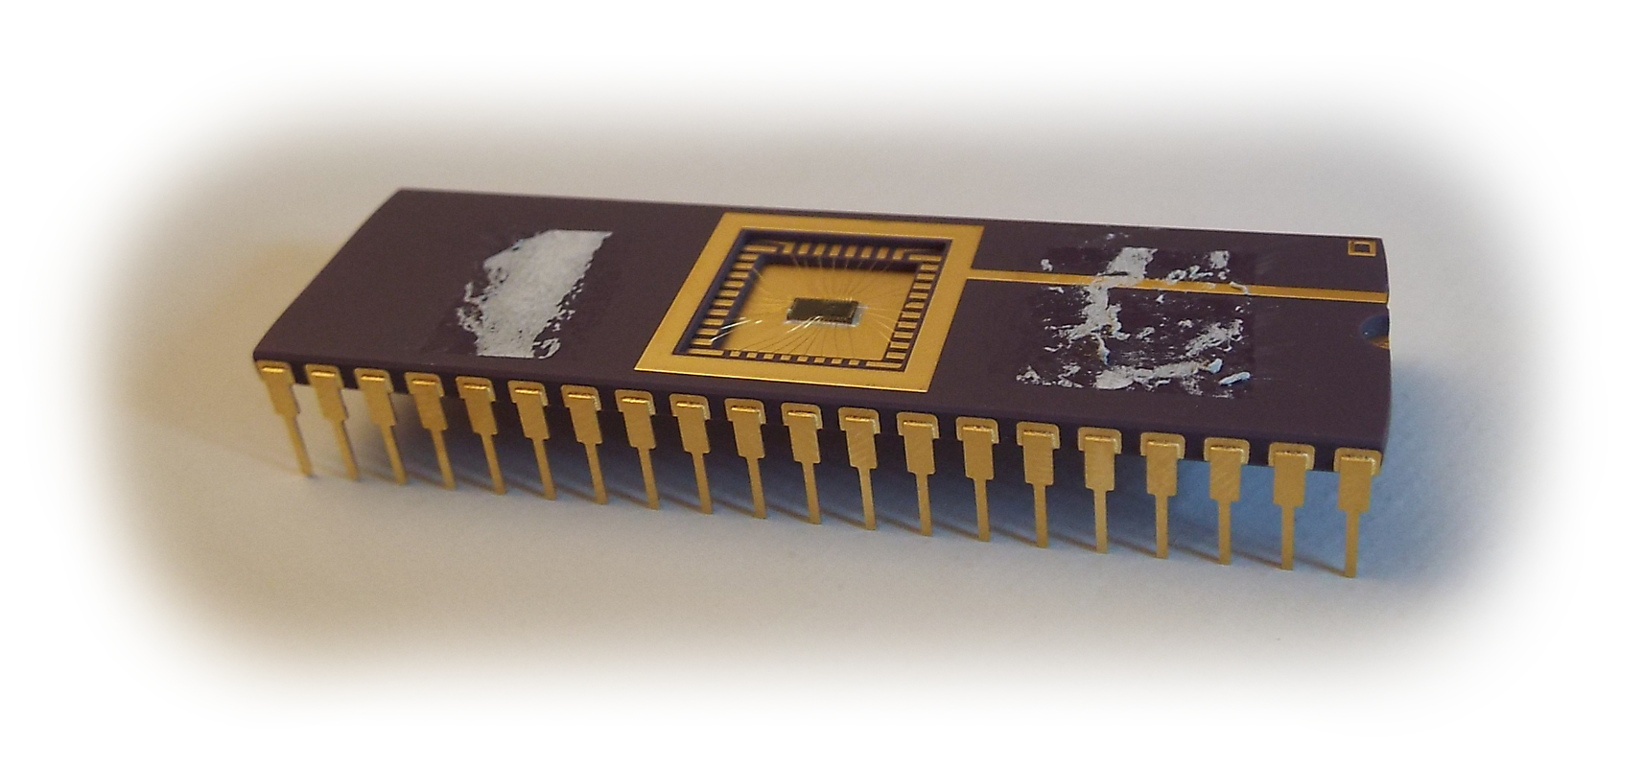
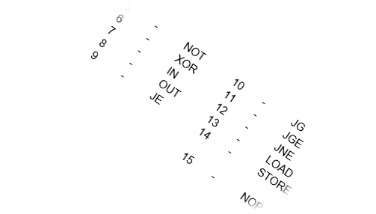
Compact Integrated Processor Custom CMOS CPU with Integrated Memory
Testing and Demonstration
To show the multifunction capabilities of this chip, a circuit board with appropriate output capabilities was constructed. A collection of eight LEDs are connected through driver transistors to the eight-bit output of the chip. Eight input buttons provide interaction with the user and a tunable clock generator has a frequency range from about 600Hz to 7kHz. A programming port is also integrated into the design, allowing easy in-system loading of programs into the memory.
Design and Fabrication
This processor was designed using Cadence Design Systems’ “Virtuoso” layout tool. All design work, including both SRAM and logic, was done manually. The chip was fabricated through the MOSIS service using ON Semiconductor’s C5N process. Minimum gate length is approximately 500nm. Prominent functional blocks include the control unit’s combinational logic with approximately 150 logic gates. There are about 35,000 transistors total, with most being used for the SRAM.
Developed by:
Jared Hayes
Nick Repetti
Jason Silic
Market Viability
Built on only 4.5mm² of silicon, this chip is able to operate in extremely small form factors and embedded systems. The 512 bytes of onboard memory is an unusual feature for a chip this small. The ideal target market would be simple embedded applications requiring only basic integer operations. Because of the older technology used in this chip mass production would be very economical.
On-Die Memory
The built-in SRAM contains program instructions and data. This type of memory will lose the stored data when power is lost but is very simple to fabricate with standard transistors. Our design, known as the Von Neumann architecture, can be combined with the flexible control instructions to implement subroutines. A generous scratch space with eight registers minimizes memory access requirements, leading to more compact and memory-efficient programs.
Specifications and Performance
This CPU is an 8-bit microprocessor based on the MIPS architecture. The instruction set includes most integer instructions excluding multiplication and division. Arithmetic and logic instructions (excluding shift and rotate) execute in five clock cycles. Control instructions execute in four clock cycles. At a clock speed of 7kHz and with five clock cycles per instruction our chip will execute about 1,400 instructions per second.
A special feature of our design is an integrated memory loader circuit that facilitates loading the SRAM. Programs can be loaded in under a second.

