Slide 1
EE497 - Senior Design
Faculty Mentor: Dr. Baker
12/12/2014
8-bit MIPS Microprocessor
Jared Hayes, Nick Repetti, Jason Silic
Notes:
Time Overview: SRAM: 1 min, CU: 2 min, ALU: 1 min, RF: 1 min
Intro: 1 min, Conclusion: 1 min, Simulation: 3 mins

Slide 2
INTRODUCTION
Problem and Our Motivation
Learning computer processor design can be a daunting task for beginners
It is difficult to physically demonstrate how a processor works
Wanted to design a processor that could be used to help students learn
Simple enough for students to understand, yet complex enough to cover the major aspects of processor design
2 of 29
Notes:
NICK

Slide 3
OVERVIEW
Our Project
We are designing an 8-bit Microprocessor and fabricating it on an IC
RISC architecture based on a simplified MIPS instruction set
Will provide students with schematics, simulations, and documentation
3 of 29
Notes:
NICK

Slide 4
OVERVIEW
Our Faculty Mentor, Dr. Baker, is able to fabricate ICs with ON Semiconductor’s C5 process through the MOSIS service.
Our processor has a complete instruction set, as well as an onboard SRAM for storage of both instructions and data.
Major Components:
SRAM
Control Unit (CU)
Arithmetic Logic Unit (ALU)
Register File (RF)
4 of 29
Notes:
JASON

Slide 5
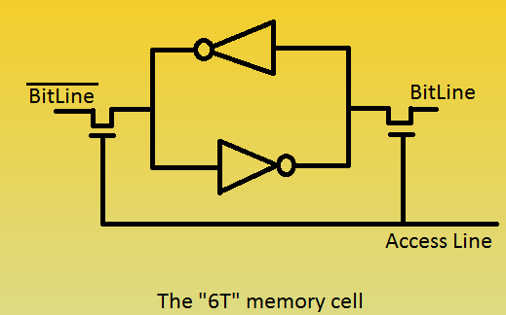
SRAM
Memory Basics
The cross-coupled inverters store the data bit. The access transistors place the stored bit on the bitlines.
Because two transistors are used to make a CMOS inverter, this memory cell uses six transistors and is therefore known as the 6T SRAM cell.
To write data to the cell, a strong NMOS transistor pulls one of the bitlines low, overwriting the data in the cell.
5 of 29
Notes:
JASON

Slide 6
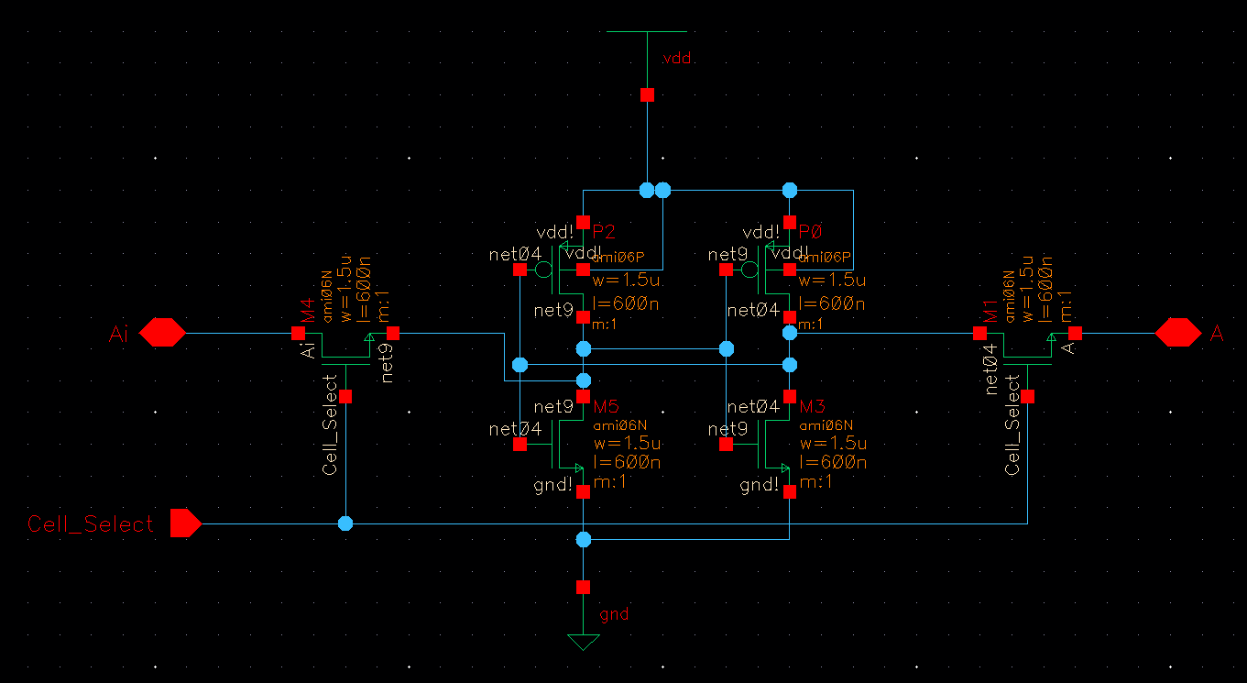
SRAM
Cell Schematic
6 of 29
Notes:
JASON

Slide 7
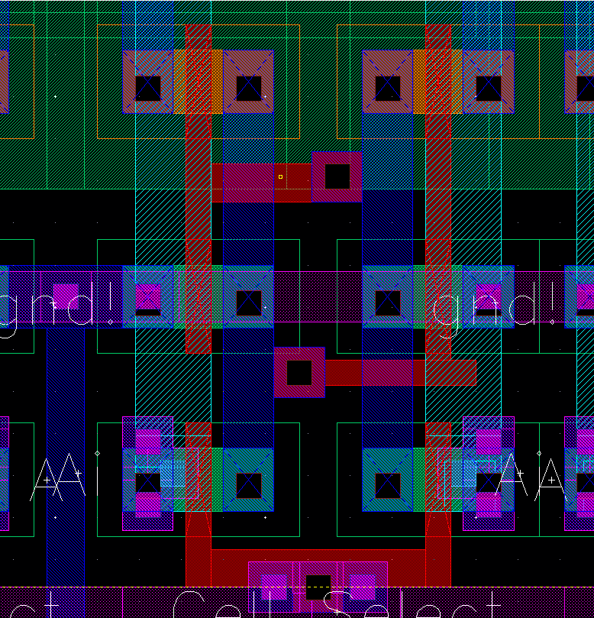
SRAM
Cell Layout
7 of 29
Notes:
JASON

Slide 8
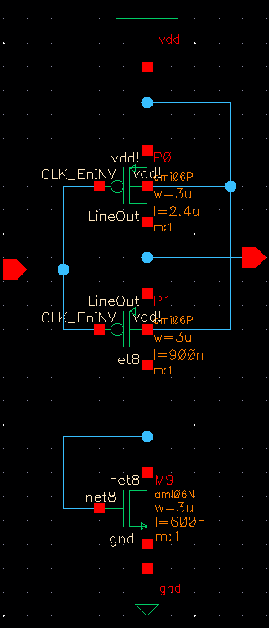
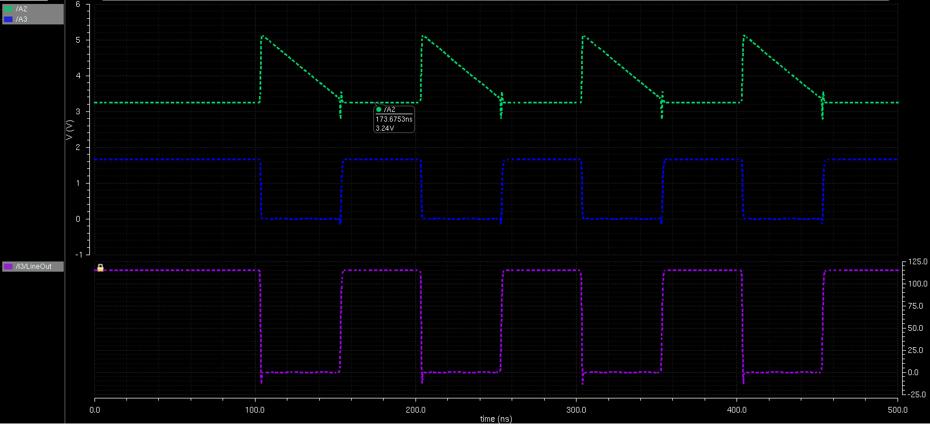
SRAM
The Precharge Problem
As noted previously, a low voltage on the bitline will overwrite the data in the cell. However, there is enough capacitance in the bitlines to cause overwriting even when the write transistors are not activated.
The solution is to “precharge” the bitlines to a relatively high voltage every clock cycle. This ensures that when a read operation executes the data stored in the memory will not be corrupted.
8 of 29
Notes:
JASON

Slide 9
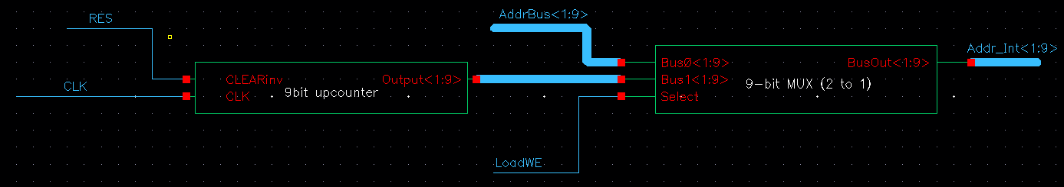
SRAM
Loading Data In
When our CPU is first powered on, it needs to have a program loaded into memory. The loading circuitry integrated into the SRAM simplifies this process. A 9-bit upcounter supplies the current address so that successive bytes can placed on the loading pins at the active clock edges without any other effort on the part of the external circuit.
Below we can note that the LoadWE (Load Write Enable) signal will send the upcounter’s address to the address decoder of the SRAM.
9 of 29
Notes:
JASON

Slide 10
CONTROL UNIT
The Control Unit (CU) generates control signals that synchronize the ALU, memory, Register File, and IO circuits.
Inside the CU reside the Instruction Register (16 bits) and Program Counter. A 3-bit step counter keeps track of the current instruction step and a 3-bit downcounter controls the number of places to shift for the shift instructions.
The total number of control signals generated is 25.
10 of 29
Notes:
JASON

Slide 11
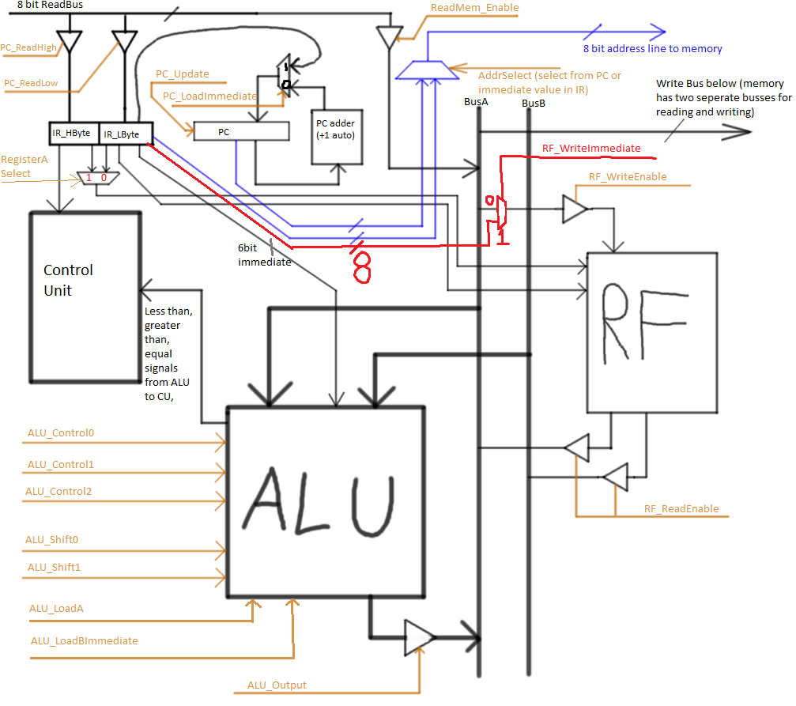
CONTROL UNIT
SET Instruction Walkthrough
11 of 29
Notes:
JASON

Slide 12
CONTROL UNIT
SET Instruction Walkthrough
Fetch Cycle
Step Counter Signals asserted for each step
000 - PC_Update, PC_ReadLow
001 - PC_Update, PC_RealHigh ; Load second byte into IR.
010 - RF_WriteImmediate,RegisterA_Select, Step_Reset, RF_WriteEnable
Step_Reset is asserted at the end of every instruction cycle.
12 of 29
Notes:
JASON

Slide 13
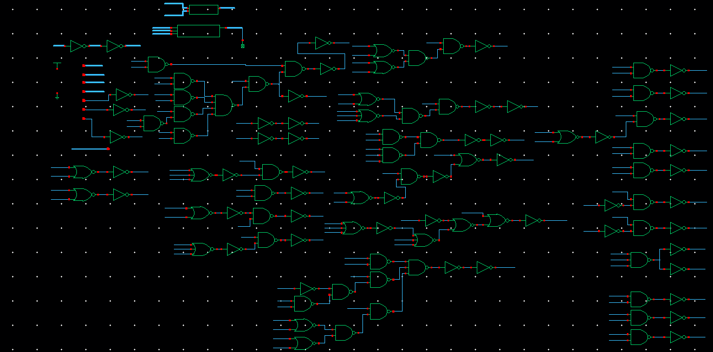
CONTROL UNIT
Combinational Logic Schematic
13 of 29
Notes:
JASON

Slide 14
ALU
Background
Responsible for all of the arithmetic, logic, and shift operations
Does the calculations required for the jump instructions
A three bit and a two bit control signal determine which operation to be performed on the input data from Bus A and Bus B
14 of 29
Notes:
NICK

Slide 15
ALU
Operations
ALU_Control:
000 - AND 100 - PASS REGISTER A
001 - OR 101 - NOT
010 - ADD 110 - XOR
011 - SUBTRACT 111 - unused
ALU_Shift:
00 - PASS DATA 10 - SHIFT RIGHT
01 - SHIFT LEFT 11 - ROTATE RIGHT
15 of 29
Notes:
NICK

Slide 16
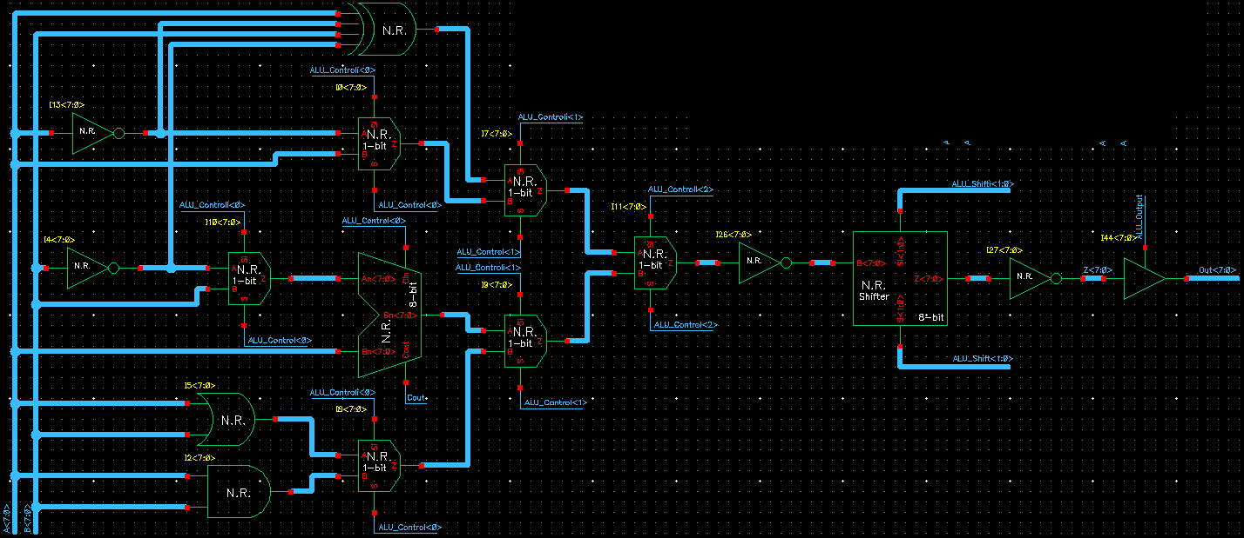
ALU
Top Level Schematic
16 of 29
Notes:
NICK

Slide 17
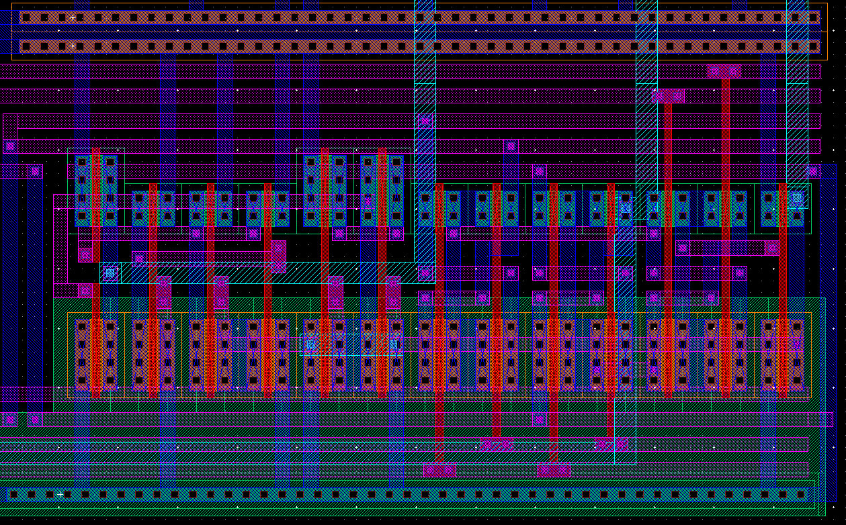
ALU
Barrel Shifter Layout (1-bit)
17 of 29
Notes:
NICK

Slide 18
REGISTER FILE
Background
Stores data in registers specified by the instruction register for use by the ALU.
Reads in 3-bit opcodes and decodes them into the clocks of each register.
This register file can read two registers and write to a single register at once.
Eight 8-bit Registers using D Flip-Flops > 144 transistors per register
18 of 29
Notes:
JARED

Slide 19
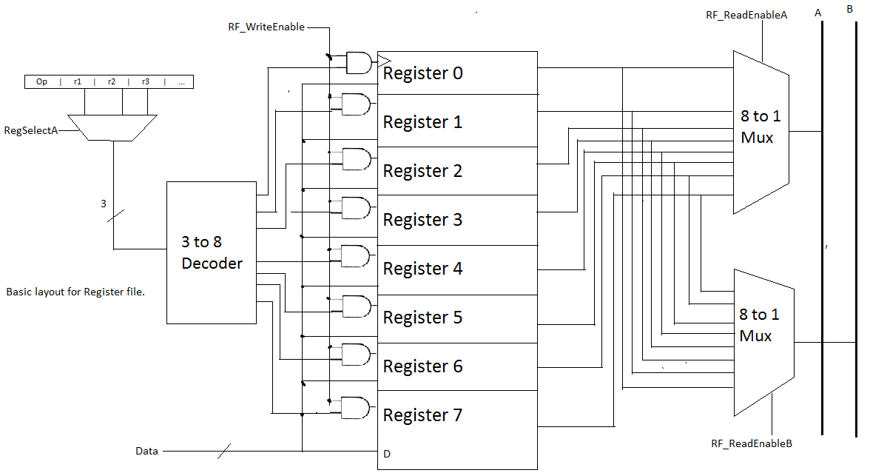
REGISTER FILE
General Overview
19 of 29
Notes:
JARED

Slide 20
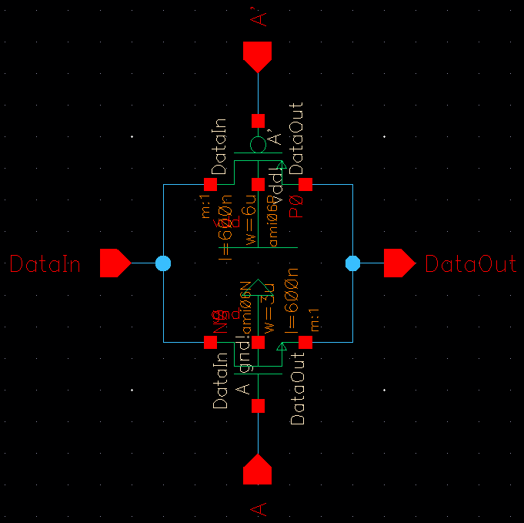
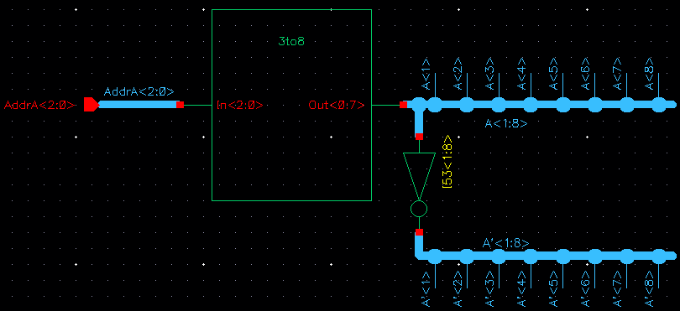
REGISTER FILE
3-to-8 Decoders & Transmission Gates
Two 3-to-8 decoders drive transmission gate enables for multiplexing
Used in place of 8-to-1 MUX’s
Determines which registers are output onto the bus
20 of 29
Notes:
JARED

Slide 21
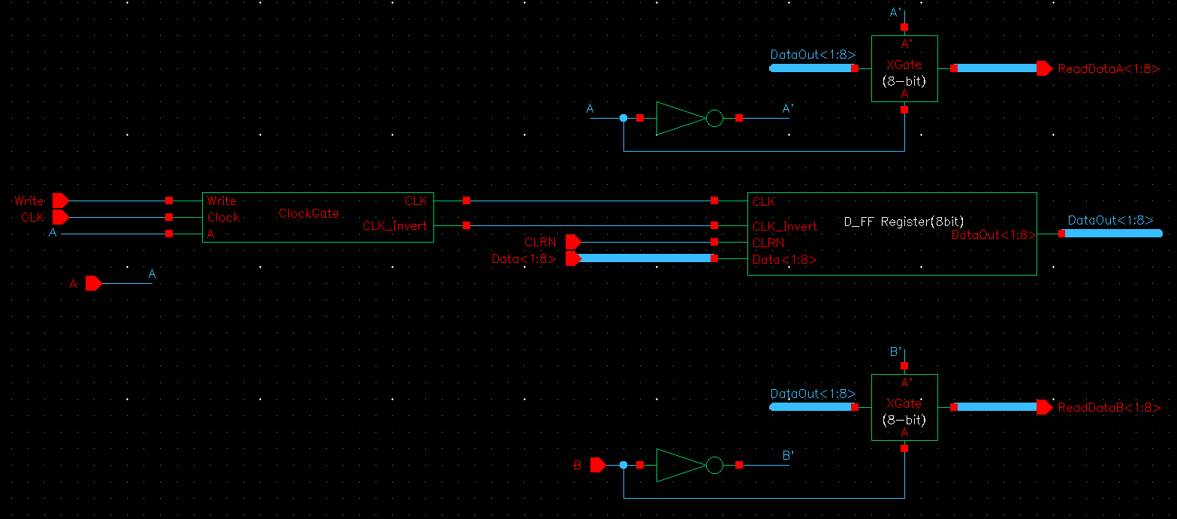
REGISTER FILE
Single Register File Cell
Signals Write_Enable, CLK, and Decoder A outputs drive each register’s clock
DataOut<1:8> gets sent to the 8-bit transmission gates, which are enabled by inputs A and B from the decoders
21 of 29
Notes:
JARED

Slide 22
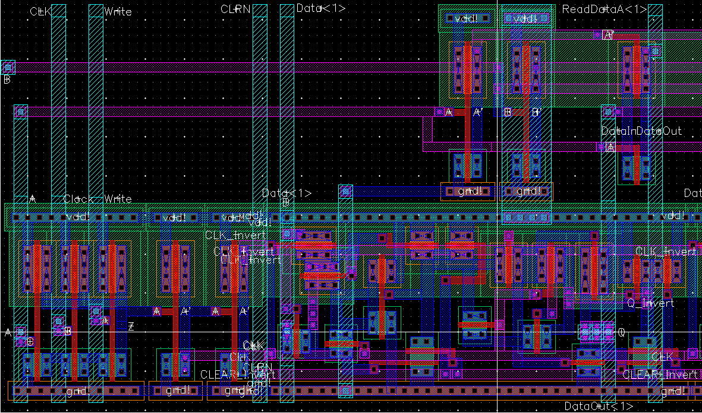
REGISTER FILE
Register File Cell Layout
22 of 29
Notes:
JARED

Slide 23
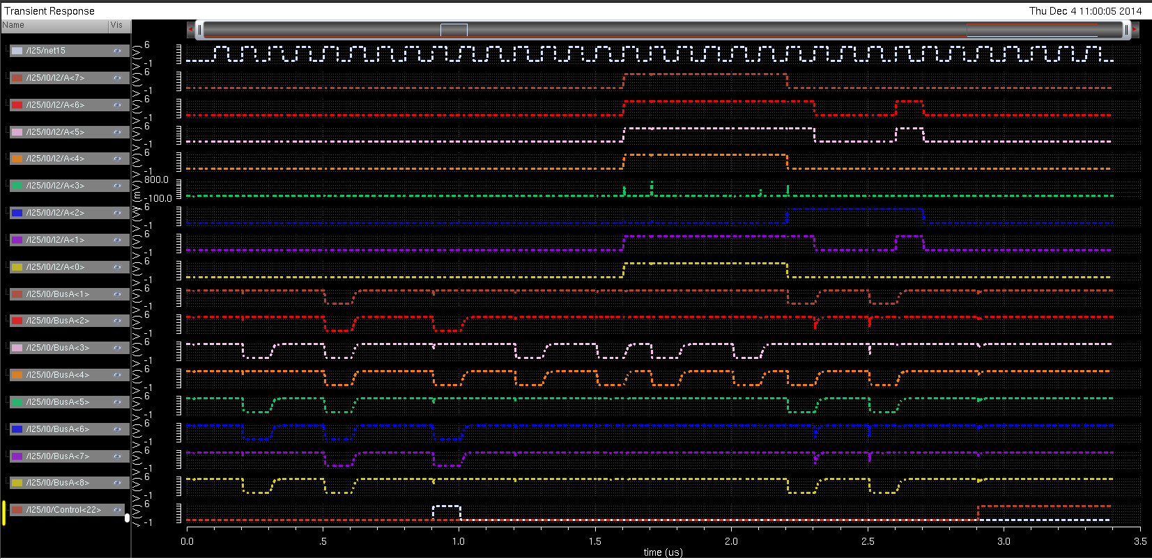
PROGRESS
Simulation Example: XOR operation
23 of 29
Notes:
JASON

Slide 24
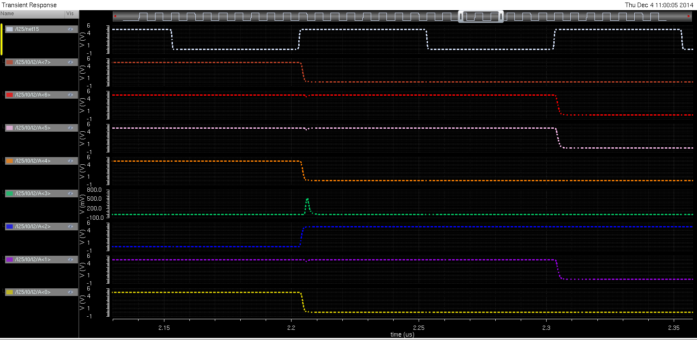
PROGRESS
Exclusive OR: 1 0 0 1 0 1 0 1
1 1 1 1 0 0 1 1
0 1 1 0 0 1 1 0
24 of 29
Notes:
JASON

Slide 25
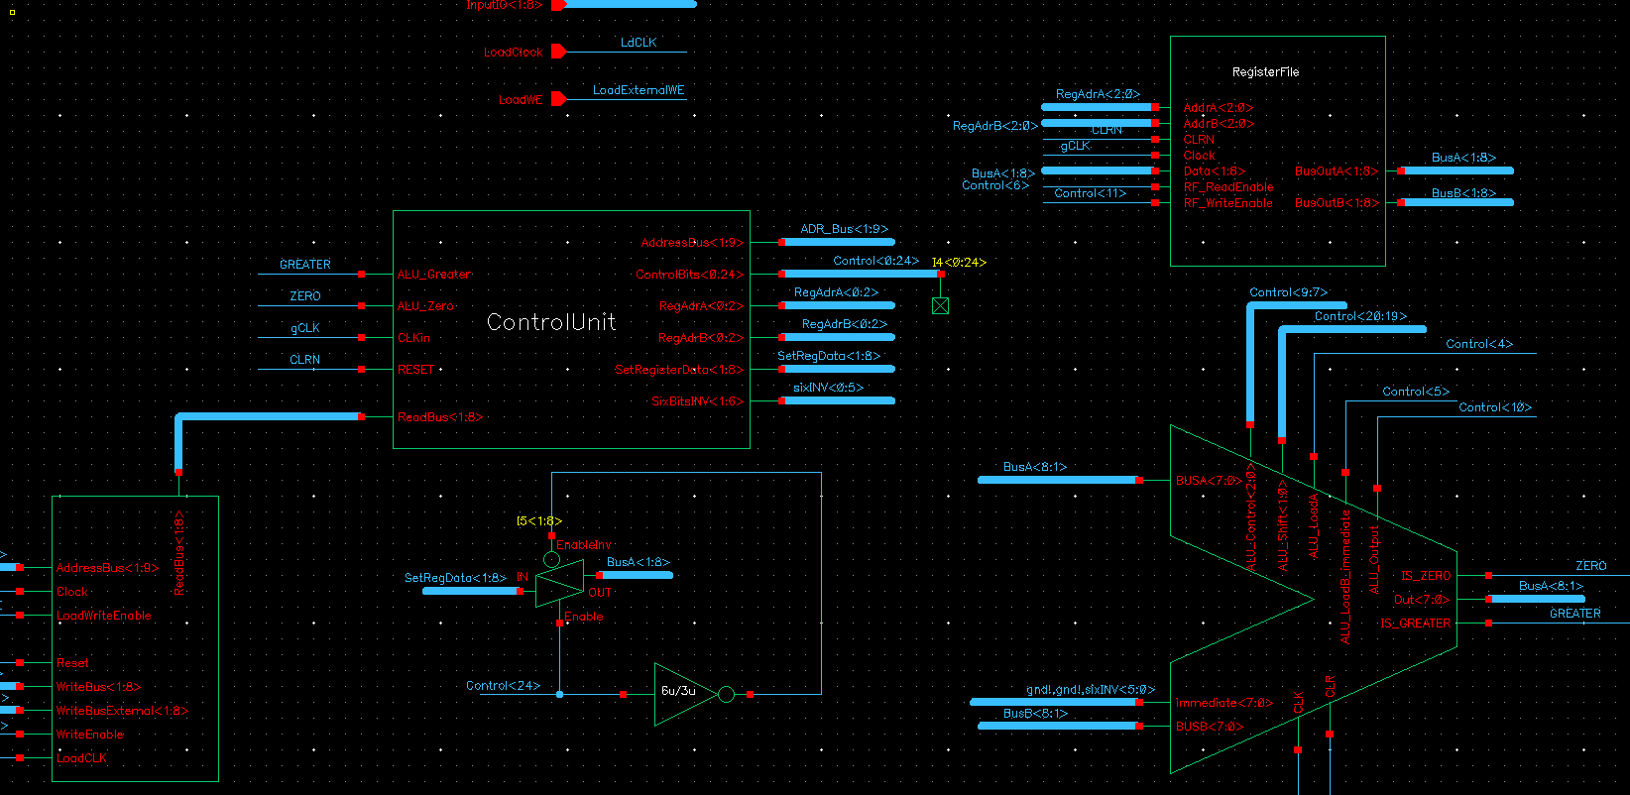
PROGRESS
Complete Schematic
25 of 29
Notes:
JASON

Slide 26
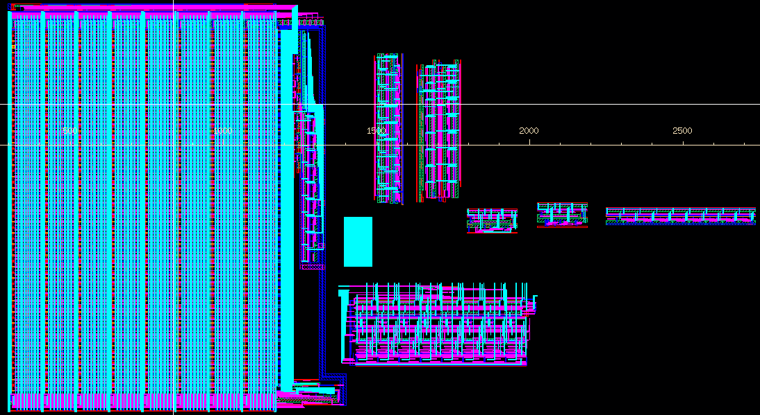
PROGRESS
Overall Layout
26 of 29
Notes:
JASON

Slide 27
CONCLUSION
Cost Estimation
AVR ATMega328P microcontroller $4.00
LEDs & I/O Devices $5.00
PCB $100.00
Chip Fabrication $0.00
Total: $109.00
27 of 29
Notes:
JARED

Slide 28
CONCLUSION
Future Work
Complete the layout and submit chip for fabrication
Design a clock generation circuit
Design and implement a PCB to test and verify the physical IC with I/O (e.g. LED output)
Program microcontroller to load data onto the chip
Write documentation/user’s manual
Make a polished final presentation and report
28 of 29
Notes:
JARED

Slide 29
CONCLUSION
Any Questions?
29 of 29
Notes:
JARED

