Slide 1
Universal Pie Time
Fixing Nutritional Imbalance by shipping pies everywhere, every time

Slide 2
What are we?
People starving is bad
Nutritional balance is important
Countries aren’t currently balanced
WE WILL FIX THAT

Slide 3
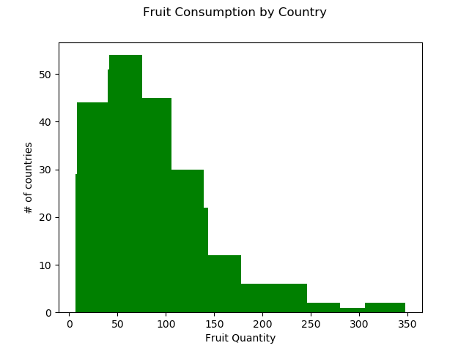
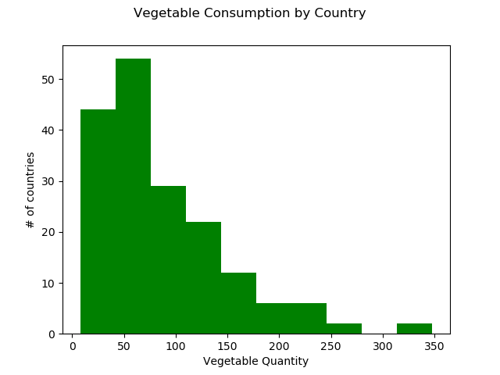
Countries aren’t balanced

Slide 4
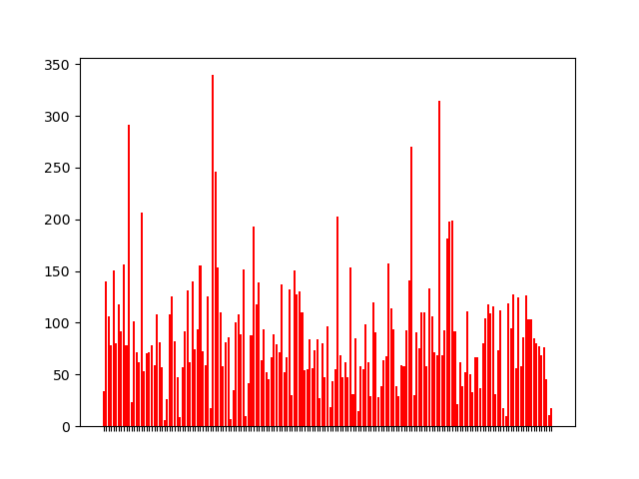
What’s the problem here?
Vegetables and Fruits are equal on the food pyramid
Food pyramids don’t change by country
Look at that fruit by country line thingy
These fruit lines are too different

Slide 5
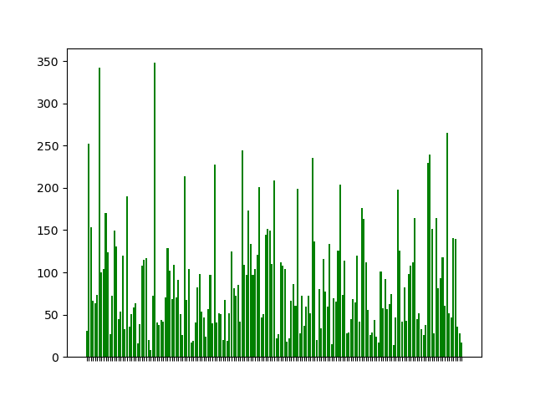
Why should I care?
You can donate money to help
You have too much fruit and vegetables if you’re seeing this
With your money we can move the fruits
These vegetables are even worse!

Slide 6
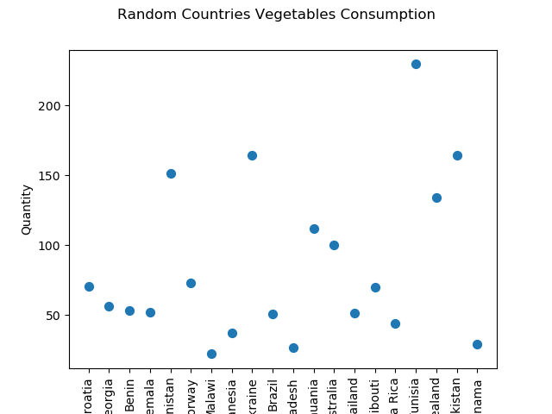
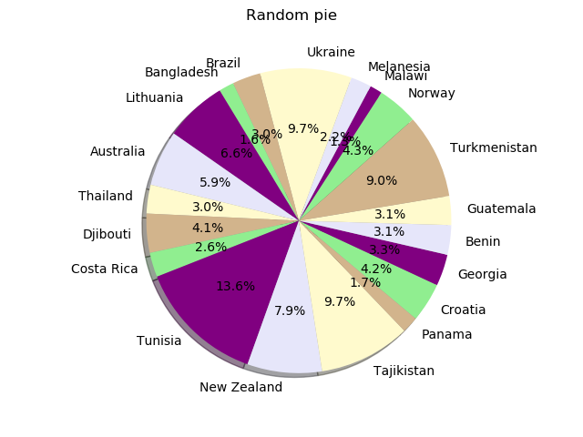
Exemplifying Random Sample

Slide 7
What exactly will be done?
You give us money
We take some fruits and vegetables from those who have too much
We turn them into pie
These pies will be equally fruit and vegetable
They should be pie shape when we arrive
We use the money to ship the pies
Profit?

Slide 8
Thank you for watching!
You might not solve world hunger, but you can solve world nutritional imbalance.

Slide 9
Works Cited
https://ourworldindata.org/diet-compositions

