Slide 1

Tailored Educational System

Slide 2
Team members :
Amr Moslhy Maher
Asmaa Abdeldayem Wasel
Basmala Ahmed Ali
Bassant Hassib Mostafa
Hosny Hany Hammad
Hadir Maher El Sayed
Nada Mohamed Saleh
Yara Hazem Zahra
Supervised by:
Dr. Mohamed Ashor
Eng. Amal Ghoneim

Slide 3
Introduction:
Welcome to the future of education with the Tailored Education Chatbot.
Designed to revolutionize learning through personalized assistance.
We all know chat GPT , the idea of It provides the solution , but it does not appear to you what this is and How to learn this and where you will learn this.
The chatbot appear to you what this is and How to learn this and where you will learn this by many links.

Slide 4
Functional Requirement :
Road Maps
Search About a Question

Slide 5

Why Tailored Education Chatbot?
Addressing the need for personalized and accessible learning in a digital age

Slide 6

Tailored Educational System:
This System is concerned with learning and help people to get learning in an easy way and the user can choose the suitable track for him, we all know that AI made learning easy for all users from all over world, so we use AI in this system.

Slide 7
It is also designed to provide the user with information about how to start learning from zero until becoming hero in the track.
Road Maps

Slide 8
we have collected the data set from the many websites to have a large dataset through which we can classify the question by using Machine learning algorithms.
The system of tailored educational system involves the analysis of a comprehensive dataset of various question.
These algorithms can be trained on large datasets to learn to benefit the users
Search About a Question

Slide 9

Problem statement :
The problem of choosing the track is a major concern for the students around the world.

Slide 10

Many students face the problem of learning many topics to do something simple.

Slide 11

Many students fall into confusion to choose the suitable track for them.
searching about the any question belong to programming have become take much time and effort and Distracting students' thoughts.

Slide 12
problem Solution :
The system available many of track and information about each track to guides the user to learn all information from zero to advanced knowledge of each track.
The chatbot replies to the user by a lot of data the boot was training.
The system allows users to search for any information that belongs to any available track in the system.

Slide 13
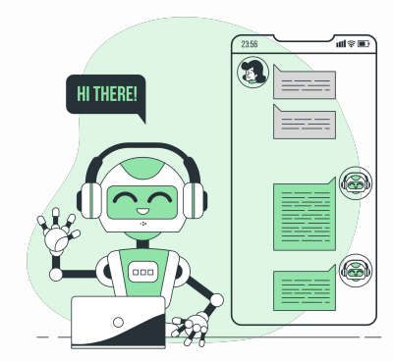
Tailored Education Chatbot: Phase 2 (Implementation)

Slide 14
NLP Chat Bot
Chatbot Functionality
User Interaction: The chatbot processes user input and predicts the intent.
Response Generation: Based on the predicted intent, a suitable response is generated
Data Preparation
NLP techniques
Model Selection Deployment inside App
Main Components :

Slide 15
Data Preparation
Data Preprocessing
Tokenization: The process of breaking down text into individual words or tokens.
Stopwords Removal: Removing common words (e.g., 'and', 'the') that do not contribute significant meaning.
Lemmatization: Reducing words to their base or root form (e.g., 'running' to 'run').

Slide 16
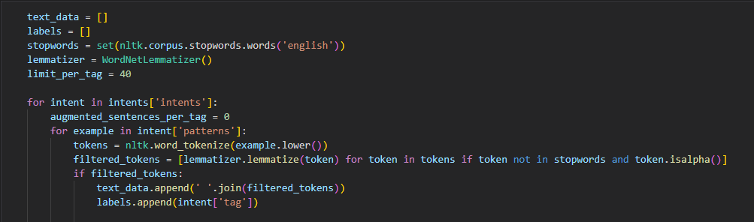
Data Preparation
Code snippet

Slide 17
(NLP)Synonym Augmentation
Purpose
Data Augmentation: Enhances the dataset by generating variations of sentences to improve model performance and robustness.
Process
Synonym Replacement: Replaces words in sentences with their synonyms to create new sentences.

Slide 18
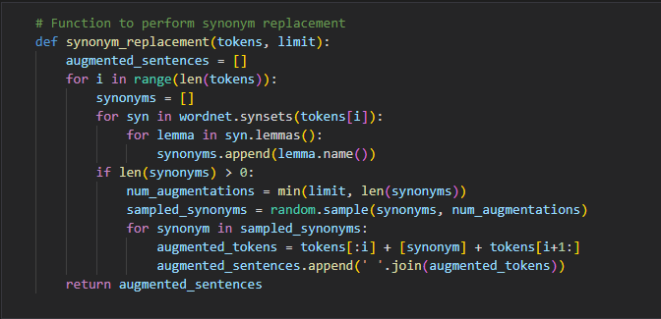
(NLP)Synonym Augmentation
Example Code Snippet:

Slide 19
(NLP)Synonym Augmentation
Explanation
Token Processing: For each token in the sentence, find its synonyms using WordNet.
Synonym Sampling: Sample a limited number of synonyms to avoid excessive augmentation.
Sentence Generation: Replace the token with each sampled synonym to create new augmented sentences.
Benefits
Increased Dataset Size: Generates more training data without manual labeling.
Model Generalization: Helps the model generalize better by learning from varied expressions of the same intent.

Slide 20
(NLP)Synonym Augmentation
Benefits of NLP Techniques
Improved Data Quality: Techniques like stopwords removal and lemmatization ensure the dataset is clean and consistent.
Enhanced Model Performance: Synonym replacement increases the size and diversity of the training data, leading to better generalization.
Efficient Text Processing: Tokenization and lemmatization make it easier to analyze and process text data.

Slide 21
Model Selection
Models Considered
Multinomial Naive Bayes: Effective for text classification with features represented as word frequencies.
Decision Tree: Simple to understand and interpret, suitable for small to medium datasets.
Random Forest: An ensemble method that combines multiple decision trees to improve accuracy and control over-fitting.
With [GridSearchCV] method we can make thing like Competition between multiple models and select the one with the best accuracy number

Slide 22
The find_best_model function:
Splits the dataset into training and testing sets.
Defines several machine learning models and their hyperparameter grids.
Uses grid search with cross-validation to find the best hyperparameters for each model.
Compares the models based on their performance on the test set.
Identifies and returns the best-performing model.
Model Selection
find_best_model function:
X and y: Feature matrix and target vector, respectively.
test_size=0.2: 20% of the data is used as a test set, and the remaining 80% as a training set.
random_state=100: used for initializing the internal random number generator, which will decide the splitting of data into train and test

Slide 23
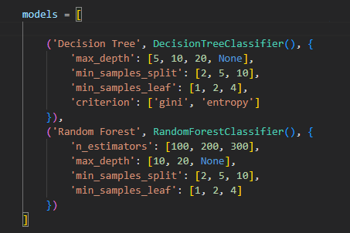
Model Selection
A list of tuples, where each tuple contains:
The name of the model (for reference).
The model instance.
A dictionary of hyperparameter options to be tuned using GridSearchCV

Slide 24
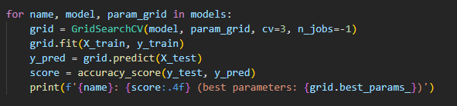
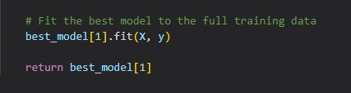
Model Selection
Grid Search for Hyperparameter Tuning and Model Evaluation
GridSearchCV: Searches over the specified parameter grid for the best combination of parameters.
n_jobs=-1: Utilizes all available CPU cores for the search.
fit: Trains the model using the training data.
predict: Makes predictions on the test data.
accuracy_score: Calculates the accuracy of the model on the test data.
print: Displays the model name, accuracy score, and best hyperparameters found.

Slide 25
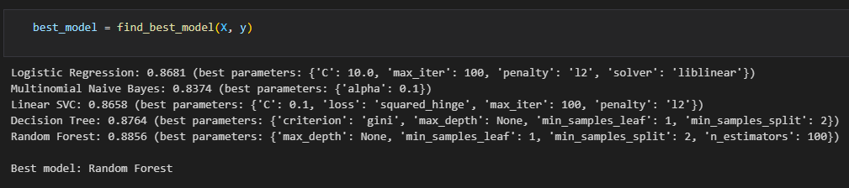
Model Selection
After running find_best_model function including Grid Search
Random Forest is giving us the best accuracy score with 88%

Slide 26
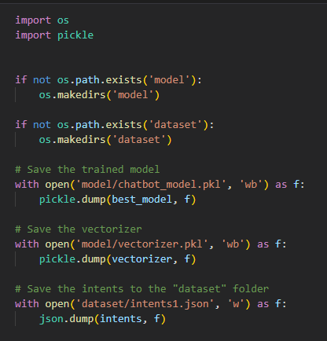
Model Selection
Saving Model
Serialization with Pickle: Convert Python objects (model and vectorizer) into byte streams to save to disk.
JSON for Data: Store structured data (intents) in a readable and easily accessible format.

Slide 27
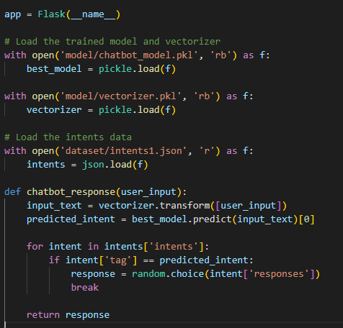
Model Deployment (Flask)
Purpose: Serve a web interface and API for a machine learning-based chatbot.
Technologies Used:
Flask: Web framework.
pickle: Load trained model and vectorizer.
json: Load intents data.
random: Select random responses.

Slide 28
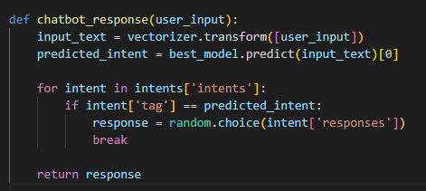
Model Deployment (Flask)
Generating Responses
After predicting the most accurate intent labeled by tag, then select one random response from this intent

Slide 29
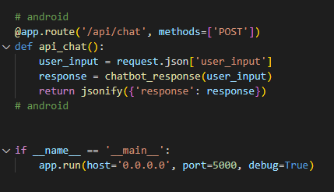
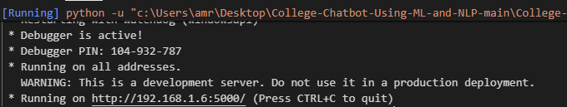
Model Deployment (Flask)
API end point and getting Flask app ready to launch on local machine server

Slide 30
Collecting Data:
How it works ?
We collected a data set on all this tracks.
The data we collected on these tracks includes every information about it and links to show How to learn every topic of these track and what these track.
Some data is also in the form of questions and answers.
Frontend
Android
Backend
Flutter
Full Stack
ASP.NET core
AI and Data Scientist
UX Design

Slide 31
Road Maps
Collected Data
Search About a Question

Slide 32
Data Preparation
Data Collection:
Source: Data is collected from predefined intents and patterns specified in a JSON file.
Structure: Each intent contains a tag, patterns (user inputs), and responses.

Slide 33
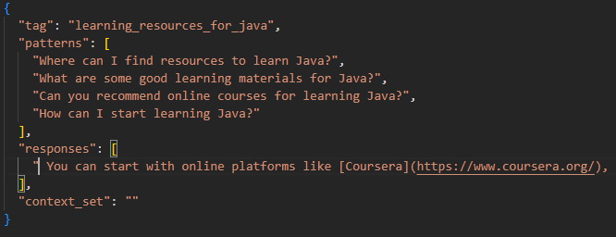
Data Preparation
Data Collection:
Structure Demo:

Slide 34
User interface design :
How it works ?​
we intend to use this to made application to helps people get learning in an easy way.
The app features a user-friendly interface that allows users to easily navigate through the different sections, including rood maps, chatbot to choose my track and search about a question.

Slide 35
How it works ?​
User interface tools :
we have made the authentication on the Application by using google firebase.
We have implemented MVVM in the app.
We have implemented the clean Architecture.
We have used Api in the app.
We have used navigation drawer layout.
We have used shared Preferences in the app.

Slide 36
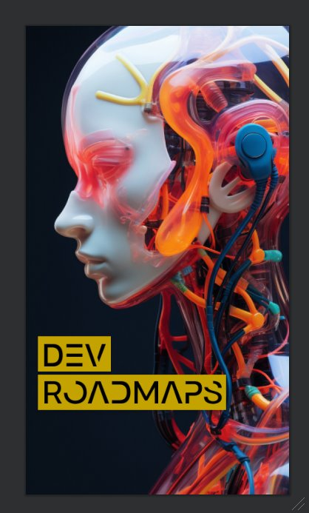
Splash Screen:
Upon launching the application, users will be greeted by the initial screen known as the "Splash Screen."

Slide 37
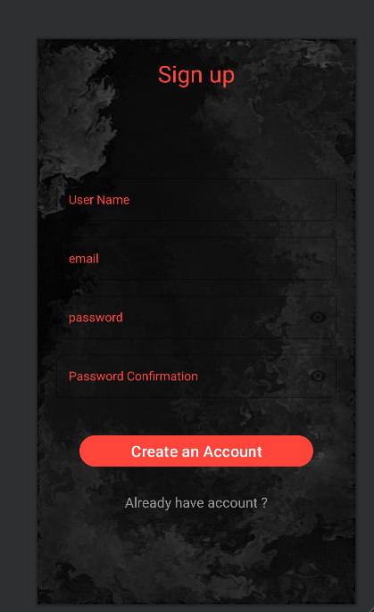
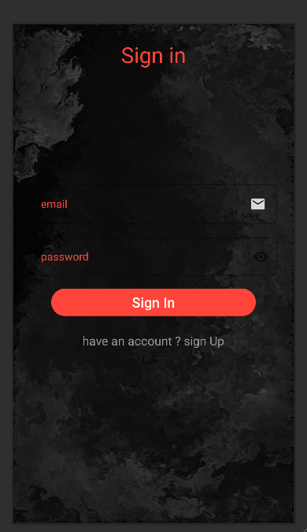
Sign Up :
Within this screen, users can create a new account within the application. To do so, they are prompted to input their name, personal email.
If the entered password does not match, a warning message will be displayed, notifying the user that the password is not identical.
Sign In :
User can sign in to the application with your email and password

Slide 38
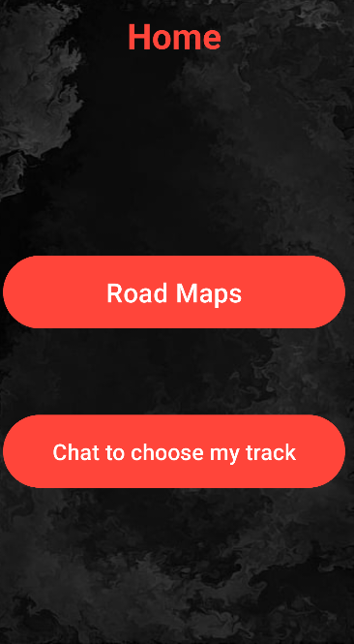
Sign Up :
Once they have successfully Sign up, they will be redirected to the app and granted access.
Home Screen:
This screen is the most critical part of the application. In this screen, the user can do many tasks and navigate between them and there is a Settings panel.

Slide 39
Sign In :
Once they have successfully Sign in, they will be redirected back to the app and granted access.
Home Screen:
This screen is the most critical part of the application. In this screen, the user can do many tasks and navigate between them and there is a Settings panel.

Slide 40
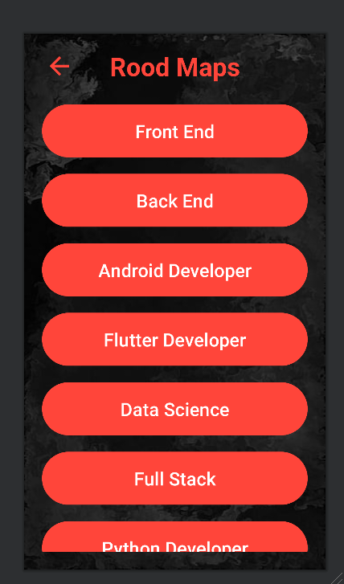
Home Screen:
If the user wants to show all tracks they can click on the button of “Rood Maps”.
Rood Maps Screen:
The screen shows a set of tracks, the user can know any information that is relevant about any track.

Slide 41
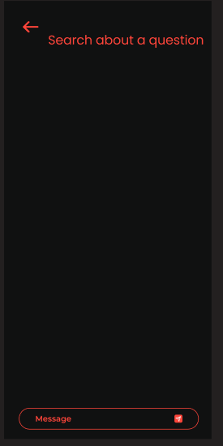
Home Screen:
If the user wants to chat to the chatbot to search about any question related to learning can click on the button of “Search about a question”.
Search About a Question Screen:
The screen is also designed to chat with the user and chatbot, it is aimed to answer any question belonging to the learning such as: "How make API “ .

Slide 42
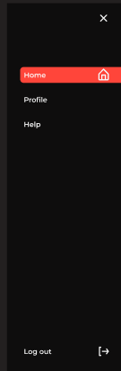
• Settings Screen :
Settings panel, where you can go to the Profile screen and Help screen from it and log out too.
Home Screen:
In this screen, user con go to a Settings panel.

Slide 43
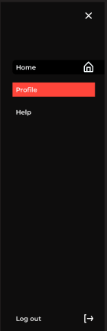
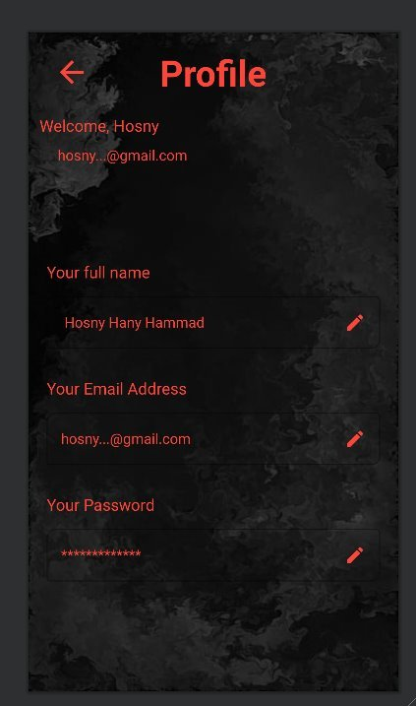
Profile Screen:
It is plays the user's personal details If the user wants to edit in his profile, including their username, personal email address and password.
• Settings Screen :
Settings panel, where you can go to the Profile screen

Slide 44
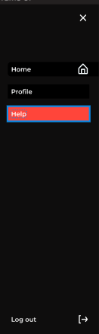

Help Screen :
The screen shows a set of information about how to use the Application and some information about the people who made this.
• Settings Screen :
Settings panel, where you can go to Help screen from it and log out too.

Slide 45
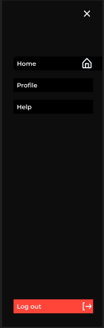
where you can log out to left the application.

Slide 46
User interface design :
How it works ?​
We also used the website as a user interface
to make the application available for use in all ways on mobile phone and computer device.

Slide 47
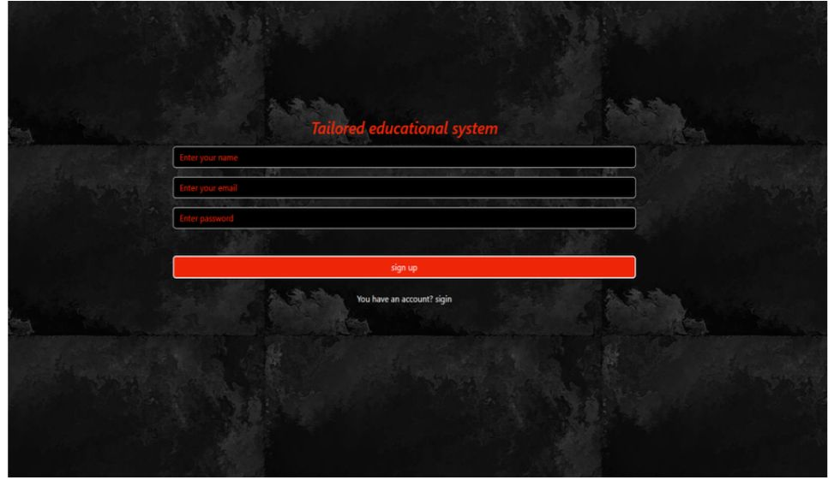
Sign-up Page :
The sign-up page is a registration portal where users create new accounts to access a system or service.
It usually involves providing essential information, like a username, email, and password.

Slide 48
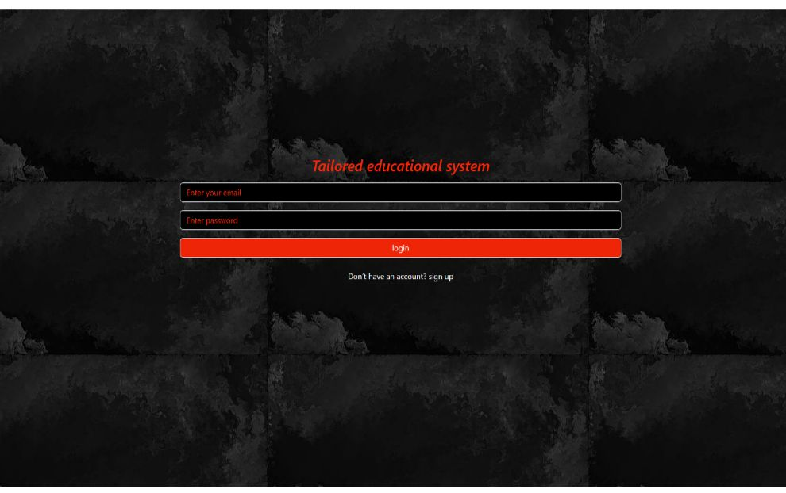
Sign In Page :​
The login screen is a secure gateway to access a system or application. It typically prompts users to enter their credentials, such as a username and password, ensuring only authorized individuals gain entry​.

Slide 49
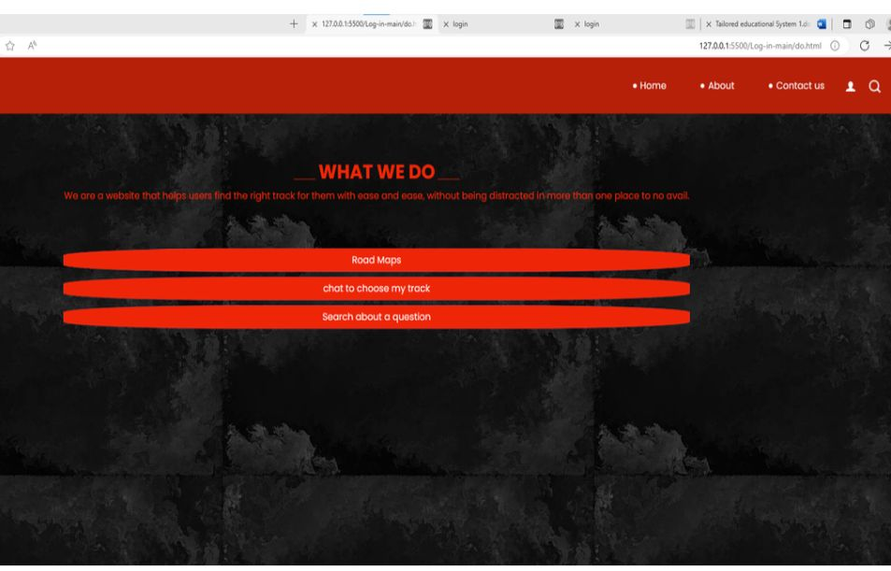
Home Page :
This home page servers as a concise overview of our website, we are an integrated educational website that makes it easy for students or researchers to quickly reach what they are looking for without distraction or a long time by talking to a chatbot or searching through our website.

Slide 50
Future work :
In the future, we plan to develop a new version of our application and a website that will achieve high accuracy in choosing the track and answer about any question belonging to learning.
We plan to add many tracks to our application and website.

Slide 51
We plan to add another function called: (Choose suitable track).
We plan to let the user do generate roadmaps with AI.

