Slide 1

Tronix web application

Slide 2
01
Introduction
02
Main Feature
06
Conclusion
03
Technologies
Outline
04
Implementation
05
Testing

Slide 3
01
INTRODUCTION

Slide 4
Introduction
The "Tronix" web application will make it easier for people in Palestine to buy electronic devices. Users can browse, compare prices, and buy products all in one place. For business owners, the app helps them reach more customers and sell more products. It also gives small and new stores a chance to show their products and increase their sales.

Slide 5
Today in the world everything happens online, electronics stores have become excellent at giving
you all the important details about smart devices. They make it easier for you to choose what you
want by sharing information about many different devices. This helps you choose faster and reduce
mistakes when purchasing electronic devices.
Motivation
And
Overview
E-commerce means selling things or providing a service over the Internet. It is an excellent choice
for companies to do business on the Internet. People love it a lot because it saves time and money,
and they can shop anywhere.

Slide 6
Designing a user-friendly interface for easy searching and purchasing.
Reducing the time and effort of the search process and saving customers money through company offers and gifts.
Helping suppliers increase sales by providing a platform to display products.
Enabling customers to track their sales history and suppliers to monitor sales through reports.
Implementing strong security measures to protect customer and companies information “hash function”
Objectives

Slide 7
Problem Statement
Customers-related issues
Companies and stores -related issues
• People suffer from difficulty in purchasing electronic devices due to the multiplicity of stores and their distribution in different places, which requires a large amount of time to move between these stores and companies.
•The web application helps save customers time and effort by providing all information and comparisons in one place.
• Small and emerging stores suffer from a lack of ability to reach a large number of customers and increase their sales.
•Stores need an effective platform to promote their products and reach customers more broadly and effectively.

Slide 8
02
Main Feature

Slide 9
Customer features
Company Features
Admin Features
Receiving requests for admission to the accounts
• The ability to control customers and companies accounts
● Company reports
● Shopping cart
● Cancel the order
● The ability to add devices and modify specifications
● Track the order status after placing it.
● View orders
● Sending notifications to the company when a product is ordered
● View orders
● Reporsts

Slide 10
Technologies
03

Slide 11







Technologies

Slide 12
Implementation
04

Slide 13

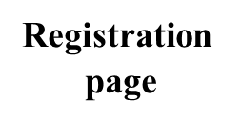






Welcome page
Product
order
page
Shopping cart
page

Slide 14
Testing
05

Slide 15
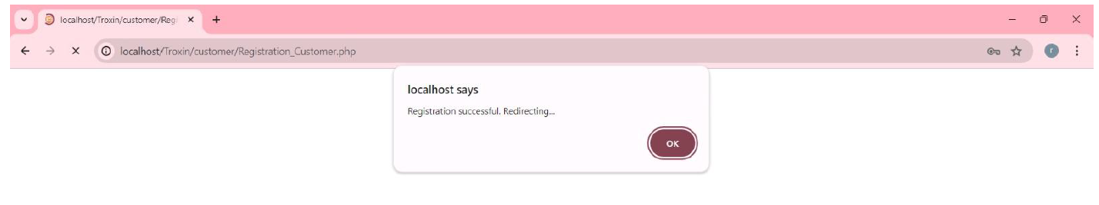
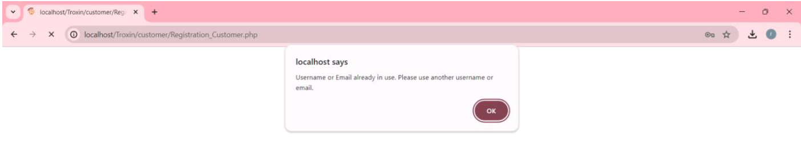
✓ Test1: Verify the functionality of user registration on the "Tronix Web Application."

Slide 16
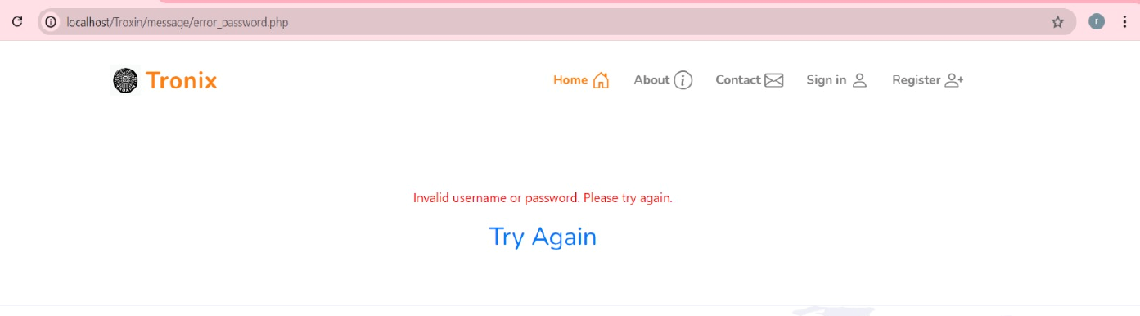
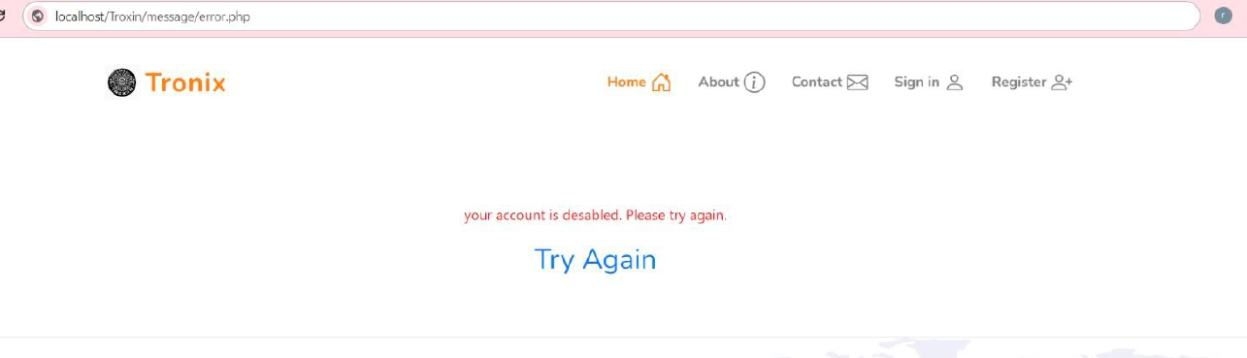
✓ Test2: Verify the login functionality for regular users on the "Tronix Web Application."

Slide 17
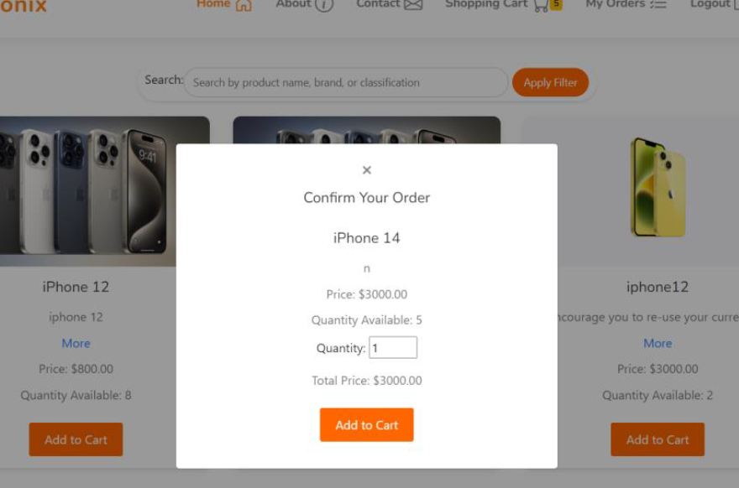
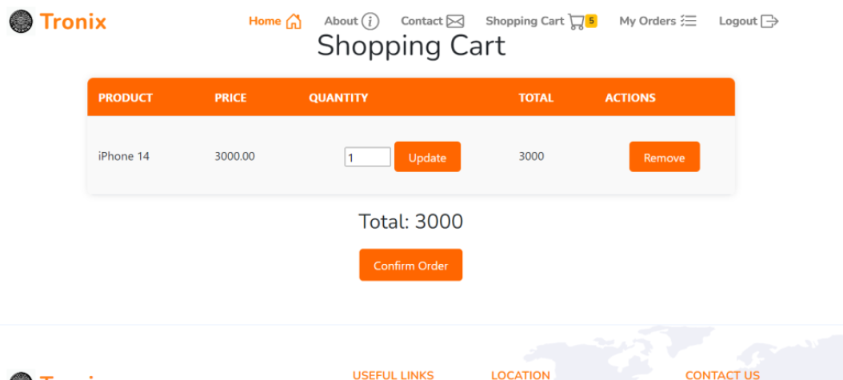
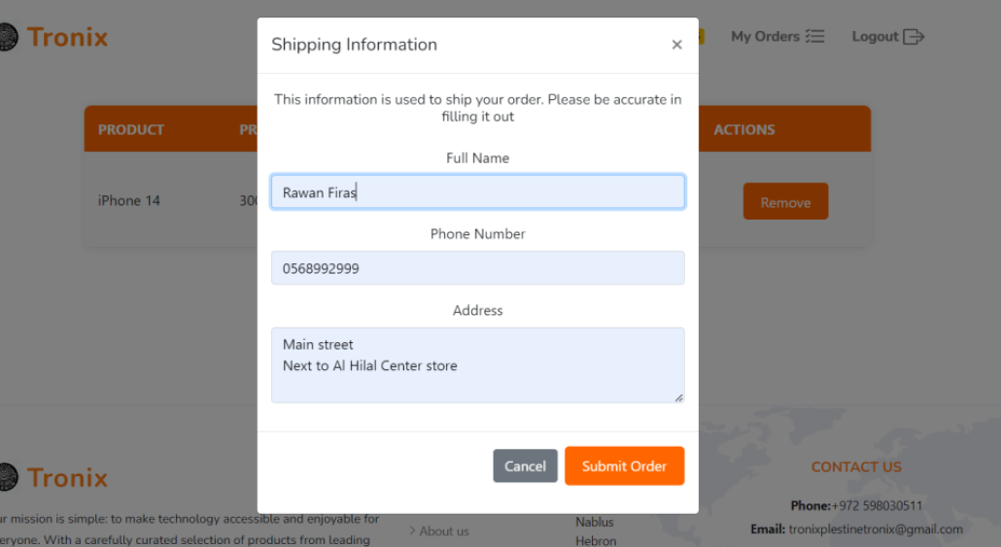
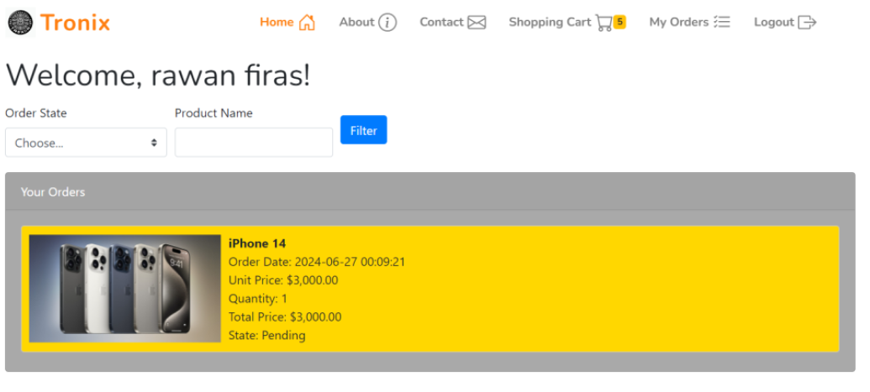
✓ Test 3: Verify the functionality of the "Tronix Web Application" for adding products to the cart and checking out.

Slide 18
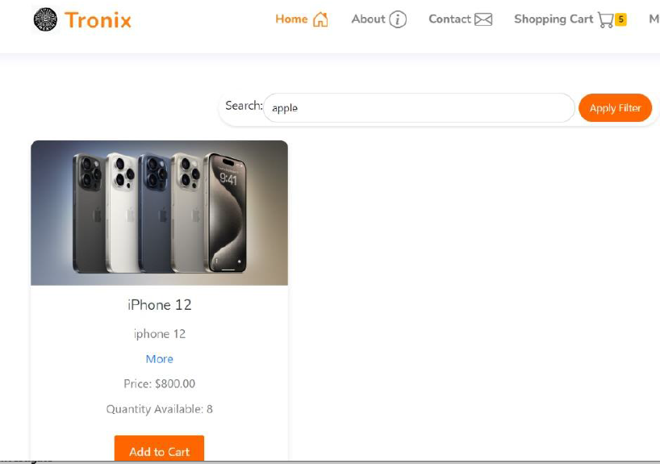
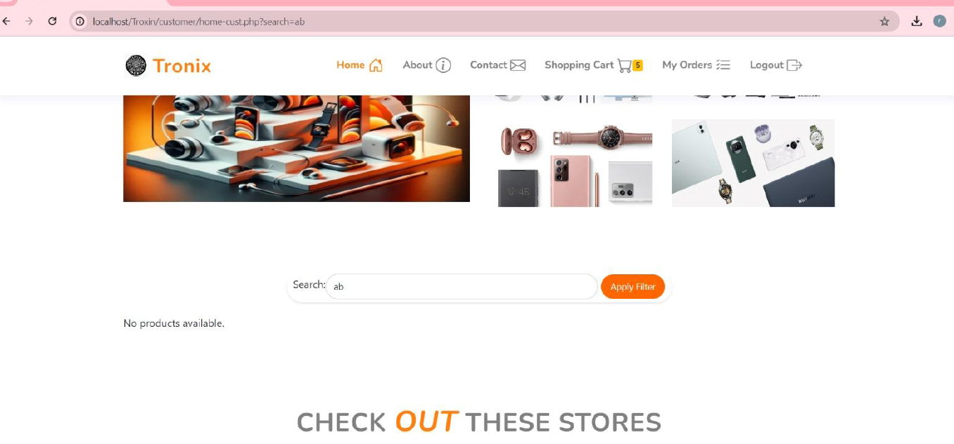
✓ Test4: Verify the functionality of the search feature on the "Tronix Web Application."

Slide 19

Future work
In the future, after creating our web application, we hope to keep it updated by adding new features that help users use it efficiently. Moreover, we may add an online payment section,In the end, we may update the application with another innovative feature, such as chat, to facilitate communication with companies and know the details more precisely. There will also be an annual subscription for every store that registers on the site, so that there will be a small profit return for the site owners.

Slide 20
Conclusion
“Tronix” is ​​a web application that helps people here in Palestine shop online in an easy and convenient way to buy the devices they want from various stores and companies in Palestine. Therefore, it will save people time and effort and also help stores advance online.

Slide 21
Thank you for watching

