Slide 1

AGENDA
AMERICAN INTERNATIONAL
UNIVERSITY-BANGLADESH
408/1, Kuratoli, Khilkhet, Dhaka 1229
WHAT THE PAPER IS ABOUT
MOTIVATION
METHOD OVERVIEW
Sequential Training of GANs Against GAN-Classifiers Reveals Correlated Knowledge Gaps
ARKANATH PATHAK, NICHOLAS DUFOUR
KEY RESULTS
RELATED WORK
RESEARCH GAP
PROPOSED HYPOTHESIS SOLUTION
PRESENTER: ARAFAT HOSSAIN
ID: 23-50277-1
CONCLUSION
COMPUTER VISION AND PATTERN RECOGNITION
FALL 2025-2026, SECTION: B

Slide 2
AGENDA
WHAT THE PAPER IS ABOUT
Detection of GAN-generated images using classifiers
Existence of consistent artifacts in GAN outputs
Artifacts are shared across independently trained GANs
Study interaction between GANs and external GAN-classifiers
MOTIVATION
METHOD OVERVIEW
KEY RESULTS
RELATED WORK
RESEARCH GAP
PROPOSED HYPOTHESIS SOLUTION
CONCLUSION

Slide 3
WHAT IS THE PAPER ABOUT
WHAT THE PAPER IS ABOUT
GAN images look realistic but still contain hidden artifacts
External classifiers can detect GAN images reliably
Indicates systematic “knowledge gaps” in GAN training
Need to understand why these artifacts persist
Need to study how GANs adapt when forced to remove artifacts
Detection of GAN-generated images using classifiers
Existence of consistent artifacts in GAN outputs
Artifacts are shared across independently trained GANs
Study interaction between GANs and external GAN-classifiers
MOTIVATION
METHOD OVERVIEW
KEY RESULTS
RELATED WORK
RESEARCH GAP
PROPOSED HYPOTHESIS SOLUTION
CONCLUSION

Slide 4
MOTIVATION
Generator creates fake images from random noise
Discriminator distinguishes real vs fake images
Adversarial training between Generator and Discriminator
Goal: Generator fools the Discriminator
GAN images look realistic but still contain hidden artifacts
External classifiers can detect GAN images reliably
Indicates systematic “knowledge gaps” in GAN training
Need to understand why these artifacts persist
Need to study how GANs adapt when forced to remove artifacts
Detection of GAN-generated images using classifiers
Existence of consistent artifacts in GAN outputs
Artifacts are shared across independently trained GANs
Study interaction between GANs and external GAN-classifiers

Slide 5
BACKGROUND (GAN OVERVIEW)
Sequential training of GANs and GAN-classifiers
Multiple GANs trained independently per iteration
Classifiers trained on outputs from multiple GANs
Modified GAN loss to also fool frozen classifiers
Two strategies:
Fool-all loss
Memoryless loss
Generator creates fake images from random noise
Discriminator distinguishes real vs fake images
Adversarial training between Generator and Discriminator
Goal: Generator fools the Discriminator
GAN images look realistic but still contain hidden artifacts
External classifiers can detect GAN images reliably
Indicates systematic “knowledge gaps” in GAN training
Need to understand why these artifacts persist
Need to study how GANs adapt when forced to remove artifacts

Slide 6
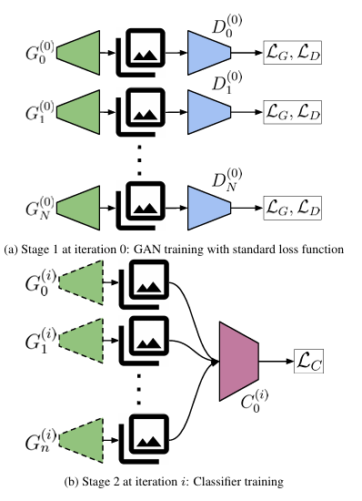
PROPOSED METHOD
Generator with standard GAN discriminator
Additional frozen classifier inputs to generator loss
Iterative training across multiple rounds
Separate classifier training stage
Sequential training of GANs and GAN-classifiers
Multiple GANs trained independently per iteration
Classifiers trained on outputs from multiple GANs
Modified GAN loss to also fool frozen classifiers
Two strategies:
Fool-all loss
Memoryless loss
Generator creates fake images from random noise
Discriminator distinguishes real vs fake images
Adversarial training between Generator and Discriminator
Goal: Generator fools the Discriminator

Slide 7
MODEL ARCHITECTURE DIAGRAM
MNIST dataset for low-dimensional setting
FFHQ dataset for high-dimensional setting
DCGAN used for MNIST
StyleGAN2 used for FFHQ
Classifier architectures:
ResNet-50
Inception-v3
MobileNetV2
Generator with standard GAN discriminator
Additional frozen classifier inputs to generator loss
Iterative training across multiple rounds
Separate classifier training stage
Sequential training of GANs and GAN-classifiers
Multiple GANs trained independently per iteration
Classifiers trained on outputs from multiple GANs
Modified GAN loss to also fool frozen classifiers
Two strategies:
Fool-all loss
Memoryless loss

Slide 8
DATASET AND EXPERIMENTAL SETUP
MNIST dataset for low-dimensional setting
FFHQ dataset for high-dimensional setting
DCGAN used for MNIST
StyleGAN2 used for FFHQ
Classifier architectures:
ResNet-50
Inception-v3
MobileNetV2
Generator with standard GAN discriminator
Additional frozen classifier inputs to generator loss
Iterative training across multiple rounds
Separate classifier training stage
Evaluation metric: classification accuracy
GAN fooling measured by drop in classifier accuracy
FID used to measure image quality (StyleGAN2)
Visual inspection for output quality
Generalization tested on unseen GAN instances

Slide 9
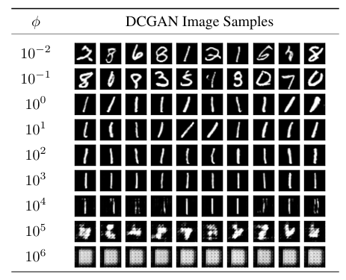
RESULT & EVALUATION
GAN images maintain visual quality after training
No degradation for StyleGAN2 across iterations
DCGAN outputs degrade when classifier pressure increases
MNIST dataset for low-dimensional setting
FFHQ dataset for high-dimensional setting
DCGAN used for MNIST
StyleGAN2 used for FFHQ
Classifier architectures:
ResNet-50
Inception-v3
MobileNetV2
Evaluation metric: classification accuracy
GAN fooling measured by drop in classifier accuracy
FID used to measure image quality (StyleGAN2)
Visual inspection for output quality
Generalization tested on unseen GAN instances

Slide 10
VISUAL RESULTS
GAN images maintain visual quality after training
No degradation for StyleGAN2 across iterations
DCGAN outputs degrade when classifier pressure increases
GAN artifacts are correlated across generators
DCGAN cannot fool classifiers without quality loss
StyleGAN2 fool classifiers without quality loss
Classifier capacity strongly affects learned artifacts
Artifacts shift in an ordered, repeatable way
Evaluation metric: classification accuracy
GAN fooling measured by drop in classifier accuracy
FID used to measure image quality (StyleGAN2)
Visual inspection for output quality
Generalization tested on unseen GAN instances

Slide 11
KEY FINDINGS
GAN images maintain visual quality after training
No degradation for StyleGAN2 across iterations
DCGAN outputs degrade when classifier pressure increases
GAN artifacts are correlated across generators
DCGAN cannot fool classifiers without quality loss
StyleGAN2 fool classifiers without quality loss
Classifier capacity strongly affects learned artifacts
Artifacts shift in an ordered, repeatable way
CNN-Generated Images Are Surprisingly Easy to Spot (Wang et al., 2020)
CNN-based GAN image detection
Shows generalization across GAN architectures
Does not study GAN adaptation to classifiers

Slide 12
RELATED WORK
What Makes Fake Images Detectable? (Chai et al., 2020)
Studies properties of detectable GAN artifacts
Focuses on detection, not generator retraining
No iterative GAN–classifier interaction
CNN-Generated Images Are Surprisingly Easy to Spot (Wang et al., 2020)
CNN-based GAN image detection
Shows generalization across GAN architectures
Does not study GAN adaptation to classifiers
GAN artifacts are correlated across generators
DCGAN cannot fool classifiers without quality loss
StyleGAN2 fool classifiers without quality loss
Classifier capacity strongly affects learned artifacts
Artifacts shift in an ordered, repeatable way

Slide 13
RELATED WORK
What Makes Fake Images Detectable? (Chai et al., 2020)
Studies properties of detectable GAN artifacts
Focuses on detection, not generator retraining
No iterative GAN–classifier interaction
Limited to DCGAN and StyleGAN2 architectures
Only image domain studied
No semantic analysis of artifact types
Computationally expensive experiments
No real-world deployment evaluation
CNN-Generated Images Are Surprisingly Easy to Spot (Wang et al., 2020)
CNN-based GAN image detection
Shows generalization across GAN architectures
Does not study GAN adaptation to classifiers

Slide 14
LIMITATION OF THE PAPER
No explicit localization of artifact regions
No measurement of artifact semantic meaning
Limited study of cross-architecture artifact overlap
No adaptive or dynamic classifier selection
Important for robust GAN detection and defense
What Makes Fake Images Detectable? (Chai et al., 2020)
Studies properties of detectable GAN artifacts
Focuses on detection, not generator retraining
No iterative GAN–classifier interaction
Limited to DCGAN and StyleGAN2 architectures
Only image domain studied
No semantic analysis of artifact types
Computationally expensive experiments
No real-world deployment evaluation

Slide 15
RESEARCH GAP
No explicit localization of artifact regions
No measurement of artifact semantic meaning
Limited study of cross-architecture artifact overlap
No adaptive or dynamic classifier selection
Important for robust GAN detection and defense
Problem: GANs shift artifacts instead of removing them
Hypothesis: Artifact localization improves artifact removal
Introduce artifact-aware attention loss in GAN training
Use classifier feature maps to guide generator updates
Extend existing sequential GAN-classifier framework
Limited to DCGAN and StyleGAN2 architectures
Only image domain studied
No semantic analysis of artifact types
Computationally expensive experiments
No real-world deployment evaluation

Slide 16
PROPOSED SOLUTION
Paper reveals structured and correlated GAN artifacts
Shows limits of GAN self-correction
Highlight role of classifier capacity
Proposed extension targets artifact localization
Contributes toward more robust GAN generation
No explicit localization of artifact regions
No measurement of artifact semantic meaning
Limited study of cross-architecture artifact overlap
No adaptive or dynamic classifier selection
Important for robust GAN detection and defense
Problem: GANs shift artifacts instead of removing them
Hypothesis: Artifact localization improves artifact removal
Introduce artifact-aware attention loss in GAN training
Use classifier feature maps to guide generator updates
Extend existing sequential GAN-classifier framework

Slide 17
CONCLUSION
Paper reveals structured and correlated GAN artifacts
Shows limits of GAN self-correction
Highlight role of classifier capacity
Proposed extension targets artifact localization
Contributes toward more robust GAN generation
Problem: GANs shift artifacts instead of removing them
Hypothesis: Artifact localization improves artifact removal
Introduce artifact-aware attention loss in GAN training
Use classifier feature maps to guide generator updates
Extend existing sequential GAN-classifier framework
THANK YOU

Slide 18
OBJECTIVE
THANK YOU

