Slide 1
ADVANCED FACE RECOGNITION BASED ON LBPH ALGORITHM
*Local Binary Pattern Histogram(LBPH), Haar Cascade, Machine Learning
PRESENTED BY
Mir Mahadi Hossain(17320003)
Farhana Akhter(17120003)
Md. Manzur Morshed Osheem(19120013)
Jannatul Bakee(19120009) Dept. of CSE Fareast International University
SUPERVISED BY
Sabbir Ahmed Sibli Lecturer Dept. of CSE Fareast International University

Slide 2
OUTLINE
Introduction
Applications of Face Recognition
Challenges with LBPH Algorithm
Literature Review
Goals of Our Research
Our Proposed Model
Methodology
Experimental Outcome
Conclusion
References

Slide 3
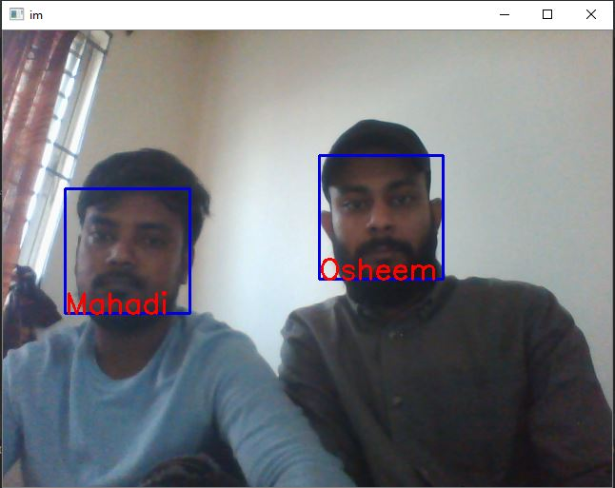
INTRO: FACE RECOGNITION
A facial recognition system is a technology capable of matching a human face from a digital image or a video frame against a database of faces , typically employed to authenticate users through ID verification services , worked by pinpointing and measuring facial features from a given image.

Slide 4
APPLICATION OF FACE RECOGNITION
To improve security and surveillance.
To improve our traffic system.
Image dataset investigation to prevent crimes.
Human computer interaction.

Slide 5
CHALLENGES WITH LBPH ALGORITHM
Unable to detect face in shadowy.
Unable to detect multiple faces.
Displaying the names incorrectly.
Dataset training error.

Slide 6
LITERATURE REVIEW
In the past, many researchers did researches on face recognition using LBPH. Although, it is pretty new technology, researchers have several works on the face recognition using Local Binary Pattern Histogram.
M. Ameen Chhajro, Kamlesh Kumar, M. Malook Rind, Aftab Ahmed Shaikh, Haque Nawaz, and Rafaqat Hussain Arain, Pedestrian Detection Approach for Driver Assisted System using Haar based Cascade Classifiers, India,(2018)
Alexander Mordvintsev and Abid K, Face Detection using Haar Cascades , Russia(2013)
Helvig Jensen,Implementing the Viola-Jones Face Detection Algorithm. P-11, USA,(2008), Kongens Lyngby IMM-M.Sc.-2008–93.
Timo Ahonen, Abdenour Hadid, and Matti Pietik¨ainen, Face Recognition with Local Binary Patterns, Finland,(2004), P-472

Slide 7
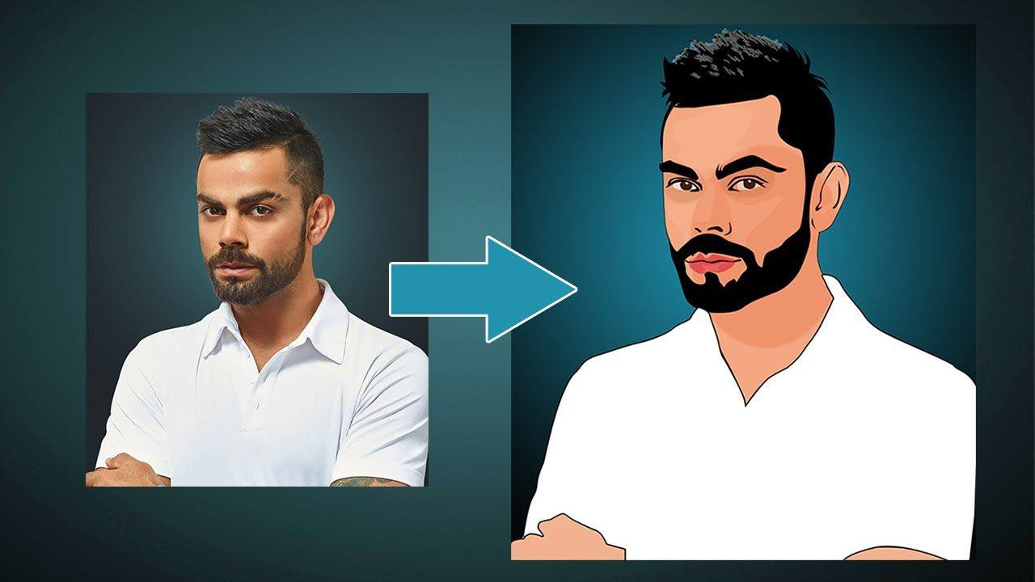
GOALS OF OUR RESEARCH
To develop a dynamic system for avoiding unauthorized access.
To build a face recognition system to merge it with social sites so that it may create avatar according to the user faces. It will be used for virtual reality.
To create a system for identifying gender on unwanted death.

Slide 8
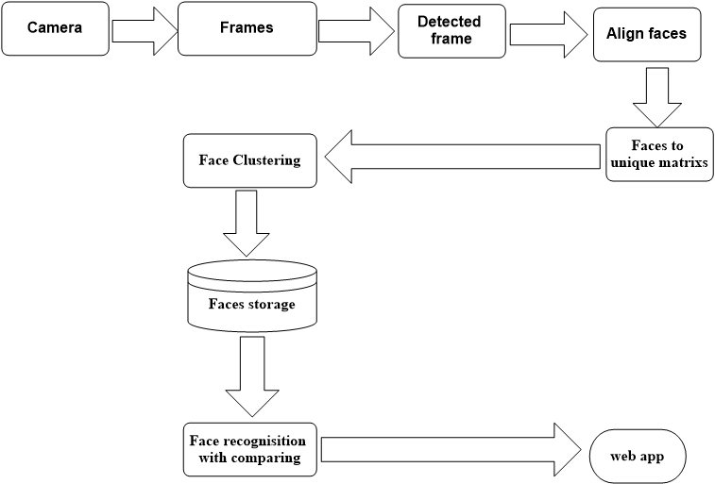
PROPOSED MODEL
Fig: Proposed model of whole system

Slide 9
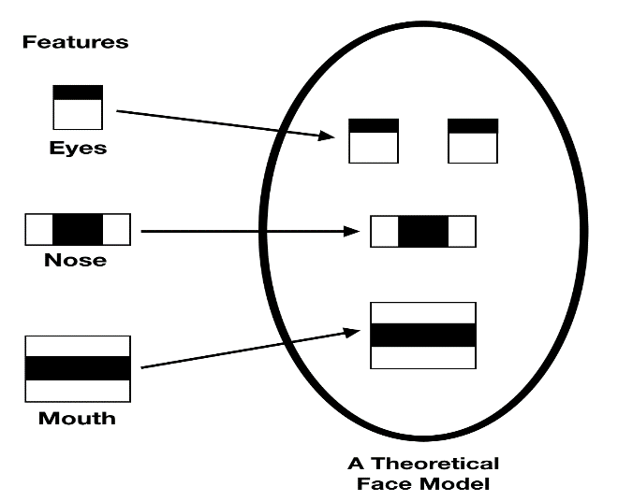
6+ +
METHODOLOGY(Cont.)
Face detection :
For detecting faces we use Hear cascade classifier.
Fig 3.1: Cascade classifier features

Slide 10
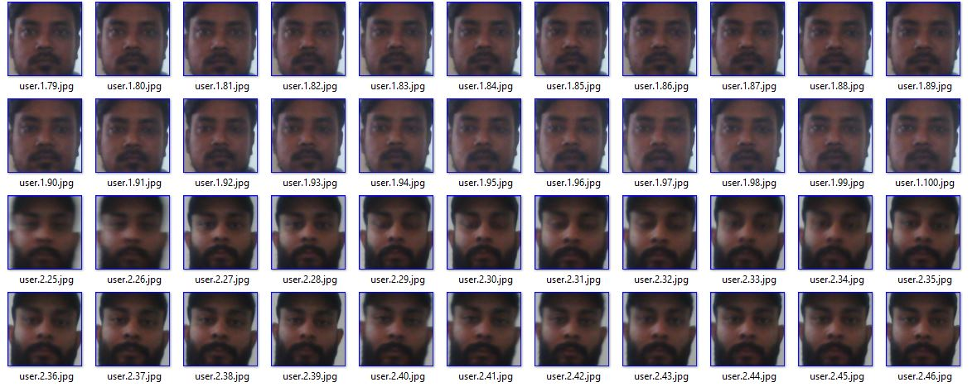
METHODOLOGY(Cont.)
Training Data:
After detecting faces we have to train those faces. Then trained image is stored in .yml file as unique matrix.
Figure 3.2. Trained Dataset

Slide 11
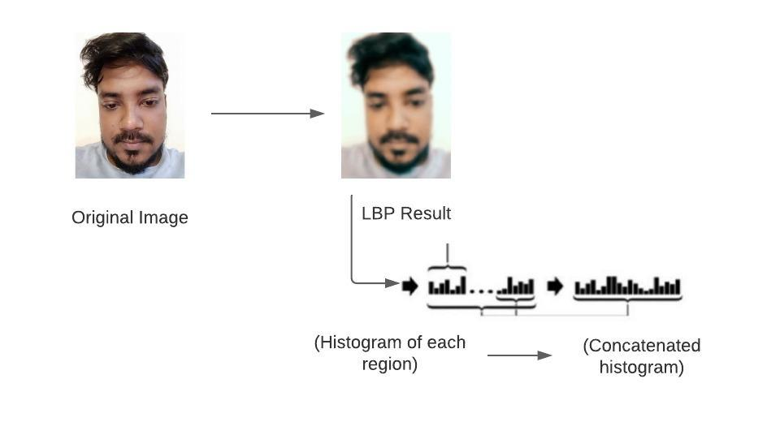

METHODOLOGY(Cont.)
Recognize faces:
The algorithm of face recognition is local binary pattern histogram.
Fig 3.4: Extract histogram from original image

Slide 12
METHODOLOGY
Recognition faces:
Finally, we make it possible to recognize multiple faces at a time.
Figure 4.4: Recognition of multiple faces

Slide 13
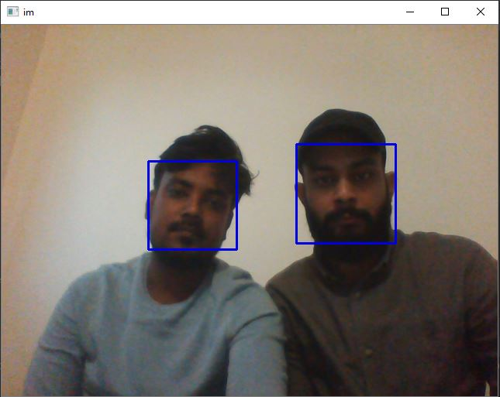
EXPERIMENTAL OUTCOME
Fig 4.2:Detect multiple faces
Fig 4.4: Recognition of multiple faces

Slide 14
CONCLUSION
In this presentation we tried to give an idea about face recognition using Local Binary Pattern Histogram.
Here, we focused on overall Haar cascade classifier to detect object.
Though it was cumbersome but we did it.
So,” not quantity, quality is our destiny”.

Slide 15
REFERENCES
Illias Maglogiannis, Demosthenes Vouyioukas, Chris Aggelopoulos, “Face detection and recognition of natural human emotion using Markov random fields”. DOI 10.007/s00779 007 0165 0
Tomasz Marciniak, Agata Chielewska, Radoslaw Wechan, Mariana Parzych, Adam Dabrowski, “Influence of low resolution of images on reliability of face detection and recognition”. DOI 10.1007/s11042 013 1568 8
H. Zhi, S. Lui, “Face recognition based on genetic algorithm”, J. Vis Commun, Image R. (2018), doi: https://doi.org/10.1016/j.jvcir.2018.12.012
Shonal Chaudhry, Rohitash Chandra, “Face detection and recognition in an unconstrained for mobile visual assistive system” Artificial Intelligence and Cybernetics Research Group Software Foundation, Nausori, Fiji.
Alireza Tofighi, S Amirhassan Monadjemi, “Face detection and recognition using skin color and Adaboost algorithm combined with Gabour features and SVM classifier”. Volume : 1
Savvides et al., “Dynamic feature Matching (DFM) for partial face recognition.”
J. Long, E. Shelhamer, T. Darrell, “Fully convolutional networks for sematic segmentation”, The IEE Conference on Computer Vision and Pattern Recognition (CVPR), Boston, MA, USA,2015. Doi: 10.1109/CVPR. 2015.7298965

