Slide 1





MOVEWITH
ME
Enterprise Application Engineering
Group 7

Slide 2





OUR TEAM
Name | Role
Md Farhad Hossain | Product Owner & Developer
Neha Bobby | Scrum Master & Developer
Sudhandra Babu | Developer
Areeb Hussain | Developer
Soham Sandeep More | Developer
Padmaakarthy Subbulakshmi | Developer

Slide 3
EPICS
1
  ESPW2-1 — Project Setup & Requirements
2
  ESPW2-2 — Core Ride & Rental Features
3
  ESPW2-3 — AI Recommendation & Verification System
4
  ESPW2-4 — Payment & Security System
5
  ESPW2-5 — Testing & Quality Assurance
6
  ESPW2-6 — Documentation & Presentation

Slide 4
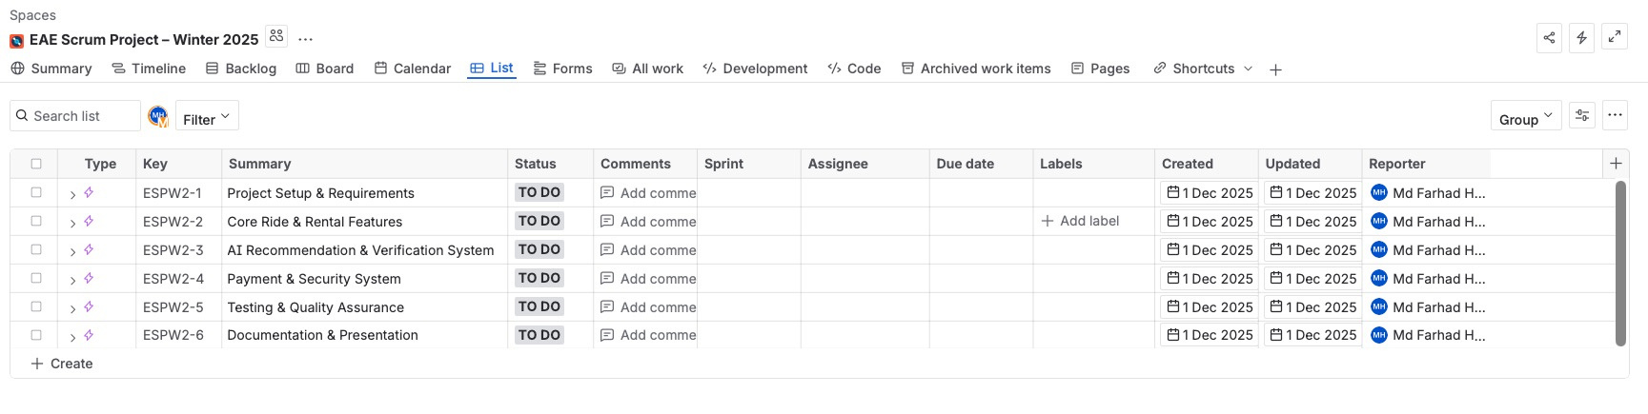
EPIC
The MoveWithMe Product Backlog is organized into six core Epics.
Epics are large bodies of work that represent major functional areas or strategic initiatives within the project. This was done using the Jira tool.

Slide 5
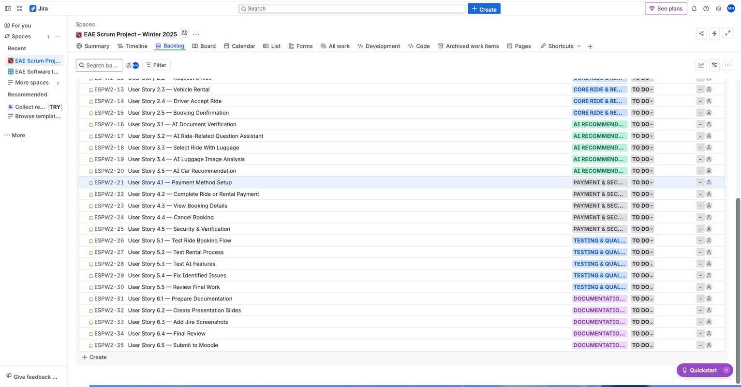
BACKLOG STORIES
Simple descriptions of a feature written from the user’s perspective, explaining what they need and why

Slide 6
ROLE
•The Product Owner (PO) serves as the vision expert, responsible for prioritizing the work and defining what should be built to maximize value. In this project, Md Farhad Hossain fulfilled the role of Product Owner and was responsible for the final project summary, sprint planning, and GitHub setup.”
•The Scrum Master (SM), Neha Bobby, supports the team by coaching them, ensuring adherence to the Scrum framework, facilitate daily meetings.

Slide 7
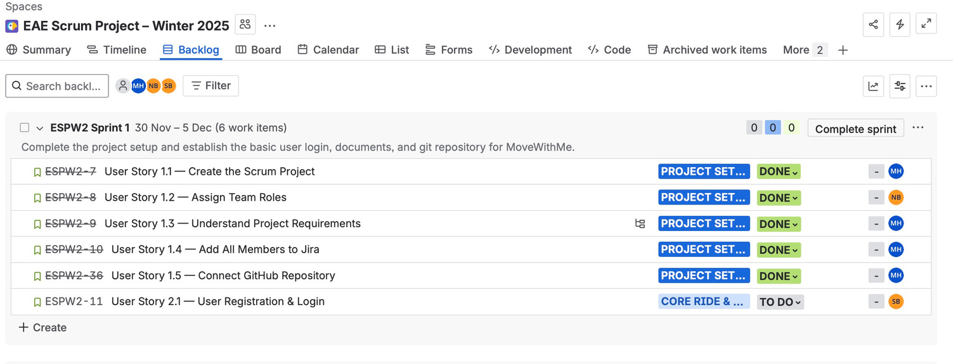
SPRINT PLANING
It is the event where the team selects work from the Product Backlog to create the Sprint Backlog.
•We completed our sprint goal of project setup, team assignment, GitHub integration, and preparing the core features for development.

Slide 8
DAILY SCRUM
The 15-minute time-boxed event where the Developers inspect progress toward the Sprint Goal using the Scrum Board.
During each meeting, sometimes lasting more than 15 minutes.
  We use our Scrum Board to manage and track our workflow.
  Sprint Planning begins in the To Do column, where all tasks move through the stages To Do → In Progress → Done.
  All tasks committed to in the sprint are reflected on this board.

Slide 9
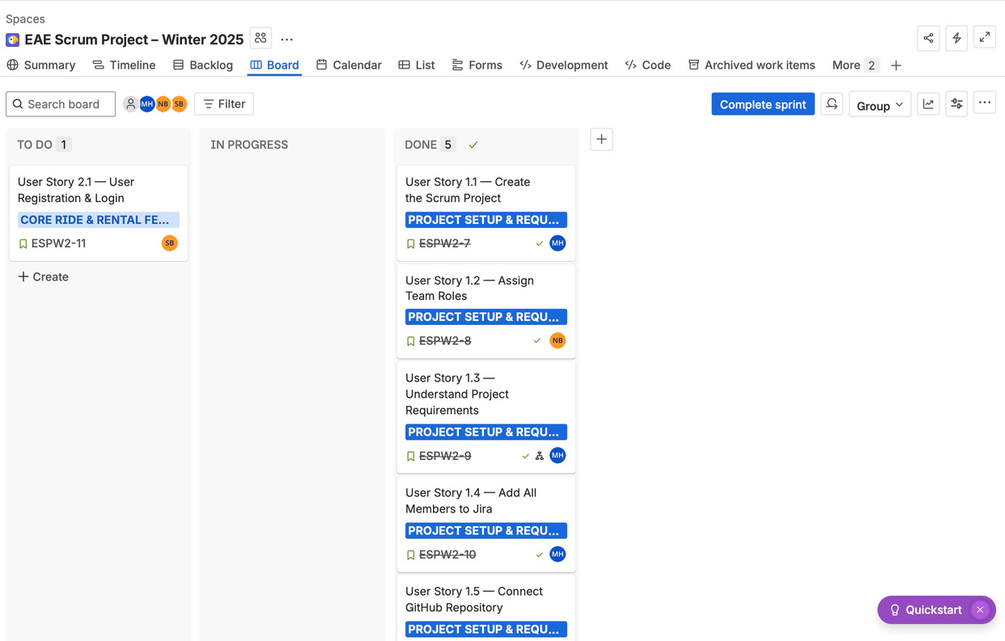
SCRUM BOARD
Visual tool used to track the progress of sprint tasks, showing work moving from To Do, to In Progress, to Done.

Slide 10
BURNDOWN CHART
The burndown chart shows the remaining work in Sprint 1 and tracks progress toward completing all user stories. It visualizes how tasks decreased over time compared to the ideal burn rate.
The Chart shows the remaining work in Sprint 1, tracks the progress of all user stories. Illustrate how tasks decreased overtime, compared to the ideal burn rate

Slide 11
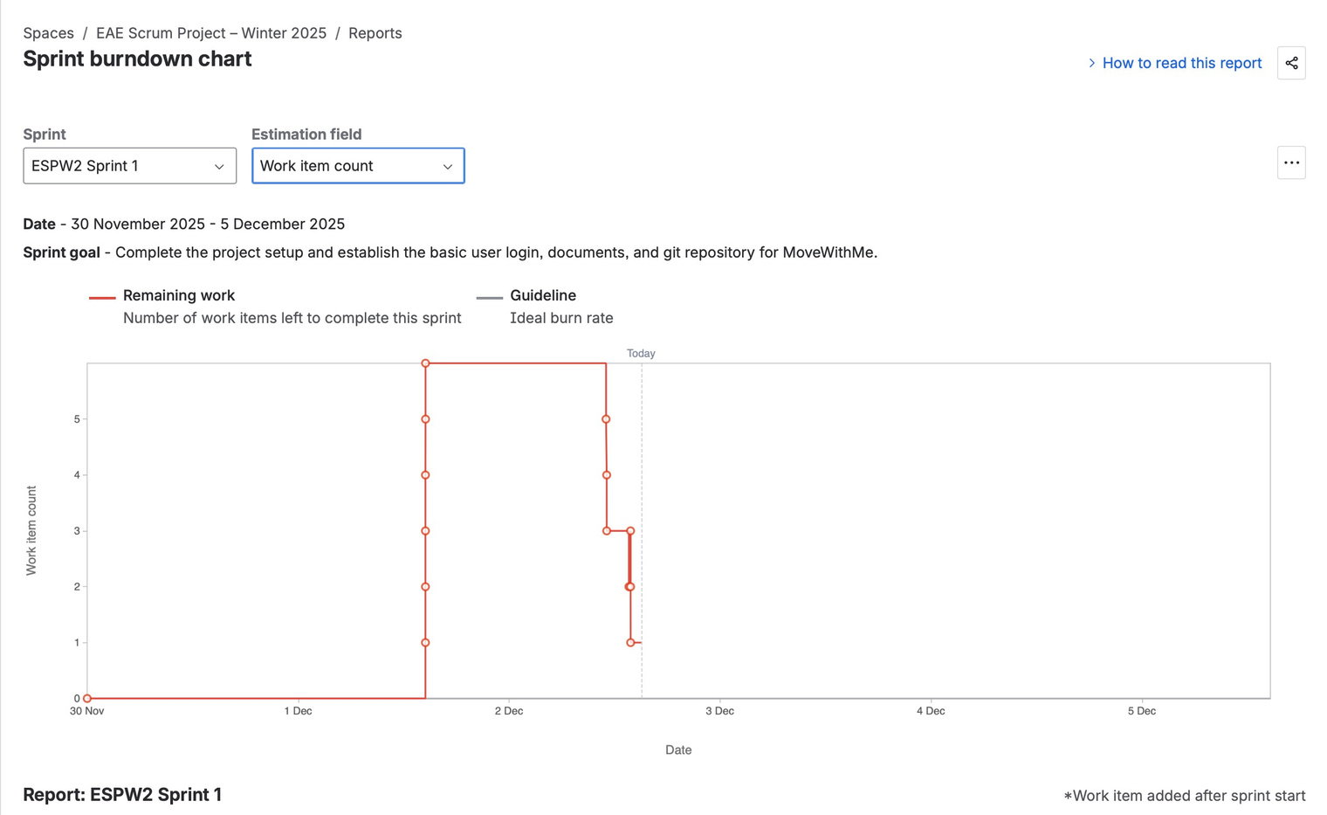
BURNDOWN CHART

Slide 12
SPRINT RETROSPECTIVE
.
What Went Well (Good) | What Didn’t Go Well (Bad)
Team collaborated effectively in Jira & GitHub | Minor confusion with branch naming
Roles were clearly understood | Some of us were unfamiliar with Jira navigation
Requirements were documented early | One user story remained incomplete
GitHub integration successful, And rules has been set in repository | Project Template Setup
All setup tasks finished on time | —

Slide 13
SPRINT RETROSPECTIVE
Start | Stop | Continue
Make simple drawings or designs of the screens | Stop pushing directly to main | Continue using feature branches
Clearly describe what the feature must do so the team knows exactly when the work is considered | Stop working without naming conventions | Continue clear documentation in repo & Jira
— | — | Continue daily communication

Slide 14
THANK
YOU
WHAT CAN WE IMPROVE?

