Slide 1
Information Engineering and Computer Science(M.Sc.)-2020
Innovation Management
Dr. Anuradha Jain
Name of the Project: Students life during Covid-19
Submitted by: Group-09
Md Sanowar Hossain (26575)
Md Shahin Howlader (27774)
Hossen Ali (27772)
Shah-Alam Rasel (28127)
Md Abdulla-al Rabby (28178)
Md Amanur Rahman (28225)
Moriom Huque Mitu (28388)

Slide 2
Design Brief:
Students life during Covid-19
Business problem or opportunity? During this pandemic (Covid-19), students of HSRW are facing with various online interactive activities such as physical library exercise, face-face interactive with the teacher, friends, and staff, hampering on group activities. This application is mainly concentrated on single online platform that providing some necessary resources and materials to increase the student's academic knowledge and skills, entertainment, and physically fit.
2. Scope: Digital library is one kind of solution to get the students requirements that can be solved the physical library exercise. The online blog can also be a solution to solve the academic group problems, Online gym tutorial can give guidance how to fit physically, entertainment(suggestion about movies, chatting with friends, reading magazines), and online guidance on how to make food. This is because we are going to offer many functionalities in a single online platform for the HSRW students to utilize their times in a more efficient way.
3. Key questions to be answered are: Can students of other universities get benefits from this application? What are the possible entertainment activities during the Covid-19? What are the alternative activities would like to prefer? Are other university students facing the same types of problems? What kind of movies are available in this platform? What kind of books will be available related to fitness and precautions for COVID 19? What kind of cooking related tutorials are available?

Slide 3
Design Brief:
Students life during Covid-19
4. Target users: The students of HSRW are attending their classes through online from different time zone because of holding in different countries due to pandemic Covid-19. So, this project is going to focus on HSRW students who have to login into this system with their matriculation number in order to fulfill their requirements.
5. Research plan: This project has researched all the functionalities by 07 members of this group in order to find out the problems and solutions during this Covid-19 period.
6. Success Metrics: There are many reasons in Covid-19 periods for the target students for example how many users are available, how many books are downloaded from the online library by 07 users, how many gym activities are going to define the success metrics of our project by 07 users, how many users are participated with chatting box.
7. Project Plan, resources: 07 students, Part-time for 2 weeks and this project will be closed by end up August 2020.

Slide 4


Visualisation:
Students life during Covid-19
Gain
Pain- student in pain
Aspire – Chatting with friends, Enjoying movie, Cooking different items, quality time passing for physical fitness by online training, physical movement, social interaction, physically fit, passing quality time, reading eBook.
Measure success: More students learn cooking, more students soft skill learning by online course, more students feeling fit, more feeling mentally fit, good results in studies.
he/she benefit? Physically library issues solved, entertainment issues solved, Students mental issues solved, fitness issues solved, interaction issues solved. They can pass idle time.
What can you offer them?
Innovative ways to train cooking
Getting used to studying online (paradigm shift)
Innovative ways to read books
Innovative ways of remaining fit
Offer good resources suggestion for entertainment
Help ways to keep off your worries
offer interactive way to pass good time
Offer interactive way to learn physical activity
Bad day – unavailable access to library, hampering on group work, Laziness, depression, physically unfit, can’t cooking, unavailability of online resource for learning, getting fat day by day, monotonous daily routine, can’t sleep properly, do not pass interactive time, worries about covid-19 pandemic?
Afraid of – Running short of money, missing courses, losing job, less activity, getting Corona, worries about family back in country, isolation, loosing job, getting Corona, loneliness, poor grades.
Responsibility – Completing semester, getting job, staying active and healthy, staying mentally sound, group meetings.
Obstacles- Different time zone, low speed internet connection, less amount of free online resources, no knowledge about cooking, less knowledge about physical activity, gadgets not working, working and studying, equipment for exercise, books are not available, less entertainment option, no student jobs, no visa, no flights, don’t understand course structure..
Assist to HSRW students for mentally and physically healthy

Slide 5


Visualisation:
Students life during Covid-19
Needs:
Insight (for your business):
Activities: During this pandemic, daily routine ought to be modified in the convenient way. Doing exercise for mentally and physically fit, getting proper food to increase the immune system, enough time to be entertained and socially interact, enrolled in class to get the good results, doing studies from online library to increase the knowledge that all should be included in the new planned routine.
Desires: Getting access to library from anywhere, anytime to study, enough time to doing assignments and project work, Staying healthy in both mentally and physically, interactive lecture, good results, stress free lifestyle.
Possible disconnect …….
Lack of recourses: Less reading materials availability
Health condition – in this pandemic time more possibility become mentally and physically sick.
Inadaptability – new lifestyle, new rules and regulation along with online classes .
Online classes – software and connection issues
Contradictions. “Why?”
New lifestyle is the more challenging job for the new students. 1st semester students are facing many problems such as university enrollment issues, new place, new society, new friends group, new project group this Covid-19 period.
Lacking social interaction – everyone loves to interact with friends and family but now its impossible.
University issues: too many online classes , too many assignments, new assessment technique, new making group mates, too many solving alone.
Introvert – can adopt this condition easily than others(extrovert, ambient)

Slide 6
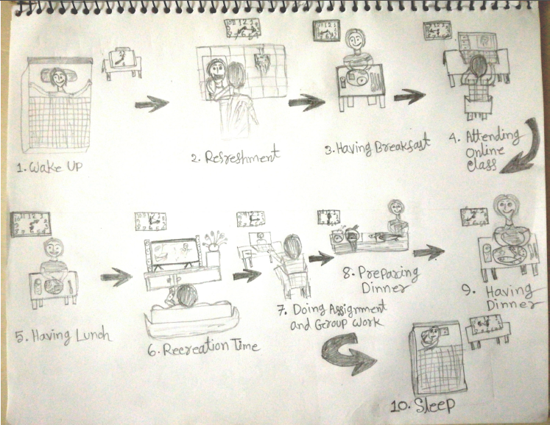
Visualization Design:
Students life during Covid-19

Slide 7

Virtual Interactivity with Students in Covid-19
Persona: Akash Ahmad
Background:
Age: 27
Location: Kleve, Germany
From: Bangladesh
Occupation: Software developer (Part time)
Status: Single
Education: Postgraduate student, HSRW
Expertise: Programming
Attributes:
Have a strong grasp of computer science fundamentals.
Ability to Self-Manage.
Can write clean, logical, high-quality code using test-driven development.
Consultant mindset and passionate about doing really good work .
Strong Communication Skills and ability to be a good team member.
Positive Attitude and Quick Learning Ability.
Goals:
Will complete study and do full time job.
Will read 200 books every year.
Make his own library.
Commitment to improved mental health.
Challenges:
Straggling to do online lectures.
Can’t use library to reads books and being frustrated .
“Reading books is my favorite leisure time activity”
23-08-2020
© Innovation Management – Anuradha Jain
Notes:
7

Slide 8

Virtual Interactivity with Students in Covid-19
Persona: Asha Rahman
Background:
Name: Asha Rahman
Age: 25
Location: Essen, Germany
From: Bangladesh
Occupation: Marketing officer
Status: Single
Education: Graduate
Expertise: Analytical Thinking, Communication
Personality: Extrovert
Attributes:
Fast reader
Always finish a book.
Likes hardcovers and boxed collections.
Reads physical copies but prefer e Books.
Great internet knowledge.
Plays online games.
Challenges:
Can’t explore new books.
Increases mental steers
Straggling with online communication.
Goals:
Want to complete post graduation.
Discovering new books to read.
Finding unique stories.
Cataloging book collection.
“Books are way better than movies”
23-08-2020
© Innovation Management – Anuradha Jain
Notes:
8

Slide 9

Virtual Interactivity with Students in Covid-19
Persona: Erina Mahbob
Background:
Age: 30
Location: Dortmund, Germany
From: Bangladesh
Occupation: Part time student
Field: German Language
Status: Married with two kids
Hobbies: Reading books, Music
Personality: Introvert, Self motivated
Attributes:
Experienced library user, usages almost everyday.
Excellent computer skill.
Open minded.
Very busy, needs help staying organize.
Likes online interaction and online reading.
Advance researcher.
Great full for helps.
Goals:
Wants to independent.
Wants useful tools to save time and be organize.
Wants to explore everything in the library.
Needs a way to share research, establish presence in her field.
Challenges:
Overeating
Can’t do exercise.
Can’t find necessary books for reading.
Weight gain.
“I want to achieve best result”
23-08-2020
© Innovation Management – Anuradha Jain
Notes:
9

Slide 10
Students life during Covid-19
Journey Mapping:
We first used time to study the map, then generalized it as phases
PHASES
WAKE UP
STUDY
LUNCH
STUDY & WORK
DINNER
RELAX
SLEEP
ACTIVITIES
Wake Up
Personal higene
Exercise
Shower
breakfast
Check emails
Attend online classes
Self study
Interact with family by internet
Cooking
Having lunch
Attend online class
Self study
Check emails
Group work
Cooking
Having Dinner
Talk with Friends and family
Watching Movies
Indoor sports
Listen to music
Gossiping with Room mates
Personal higene
sleep
Aactivities are the goals want to achieve today
Hear a persona is interviewed and asked for what makes him or her happy on any day.
The idea is to catch insights on the emotion.
What makes the person happy, and what makes the person sad
HIGH
Exercise
Physical training
Breakfast
Checking emails
Attending in classes
Hygienic Food
Online Tutorial for cooking
Completing tasks
Learning new skills
Healthy food
Eating on time
Interactive in online games
Digital entertainment
Nice musics
Gossip with favorite topics
Sound sleep
LOW
Missed exercise
No shower
Reading online newspaper
Sleepy
No attention
Lack of ingredients
Unhealthy food
Distracted
No job availability
Fear of loosing job
Eating too much
Not in a mood of dinner
Bad mood
Demotivaed
Tired
Loneliness
No energy for personal care
late Sleep

Slide 11
Students life during Covid-19
Value Analysis (Covid-19):
WAKE UP
STUDY
LUNCH
STUDY & WORK
DINNER
RELAX
SLEEP
1
2
3
4
5
6
7
Wake Up at 6 AM
Jogging
Shower
Breakfast
Check emails
Attend online classes
Accessing e-books
Online tutorial + Cooking
Less time to cook
Lack of ingredients
Online Meeting
Assignments
Group work
Self study
Prepare dinner
No energy for cooking
Talking with Friends and family
Watching Movies and indoor sports
Listen to music
Reading book
sleep
Best case scenerio
HIGH
Jogging
Breakfast
Interactive sessions with professors and classmates
Enjoyable session with friends
Completing tasks
Interactive in online games
Digital entertainment
Sound sleep
Motivational Levels:
LOW
Not cooked perfectly
Tired
Worst case scenerio
Needs to
Make a well plan
Checking all activities
Is everything good?
Do you fell well in mentally and physically?
Ready for service

Slide 12
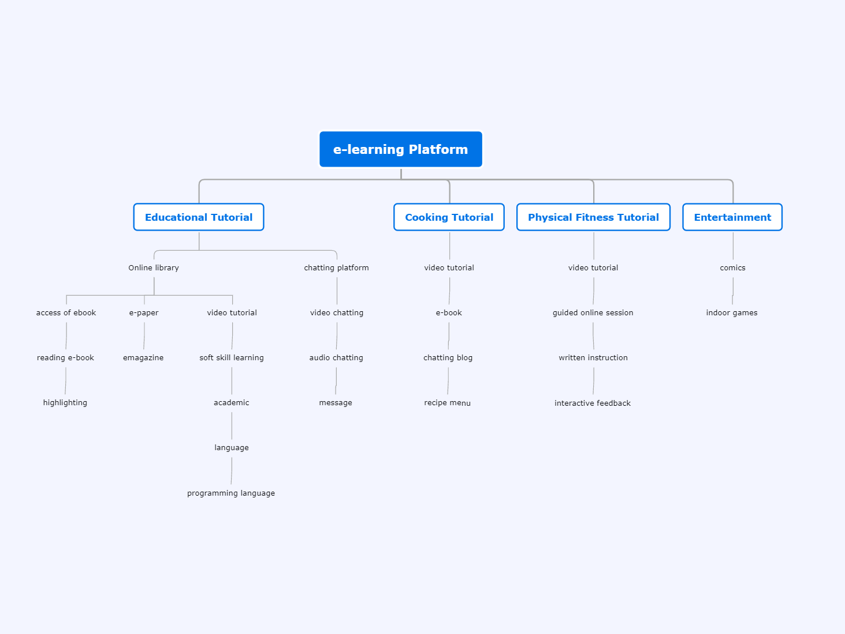
Students life during Covid-19
Mind Mapping:
Notes:
e-learning Platform
Educational Tutorial
Online library
access of ebook
reading e-book
highlighting
e-paper
emagazine
video tutorial
soft skill learning
academic
language
programming language
chatting platform
video chatting
audio chatting
message
Cooking Tutorial
video tutorial
e-book
chatting blog
recipe menu
Physical Fitness Tutorial
video tutorial
guided online session
written instruction
interactive feedback
Entertainment
comics
indoor games

Slide 13
Design Criteria:
Students life during Covid-19
Design Goal:
This an idea will build a scalable internet-based solution mainly for the HSRW students who will get the best benefits from this app during this Covid-19 period. There are some benefits as below mentioned.
Students will get more options such as online education, entertainment, cooking tutorials, and physical fitness training materials to pass their boring time using this app.
This app will suggest how to utilize their leisure time in a dynamic way by watching the new movies, reading eBooks, Magazines, and the online newspapers.
This project will also give some instruction on video games that students can play and enjoy it during this pandemic situation.
This e-learning platform will provide some basic, but essential training skills for example programming language, German language, and soft skills to develop his/her future career.
This project will give some instruction on physical and mental fitness training such as Yoga to reduce anxiety, depression, and negative mood. As a result, students can develop their self-esteem and cognitive function

Slide 14
Design Criteria:
Students life during Covid-19
User Perception: This is free open source tools tutorial for the HSRW students. It is user-friend and students can use it very easily. Also, students will get a notifications message from this app when the new module will come.
Physical Attributes: Any internet accessible devices such as smartphone, laptop, desktop computer, Tablet, Smart TV, eBook Reader, Digital Camera, and Game Console allow accessing this service.
Functional Attributes: The security system of users is the main focus in this app because lots of user information will have in our database. Similarly, we will make sure to the potential users about upcoming new movies, eBooks, cooking tutorials, and physical fitness tutorials so that users always feel necessity using this e-learning platform again and again. Moreover, we will get feedback on any bug or updating information from users through a report center that can be helpful in improving this e-learning application.
Constraints: Within 2 weeks is required for a proof of concept. Now, we are working on data collection and requirements analysis. The matriculation id of students is mandatory to login into our system. So we need to permission using this matriculation id of our system from the university authority, but still it is pending. We are also working on this part.

Slide 15
Brainstorming:
Students life during Covid-19
From Design criteria | Dominant logic From current business | Contra logic Supporting criteria
Physical Flows | Library closed Closed Fitness center Cafeteria closed Cook at home No career related offer from the university No entertainment | Suggestion online e-book access Suggestion online physical exercise training. Online training platform for Cooking Suggestion online food delivered platform Suggestion e-learning platform for career related self development Suggestion for movies, eBook, and online indoor games.
Information Flows | No access in library No information about keeping fit No knowledge how to cook Student has no update release of movie, online games, eBooks, cooking tutorials. | Educational learning for academic study Personal learning about physical fitness Knowledge gathering on cooking. Get updated information about movies, online games, eBooks, cooking tutorials.

Slide 16
Concept Development:
Students life during Covid-19
We have used the design criteria, brainstorming, and mind mapping results and selected the one idea to develop the app for HSRW students that can be helpful during this the Covid-19 period. The step process of e-learning app development is given below.
Step 1: Generating(Internal and External SWOT Analysis)
Step 2: Screening The Idea(e-learning platform)
Step 3: Testing The Concept(Concept testing is done by students after idea screening)
Step 4: App development Analytics(metrics, value)
Step 5: Beta / Marketability Tests(Arranging private tests groups, launching beta versions)
Step 6: Technicalities + Product Development
Step 7: Commercialize(Launching for users and monitoring the progress)
Step 8: Post-launch review and users feedback (need user feedback for future improvement)

Slide 17
Napkin Pitch:
Students life during Covid-19
Needs:
Online library is very important to concentrate the academic study during the Covid-19
For international students, online cooking tutorials is essential in the daily life in this period.
To concentrate on academic studies physical fitness is more crucial than anything.
Entertainment plays a vital role to increase the motivational level during this pandemic period.
Approach:
This app will offer online exercise traing tutorila to remain fit.
It also will provide good source of information about ebook , online games, and entertainment.
This app also offer career oriented development option.
It also offer cooking tutorial.
Benefit:
Reading materials availability from the online platform
Students are benefitted by some basic knowledge of cooking, physical exercise, career oriented self development.
Getting recipe in short time for cooking
Mentally and physically remain healthy
Competitor:
YouTube, Udemy, Coursera, Tasty Food, Runtastic.

Slide 18
Assumption Testing:
Students life during Covid-19
Q1. Who are our target users?
The students of HSRW will be our target user.
Q2. How many students are you expecting to use this service?
We are assuming that around 70% students of HSRW will be using this e-learning platform during the Covid-19 period.
Q3. Have you thought about user security how to ensure security integrity for them?
Yes, we have already focused on unauthorized access or corruption by data integrity to ensure the user's data security.
Q4. Why will we use this app?
This e-learning platform is an excellent platform for students who want to learn the language, who wants to read eBook, watching movies, playing video games, learning cooking recipes, learning physical fitness. All items are in a single platform to pass their boring time this pandemic situation. This is because we will use this app during this pandemic period.
Q5. is it a user-friend?
Yes, it is a free and user-friend tool.

Slide 19
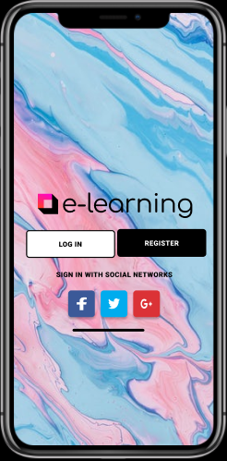
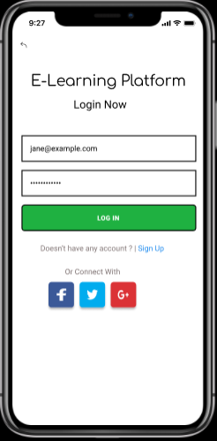
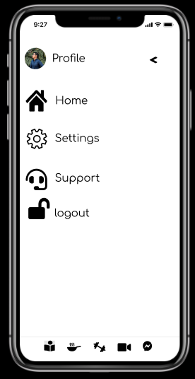
Rapid Prototyping:
Students life during Covid-19
https://www.figma.com/proto/Y5csgXboPUgGreCB3jmi45/E-learning-App?node-id=0%3A2&scaling=scale-down&fbclid=IwAR1F_
jw8q6L2Hmz6yPXaEAVHiDrzaE658WovbgfZYtveoSgTfUd33oAppyo

Slide 20
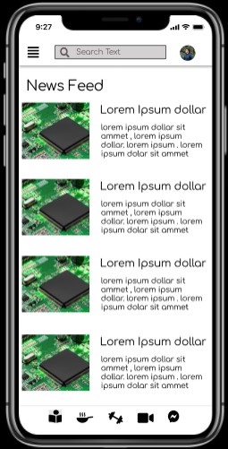
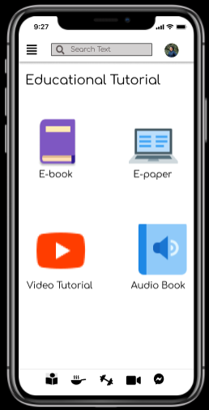
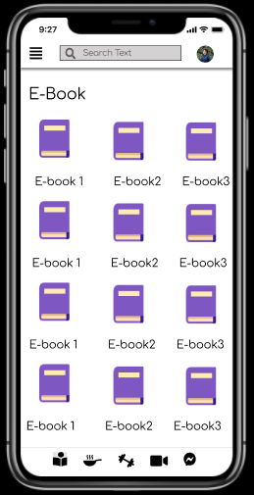
Rapid Prototyping:
Students life during Covid-19

Slide 21
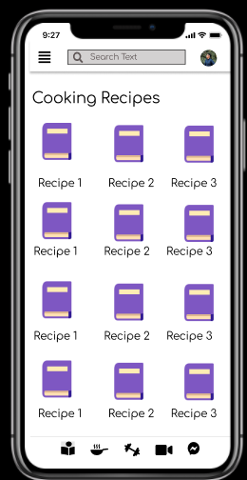
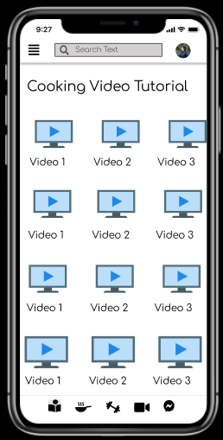
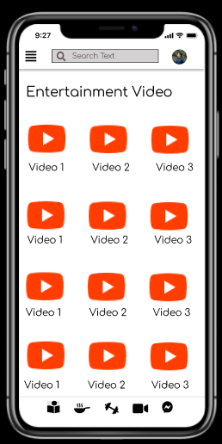
Rapid Prototyping:
Students life during Covid-19

