Slide 1
CSE303
Lecture 5: Sampling

Slide 2
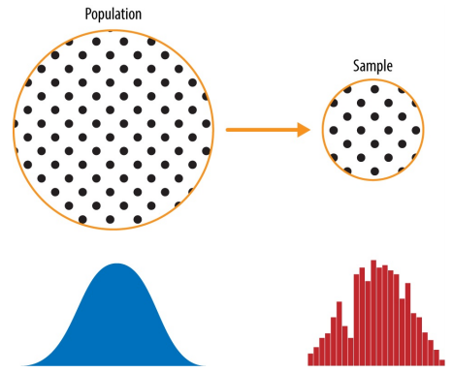
Sampling
Sampling is a process used in statistical analysis in which a predetermined number of observations are taken from a larger population.

Slide 3
Some key terms
Sample: A subset from a larger data set.
Population: The larger data set or idea of a data set.
N: The size of the population. (number of elements in the whole dataset)
n: The size of the sample. (number of elements in the subset)
Random sampling: Drawing elements into a sample at random.
Stratified sampling: Dividing the population into strata and randomly sampling from each strata.
Simple random sample: The sample that results from random sampling without stratifying the population.
Sample bias: A sample that misrepresents the population.

Slide 4
Simple random sampling
Random sampling is a process in which each available member of the population being sampled has an equal chance of being chosen for the sample at each draw.
The sample that results is called a simple random sample.
Sampling can be done with replacement, in which observations are put back in the population after each draw for possible future reselection.
Or it can be done without replacement, in which case observations, once selected, are unavailable for future draws.

Slide 5
Example: Random Sampling with replacement
Box 1
Find the probability of picking two red toys from Box1 when you draw the samples with replacement.
P (first toy is RED) * P (second toy is RED)
= 3/7 * 3/7 = 9/49

Slide 6
Example: Random Sampling without replacement
Box 1
Find the probability of picking two red toys from Box1 when you draw the samples without replacement.
P (first toy is RED 3/7 ) *
P (second toy is RED 2/6)
= 3/7 * 2/6
= 6/42
= 1/7

Slide 7
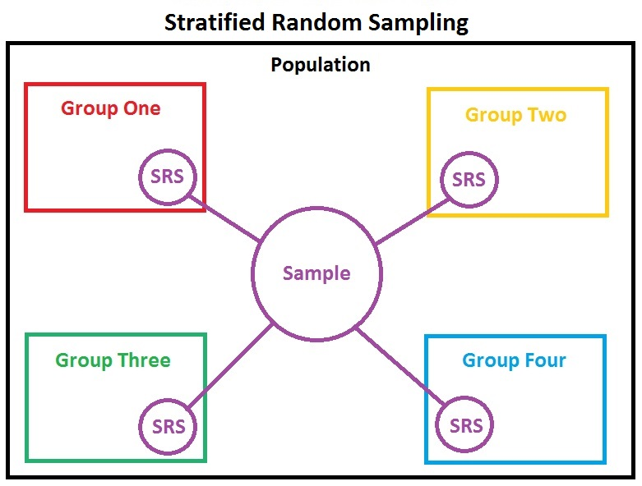
Stratified sampling
Stratification is the process of dividing members of the population into homogeneous subgroups before sampling. The strata should define a partition of the population.
That is, it should be collectively exhaustive and mutually exclusive: every element in the population must be assigned to one and only one stratum/partition.
10%
30%
20%
40%

Slide 8
Properties of Strata/Partition in Stratified Sampling
Collectively Exhaustive: P1 U P2 U P3 = Entire Population
Mutually Exclusive: P1 INTERSECT P2 INTERSECT P3 = NULL

Slide 9
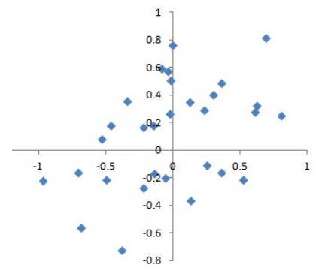
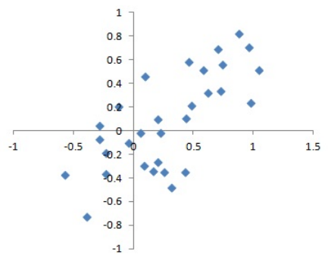
BIAS
Statistical bias refers to measurement or sampling errors that are systematic and produced by the measurement or sampling process.
Gun shots with True Aim
Gun shots with Biased Aim

Slide 10
SELF-SELECTION SAMPLING BIAS
Size versus Quality: When Does Size Matter?
In the era of big data, it is sometimes surprising that smaller is better. Time and effort spent on random sampling not only reduce bias, but also allow greater attention to data exploration and data quality. For example, missing data and outliers may contain useful information. It might be prohibitively expensive to track down missing values or evaluate outliers in millions of records, but doing so in a sample of several thousand records may be feasible. Data plotting and manual inspection bog down if there is too much data.
The classic scenario for the value of big data is when the data is not only big, but sparse as well. Consider the search queries received by Google, where columns are terms, rows are individual search queries, and cell values are either 0 or 1, depending on whether a query contains a term. The goal is to determine the best predicted search destination for a given query. There are over 150,000 words in the English language, and Google processes over 1 trillion queries per year. This yields a huge matrix, the vast majority of whose entries are “0.”

Slide 11

Sample mean vs. population mean
$\overline{x}= \frac{\sum{x}}{n}$ (Sample Mean) , Sample variance = $\frac{\sum{\left(xi −\overline{x}\right)2}}{n−1}$
$µ= \frac{\sum{x}}{N}$ (Population Mean), Population variance, sigma² = $\frac{\sum{\left(xi −\overline{x}\right)2}}{N}$

Slide 12
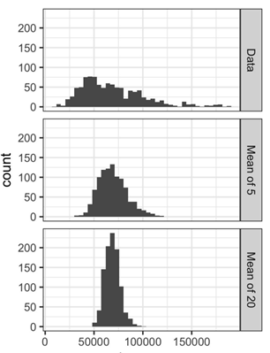
SAMPLING DISTRIBUTION of a STATISTICS
The term sampling distribution of a statistic refers to the distribution of some sample statistic, over many samples drawn from the same population.
Sampling distribution of a sample mean:
Given a dataset, take a sample, and then compute the mean.
Repeat this step many times (10000)
Plot the sampling distribution
It will look like a bell-shaped curve

Slide 13
Example
Dataset – 10, 8, 3, 7, 1, 2, 5, 6, 9, 4
Sample Size = 4
Sample 1 (with replacement) → 2, 2, 4, 6 = 3.5
Sample 2 (with replacement) → 9, 9, 10, 8 = 9.0
…….
Sample 10000 (with replacement) → 5, 6, 5, 7 = 5.75

Slide 14
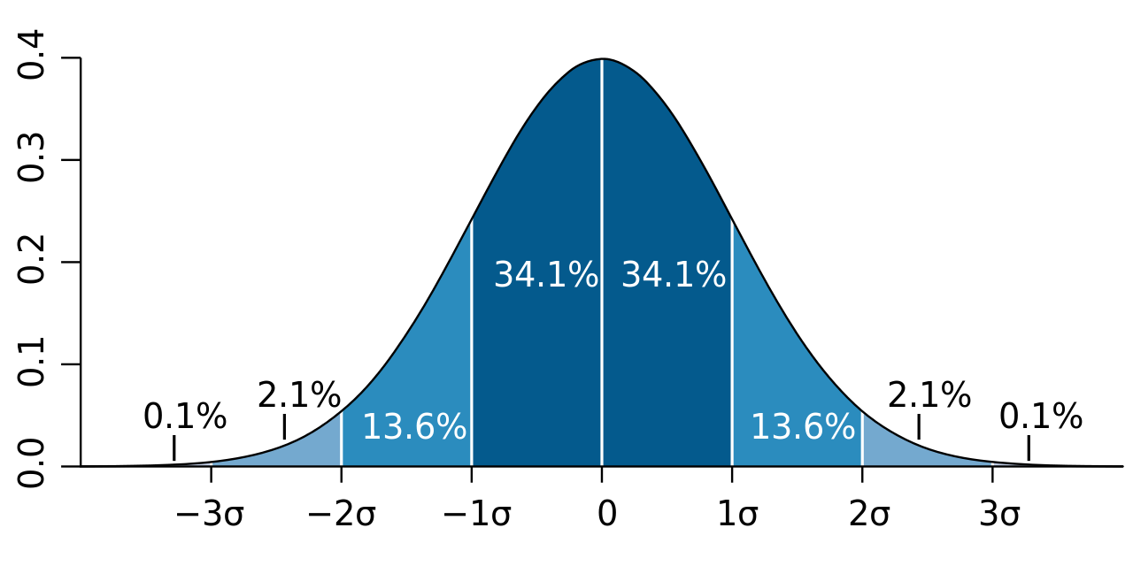
Normal distribution
Notes:
For the normal distribution, the values less than one standard deviation away from the mean account for 68.27% of the set; while two standard deviations from the mean account for 95.45%; and three standard deviations account for 99.73%.

Slide 15
Central limit theorem
The tendency of the sampling distribution to take on a normal shape as sample size rises.
We can prove it through an experiment!

Slide 16
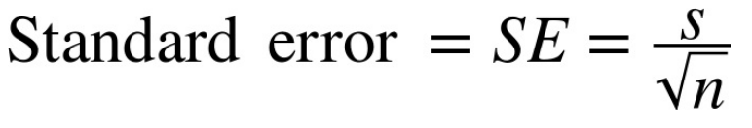
Standard error
The standard error is a single metric that sums up the variability in the sampling distribution for a statistic. The standard error can be estimated using a statistic based on the standard deviation s of the sample values, and the sample size n:

Slide 17
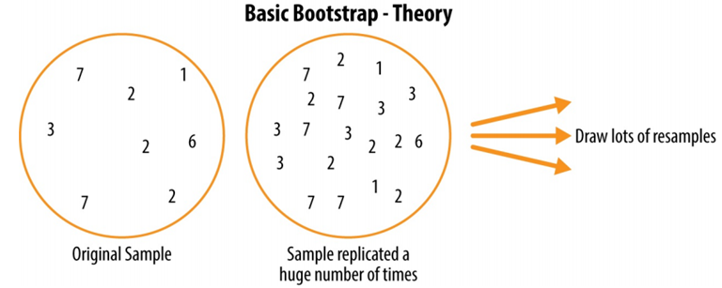
SAMPLING DISTRIBUTION: The Bootstrap method
One easy and effective way to estimate the sampling distribution of a statistic, or of model parameters, is to draw additional samples, with replacement, from the sample itself and recalculate the statistic or model for each resample.

Slide 18
Calculating standard error using bootstrap method
Draw a sample value, record, replace it.
Repeat n times.
Record the mean of the n resampled values.
Repeat steps 1–3 for R times.
Use the R results to:
Calculate their standard deviation (this estimates sample mean standard error).
Produce a histogram or boxplot.
Find a confidence interval.

Slide 19
CONFIDENCE INTERVAL FROM BOOTSTRAPING
Objective: Finding the mean age of the undergraduate students of the CSE Department.
From the population (2000 students) → choose 20 data points (sample set)
From the sample (20 data points) → resampling the dataset n times (n = 100)
From the resample dataset (100 data points) → calculate the mean
Repeat R times
(R = 1000)
1000 mean values → 18.5, 19.6, 21.1, ……… → Sampling Distribution of the Mean
Further, calculate the standard deviation.
Then, we can calculate the standard error, SE = standard deviation / SQRT (n)
We can also find the confidence interval.
Confidence Interval → A range of value, representing the mean, is associated with a probability P (confidence level) indicating that the mean would be in the given range with P probability.

Slide 20
Confidence Interval: 17.5 – 18.5 with 90% confidence level.
It means that if we draw the samples and follow the bootstrap method to calculate the mean then out of 100 times, 90 times the value will be within the range of 17.5 to 18.5.
The confidence interval helps us to infer the population statistics (mean) based on the sampling distribution.

Slide 21
Confidence interval
A confidence interval, in statistics, refers to the probability (confidence level) that a population parameter will fall between a set of values for a certain proportion of times.
Confidence intervals measure the degree of uncertainty or certainty in a sampling method.
It tells you how confident you can be that the results from a poll or survey reflect what you would expect to find if it were possible to survey the entire population.
Confidence interval at 95% confidence level: It means that should you repeat an experiment or survey over and over again, 95 percent of the time your results will match the results you get from a population (in other words, your statistics would be sound!)

Slide 22
CONFIDENCE INTERVAL using Bootstrap method
Draw a random sample of size n with replacement from the data (a resample).
Record the statistic of interest for the resample.
Repeat steps 1–2 for many (R) times.
For an x% confidence interval, trim [(1 – [x/100]) / 2]% of the R resample results from either end of the distribution.
The trim points are the endpoints of an x% bootstrap confidence interval.

Slide 23
Useful resources
Chapter 2, Practical Statistics for Data Scientists by Bruce and Bruce

Slide 24
Thank you

