Slide 1
Diagnosing ML System: Bias, Variance and Regularization

Slide 2
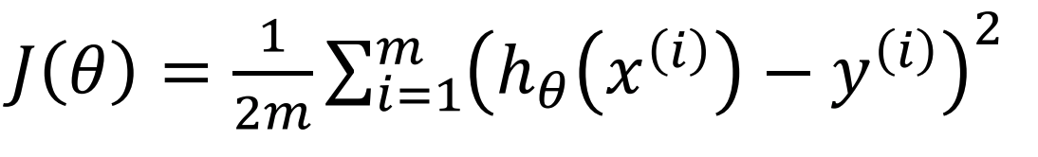
Debugging a learning algorithm
You have built an awesome linear regression model
Work perfectly on the training data
Source: Andrew Ng

Slide 3
Debugging a learning algorithm
You have built you awesome linear regression model predicting price
Work perfectly on you testing data
Then it fails miserably when you test it on the new data you collected
Source: Andrew Ng

Slide 4
Debugging a learning algorithm
You have built you awesome linear regression model predicting price
Work perfectly on you testing data
Then it fails miserably when you test it on the new data you collected
What to do now?
Source: Andrew Ng

Slide 5
Things You Can Try
Get more data
Try different features
Try tuning your hyperparameter

Slide 6
Things You Can Try
Get more data
Try different features
Try tuning your hyperparameter
But which should I try first?

Slide 7
Diagnosing Machine Learning System
Figure out what is wrong first
Diagnosing your system takes time, but it can save your time as well
Ultimate goal: low generalization error → Regularization

Slide 8
Evaluate Your Hypothesis: Regression
Price ($)
Price ($)
Price ($)
Size (ft)
Size (ft)
Size (ft)
Source: Andrew Ng

Slide 9
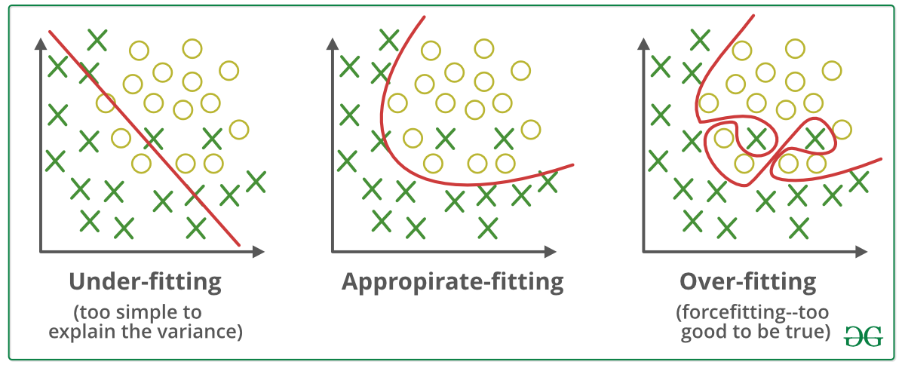
Evaluate Your Hypothesis: Classification

Slide 10
Regularization: A solution to Overfitting
Overfitting is a phenomenon that occurs when a Machine Learning model is constraint to training set and not able to perform well on unseen data.
Regularization is a technique used to reduce the errors by fitting the function appropriately on the given training set and avoiding overfitting. The commonly used regularization techniques are :
L1 regularization → LASSO Regression
L2 regularization → RIDGE Regression

Slide 11

Evaluate Your Hypothesis
Price ($)
Price ($)
Price ($)
Size (ft)
Size (ft)
Size (ft)
Underfit
Just right
Overfit
Source: Andrew Ng

Slide 12
Model Selection
Model does not generalize to unseen data
Fail to predict things that are not in training sample
Pick a model that has lower generalization error

Slide 13
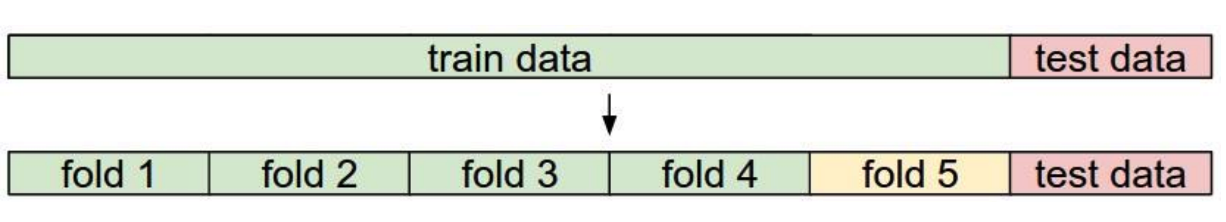
Cross Validation
Model does not generalize to unseen data
Fail to predict things that are not in training sample
Pick a model that has lower generalization error
How to evaluate generalization error?

Slide 14
Model Selection
Model does not generalize to unseen data
Fail to predict things that are not in training sample
Pick a model that has lower generalization error
How to evaluate generalization error?
Split your data into train, validation, and test set.
Use test set error as an estimator of generalization error

Slide 15
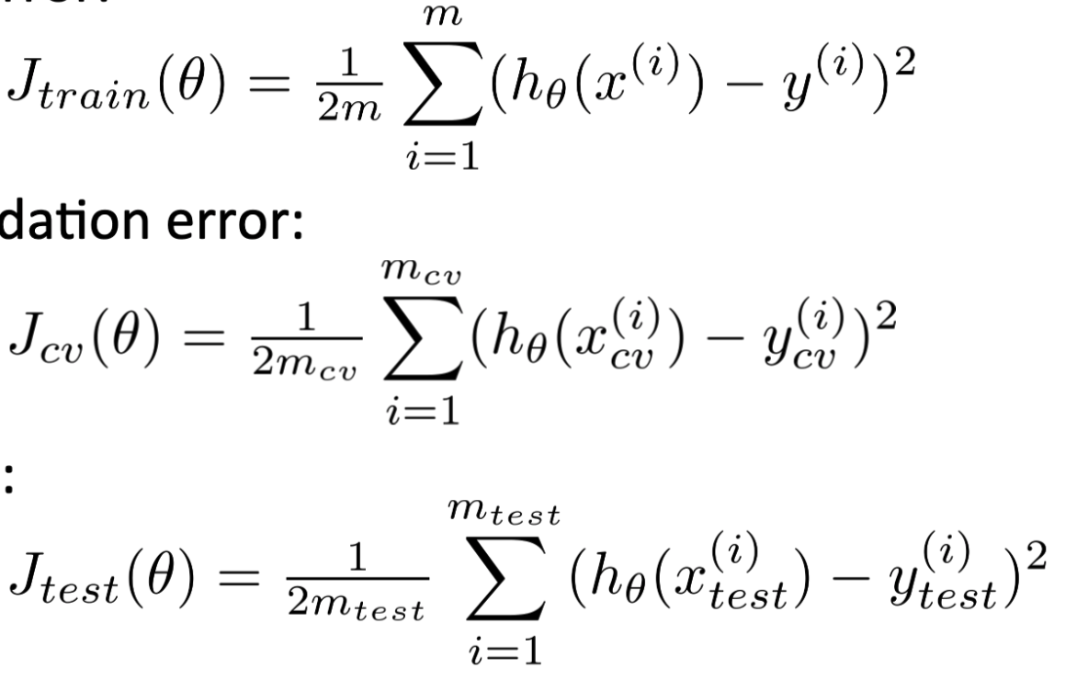
Model Selection
Training error
Validation error
Test error

Slide 16
Model Selection
Training error
Validation error
Test error
Procedure:
Step 1. Train on training set
Step 2. Evaluate validation error
Step 3. Pick the best model based on Step 2.
Step 4. Evaluate the test error

Slide 17
Bias/Variance Trade-off
Price ($)
Price ($)
Price ($)
Size (ft)
Size (ft)
Size (ft)
Underfit
Overfit
Just right
Source: Andrew Ng

Slide 18
Bias vs. Variance
We can define bias as the error between average model prediction and the ground truth. Moreover, it describes how well the model matches the training data set:
A model with a higher bias would not match the data set closely.
A low bias model will closely match the training data set.
Variance refers to the changes in the model when using different portions of the training data set/unseen data. It is the variability in the model prediction—how much the ML function can adjust depending on the given data set.

Slide 19
Bias/Variance Trade-off
Price ($)
Price ($)
Price ($)
Size (ft)
Size (ft)
Size (ft)
Underfit
High bias
Overfit
High Variance
Just right
Source: Andrew Ng

Slide 20
Bias/Variance Trade-off
Price ($)
Price ($)
Price ($)
Size (ft)
Size (ft)
Size (ft)
Underfit
High bias
Too simple
Overfit
High Variance
Too Complex
Just right
Source: Andrew Ng

Slide 21
Linear Regression with Regularization
Price ($)
Price ($)
Price ($)
Size (ft)
Size (ft)
Size (ft)
Underfit
High bias
Too simple
Too much regularization
Overfit
High Variance
Too Complex
Too little regularization
Just right
Source: Andrew Ng

Slide 22
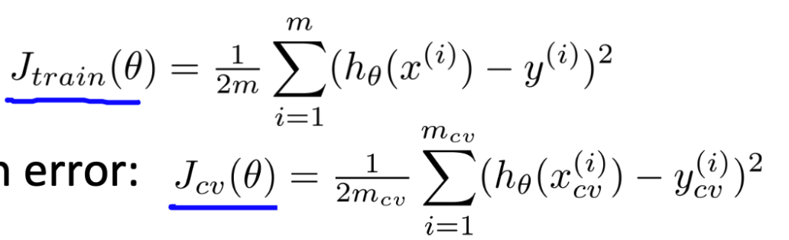
Bias / Variance Trade-off
Training error
Cross-validation error
Loss
Degree of Polynomial
Source: Andrew Ng

Slide 23
Bias / Variance Trade-off
Training error
Cross-validation error
High bias
High Variance
Loss
Degree of Polynomial

Slide 24
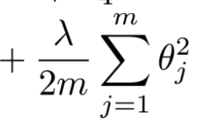
Bias / Variance Trade-off with Regularization
Training error
Cross-validation error
Loss
λ
Source: Andrew Ng

Slide 25
Bias / Variance Trade-off with Regularization
Training error
Cross-validation error
High Variance
High bias
Loss
λ
Source: Andrew Ng

Slide 26
Problem: Fail to Generalize
Should we get more data?

Slide 27
Problem: Fail to Generalize
Should we get more data?
Getting more data does not always help

Slide 28
Problem: Fail to Generalize
Should we get more data?
Getting more data does not always help
How do we know if we should collect more data?

Slide 29
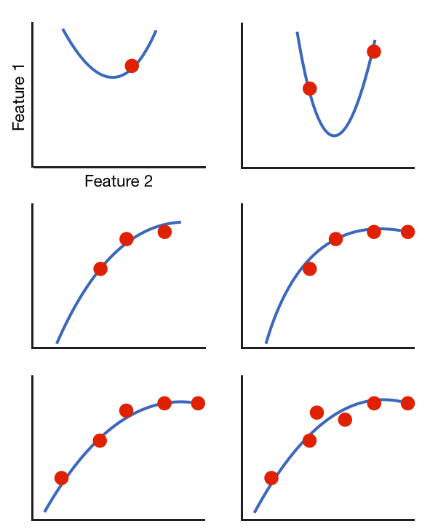
Learning Curve
m=1
m=2
m=3
m=4
m=5
m=6

Slide 30
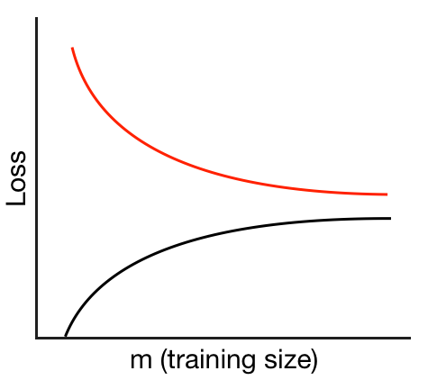
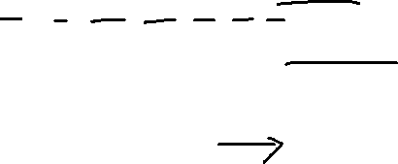
Learning Curve
m=1
m=2
m=3
m=4
m=5
m=6

Slide 31
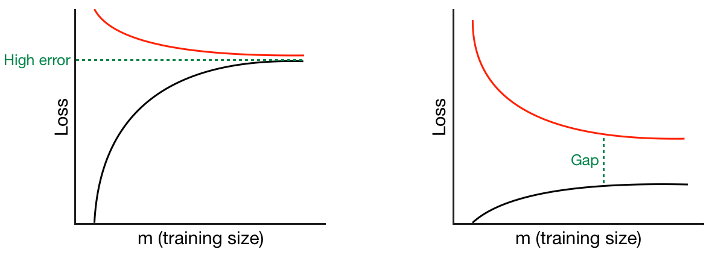
Learning Curve

Slide 32
Learning Curve
Underfit
High bias
Overfit
High Variance

Slide 33
Learning Curve
Does adding more data help?
Price ($)
Size (ft)
Underfit
High bias

Slide 34
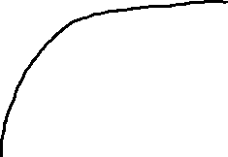
Learning Curve
Does adding more data help?
Price ($)
Size (ft)
Underfit
High bias

Slide 35
Learning Curve
Does adding more data help?
Price ($)
Size (ft)
Underfit
High bias

Slide 36
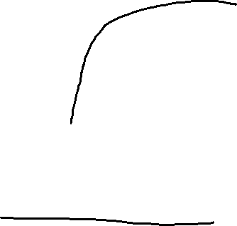
Learning Curve
Does adding more data help?
Price ($)
Price ($)
Size (ft)
Size (ft)
More data doesn't help when your model has high bias

Slide 37
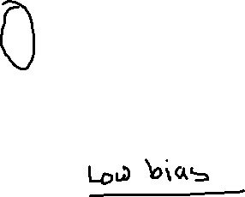
Learning Curve
Does adding more data help?
Price ($)
Size (ft)
Overfit
High Variance

Slide 38
Learning Curve
Does adding more data help?
Price ($)
Size (ft)
Overfit
High Variance

Slide 39
Learning Curve
Does adding more data help?
Price ($)
Price ($)
Size (ft)
Size (ft)
More data is likely to help when your model has high variance

Slide 40
Algorithm | Bias | Variance
Linear Regression | High Bias | Less Variance
Decision Tree | Low Bias | High Variance
Bagging | Low Bias | High Variance (Less than Decision Tree)
Random Forest | Low Bias | High Variance (Less than Decision Tree and Bagging)

Slide 41
Things You Can Try
Get more data
When you have high variance
Try different features
Adding feature helps fix high bias
Using smaller sets of feature fix high variance
Try tuning your hyperparameter
Decrease regularization when bias is high
Increase regularization when variance is high

Slide 42
Things You Can Try
Get more data
When you have high variance
Try different features
Adding feature helps fix high bias
Using smaller sets of feature fix high variance
Try tuning your hyperparameter
Decrease regularization when bias is high
Increase regularization when variance is high
Analyze your model before you act

Slide 43
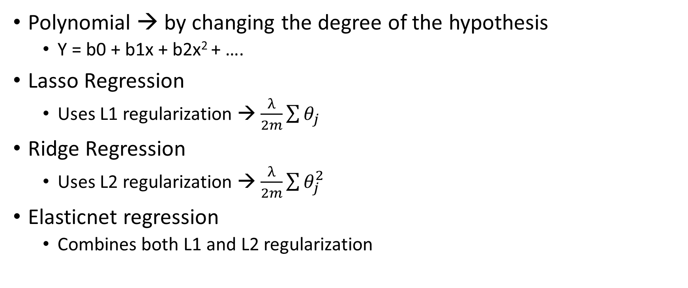
Types of Linear Regression (with Regularization Parameter)
Polynomial → by changing the degree of the hypothesis
Y = b0 + b1x + b2x² + ….
Lasso Regression
Uses L1 regularization → $\frac{λ}{2m}\sum{θ_{j}}$
Ridge Regression
Uses L2 regularization → $\frac{λ}{2m}\sum{θ_{j}^{2}}$
Elasticnet regression
Combines both L1 and L2 regularization

