Slide 1
CSE 350 Data Communication
Lecture 1: Introduction

Slide 2
What is data communication?
Data refers to information.
Data communications are
the exchange of data between two devices
Focus on transmission medium such as wire cable.
Fundamental characteristics of a data communication system:
Delivery – must deliver data to correct destination.
Accuracy – must deliver the data accurately.
Timelines – must deliver data in a timely manner.
Jitter – refers to the variation in packet arrival time.
.

Slide 3
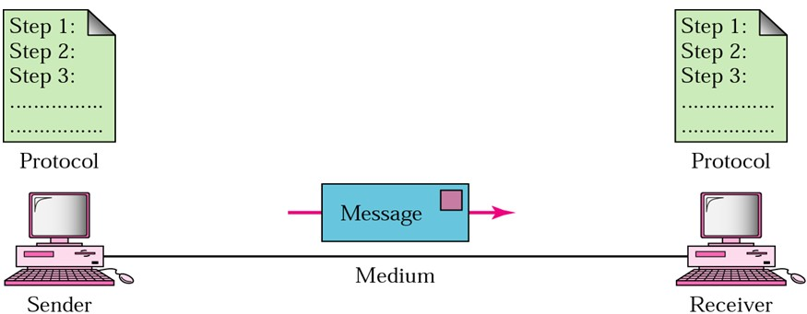
Components of a Data Communication System
Components of a Data Communication System:
Message – the information to be communicated.
Sender – device that sends the message.
Receiver – device that receives the message.
Transmission medium – physical path by which a message travels from sender to receiver.
Protocol –a set of rules that govern data communication.

Slide 4
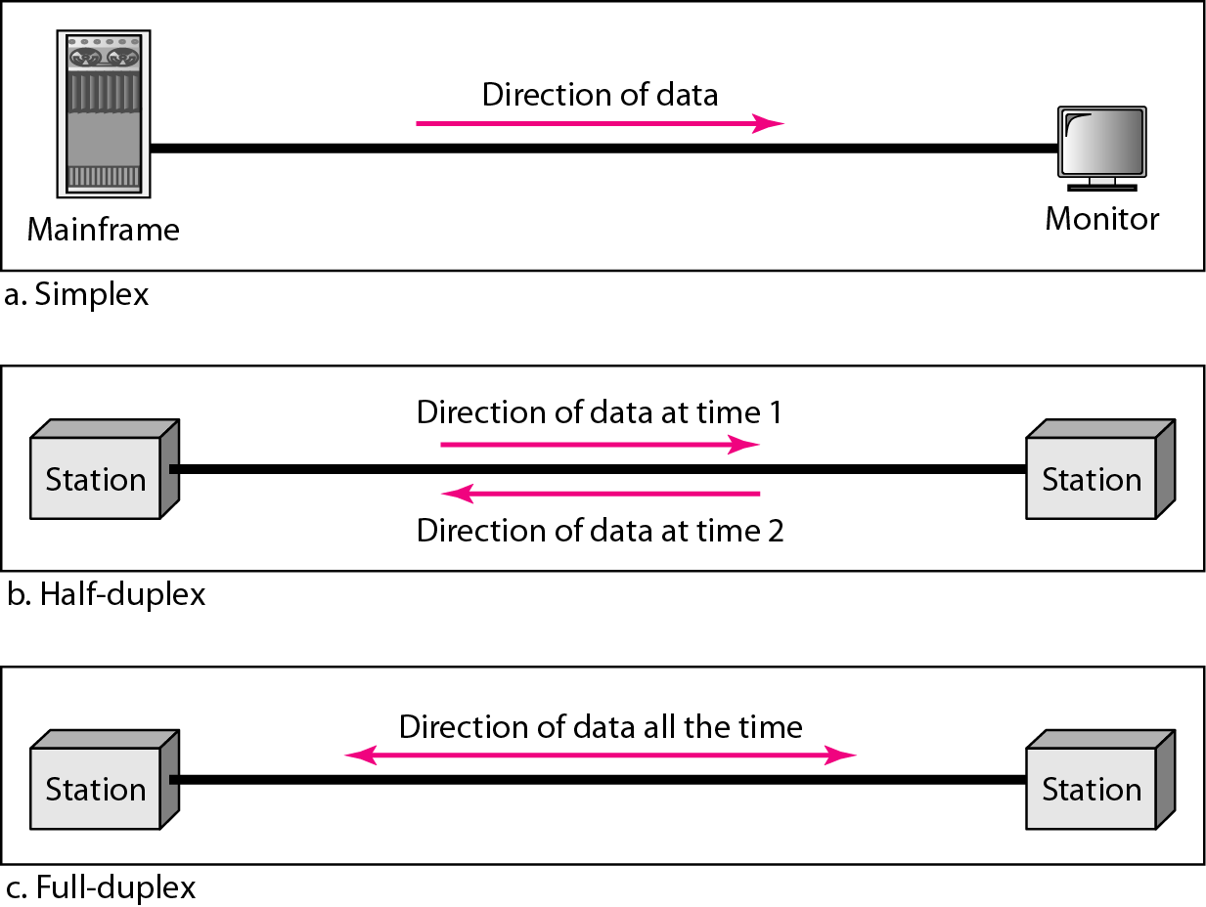
Data Flow (simplex, half-duplex, and full-duplex)
Simplex:
keyboard and
monitor.
Half- duplex:
Walkie- talkies
Full- duplex:
Telephone line

Slide 5
NETWORKS
A network is a set of devices (often referred to as nodes) connected by communication links.
A node can be a computer, printer, or any other device capable of sending
and/or receiving data generated by other nodes on the network.
A link can be a cable, air, optical fiber, or any medium which can transport a signal carrying information.
Network Criteria:
Performance
Depends on Network Elements
Measured in terms of Delay and Throughput
Reliability
Failure rate of network components
Measured in terms of availability/robustness
Security
Data protection against corruption/loss of data due to:
Errors Malicious users

Slide 6
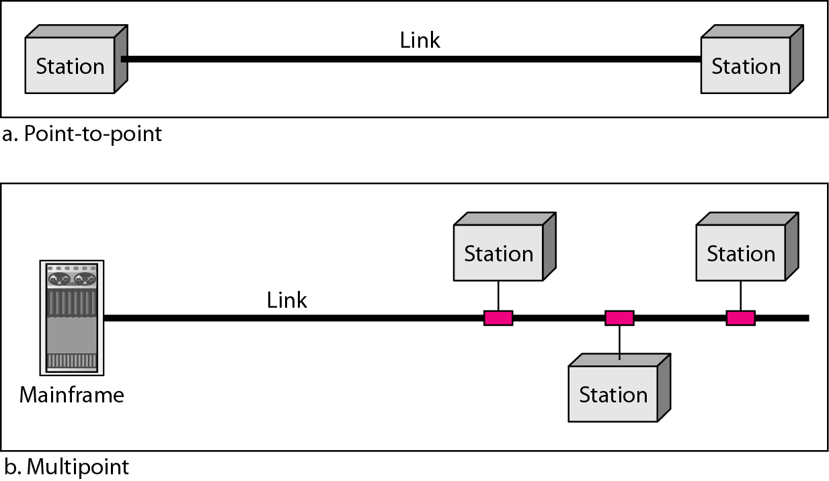
Physical Structures
Type of Connection
Point to Point – provide a dedicated link between two devices(single transmitter and receiver).
Multipoint - multiple recipients of single transmission. share a single link.

Slide 7
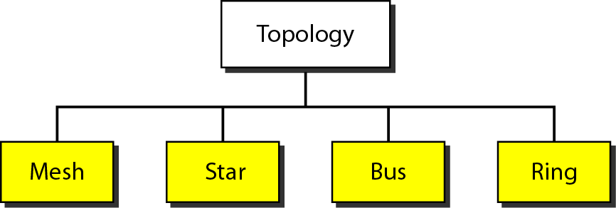
Physical Topology
Physical Topology
The way of in which a network is laid out physically.
Connection of devices
Type of transmission - unicast, mulitcast, broadcast
Figure- Categories of topology

Slide 8
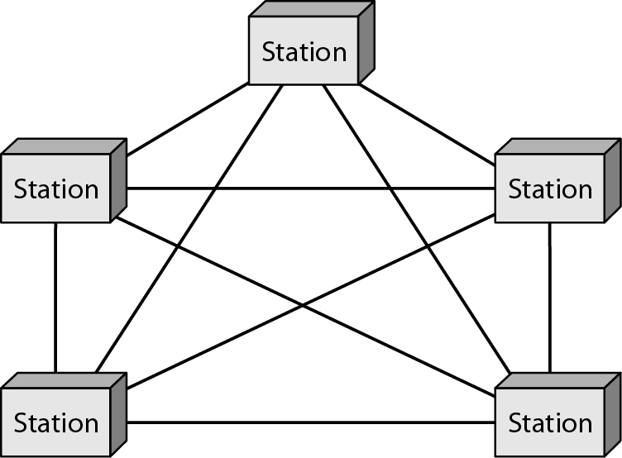
Physical Topology
Mesh topology:
Point to point connection.
F. ully connected.
Every device connect to other
devices.
Advantages:
Guarantees that each connection
carry its own data load.
Robust.
Advantage of privacy and security.
Easy to fault identification and
false isolation.
Disadvantages:
Large amount of cabling and I/O ports are needed.
Use: telephone regional office.
Figure-A fully mesh topology (five devices)

Slide 9
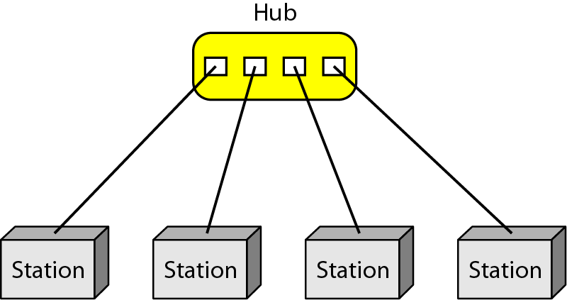
Physical Topology
Star topology:
Point to point connection.
A. central controller called hub.
Devices are not directly connect to
one another.
Advantages:
Robustness.
Easy to fault identification and
false isolation.
Far less cable than a mesh topology.
Disadvantages:
Depends the whole topology on one
Single point, Hub.
Use: LAN
Figure-A Star topology (four stations)

Slide 10
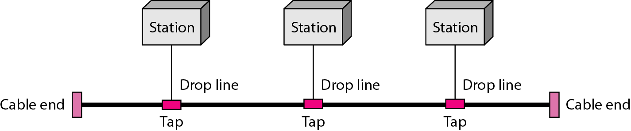
Physical Topology
Bus topology:
Multipoint connection.
O. ne long cable acts as a backbone to link all the devices.
Advantages:
Ease of installation.
Backbone cable can be laid along the most efficient path.
A bus uses less cable than a mesh or star topology.
Disadvantages:
Difficult reconnection and fault isolation.
A fault or break in the bus cable stops all transmission.
Use: Ethernet LAN.
Figure-A Bus topology (three stations)

Slide 11
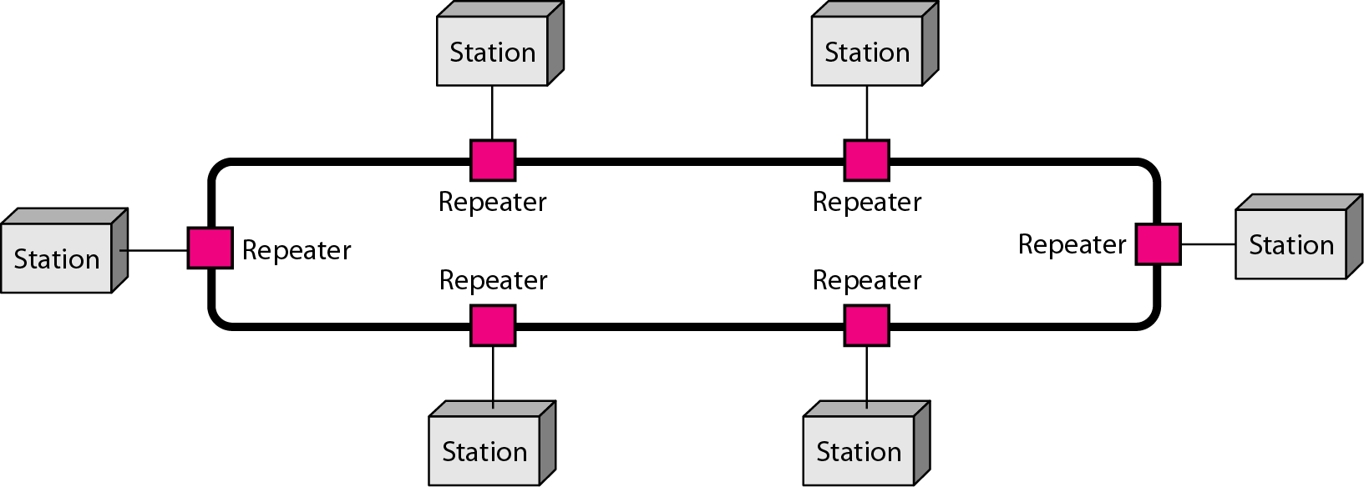
Physical Topology
Ring topology:
Point to point connection with only the two devices on either side of it.
A. dvantages:
Relatively easy to install and reconfigure.
To add or delete a device requires changing only two connections.
Disadvantages:
Unidirectional traffic.
In a simple ring, a break in the ring can disable the entire network.
Use: Token ring network.
Figure-A Ring topology (six stations)
Data Communication

Slide 12
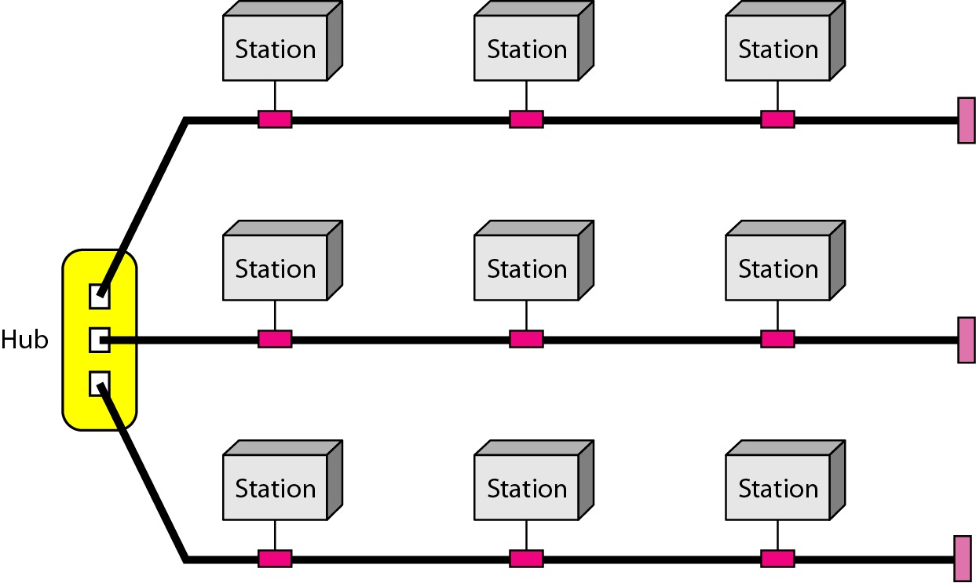
Physical Topology
Hybrid topology:
a star backbone with bus networks.
Figure-A Hybrid topology

Slide 13
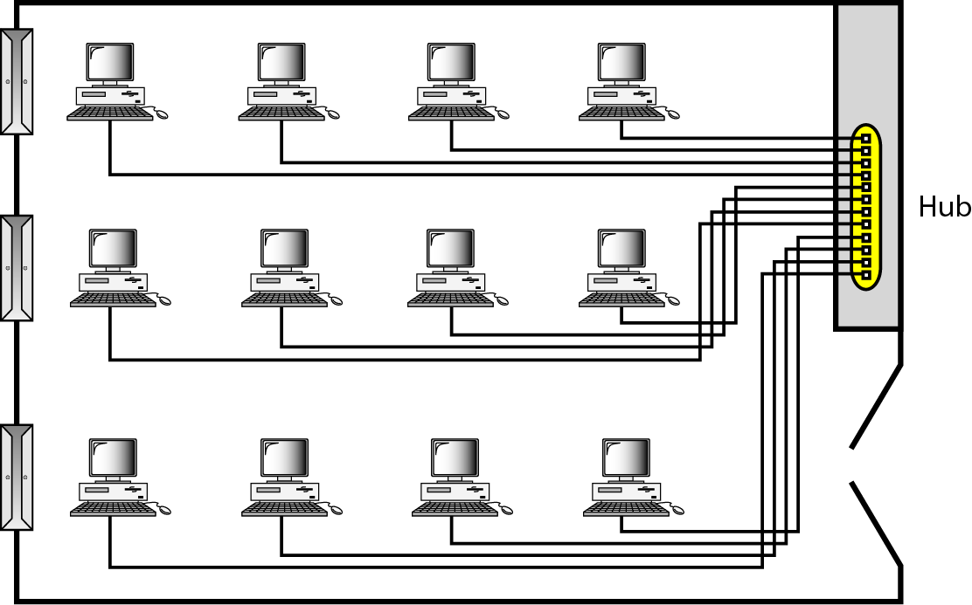
Categories of Networks
Local Area Networks (LANs)
Short distances.
. Designed to provide local interconnectivity.
Figure- An isolated LAN connecting 12 computers to a hub in a closet

Slide 14
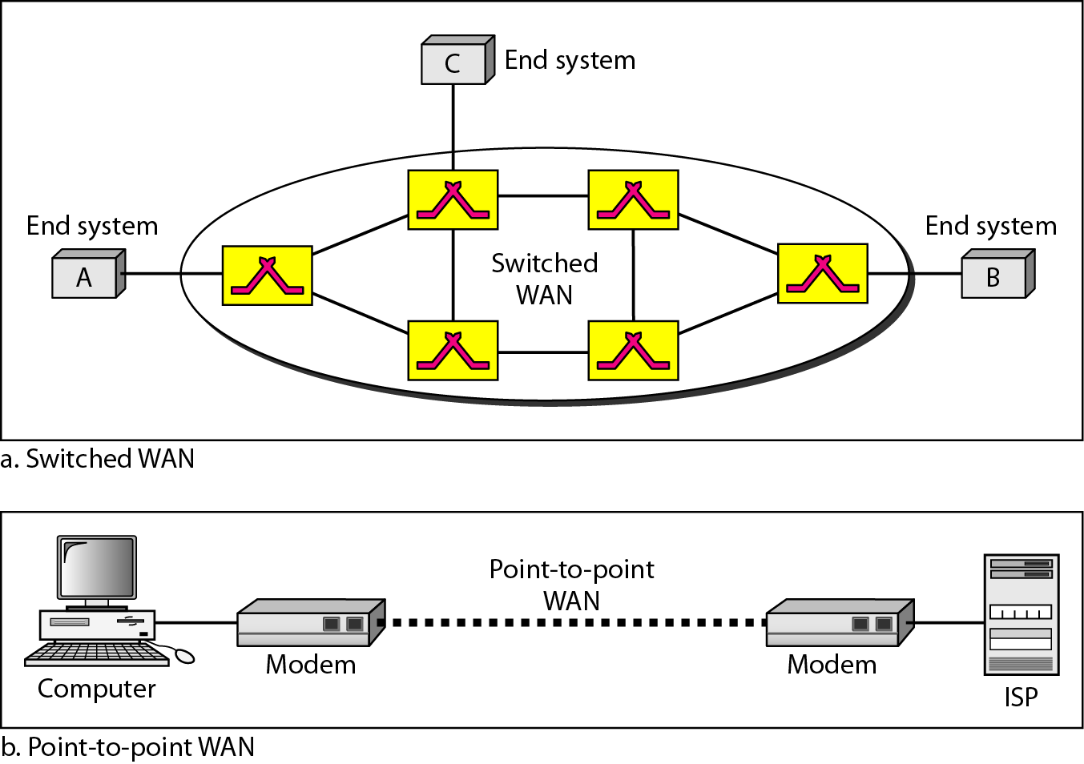
Categories of Networks
Wide Area Networks (WANs)
Long distances.
.Provide connectivity over large areas.

Slide 15
Categories of Networks
Metropolitan Area Networks (MANs)
Provide connectivity over areas such as a city, a campus.
.
THE INTERNET
The Internet has revolutionized many aspects of our daily lives.
It has affected the way we do business as well as the way we spend our
leisure time.
The Internet is a communication system that has brought a wealth of information to our fingertips and organized it for our use.

Slide 16
Protocols
A protocol is synonymous with rule.
It consists of a set of rules that govern data communications.
It de.termines what is communicated, how it is communicated and when it is
communicated.
Elements of a Protocol
Syntax
Structure or format of the data.
Indicates how to read the bits - field delineation.
Semantics
Interprets the meaning of the bits.
Knows which fields define what action.
Timing
When data should be sent and what.
Speed at which data should be sent or speed at which it is being received.

Slide 17
Thank you

