Slide 1

Artificial intelligence
Hossam Elsayed MohaMED Fakher
0 1 2 7 7 8 8 0 6 7 8
Gmail
GitHUB
Linkedin
Kaggle
S e s s I o n 1
Machine Learning

Slide 2
Agenda
Machine Learning
Types Of Machine Learning
Supervised
Unsupervised
Machine Learning Algorithms
Unsupervised (Cluster)
Steps Of Machine Learning
Evaluation Metrics
Regression
Classification

Slide 3
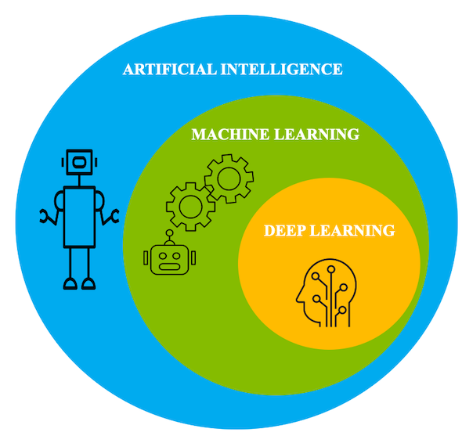
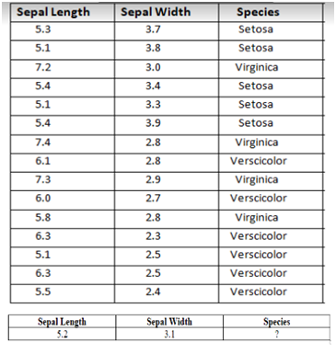
Machine Learning
is a type of artificial intelligence (AI) that allows software applications to become more accurate at predicting outcomes without being explicitly programmed to do so.

Slide 4
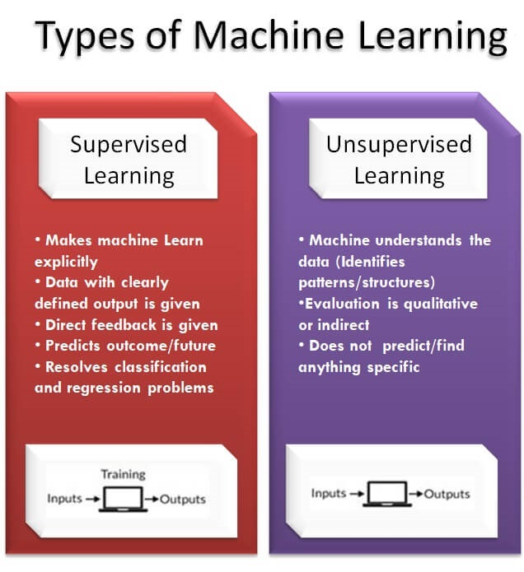
Types Of Machine Learning

Slide 5
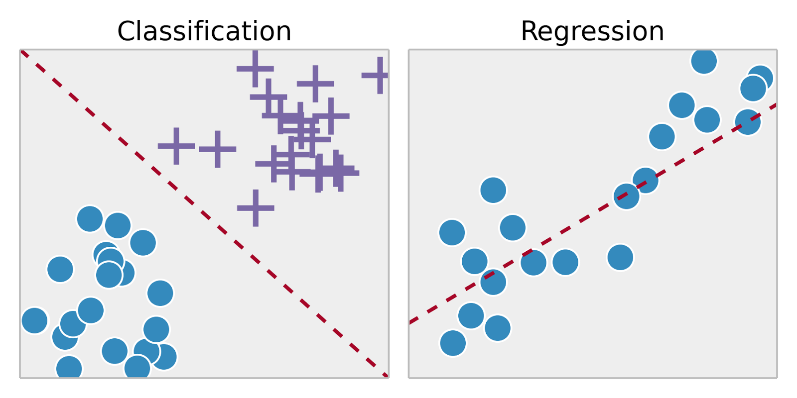
Supervised
Regression ( التوقع )
Classification (التصنيف )

Slide 6
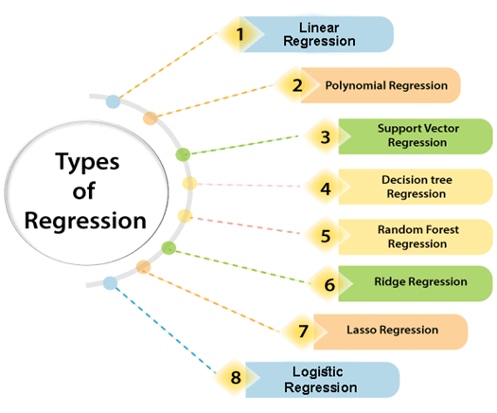
Machine Learning Algorithms

Slide 7
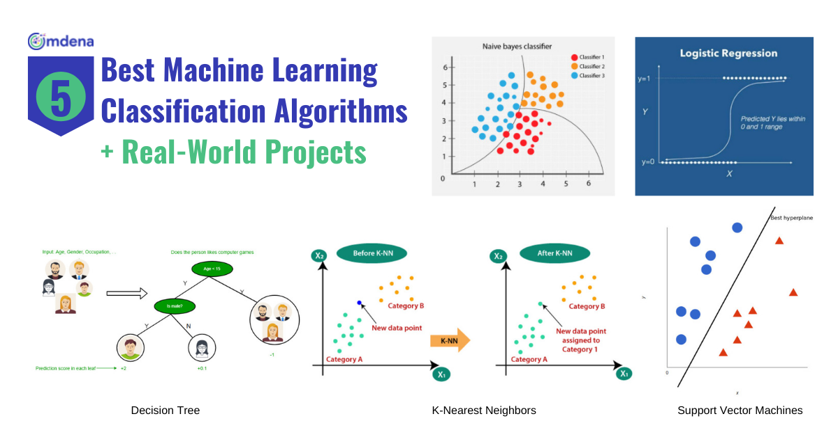
Machine learning algorithms

Slide 8
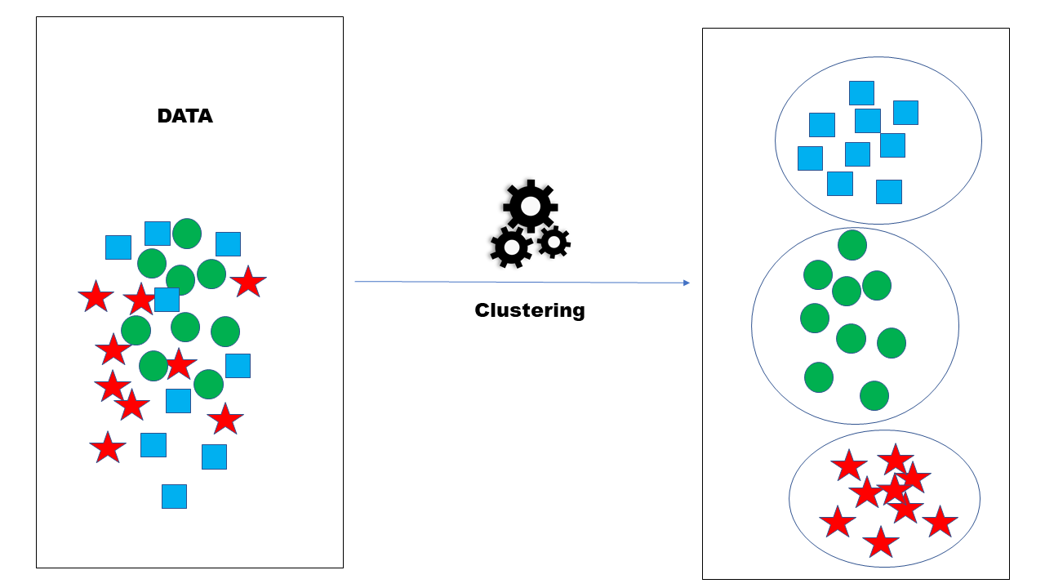
Un Supervised
cluster

Slide 9
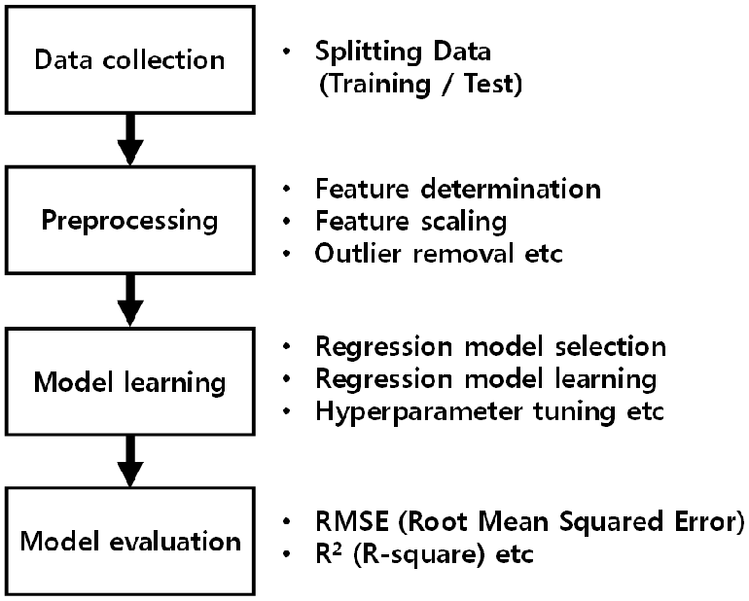
Steps Of Machine Learning

Slide 10
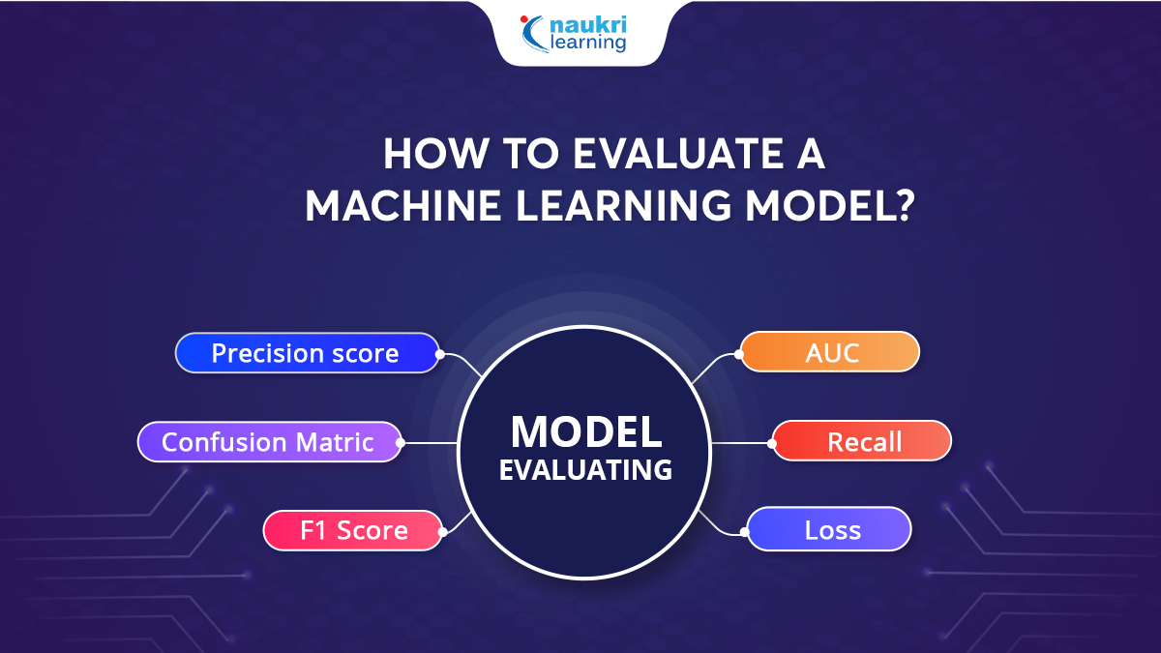
Evaluation Metrics

Slide 11
Evaluation Metrics
Regression

Slide 12
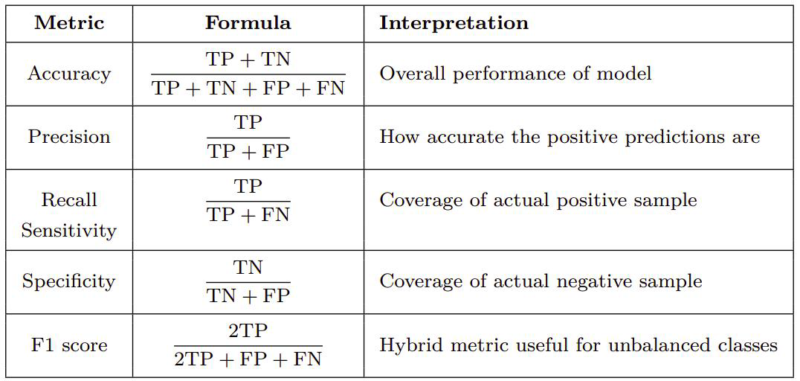
Evaluation Metrics
Classification
Confusion Matrix

Slide 13
Overfitting And Underfitting

Slide 14
Coding
https://colab.research.google.com/drive/1dbjydjhhjvl4rsjoa9abkyjfest9cgdt
https://colab.research.google.com/drive/1bljvxjarq8enfahrqstfcdbnyzucadt0#scrollto=4ab25dfb
https://colab.research.google.com/drive/12ramayxqbcf_ggu38lydte8ui6iinklk#scrollto=a683bcef

Slide 15
Thanks for listening

