Slide 1
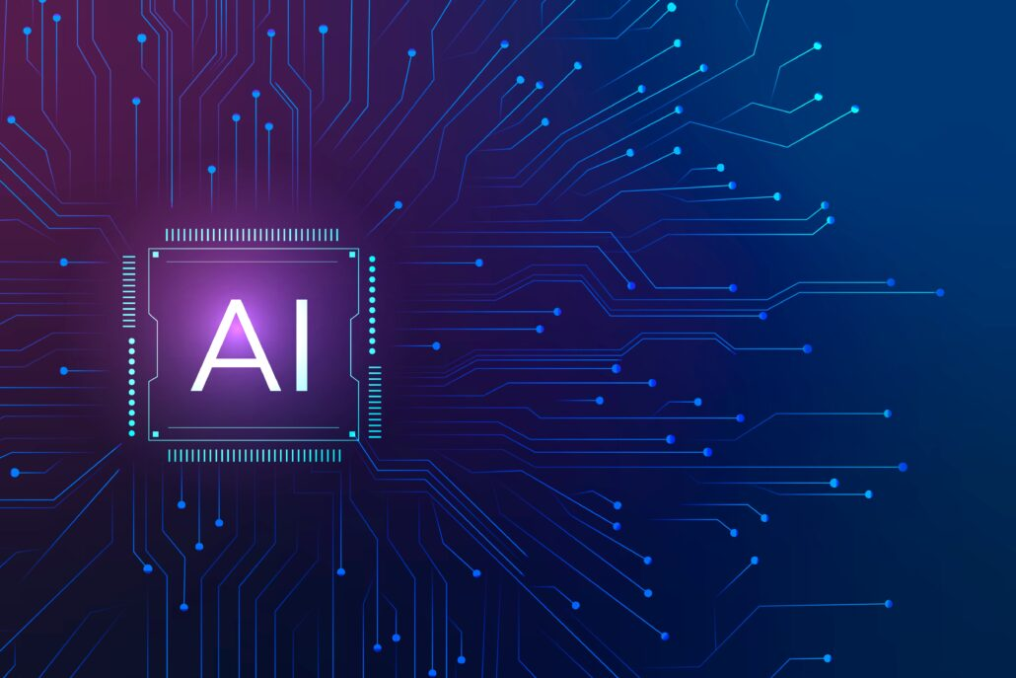
Artificial intelligence
Hossam Elsayed MohaMED Fakher
0 1 2 7 7 8 8 0 6 7 8
Gmail
GitHUB
Linkedin
Kaggle
S e s s I o n 4
Advanced CNN & TL

Slide 2
Complex Models CNN
input_A = keras.layers.Input(shape=[5], name="wide_input")
input_B = keras.layers.Input(shape=[6], name="deep_input")
hidden1 = keras.layers.Dense(30, activation="relu")(input_B)
hidden2 = keras.layers.Dense(30, activation="relu")(hidden1)
concat = keras.layers.concatenate([input_A, hidden2])
output = keras.layers.Dense(1, name="output")(concat)
model = keras.Model(inputs=[input_A, input_B], outputs=[output])

Slide 3
Complex Models CNN
input_A = keras.layers.Input(shape=[5], name="wide_input")
input_B = keras.layers.Input(shape=[6], name="deep_input")
hidden1 = keras.layers.Dense(30, activation="relu")(input_B)
hidden2 = keras.layers.Dense(30, activation="relu")(hidden1)
concat = keras.layers.concatenate([input_A, hidden2])
Aux_output = keras.layers.Dense(1, name="output")(hidden2 )
output = keras.layers.Dense(1, name="output")(concat)
model = keras.Model(inputs=[input_A, input_B], outputs=[output, Aux_output ])

Slide 4
imagenet
https://image-net.org/
ImageNet is an image database organized according to the WordNet hierarchy (currently only the nouns), in which each node of the hierarchy is depicted by hundreds and thousands of images. The project has been instrumental in advancing computer vision and deep learning research. The data is available for free to researchers for non-commercial use.
The most highly-used subset of ImageNet is the ImageNet Large Scale Visual Recognition Challenge (ILSVRC) 2012-2017 image classification and localization dataset. This dataset spans 1000 object classes and contains 1,281,167 training images, 50,000 validation images and 100,000 test images. This subset is available on Kaggle.

Slide 5
What Is Transfer Learning? (TL)
• Transfer learning generally refers to a process where a model trained on one problem is used in some way on a second related problem.
• One or more layers from the trained model are then used in a new model trained on the problem of interest.
Xception
VGG16
VGG19
ResNet50
InceptionV3
InceptionResNetV2
MobileNet
MobileNetV2
DenseNet
NASNet
We can use a pre-trained model as
1- Feature Extraction Mechanism.
2- Use Architecture
3- Train Partially

Slide 6
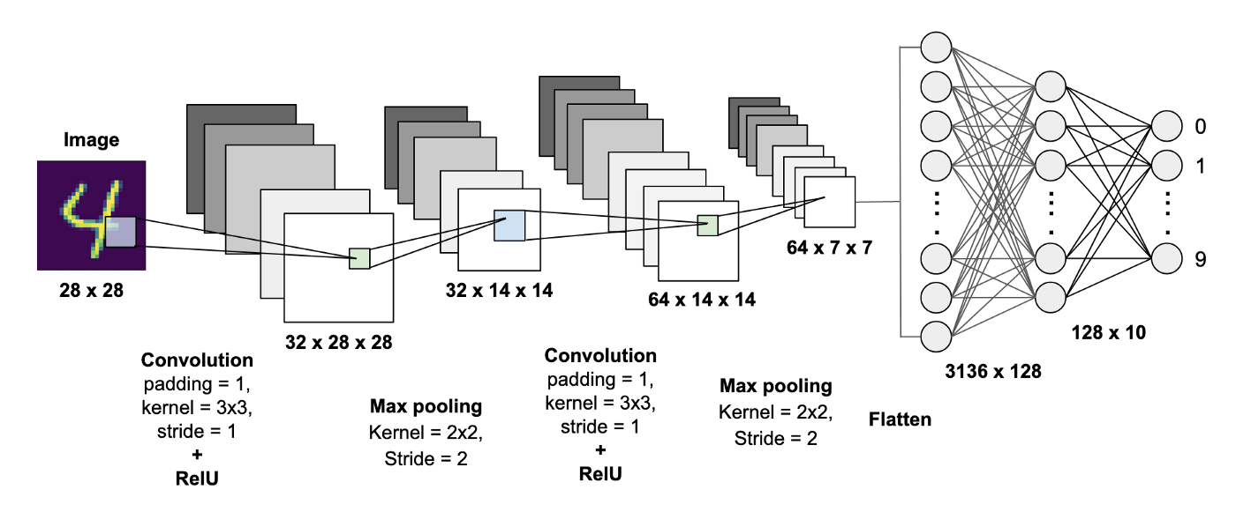
How call transfer learning?
import tensorflow as tf
from tensorflow import keras
model = keras.applications.vgg16.VGG16(weights=' imagenet‘,include_top=False,input_shape=(224,224,3))
include_top: whether to include the top layers of the network or not (False,True).
weights: one of None (random initialization) or 'imagenet' (pre-training on ImageNet).

Slide 7
feature extraction mechanism
import tensorflow as tf
from tensorflow import keras
model = keras.applications.vgg16.VGG16(weights='imagenet ' ,include_top=False ,input_shape=(224,224,3))
for layer in model.layers[:-1]:
layer.trainable = False

Slide 8
use architecture
import tensorflow as tf
from tensorflow import keras
model = keras.applications.vgg16.VGG16(weights=None ,include_top=False ,input_shape=(224,224,3))
for layer in model.layers[:-1]:
layer.trainable = True

Slide 9
train partially
import tensorflow as tf
from tensorflow import keras
model = keras.applications.vgg16.VGG16(weights='imagenet ' ,include_top=False ,input_shape=(224,224,3))
for layer in model.layers[:5]:
layer.trainable = False

Slide 10
LeNet-5

Slide 11
GoogLeNet (Inception)

Slide 12
VGG19

Slide 13
ResNet50

Slide 14
InceptionV3

Slide 15
Thanks for listening

