Slide 1

Artificial intelligence
Hossam Elsayed MohaMED Fakher
0 1 2 7 7 8 8 0 6 7 8
Gmail
GitHUB
Linkedin
Kaggle
S e s s I o n 1
Machine Learning

Slide 2
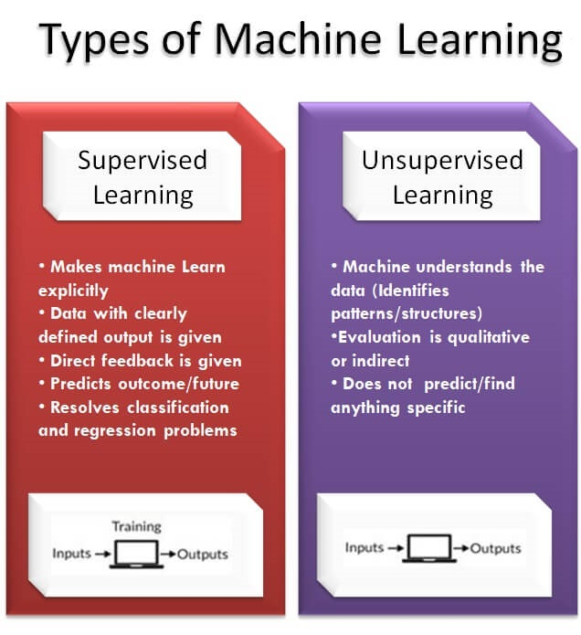
Machine Learning
is a type of artificial intelligence (AI) that allows software applications to become more accurate at predicting outcomes without being explicitly programmed to do so.

Slide 3
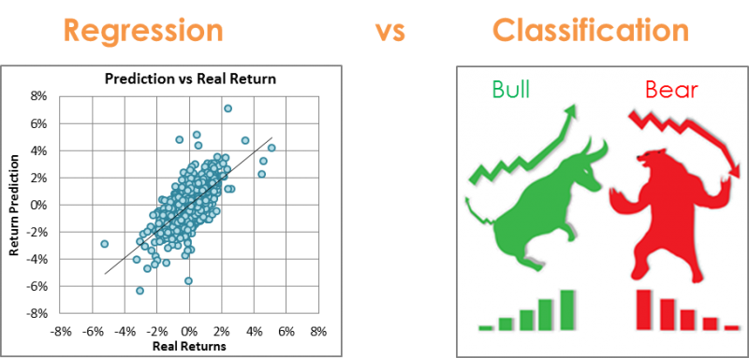
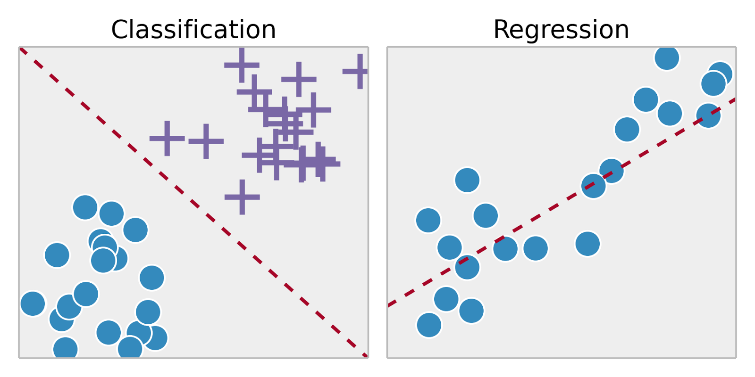
Supervised
Regression ( التوقع )
Classification (التصنيف )

Slide 4
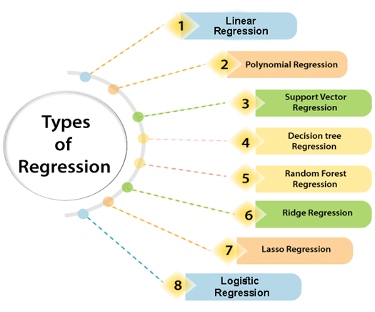
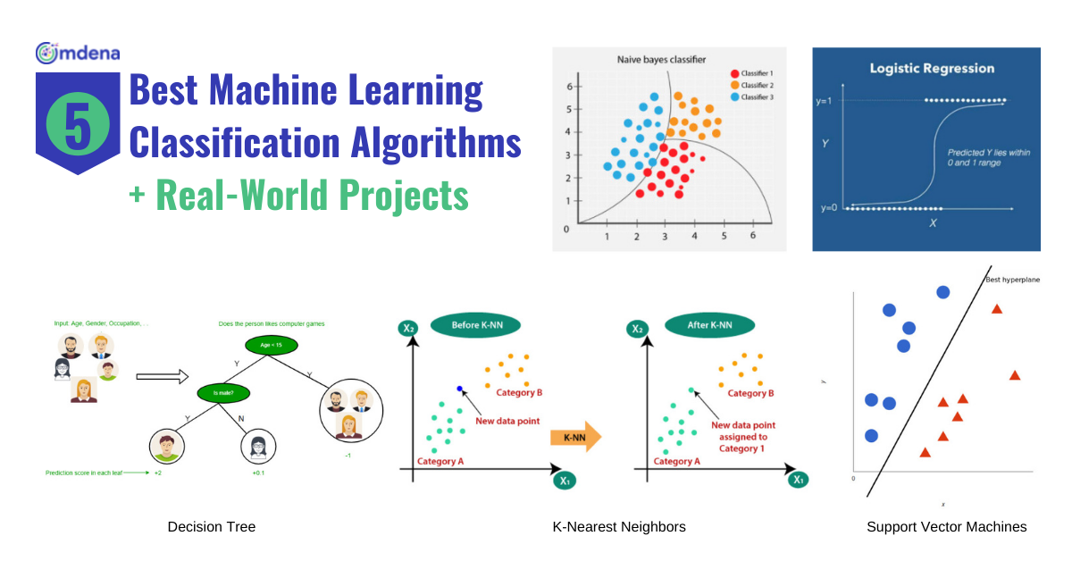
Machine learning algorithms

Slide 5
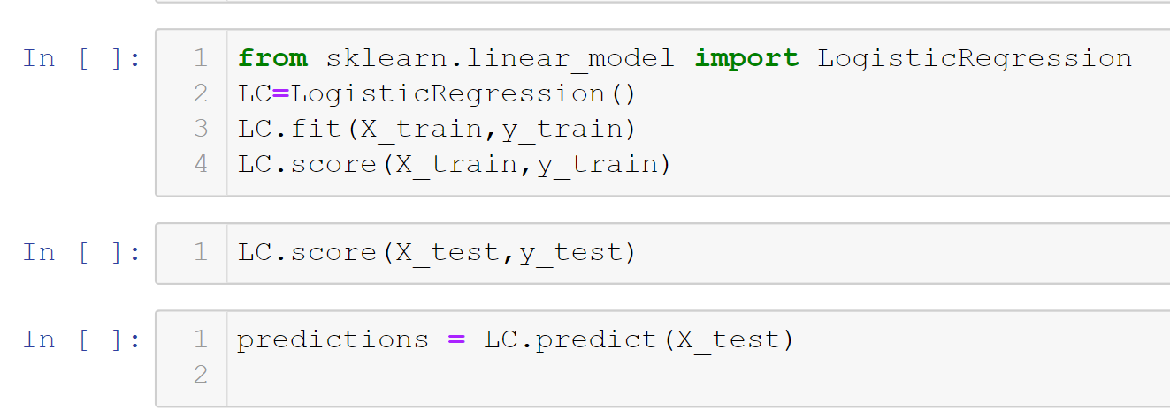
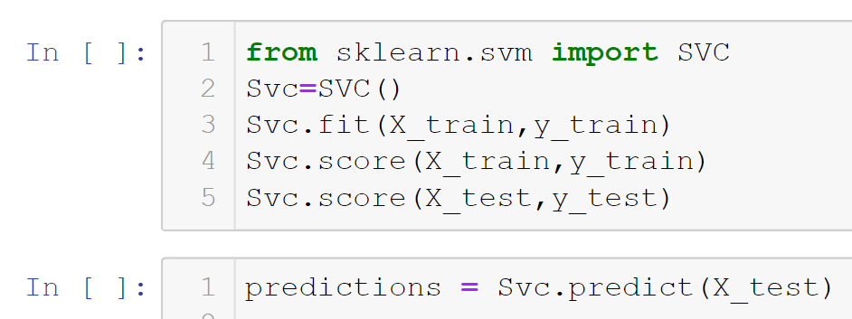
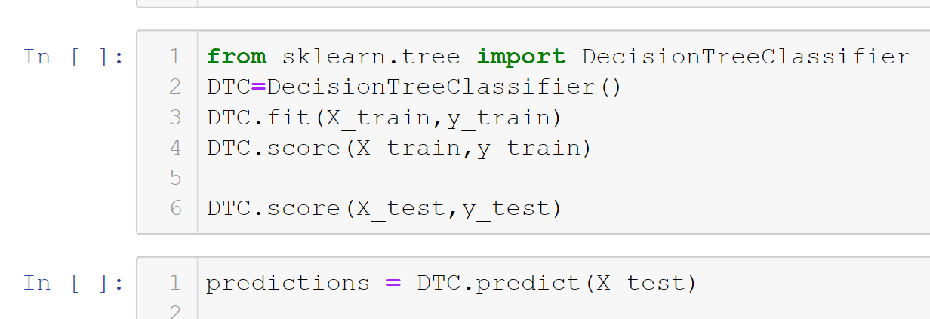
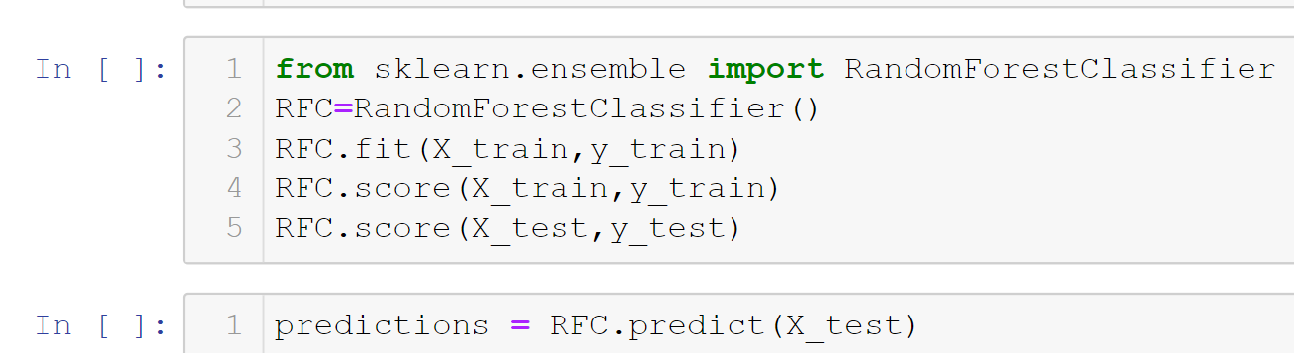

Slide 6
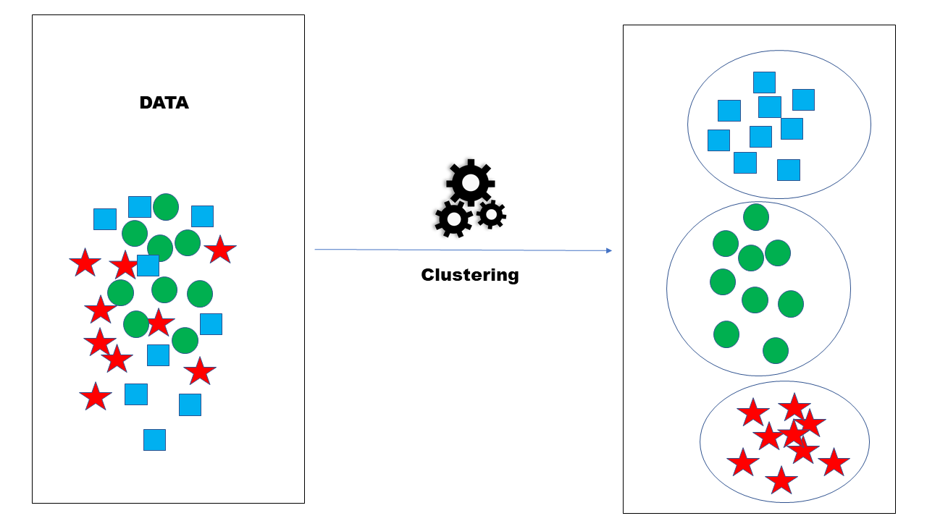
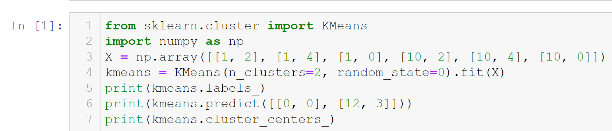
Un Supervised
cluster

Slide 7
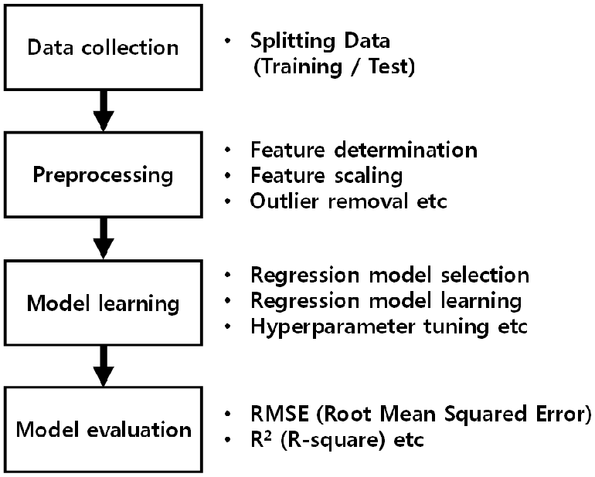
Steps of Machine learning

Slide 8
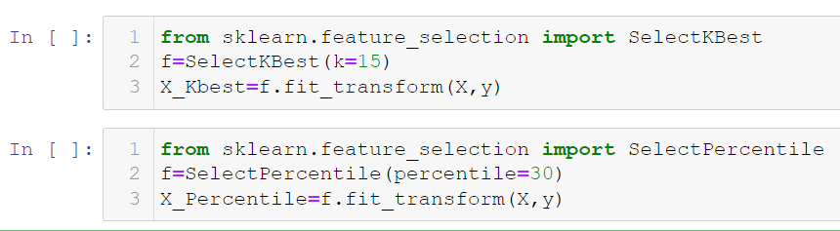
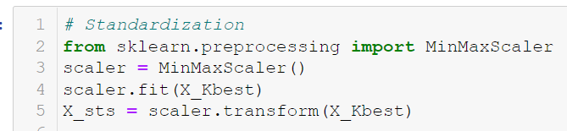
Splitting data
Feature determination (selection)
Feature scaling

Slide 9
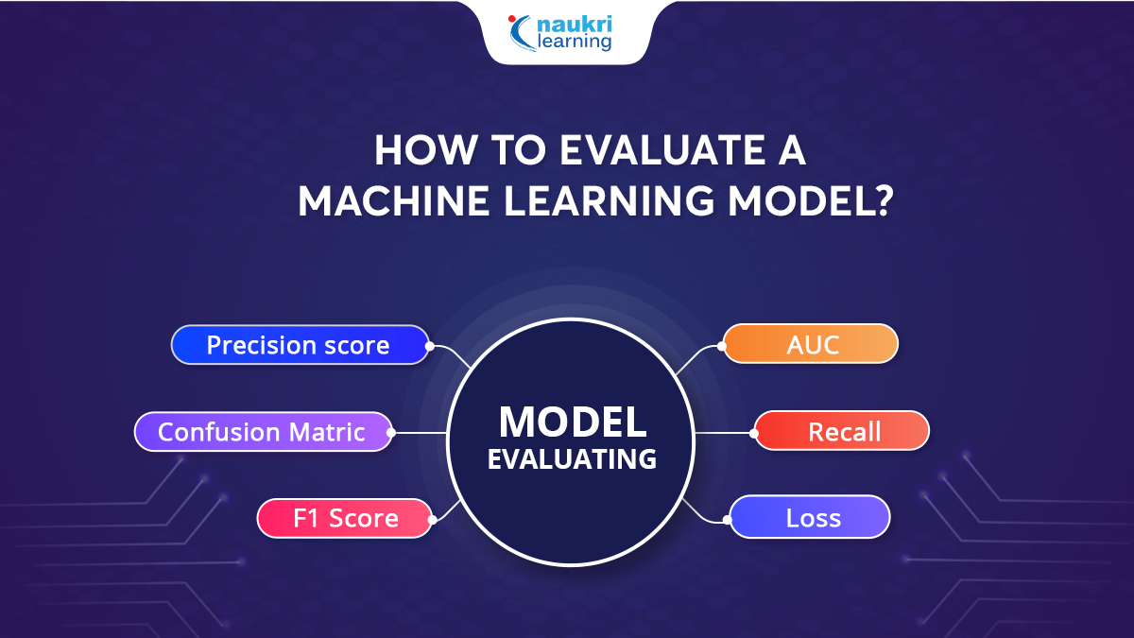
Evaluation Metrics

Slide 10
Evaluation Metrics
Regression

Slide 11
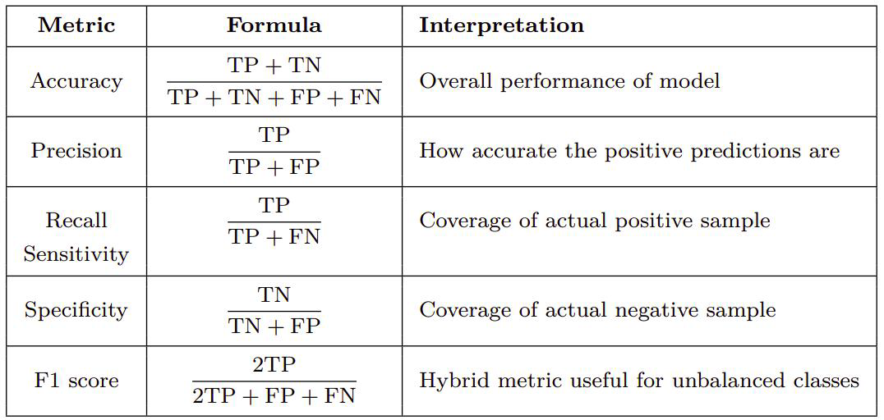
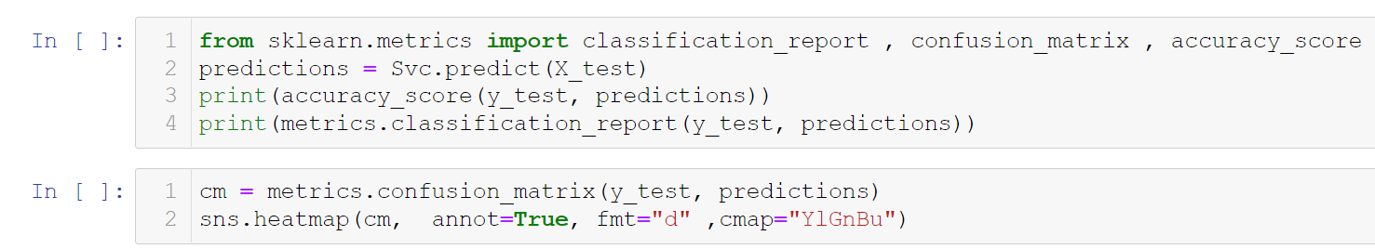
Evaluation Metrics
Classification
Confusion matrix

Slide 12
Overfitting and Underfitting

Slide 13
Thanks for listening

