Slide 1

Artificial intelligence
Hossam Elsayed MohaMED Fakher
0 1 2 7 7 8 8 0 6 7 8
Gmail
GitHUB
Linkedin
Kaggle
S e s s I o n 2
Deep Learning

Slide 2
Agenda
Neural Network Components
Activation Functions
Optimization
Loss Function

Slide 3
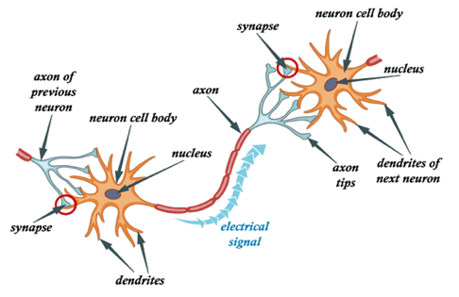
Human Brain Network
• The brain is composed of neurons linked together by synapses.
• Human brain has ~10^11 neurons ≈ number of trees in the amazon forest.
• The number of synapses ≈ number of tree leaves in the amazon forest.

Slide 4
Human Brain Network and DL

Slide 5
Neural Network Components
• Layers
• Neurons
• Weights
• Bias
• Activation Functions

Slide 6
Layers
are used to hold neurons and pass it to subsequent layers

Slide 7
Neurons
it is a mathematical operation , it takes input data multiplied by weights and pass the sum through an activation functions to other neurons

Slide 8
Weights
First they are chosen random at the beginning of training and then it optimized to reduce loss during training

Slide 9
Bias
•Bias is just like an intercept added in a linear equation
•output = sum (weights * inputs) + bias
•There is only one bias per neuron
•There is a vector of bias per layer
•Bias is a constant which helps the model in a way that it can fit best for the given data.

Slide 10
Activation Functions
• It’s a function that we use to get the output of node.
• It is also known as Transfer Function.
•The purpose of the activation function is to introduce non-linearity into the output of a neuron.
•Activation function also helps to normalize the output of any input in the range between 0 to 1 or 1 to -1 or any values according to activation function.

Slide 11
Why Activation Functions?
Without activation function, weight and bias would only have a linear transformation, or neural network is just a linear regression model, a linear equation is polynomial of one degree only which is simple to solve but limited in terms of ability to solve complex problems or higher degree polynomials.

Slide 12
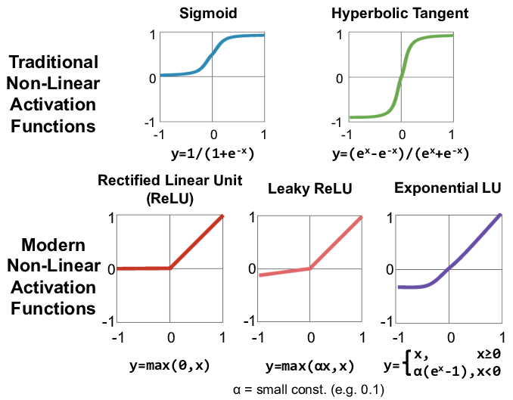
Type Of Activation Functions
Tanh

Slide 13
SOFTMAX Activation Function

Slide 14
Optimizers
Optimizers are algorithms or methods used to minimize an error function (loss function) or to maximize the efficiency of production.
Optimizers are mathematical functions which are dependent on model’s learnable parameters i.e. Weights & Biases.
Optimizers help to know how to change weights and learning rate of neural network to reduce the losses.

Slide 15
Updating Weights

Slide 16
Types Of Optimizers
• Gradient Descent
• Batch Gradient Descent
• Stochastic Gradient Descent
• Adagrad
• Rmsprop
• Adam

Slide 17
Gradient Descent
Gradient descent: is an optimization algorithm used to minimize some function by iteratively moving in the direction of steepest descent as defined by the negative of the gradient.
In machine learning, we use gradient descent to update the parameters of our model. Parameters refer to weights in neural networks.
To put it simply, we use gradient descent to minimize the cost function, J(w).

Slide 18
Learning Rate
How big/small the steps are gradient descent takes into the direction of the local minimum are determined by the learning rate, which figures out how fast or slow we will move towards the optimal weights.

Slide 19
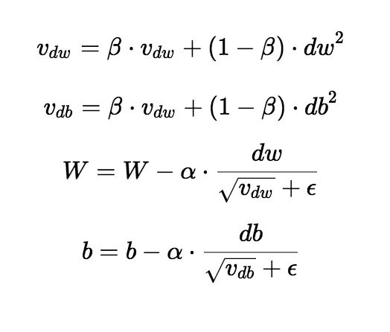
RMS-Prop
RMS-Prop is a special version of adagrad in which the learning rate is an exponential average of the gradients instead of the cumulative sum of squared gradients.
the decay rate (gamma) value is usually around 0.9 or 0.99.
Advantages:
• In rms-prop learning rate gets adjusted automatically and it chooses a different learning rate for each parameter.
• The learning rate does not decay too quickly, that allowing training to continue for much longer time
Disadvantages:
• Slow learning

Slide 20
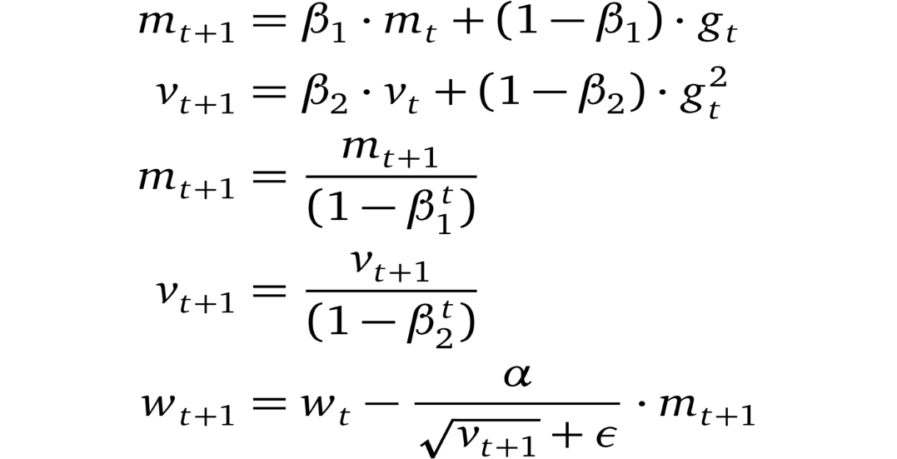
Adam
• Adam Optimizer Is One Of The Most Popular And Famous Gradient Descent Optimization Algorithms.
• The Idea Behind Adam Optimizer Is To Utilize The Momentum Concept From “Sgd With Momentum” And Adaptive Learning Rate From “Ada Delta”.
• Also We Don’t Want To Roll So Fast Just Because We Can Jump Over The Minimum, We Want To Decrease The Velocity A Little Bit For A Careful Search
• Advantages Of Adam
• Easy To Implement
• Computationally Efficient.
• Little Memory Requirements.

Slide 21
Adam vs rms-prop
Adam code
RMS-Prop code

Slide 22
Loss Functions
• Regression Loss Functions
– Mean Squared Error Loss
– Mean Absolute Error Loss
• Binary Classification Loss Functions
– Binary Cross-Entropy
• Multi-Class Classification Loss Functions
– Multi-Class Cross-Entropy Loss
– Sparse Multiclass Cross-Entropy Loss

Slide 23
Mean Squared Error [ MSE ]
Code:
model.compile(loss='mean_squared_error')

Slide 24
Mean Absolute Error Loss [ MAE ]
Code:
model.compile(loss='mean_absolute_error')

Slide 25
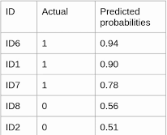
Binary Cross-entropy
Code:
model.compile(loss='binary_crossentropy' )
$$(1 )(−log{(0.94))+(1−0.94)(−\log{(1−0.94)) }}$$

Slide 26
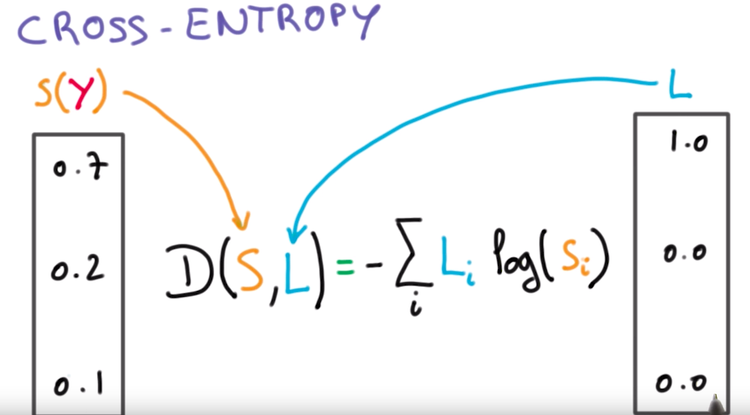
Categorical Cross Entropy
Code:
model.compile(loss='categorical_crossentropy‘)

Slide 27
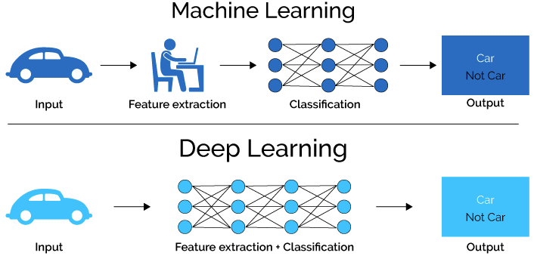
Machine Learning vs Deep Learning

Slide 28
Deep Learning
Several DL models have been proposed :
• Convolutional neural networks (CNNs).
• Autoencoders (Aes).
• Recurrent neural networks (RNNs).
• Generative adversarial networks (GANs).
• Faster RCNN and Mask RCNN.

Slide 29
Thanks for listening

