Slide 1
AIS-data-pipeline
End-to-End Automated Data Pipeline: From Data Acquisition to Visualization with Dockerized Spark, HDFS, and Airflow, Postgres and metabase.

Slide 2



Pipeline Architecture
AIS-data

Slide 3
Overview
Objective:
Create an automated system for data workflow from download to visualization.
Key Elements:
Utilizes AIS data for maritime traffic analysis.
Incorporates Docker, Apache Spark, HDFS, PostgreSQL, Metabase, and Airflow.
Process Overview:
Environment setup with Docker.
Data download/storage automation.
Daily task scheduling with Airflow.
Data cleaning and destination analysis.
Outcome:
Streamlined daily data processing for analysis readiness.
Recommendations:
Add error-handling.
Visualize with PostgreSQL.
Regular system monitoring.
Note:
The code used get the data from the local directory to ease the process of testing the pipeline

Slide 4
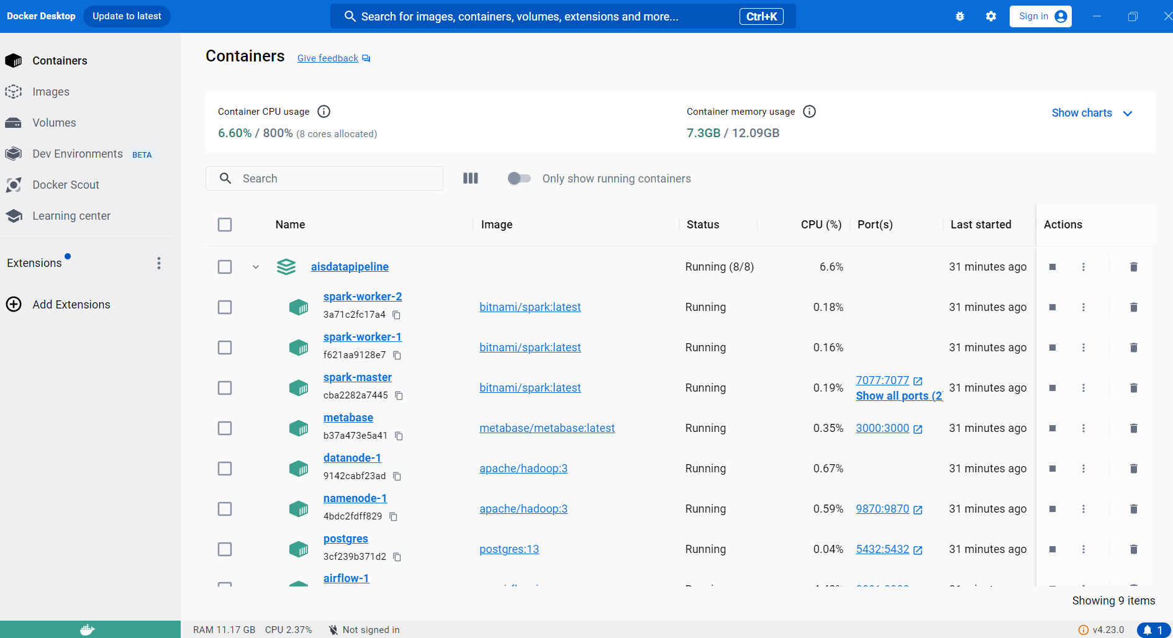
Running containers
After building the image for Airflow using a python base image
Run docker-compose up --scale spark-worker=2 -d to create two spark worker
Containers should look like this in docker desktop

Slide 5
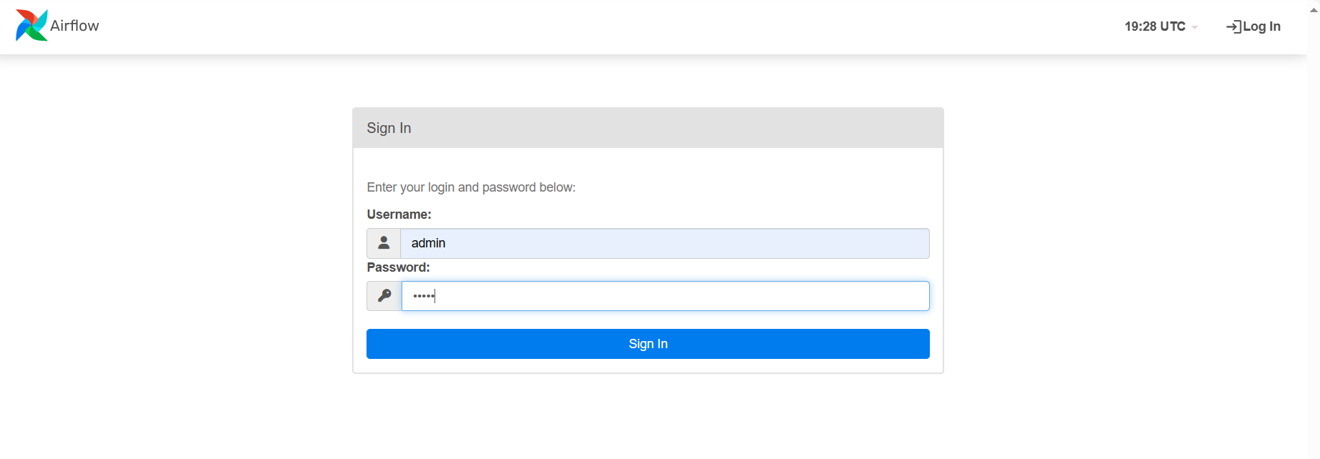
Airflow
Log in on http://localhost:8081/login/

Slide 6
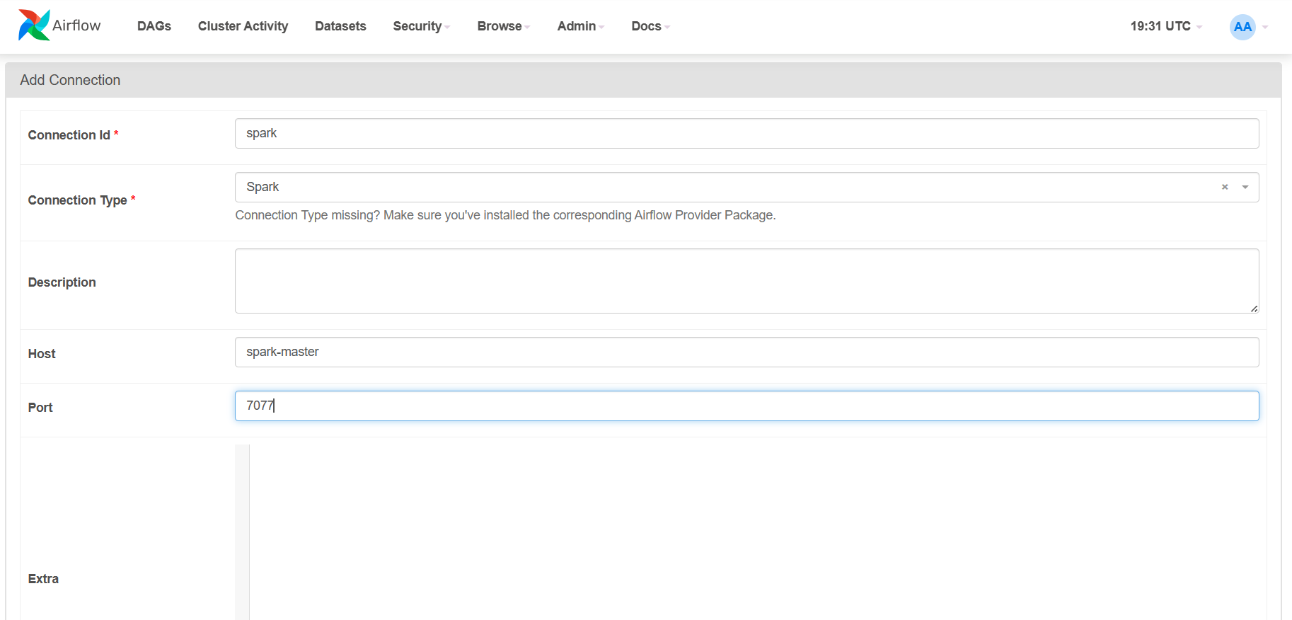
Airflow
Create a spark connection on

Slide 7
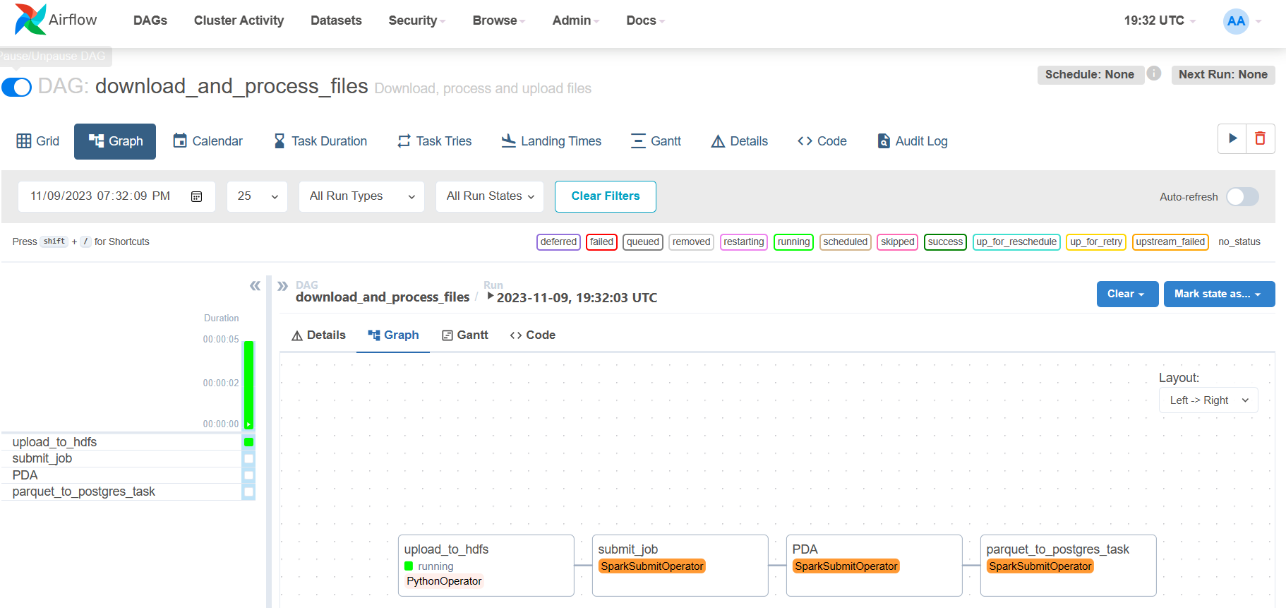
Airflow
Run and monitor Dag

Slide 8
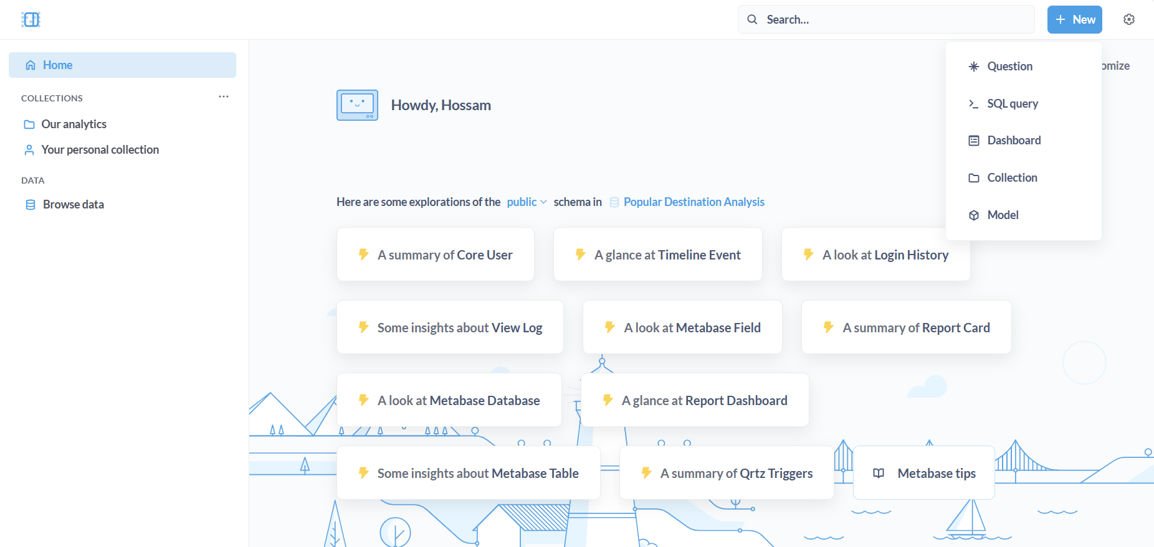
Metabase
Once the dag is done go to http://localhost:3000/ to access metabase
Sign up and add the postgres credentials
Select New > SQL Query

Slide 9
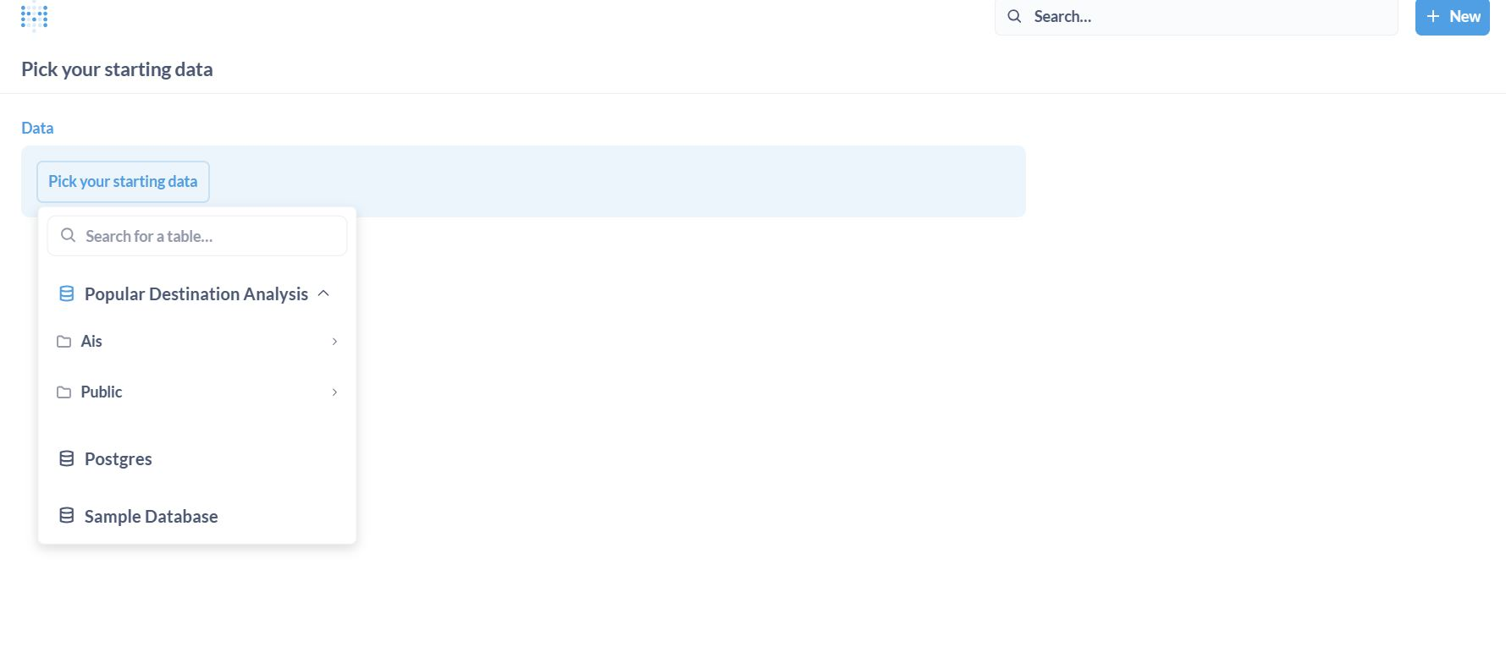
Metabase
Pick the data that was just added by the Airflow pipeline (Popular Destination Analysis)

Slide 10
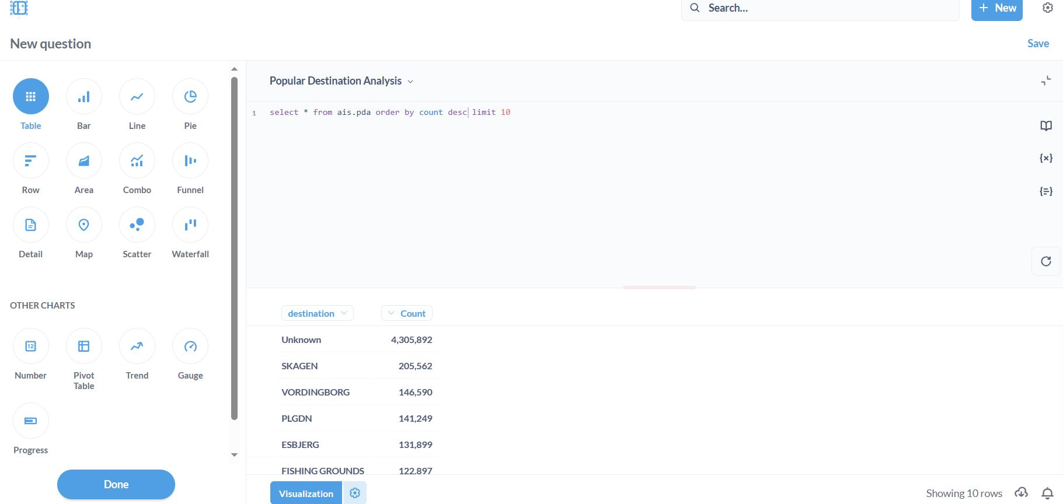
Metabase
Run a Query and visualize the top 10 destinations
You can choose from a variety of charts to visualize data and create dashboards

