Slide 1
Heart disease Analysis

Slide 2
Dataset overview
The dataset contains 10.000 entries and 21 coloumns related to heart disease risk factors.
Key features :
Age ,gender
Health metrics : Blood pressure ,cholesterol,Bmi
Lifestyle :smoking ,exercise ,Alcohol consumption
Outcome :Heart disease status

Slide 3
Demographics Analysis
Age distibution reveals the majority of vases in the 40.60 age group .
Gender distribution shows a slightly higher prevalence males .

Slide 4
Risk factor analysis
1.High cholesterol and blood pressure are strongly correlated with heart disease .
2.smoking and lack of exercis significantly increase risk
3.family history and diabetes and major contributing factors.

Slide 5
Conclusions and recommendations
1.promote regular health screening for early detection
2.Encourage lifestyle changes:reduced smoking ,increased excersise .
3.Monitor and manage cholesterol and Blood pressure levels.

Slide 6
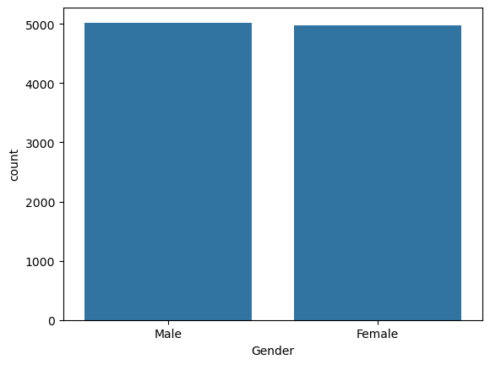
The image represents a bar chart showing the distribution of data by gender (Male and Female).
Key Observations:
The x-axis represents the Gender category, with two groups: Male and Female.
The y-axis shows the count of occurrences for each gender in the dataset.
The bars indicate that the counts for both genders are nearly equal, with approximately 5000 observations each.
This suggests a balanced dataset in terms of gender distribution

Slide 7
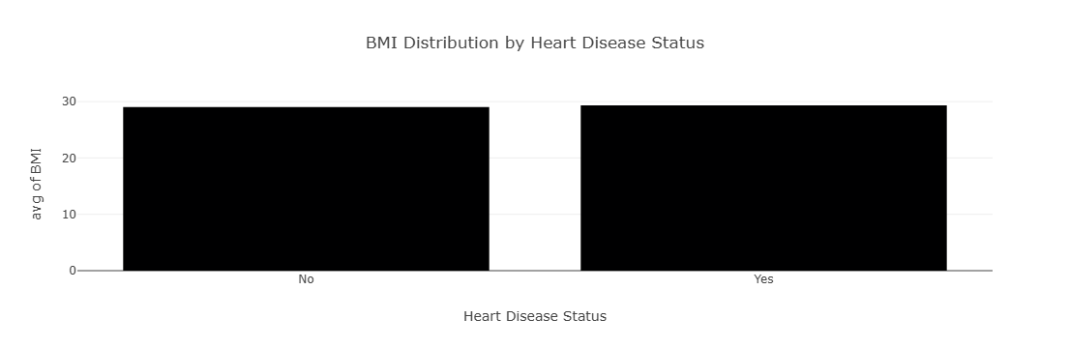
This boxplot compares BMI (Body Mass Index) distribution between two groups: individuals who have heart disease (Yes) and those who do not (No)
This shows that the body mass index of people with and without heart disease is similar, which indicates that this does not directly affect heart patients.

Slide 8
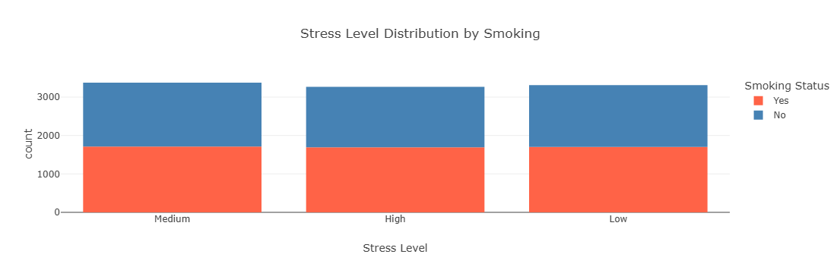
The chart you provided is a stacked bar chart illustrating the distribution of stress levels (categorized as "Medium," "High," and "Low") for heart dieases
X-Axis: Represents the different stress levels (Medium, High, and Low).
Y-Axis: Shows the count of individuals for each stress level. The total count for each stress level (Medium, High, Low) appears similar, indicating a balanced dataset across stress categories

Slide 9
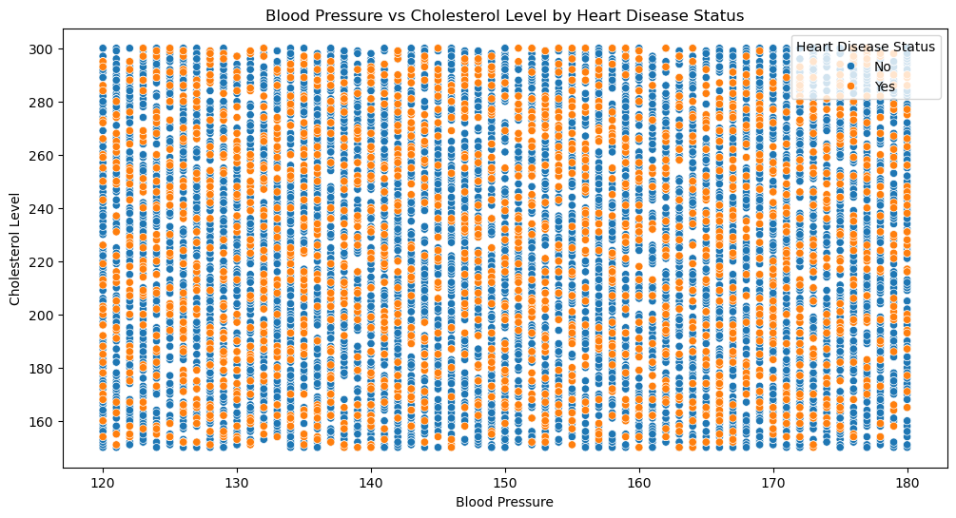
This scatter plot illustrates the relationship between Blood Pressure and Cholesterol Level, with data points colored by Heart Disease Status (blue for individuals without heart disease and orange for those with heart disease).
Insight:
Both blood pressure and cholesterol are important risk factors for heart disease, but based on this visualization, there may be other contributing factors (e.g., age, smoking, stress) needed to distinguish between those with and without heart disease

Slide 10
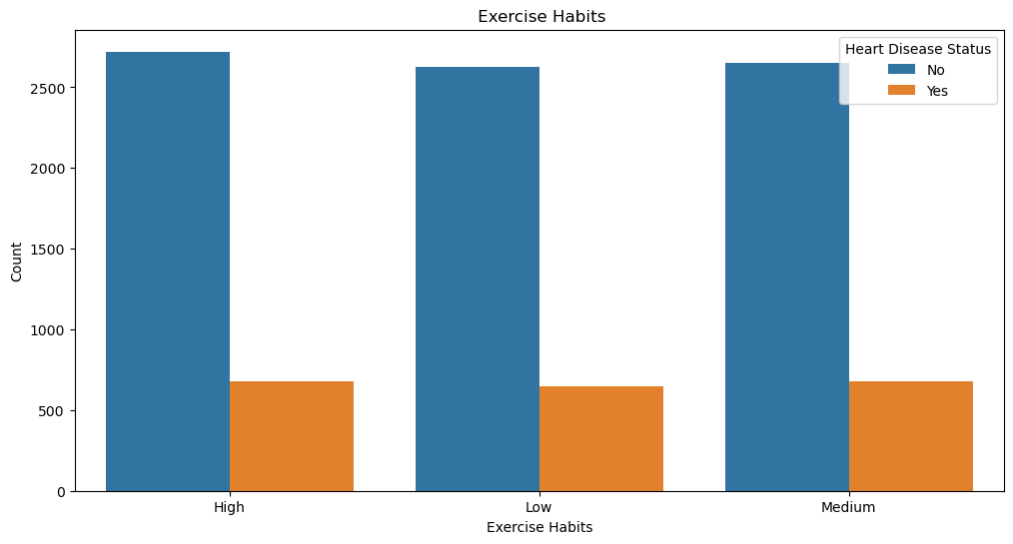
This bar chart illustrates the relationship between Exercise Habits (categorized as High, Medium, or Low) and Heart Disease Status (blue for No and orange for Yes Individuals with higher exercise habits may have a slightly lower likelihood of heart disease, suggesting that consistent physical activity might be a protective factor

Slide 11
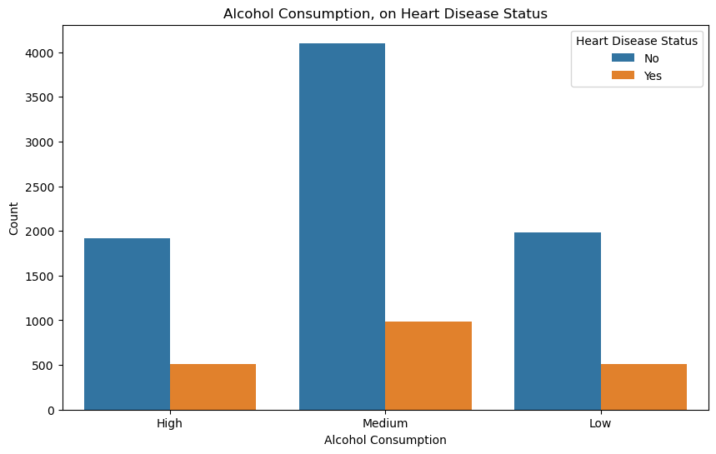
This bar chart represents the relationship between Alcohol Consumption (categorized as High, Medium, and Low) and Heart Disease Status (blue for No and orange for Yes) While medium alcohol consumption has a higher total count, it does not directly suggest a causal relationship between consumption levels and heart disease.
Other lifestyle or demographic factors might be influencing this pattern

Slide 12
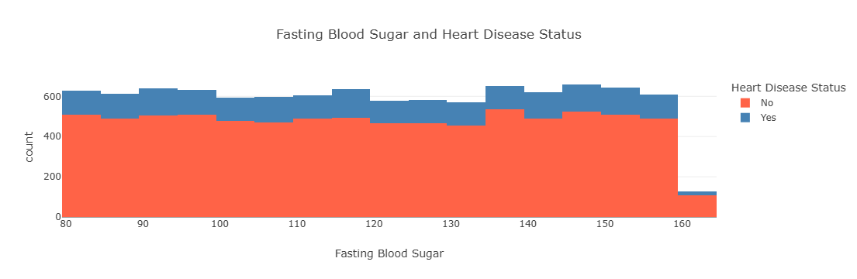
This histogram represents the relationship between fasting blood sugar and heart disease status (blue for "no" and "yes") insight The number of individuals without heart disease (red) appears to be higher at most blood sugar levels. There is a lower percentage of individuals with heart disease (blue) across different blood sugar levels.

Slide 13
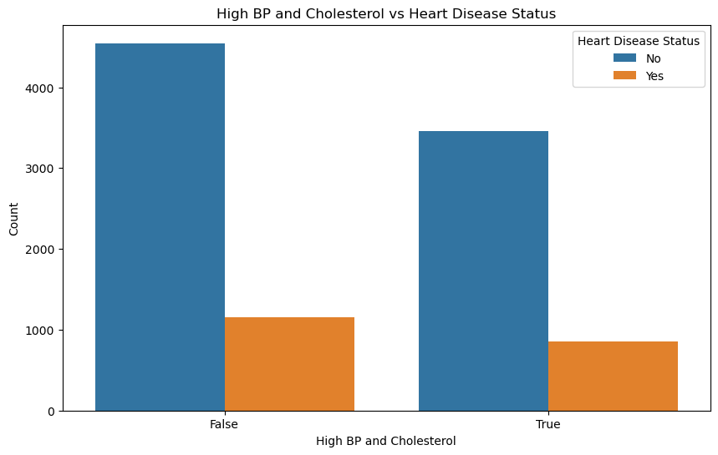
This bar chart shows the relationship between high blood pressure (BP) and cholesterol and heart disease status. Here's an explanation X-axis: Represents whether the individual has high blood pressure and cholesterol: False: No high BP or cholesterol. True: Presence of high BP or cholesterol. Y-axis: Represents the count of individuals Insights: High blood pressure and cholesterol are likely associated with an increased risk of heart disease, as the orange bar (Yes) is larger in the "True" category compared to the "False" category. However, most individuals, even with high BP or cholesterol, do not have heart disease, suggesting other factors may also contribute. .

Slide 14
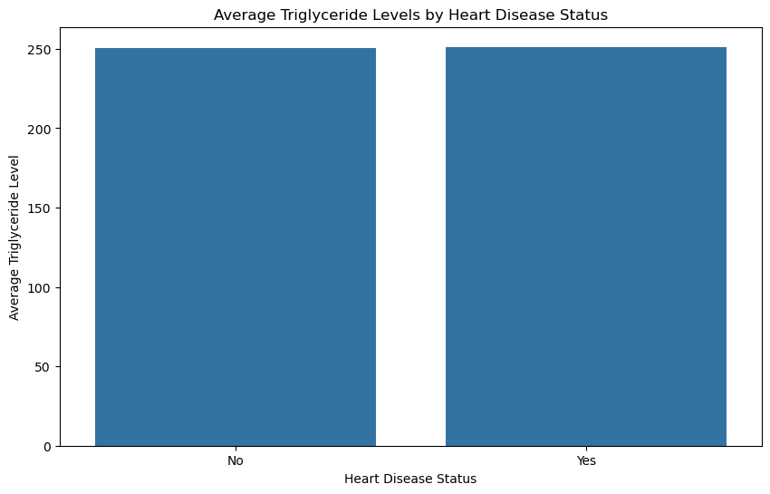
This histogram illustrates the relationship between Average triglyceride level and heart disease status. Here's the explanation:
Axes:
X-axis: Represents heart disease status:
No: Individuals without heart disease.
Yes: Individuals with heart disease.
Y-axis: Represents triglyceride level Insights:
From this plot, triglyceride level alone do not appear to be a strong differentiating factor between individuals with and without heart disease. Additional variables might need to be considered for a more comprehensive analysis

Slide 15
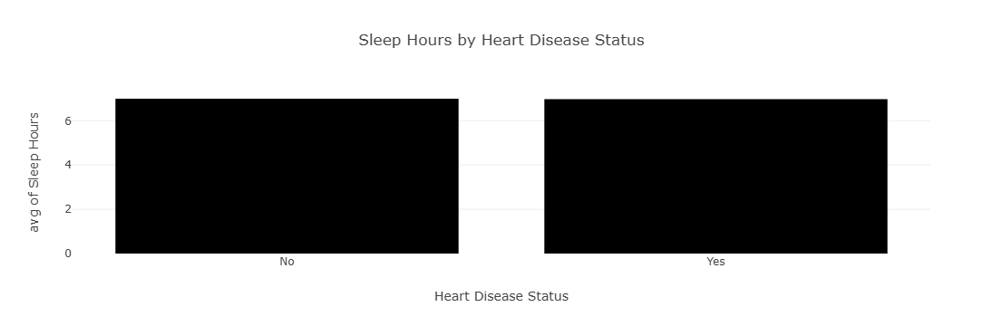
The image shows a bar chart showing the relationship between the number and average hours of sleep and the status of heart disease.
Notes:The average number of hours of sleep between the two groups (patients and non-patients) appears to be very similar.The chart indicates that there is no clear or significant difference in the average hours of sleep between individuals with heart disease and individuals without heart disease.

Slide 16
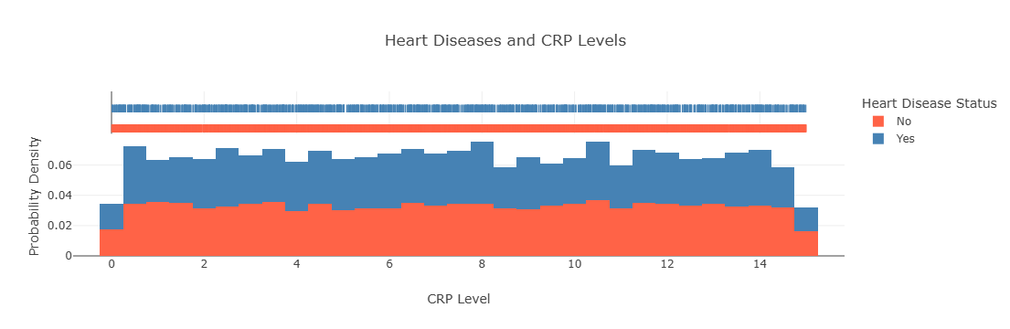
1 Title: Heart Diseases and CRP Levels 2 Horizontal axis (CRP Level): Represents the level of C-reactive protein in the blood. 3 Vertical axis (Probability Density): Represents the probability density (not the direct frequency).
s there a relationship between CRP and heart disease Yes, people with heart disease appear to have higher levels of CRP than people without. But CRP is not the only factor, there may be an overlap with other factors such as age or blood pressure.

