Slide 1
Spring PetClinic with Docker, Docker Compose, Kubernetes, CI/CD, and Ansible
By: Hossam El-Sayed Mahmoud El-Sayed El-Bassuiony

Slide 2
introduction
This project demonstrates the deployment of the Spring PetClinic application using Docker, Docker Compose for local testing, and Kubernetes for orchestration. It also includes CI/CD integration with Jenkins and automation of the installation process using Ansible. The setup features persistent storage, environment configuration using ConfigMaps and Secrets, and two deployments: one for the PetClinic application and one for MySQL. Prerequisites:
Docker
Docker Compose
Kubernetes cluster (Minikube)
kubectl CLI tool
Ansible
Jenkins

Slide 3
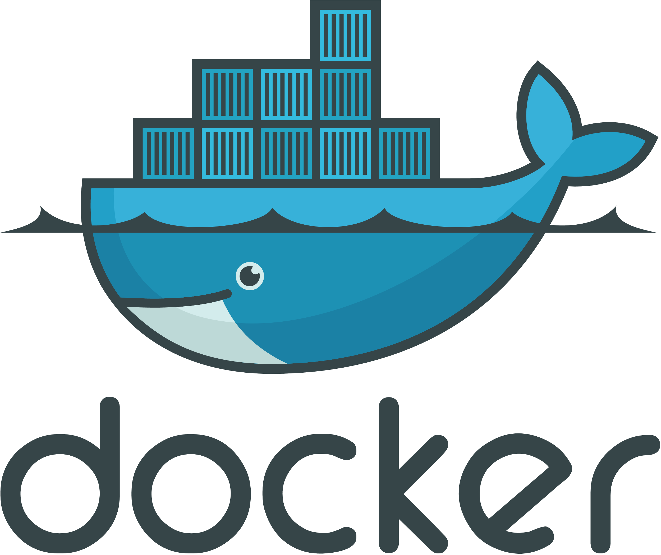
Docker Overview
Custom Docker Image:
Created for the Spring PetClinic application.
Named: hossam136/spring-petclinic-image.
Based on the official repository: spring-petclinic.
Docker Compose:
Facilitates local testing.
Provides a docker-compose-1.yaml file to set up the application and MySQL database.

Slide 4
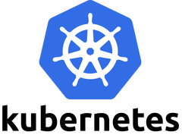
Kubernetes Overview
Kubernetes Overview:
Components:
ConfigMap: Holds environment variables for the application.
Secrets: Stores sensitive information like database credentials.
Persistent Volume (PV) and Persistent Volume Claim (PVC): Ensures data persistence for the MySQL database.
Deployments: Separate deployments for the Spring PetClinic application and the MySQL database.

Slide 5
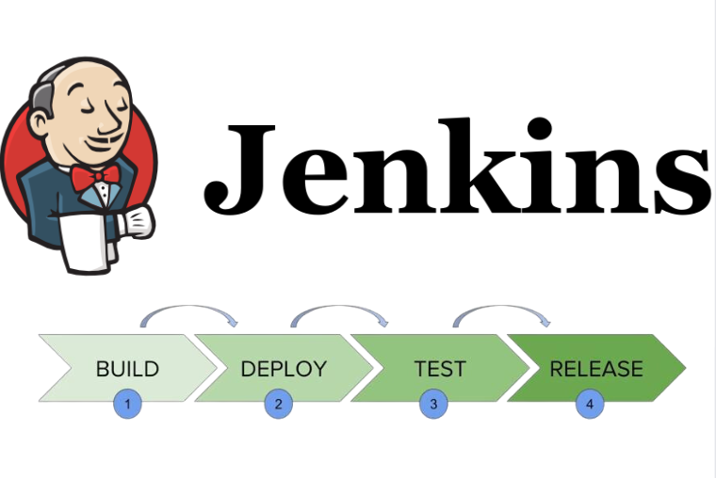
CI/CD Integration with Jenkins
CI/CD Stages
Git Checkout: Clone the repository from Git.
Build Source Code: Compile the source code.
Run Unit Tests: Execute unit tests.
Build the Package: Package the application.
Build & Tag the Docker Image: Create a Docker image.
Push the Docker Image to Docker Hub: Upload the image to Docker Hub.
Run Docker Compose: Start the application.
Send Email Notifications: Configure Jenkins to send email notifications on build success or failure.
Tear Down the Docker Environment: Clean up the Docker environment.

Slide 6
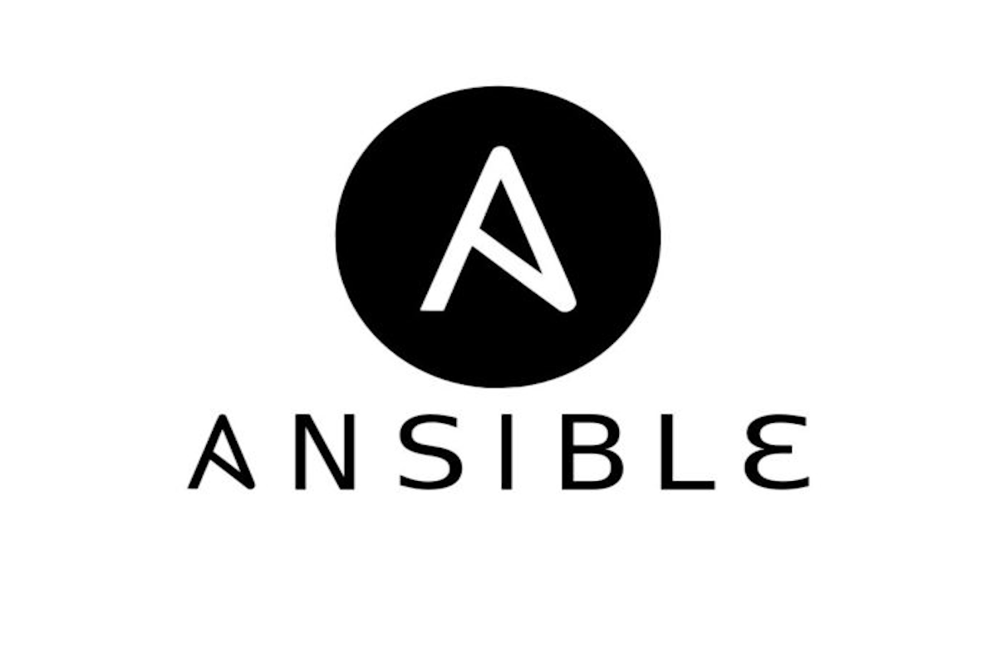
Ansible Automation
Overview:
Ansible is used to automate the installation of essential software, including Docker, Jenkins, Maven, and Java. It streamlines the setup process, ensuring all dependencies are installed and configured efficiently. Key Components of the Ansible Playbook:
Install Docker: Automates the installation of Docker.
Install Jenkins: Automates the installation of Jenkins
Install Maven: Automates the installation of Maven.
Install Java: Automates the installation of Java.

Slide 7
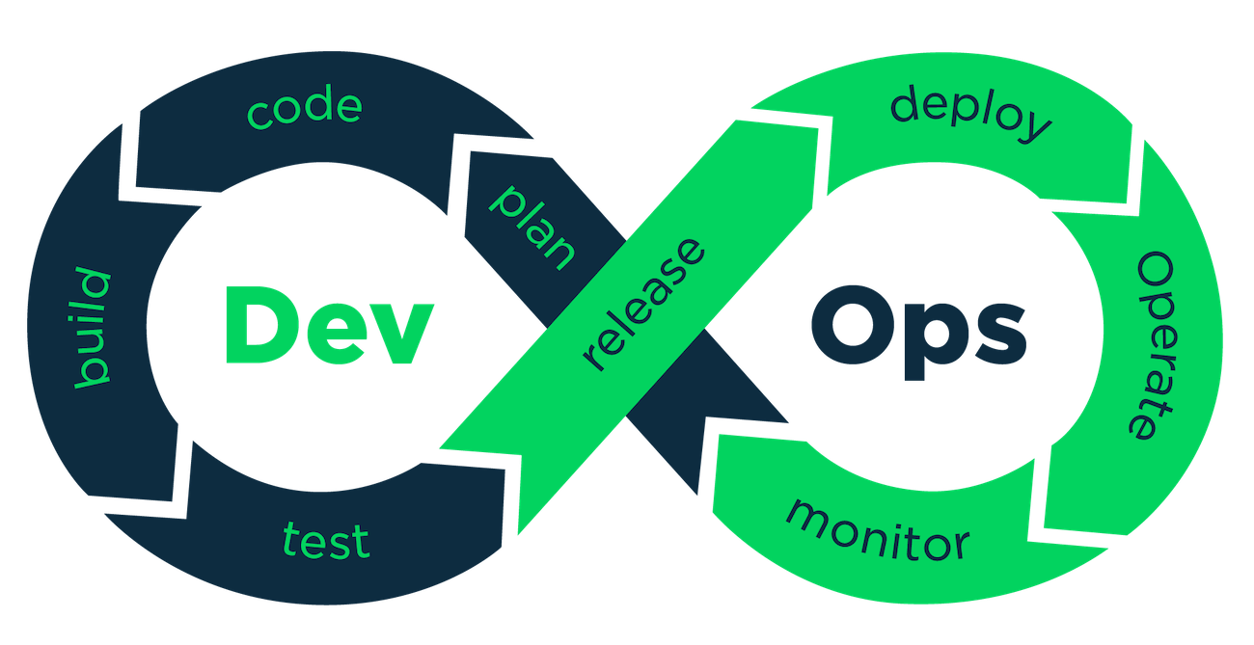
Conclusion
Deployment Success: The Spring PetClinic application is deployed effectively using Docker, Kubernetes, and Jenkins for CI/CD.
Efficiency Gains: Automation through Ansible and containerization has streamlined setup and improved reliability.
Foundation for Growth: The project enables rapid feature development and deployment, paving the way for continuous integration.
Future Opportunities: Potential enhancements include better monitoring, advanced testing strategies, and exploring additional orchestration tools.
Key Learnings: Reinforced essential DevOps principles of automation, collaboration, and resource management.

