Slide 1


Slide 1
Hossam Eldeen Elsayed
Hand gesture controlled mouse

Slide 2
What is computer vision?
Computer vision is a field that includes methods for acquiring, processing, analyzing and understanding images
Duplicates the abilities of human vision by electronically perceiving and understanding an image
Image data can take many forms, such as video sequence, depth images, views from multiple cameras or multi-dimensional data from a medical scanner

Slide 3
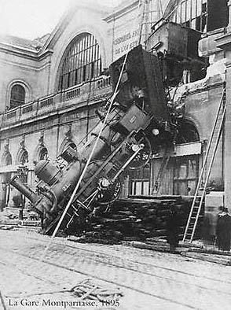
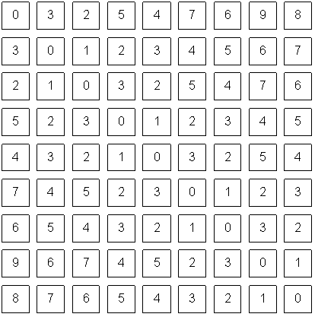
Human vision vs computer vision

Slide 4
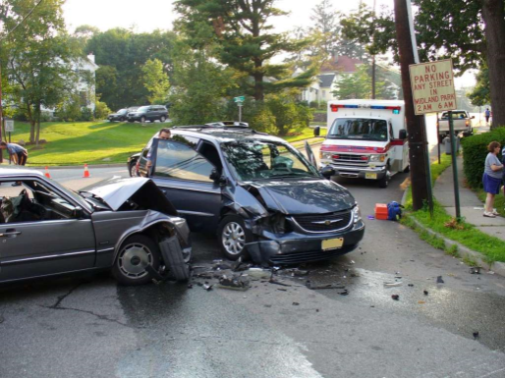
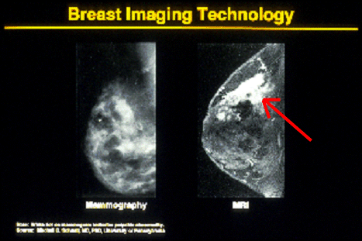


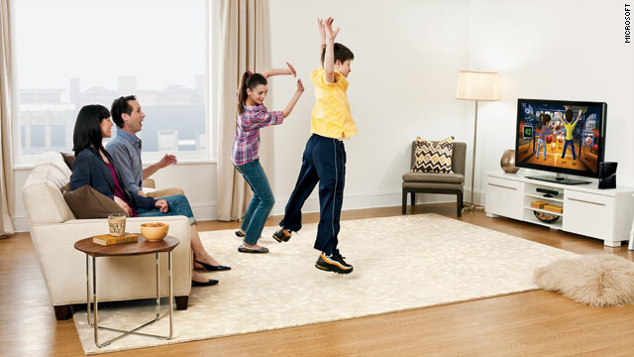
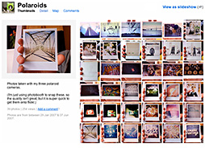
Uses of computer vision
Safety
Health
Security
Comfort
Fun
Access

Slide 5

Controlling a mouse with a camera
Implementation Plan

Slide 6
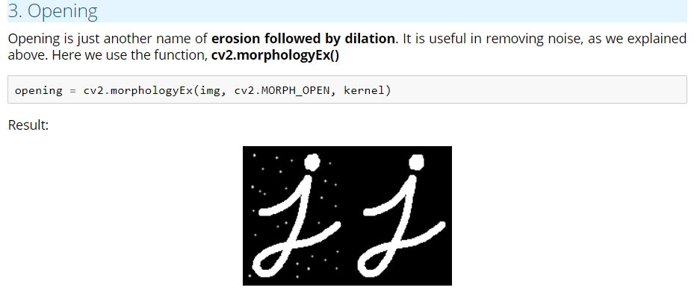
Morphology

Slide 7
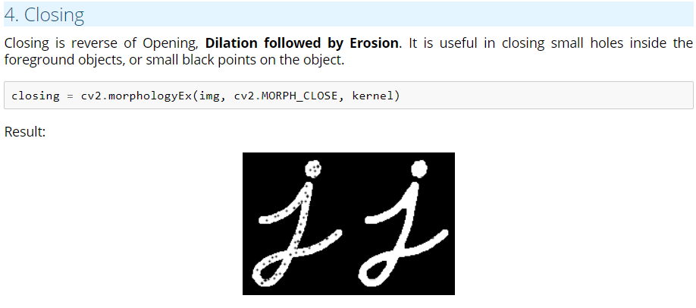
Morphology

Slide 8
Upgrading plan
Optimizing parameters for detection
Implement the project into a painting application

Slide 9
References
https://docs.opencv.org
http://vision.stanford.edu/teaching.html

Slide 10

Slide 10
THANK YOU

