Slide 1


DevSecOps SKILup Day
17-September, 2020
Shift Security Everywhere
Tim Johnson

Slide 2

Controversial Statement
DevSecOps doesn’t exist - or shouldn’t

Slide 3

The “traditional” view of Security
DEV
TEST
PRE
SEC
PROD
Notes:
Please adjust diagram to fit only in the left hand side of the box

Slide 4
The “Shift Left” view of Security
SEC
DEV
TEST
PRE
PROD
Notes:
Please adjust this diagram as well

Slide 5
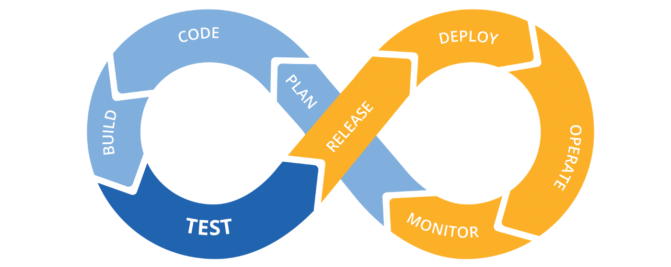
The Continuous DevOps process

Slide 6
The “Shift Security Left” Fallacy

Slide 7
The “Shift Security Left” Fallacy
What about this side?

Slide 8

Delivery Security
Notes:
Please remove the image on this ppt and replace it onto the left side

Slide 9
Delivery Exposures
Wrong Thing Released

Slide 10
Delivery Exposures
Wrong Thing Released
Unknown Changes

Slide 11
Delivery Exposures
Wrong Thing Released
Unknown Changes
Manual Steps

Slide 12
Delivery Exposures
Wrong Thing Released
Unknown Changes
Manual Steps
Deployment Failure
Notes:
Please shift so that all the words fit on the left hand side

Slide 13
Production Security
Notes:
Please adjust so the image is to the left

Slide 14
The DORA Metrics
MTTD
MTTR
We found a problem!
We fixed the problem!

Slide 15
The Scary Part
MTTD
MTTR
EXPOSURE
We found a problem!
We fixed the problem!

Slide 16
The New Metric - MTTMitigate
MTTD
MTTM
MTTR
We turned it off
or -
Rolled it back
We fixed the problem!
We found a problem!

Slide 17
The Updated DORA Metrics
MTTD = MTTM
MTTR
We found a problem!
And
We instantly;
Turned it off
or -
Rolled it back
We fixed the problem!

Slide 18
Shifting Security
Everywhere
Notes:
Same edits as other title slides please

Slide 19
Q: Where does DevSecOps fit?

Slide 20
A: Everywhere!
Delivery
Development
Production
Notes:
Please adjust to fit all in the left

Slide 21
Secure in Development
Development
The right people are making the right changes
The right sets of tests were performed
The code passed our thresholds
Notes:
Same as previous

Slide 22
Immutable pipeline & components
Changes detected, analyzed, approved
Automated everything - no manual steps
Automatic rollback on failure
Secure in Delivery
Delivery
Development
The right people are making the right changes
The right sets of tests were performed
The code passed our thresholds
Notes:
Same as previous

Slide 23
Immutable pipeline & components
Changes detected, analyzed, approved
Automated everything - no manual steps
Automatic rollback on failure
Secure in Production
Delivery
Development
The right people are making the right changes
The right sets of tests were performed
The code passed our thresholds
Bill of materials
Instant mitigation without redeployment
Graceful recovery and rollbacks
Integrated and automated
Production
Notes:
Same as previous

Slide 24
Want to know more?
www.cloudbees.com/solutions/devsecops

Slide 25
Thank You

