Slide 1

به نام خدا
K.N.Toosi University of Technology
شناسایی سیستم‌ها با الگوریتم LSI
حسین مصفا
علی شیخ الاسلامی
استاد درس: دکتر مهدی علیاری
2
بهمن 1398

Slide 2

content
LSI algorithm
Multi variable CARMA system
Box-Jenkins model
Wiener nonlinear systems
2/34
2

Slide 3
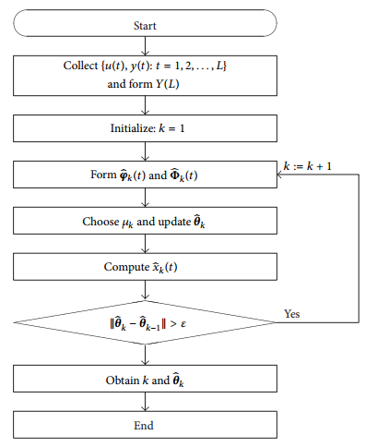
LSI Algorithm
3/34
2

Slide 4

CARMA
4/34
2

Slide 5

CARMA
5/34
2

Slide 6

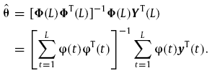
CARMA
6/34
2

Slide 7


CARMA
7/34
2

Slide 8
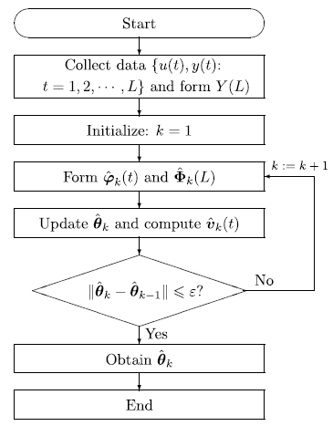
LSI Algorithm
8/34
2

Slide 9
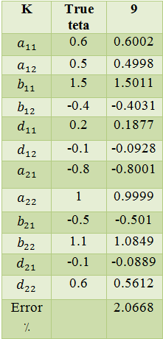
CARMA
L=1000
9/34
2

Slide 10
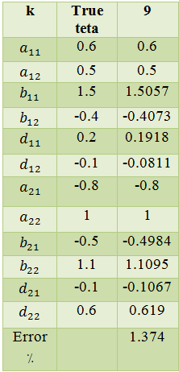
CARMA
L=2000
10/34
2

Slide 11
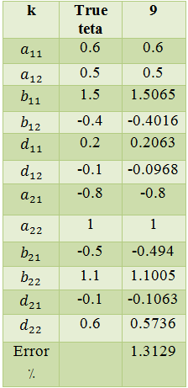
CARMA
L=3000
11/34
2

Slide 12
CARMA
Iterative method is effective!!!
12/34
2

Slide 13
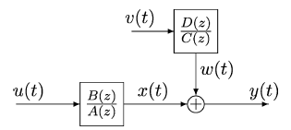
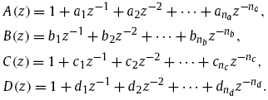
BoxJenkins
LSI algorithm is effective for bj model!!!
13/34
2

Slide 14
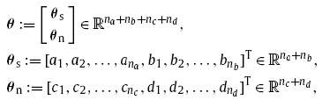
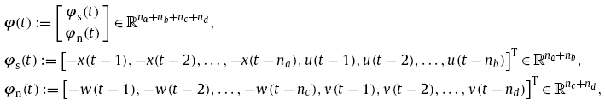

Recursive_BoxJenkins
14/34
2

Slide 15
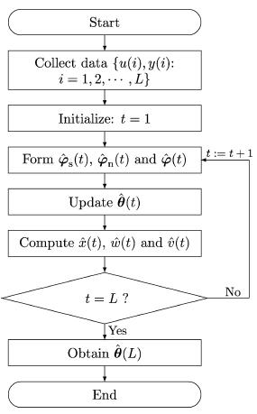
Recursive_BoxJenkins
RGELS:
15/34
2

Slide 16
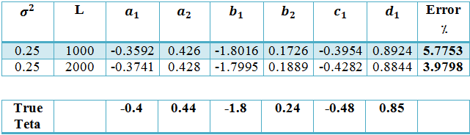
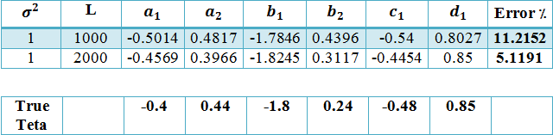
Recursive_BoxJenkins
16/34
2

Slide 17
BoxJenkins
Inner variables are unmeasurable!!
Initial value for estimate of inner variables : random
17/34
2

Slide 18
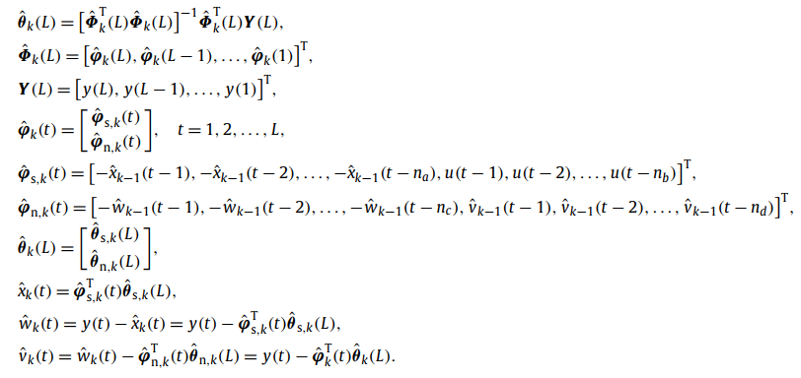
BoxJenkins
18/34
2

Slide 19
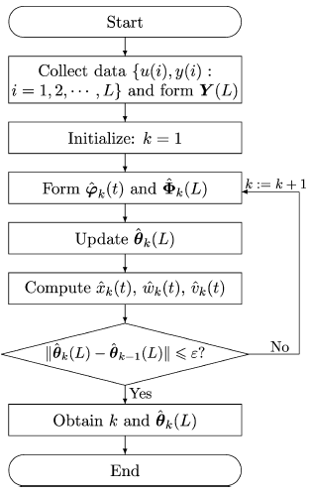
LSI Algorithm
19/34
2

Slide 20

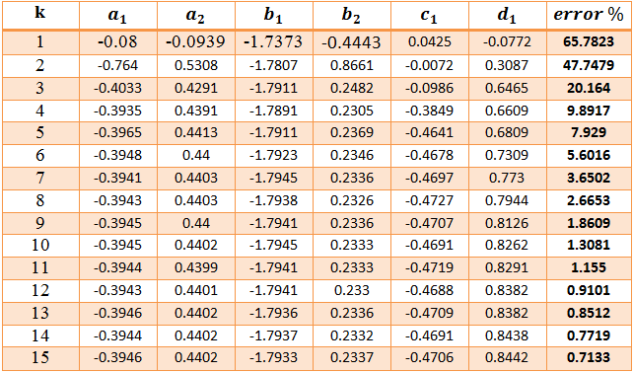
BoxJenkins
Conclusion for bj LSI :
20/34
2

Slide 21

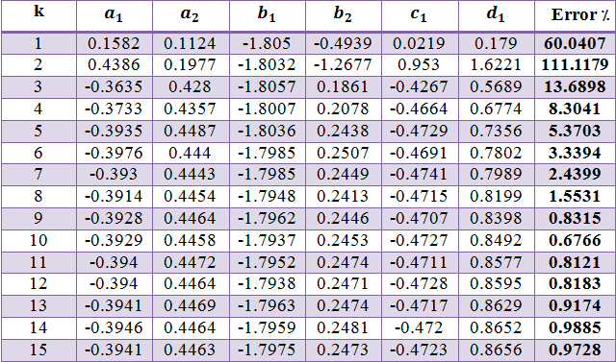
BoxJenkins
21/34
2

Slide 22
BoxJenkins
Large data length : small error
High noise variance : error increase
EFFECTIVE ALGORITHM!!!
22/34
2

Slide 23
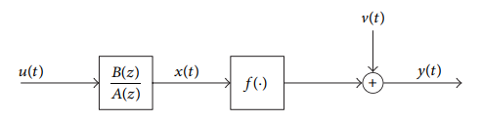




Wiener system
23/34
2

Slide 24



Wiener system
24/34
2

Slide 25

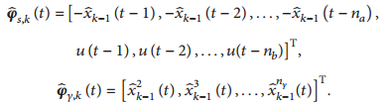
Wiener system
25/34
2

Slide 26



Wiener system
26/34
2

Slide 27
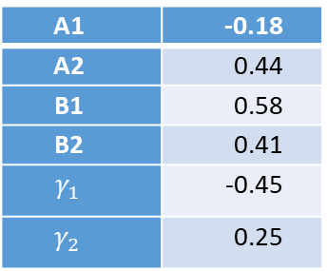
Wiener system
simulation
Without noise
A1 | -0.18
A2 | 0.44
B1 | 0.58
B2 | 0.41
 | -0.45
 | 0.25
-0.18
0.44
0.5799
0.41
-0.4501
0.2501
27/34
2

Slide 28

Wiener system
simulation
noise with
-0.1821
0.4405
0.5785
0.4078
-0.4503
0.2513
A1 | -0.18
A2 | 0.44
B1 | 0.58
B2 | 0.41
 | -0.45
 | 0.25
28/34
2

Slide 29

Wiener system
simulation
noise with
A1 | -0.18
A2 | 0.44
B1 | 0.58
B2 | 0.41
 | -0.45
 | 0.25
-0.1786
0.4410
0.5770
0.4070
-0.4602
0.2560
29/34
2

Slide 30
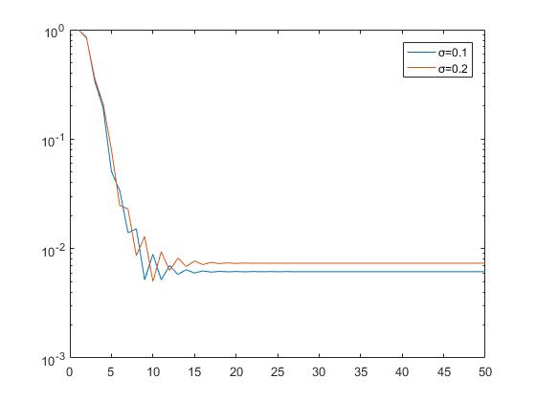
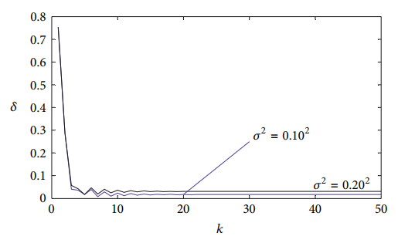

Wiener system
30/34
2

Slide 31

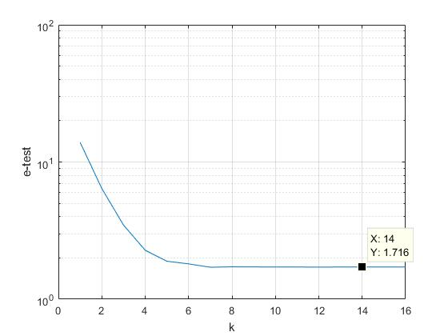
Wiener system
fi_train =fi(:,1:700,k-1);
fi_test =fi(:,701:end,k-1);
noise with
fitting=100*(1-((norm(y_hat-Y_test))/norm(Y_test-mean(Y_test)))) = 92%
31/34
2

Slide 32

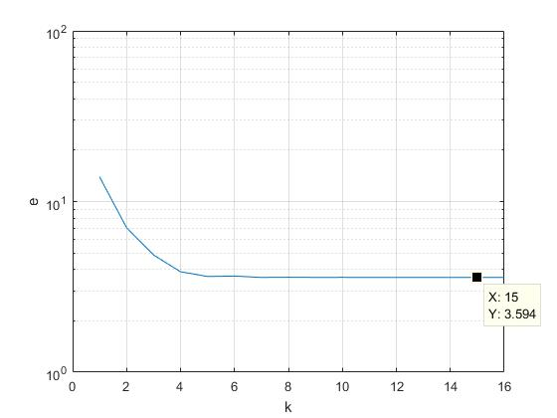
Wiener system
fi_train =fi(:,1:700,k-1);
fi_test =fi(:,701:end,k-1);
noise with
fitting=100*(1-((norm(y_hat-Y_test))/norm(Y_test-mean(Y_test)))) = 86.25%
32/34
2

Slide 33
REFERENCES
[2] Liu, Yanjun, Dongqing Wang, and Feng Ding. "Least squares based iterative algorithms for identifying Box–Jenkins models with finite measurement data." Digital Signal Processing 20.5 (2010): 1458-1467.
[3] Zhou, Lincheng, Xiangli Li, and Feng Pan. "Least-squares-based iterative identification algorithm for Wiener nonlinear systems." Journal of Applied Mathematics 2013 (2013).
[1] Bao, Bo, et al. "Least squares based iterative parameter estimation algorithm for multivariable controlled ARMA system modelling with finite measurement data." Mathematical and Computer Modelling 53.9-10 (2011): 1664-1669
33/34
2

Slide 34
سپاس از توجه شما
2

