Slide 1
Data Analysis Project Mohammadi – Vakili - Mortezaei
Presenter: Mohammadi
Daneshkar Data Science BootCamp

Slide 2
Introduction
We are given two months of tennis data (February–March 2024) in Parquet format, encompassing every tournament, match, set and game. Our first task is to ingest the schema of the dataset—covering players, tournaments, matches, sets, games and scores—to understand how tables relate.
Before diving into analytics, we’ll align on essential tennis terminology—aces, break points, tie-breaks and the like—so that our we feel comfortable when answering questions.
With our data model mapped and our jargon clarified, we’ll utilize Python (pandas/dask) to answer each project question, explicitly calling out the schemas and transformations used along the way.

Slide 3
GitHub
We also collaborated with git, and here’s the GitHub repository of this project:
https://github.com/HosseinMohammadi00427/Analysis-Project

Slide 4
Mohammadi’s task
I’ve addressed questions one through six in full, providing not only each answer but also a clear walkthrough of the analytical steps we took, the assumptions and methodology behind them, and how the underlying schema elements were used—ensuring that every result is backed by a transparent rationale.

Slide 5
My Questions
Tennis players in the dataset.
Average height of players.
Player with the highest number of wins.
Longest match recorded in the dataset.
Typical number of sets in a match.
The country that has most top tennis players.

Slide 6
Question #1
How many tennis players are in the dataset?
Tables Required
According to the schema, all the players’ data is in AwayTeam and HomeTeam parquet files. We only need the `player_id` column to distinguish players.
Coding and strategy
I load all the relevant tables and columns via dask, and save them in a csv file for future convenience.
The only idea is to find the count of unique `player_id`s.
Results
There are 2644 distinct players in the dataset (both men and women.)

Slide 7
Question #2
The average height of the players.
Tables Required
Again, the players’ height data is in AwayTeam and HomeTeam parquet files. We need the `player_id` and `height`columns to distinguish players.
Coding and strategy
I loaded data with dask and saved them in csv files. Note that I deleted the repetitive players before averaging, and also dropped missing heights. Then, I found the mean of the heights.
Results
Average height of players in the dataset is 182.1 cm.

Slide 8
Question #3
The player with the highest number of wins.
Tables Required
This one is a more sophisticated task. I have to relate three tables: Event, HomeTeam, and AwayTeam. These tables are related by `match_id` column as depicted in next slide.
In the Event table, there’s `winner_code` column with a binary entry. Entry 1 indicates that the home is winner, and 2 indicates that the away is the winner.
Also, `player_id` and `match_id`, and `full_name` are the columns that are involved from the other two tables.
I first drop duplicates of Event table (necessary for avoiding overcounting), then filter them according to their `winner_code`.Finally, join those records with 1 as winner with HomeTeam, and those with 2 will be joined by AwayTeam. Finally concatenating the results.
Finally, group by `player_id`, and counting the number of `match_id`s, combined by a sorting, will give the answer.

Slide 9

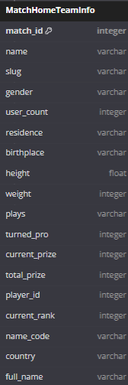

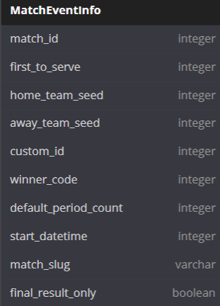



Question #3
This is how I joined in solving this question.
Filter away winners
Filter home winners
PK
FK

Slide 10
Question #3
The player with the highest number of wins.
Coding and strategy
I loaded data with dask and saved them in csv files. Preprocessings like dropping duplicates, dropping missing values were applied to avoid overcounting. At the end grouping the concatenated table of winners, and sorting them were carried out .
Results
Dmitry Popkov has the highest number of wins, with 29 wins in two months.
You can look at the table to find other top winners.

Slide 11
Question #4
Longest match recorded in the dataset.
Tables Required
Only TimeInfo parquet files were enough. We load the table, and drop unnecessary columns.
Coding and strategy
This tables contains the time spent in each set. Some records have missing `period_1`, so I can’t extract their duration, hence I drop them. I dop duplicates of `match_id` and then add the periods to find total duration of a match.
After this process, I look the distribution of `duration` and found outliers. Based on Gaussian distribution, I decided to cut 1% top durations (which last more than 6 hours!).
Results
The longest match is a match with `match_id` equal to 12170628, that took place about 295 minutes (or 5 hours approximately).

Slide 12
Question #5
Typical number of sets in a match.
Tables Required
Only Event table is required. We need the `default_period_count` column.
Coding and strategy
I load the data, and just look at their distribution with value_counts().
(I haven’t dropped duplicates of matches, since I noticed that all the games have three sets.)
Results
All the games had 3 sets.

Slide 13
Question #6
The country with most top tennis players.
Tables Required
The players data is included in HomeTeam table and AwayTeam. We need the `player_id`, `full_name`, `current_rank`, `total_prize`, `country` columns.
Coding and strategy
I consider a combined measure of success based of `current_rank` and `total_prize`. This measure is nothing but a weighted sum of their normalized scores, as implemented in compute_success_score function.
After adding `success_score` for each player, I group the table by `country`, and take mean/sum of score of players on that country.
Results
Although the United States tops the leaderboard by total score, Serbia and Poland boast higher average player scores—highlighting their exceptional per‐player talent despite smaller rosters.

