Slide 1

UWE BSc(Hons) Computer Science
Foundations of Computing:
Recursion and Fundamental Algorithms
Presented by Mohammad Hosseinabady, PhD
27 March 2026
Notes:
START recording

Slide 2
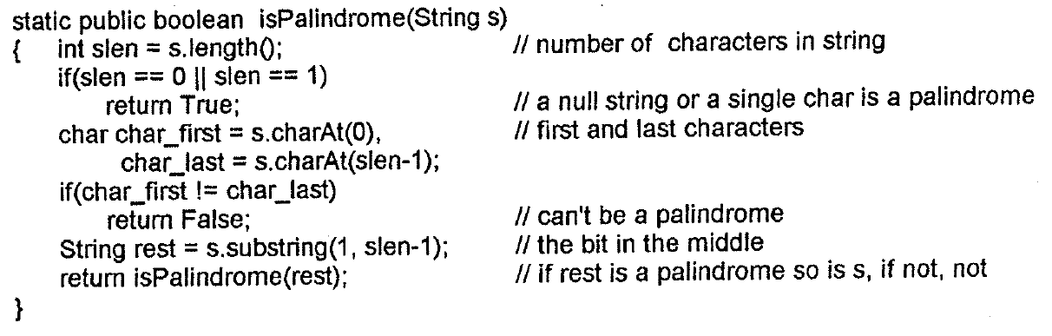
palindrome
a word or phrase that reads the same backwards as forwards, for example madam or nurses run

Slide 3
is_palindrome function in Python
def is_palindrome(s):
slen = len(s)
# Base case: a null string or a single char is a palindrome
if slen == 0 or slen == 1:
return True
# First and last characters
char_first = s[0]
char_last = s[-1] # s[-1] is a Pythonic way to get the last element
# If they don't match, it can't be a palindrome
if char_first != char_last:
return False
# "the bit in the middle"
# s[1:-1] takes everything from index 1 up to (but not including) the last index
rest = s[1:-1]
return is_palindrome(rest)

Slide 4
# Test cases
test_words = ["radar", "hello", "level", "step on no pets", "python"]
print("Palindrome Check:")
print("-" * 20)
for word in test_words:
# We use .replace(" ", "") to handle phrases with spaces if needed
result = is_palindrome(word.replace(" ", ""))
status = "Yes" if result else "No"
print(f"Is '{word}' a palindrome? {status}")

Slide 5
Answer
In every recursive call, we pass a shorter string, so, the size of string will eventually reduce to ‘1‘ or ‘0‘.
When this happens program will stop (at the first line if(slen==0 or slen==1) ...).

Slide 6
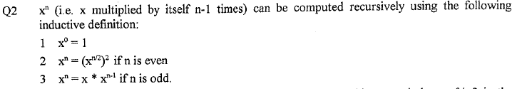
def pow_recursive(x, n):
# Rule 1: x^0 = 1
if n == 0:
return 1
# Rule 2: If n is even, x^n = (x^(n/2))^2
if n % 2 == 0:
half_power = pow_recursive(x, n // 2) # // is floor division in Python
return half_power * half_power
# Rule 3: If n is odd, x^n = x * x^(n-1)
else:
return x * pow_recursive(x, n - 1)

Slide 7
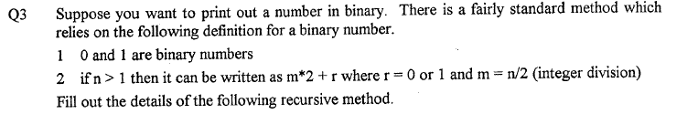
static public void printBin(int n)
{
if(n < 2)
System.out.print(…);
else {
int m = n / 2;
int r = n % 2; // r is the remainder of n/2
printBin(…);
System.out.print(…);
}
}
n
m
r

Slide 8
Python
def print_bin(n):
"""Recursively prints the binary representation of an integer."""
if n < 2:
print(n, end='') # 'end=""' prevents a new line after printing
else:
m = n // 2
r = n % 2 # r is the remainder of n/2
print_bin(m)
print(r, end='')
# Test cases
test_numbers = [6, 10, 13, 255]
print("Decimal to Binary Conversions:")
print("-" * 30)
for num in test_numbers:
print(f"Decimal {num} in Binary is: ", end='')
print_bin(num)
print() # Print a new line after the binary sequence is finished

Slide 9
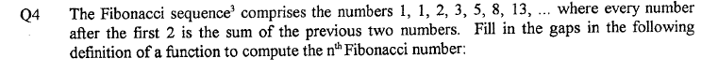
static public int fib(int n) {
if(n <= 2) return ……;
return …...........+…..……..;
}
1
fib(n - 1)
fib(n - 2)
def fib(n):
if n <= 2:
return 1
return fib(n - 1) + fib(n - 2)

Slide 10
Python Code
def fib(n):
if n <= 2:
return 1
return fib(n - 1) + fib(n - 2)

Slide 11
Q5
The gcd (greatest common divisor) of two integers is the largest whole number which divides both of them.
An example:
gcd(6, 15) is 3 because 3 divides 6 and 15 but no bigger number does.
Other examples: gcd(3, 4) = 1, gcd(2, 4) = 2, gcd(12, 9) = 3 and so on.
By convention gcd(x, 0) = x = gcd(0, x) so gcd(7, 0) = 7 for example.
Euclid worked out (a long time ago) that
if a ≥ b then either b = 0 and the gcd is a, or it's the same as gcd(b, a % b).
Assuming that when the method is first called, a ≥ b, write a gcd function in JAVA.
Can you show that 1) if a ≥ b on the first call it is on all recursive calls and 2) the recursion always terminates.

Slide 12
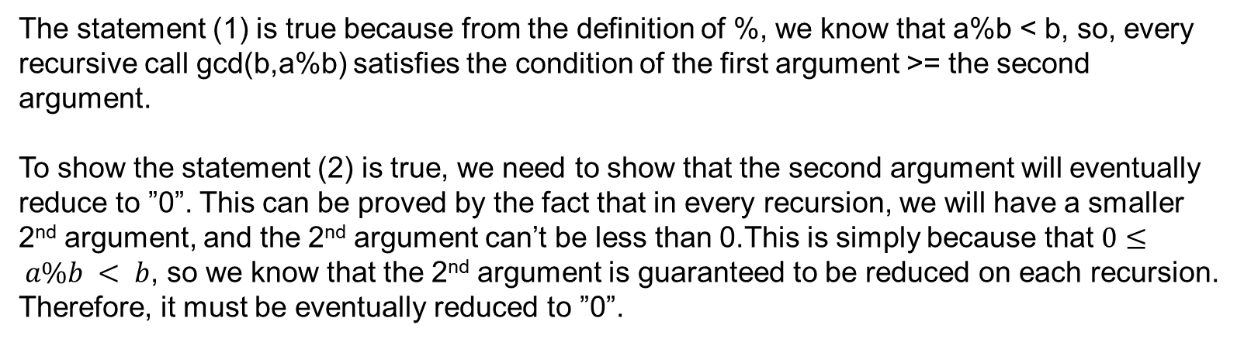
Answer: Java
public static int gcd(int a, int b) {
// Base Case: if b is 0, the gcd is a
if (b == 0) return a; // Recursive Step: gcd(b, a % b)
return gcd(b, a % b);
}
The statement (1) is true because from the definition of %, we know that a%b < b, so, every recursive call gcd(b,a%b) satisfies the condition of the first argument >= the second argument.
To show the statement (2) is true, we need to show that the second argument will eventually reduce to ”0”. This can be proved by the fact that in every recursion, we will have a smaller 2nd argument, and the 2nd argument can’t be less than 0.This is simply because that $0≤ a\%b < b$, so we know that the 2nd argument is guaranteed to be reduced on each recursion. Therefore, it must be eventually reduced to ”0”.

Slide 13
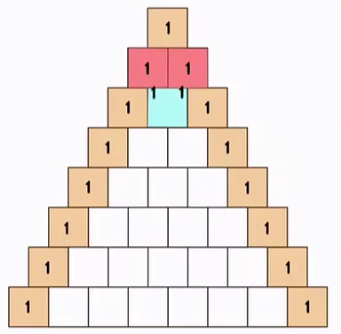
Q6
In Pascal's triangle each number is the sum of the number above it and number diagonally above it to the left (if there is no such number assume use zero). The first few rows are:
1
1
1
1
2
1
1
3
3
1
1
4
6
4
1

Slide 14
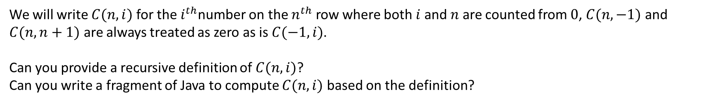
Q6
1
1
1
1
2
1
1
3
3
1
1
4
6
4
1
We will write $C(n, i)$ for the $i^{th}$number on the $n^{th}$ row where both $i$ and $n$ are counted from $0$, $C(n, −1)$ and $C(n, n+1)$ are always treated as zero as is $C(−1, i)$.
Can you provide a recursive definition of $C(n, i)$?
Can you write a fragment of Java to compute $C(n, i)$ based on the definition?

Slide 15
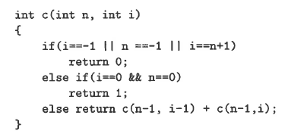
Answer
Pascal’s triangle
Recursive definition of C(n,i):
Basis: C(0,0) = 1, C(n,-1) = C(-1,n) = C(n,n+1) = 0
Induction: C(n,i) = C(n-1,i-1) + C(n-1,i)

Slide 16
Python
def c(n, i):
"""
Recursive implementation of Pascal's Triangle C(n, i).
Calculates the ith number on the nth row.
"""
# Basis/Boundary cases: C(n, -1), C(-1, n), and C(n, n+1) are 0
if i == -1 or n == -1 or i == n + 1:
return 0
# Basis: The very top of the triangle is 1
elif i == 0 and n == 0:
return 1
# Induction: C(n, i) = C(n-1, i-1) + C(n-1, i)
else:
return c(n - 1, i - 1) + c(n - 1, i)

