Slide 1

3D Semantic Novelty Detection
Hossein Kakavand Samaneh Gharedagh Sani
s308581@studenti.polito.it, s309100@studenti.polito.it

Slide 2
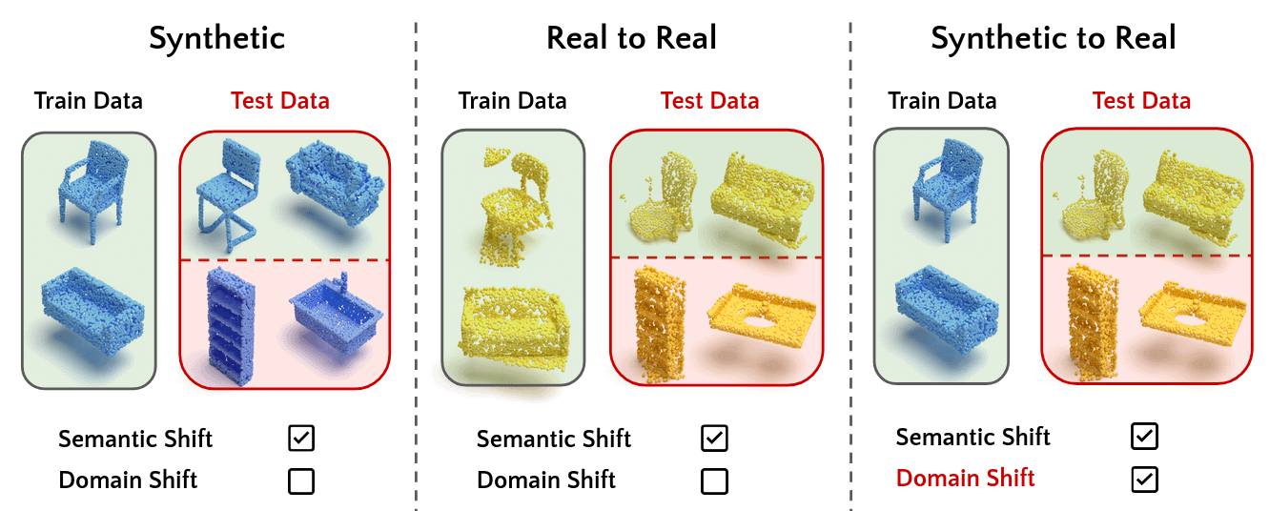
Introduction to Semantic Novelty Detection
Semantic Novelty Detection is essential in data analysis and machine learning. It involves finding new, unseen patterns or information in datasets, which is crucial for applications like anomaly detection and discovering new trends.
Semantic: Focuses on understanding the meaning and relationships within data, going beyond just structure. This helps reveal important trends and patterns that might be missed otherwise.
Novelty: Identifies new, original, or significantly different patterns within data.
Combining semantic analysis with novelty detection helps uncover valuable insights and respond proactively to data changes.
3DOS: Towards 3D Open Set Learning - Benchmarking and Understanding Semantic Novelty Detection on Point Clouds, Alliegro et al in NeurIPS 2022

Slide 3
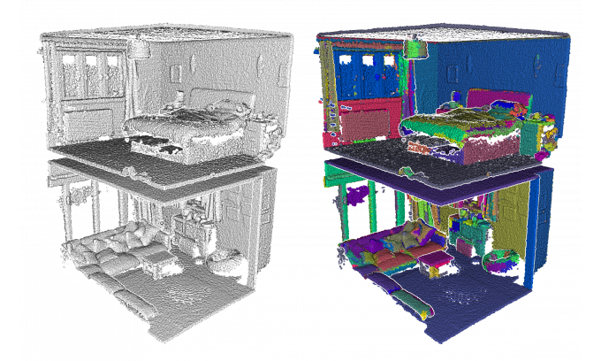
Understanding 3D Point Clouds
3D Point Clouds consist of numerous individual points in 3D space, captured using technologies like LiDAR and stereo cameras. They are used in 3D modeling, computer vision, and GIS.
Applications:
3D Modeling: Used in architecture,
engineering, and entertainment.
Computer Vision: Helps in object recognition
and scene reconstruction.
GIS: Creates accurate
geographic representations.
Challenges:
Lack of inherent structure.
No clear ordering.
Need for detailed manual annotation.

Slide 4
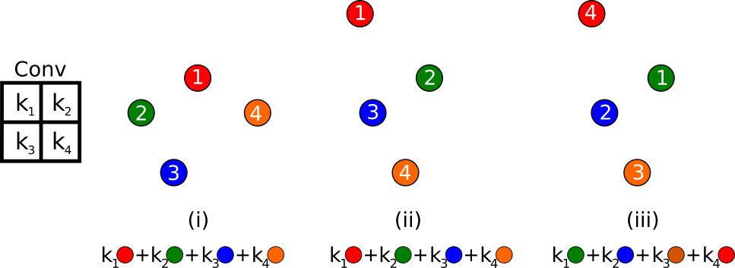
Deep Learning for 3D Point Clouds
Deep learning has shown significant promise in tackling the challenges of processing and understanding 3D shapes within point clouds. For a deep learning model to be effective in processing 3D point clouds, it must satisfy the following key requirements:
Geometric Transformations Invariance: The model’s output for downstream tasks must remain consistent even when rigid transformations (like rotation, translation, or scaling) are applied to the input data.
Permutation Invariance: The model must be invariant to the N! possible permutations of the input points.
Point cloud problem statement

Slide 5
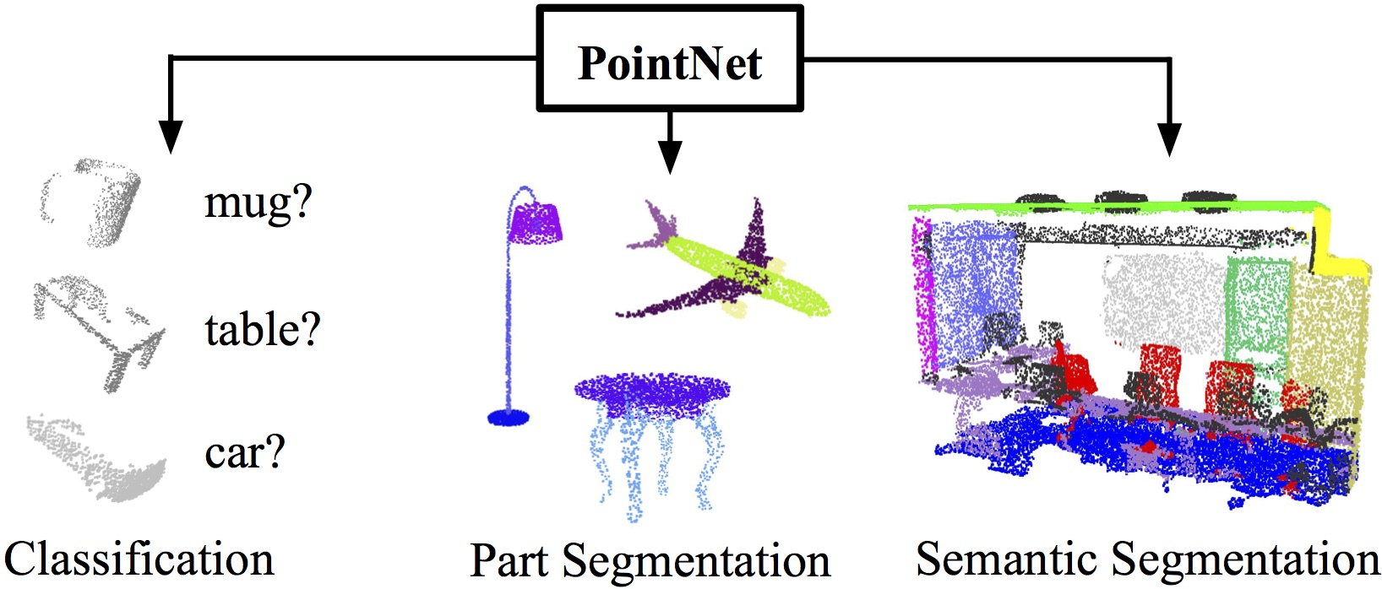
PointNet: Deep Learning for Point Clouds
PointNet is a deep learning architecture for direct point cloud processing, providing class or segment labels.
Key Innovation:
PointNet employs a single symmetric function, max pooling, to aggregate information from all points in the input data.
Insights:
PointNet effectively summarizes complex 3D shapes by identifying a sparse set of key points.
Resembles the skeleton of objects based on visualization.

Slide 6
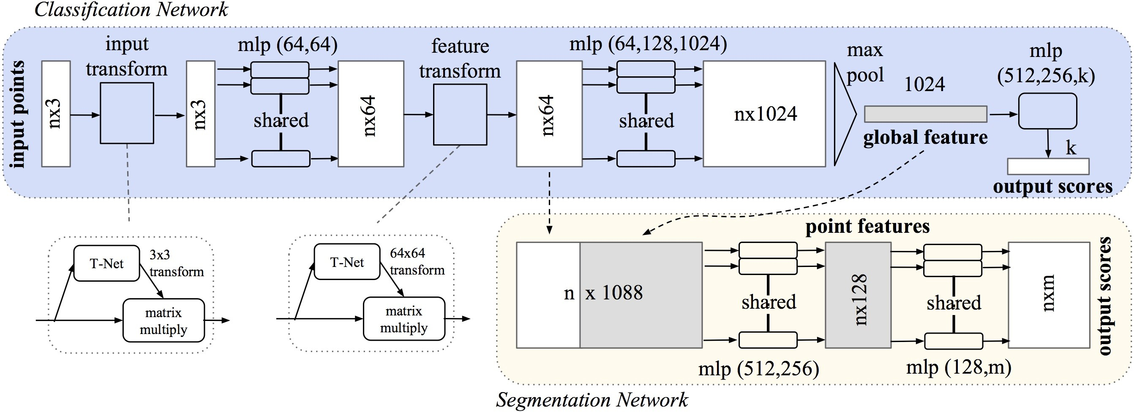
PointNet: Deep Learning for Point Clouds
Max pooling aggregates the information
Two small MLP networks
PointNet: Deep Learning on Point Sets for 3D Classification and Segmentation, Qi et al in CVPR 2017

Slide 7
DGCNN: Enhancing 3D Point Cloud Analysis
Dynamic Graph CNN (DGCNN) addresses the irregularity of point clouds using EdgeConv.
Key Features:
EdgeConv Operation: Directly processes raw point cloud data.
Permutation Invariance: Maintains performance consistency by ensuring invariance to input point permutations.
Geometric Structure Capture: Learns edge embeddings to understand spatial relationships and geometric context.
Advantages:
Robust Local Feature Learning: Groups points in both Euclidean and semantic spaces, crucial for tasks like segmentation.
Reliable Performance: Consistently accurate regardless of point order.
Versatility in Applications: Suitable for object recognition, scene understanding, and robotic perception.
(Dynamic Graph CNN for Learning on Point Clouds, YUE WANG et al)

Slide 8
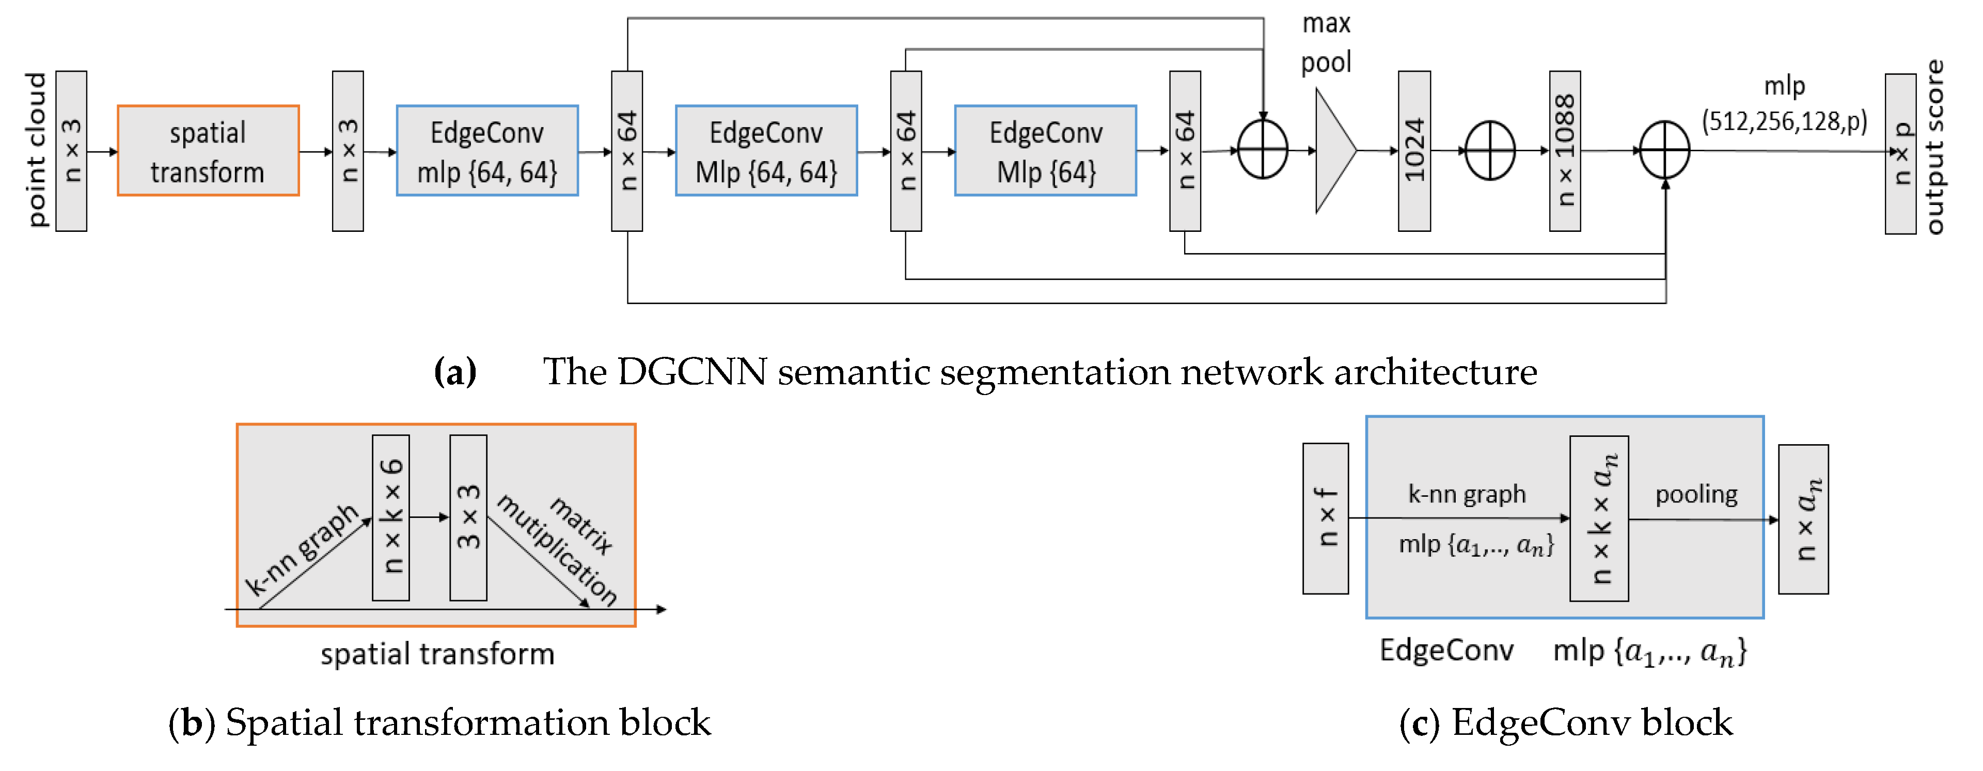
Dynamic Graph CNN
EdgeConv block: The EdgeConv block processes a tensor input by computing edge features for each point using a multi-layer perceptron (MLP).

Slide 9
3DOS: Towards 3D Open Set Learning
The 3DOS Benchmark provides a comprehensive framework for evaluating 3D Open Set learning methods, focusing on semantic novelty detection in point clouds. It covers various difficulty levels and evaluates both synthetic and real-world scenarios.
Benchmark Tracks:
Synthetic: Evaluates models using synthetic data for controlled comparisons.
Real to Real: Tests models with real-world data to assess generalization.
Synthetic to Real: Examines how well models trained on synthetic data perform on real-world data, simulating real-world deployment.
Evaluation Metrics:
AUROC (Area Under the Receiver Operating Characteristic Curve): Measures the ability to distinguish between known and unknown samples.
FPR95 (False Positive Rate at 95% True Positive Rate): Assesses false positive rate at 95% true positive rate, indicating precision and reliability.
Datasets:
Uses ShapeNetCore, ModelNet40, and ScanObjectNN to provide diverse 3D objects for thorough model evaluation.

Slide 10
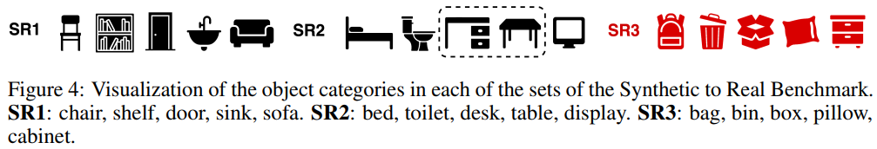
3DOS: Synthetic To Real Benchmark
Objective: Assess model performance in a cross-domain context.
Training Data: Synthetic point clouds derived from ModelNet40.
Testing Data: Real-world point clouds sourced from ScanObjectNN.
Dataset Categories:
• SR1 and SR2: Include matching classes from both ModelNet40 and
ScanObjectNN.
• SR3: Comprises ScanObjectNN classes that do not have direct
counterparts in ModelNet40 .
Methodology:
Models are trained on known classes from ModelNet40 and evaluated on both known and unknown classes from ScanObjectNN.

Slide 11
3DOS: Evaluation Methods
The evaluation of 3D Open Set learning methods in the context of semantic novelty detection involves several diverse approaches. Here are the primary families of methods used in the evaluation:
Discriminative Methods: These methods involve standard classifiers trained with cross-entropy loss, which are typically used in closed set classification. Examples include MSP, MLS, ODIN, Energy, GradNorm, and ReAct.
Representation and Distance Based Methods: Involve learning feature embeddings for identifying novel categories. (ARPL+CS Cosine proto CE (L2) SupCon and SubArcFace).
Density and Reconstruction-Based Methods: Unsupervised approaches such as Variational Autoencoders (VAE) and Normalizing Flow (NF) models fall under this category. These methods focus on reconstructing the input data and use reconstruction error as a metric for detecting novelty.
Outlier Exposure with OOD Generated Data: This approach assesses the performance of models trained with Outlier Exposure (OE), where the models are exposed to artificially generated out-of-distribution (OOD) data during training.

Slide 12
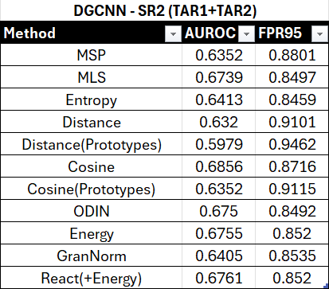
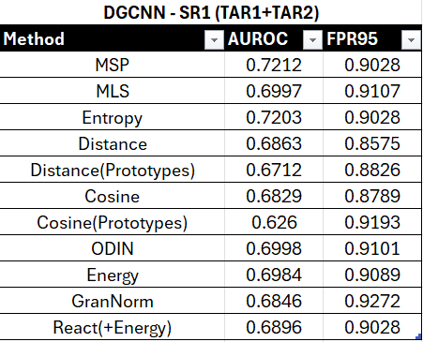
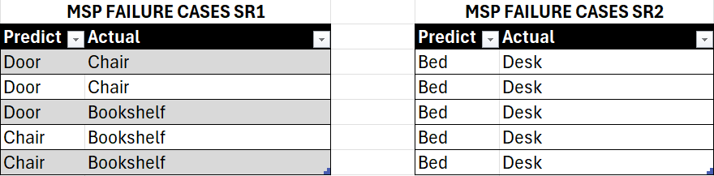
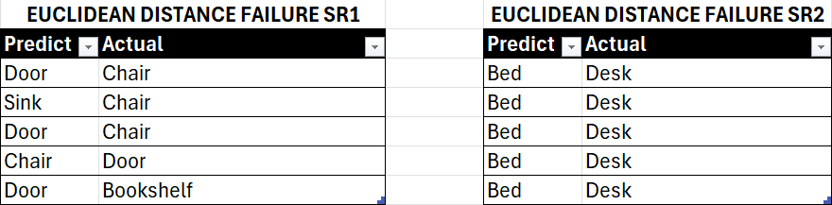
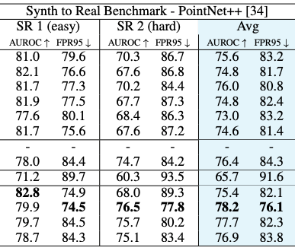
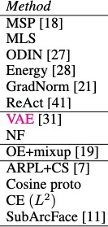
3DOS Baselines and DGCNN Failure Cases
DGCNN SR1 DGCNN SR2
MSP Metric distinct failure instances
Euclidean Distance distinct failure instances
PointNet++

Slide 13
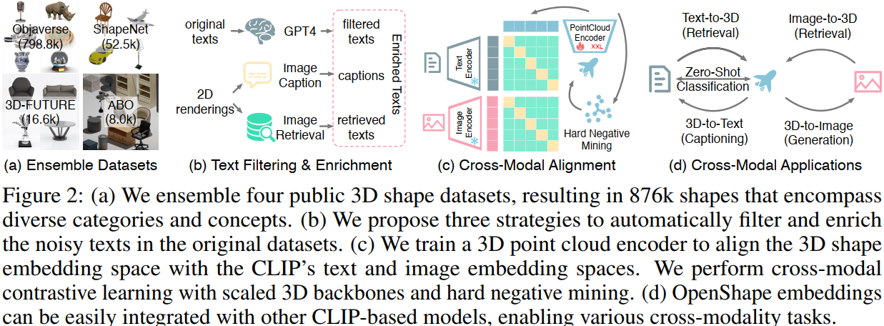
OpenShape
OpenShape is a technique designed to develop joint representations across text, images, and point clouds, with a focus on improving 3D shape comprehension in open-world contexts.
This method combines several 3D datasets, removes noisy text data, and investigates strategies for scaling 3D backbone networks.
Performance evaluations on zero-shot 3D
classification benchmarks reveal that
OpenShape achieves excellent
accuracy on the Objaverse-LVIS
and ModelNet40 datasets.

Slide 14
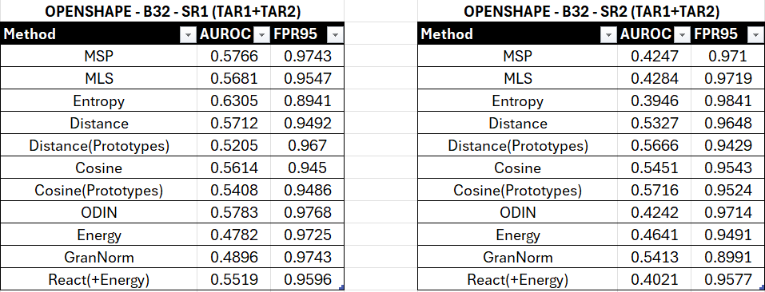
OpenShape Evaluation with 3DOS
OpenShape encounters difficulties in generalizing to real-world test data, resulting in variable performance as reflected in AUROC and FPR95 metrics across different scenarios.

Slide 15
Final results
AUROC
FPR95

Slide 16
Final results
AUROC
FPR95
While the results for OpenShape are promising, DGCNN still outperforms it in many instances.

Slide 17
Thank You for your attention
Hossein Kakavand, Samaneh Gharedagh Sani
s308581@studenti.polito.it, s309100@studenti.polito.it

