Slide 1
S.O.L.I.D?
SRP Single Responsibility Principle
OCP Open/Closed Principle
LSP Liskov Substitution Principle
ISP Interface Segregation Principle
DIP Dependency Inversion Principle
K.I.S.S Keep It Simple Stupid
Y.A.G.N.I You Aren’t Gonna Need It
D.R.Y Don’t Repeat YourSelf
And ….

Slide 2
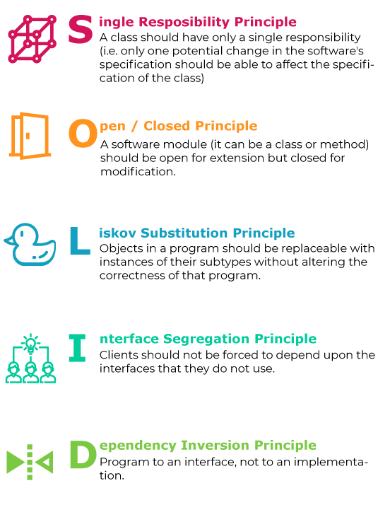
https://itnext.io
https://en.wikipedia.org
https://refactoring.guru
Background vector created by Harryarts - www.freepik.com

Slide 3
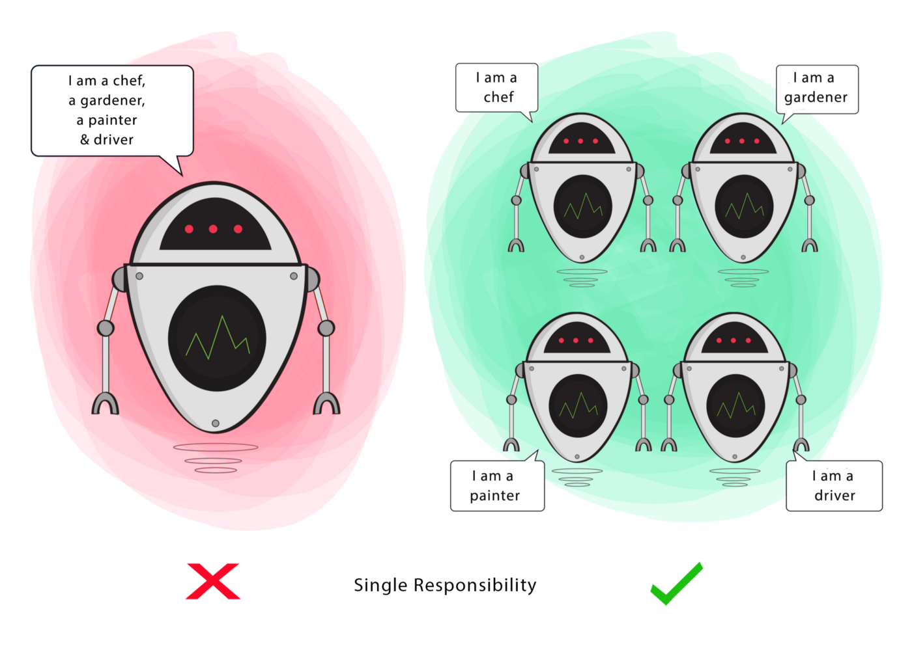

Slide 4
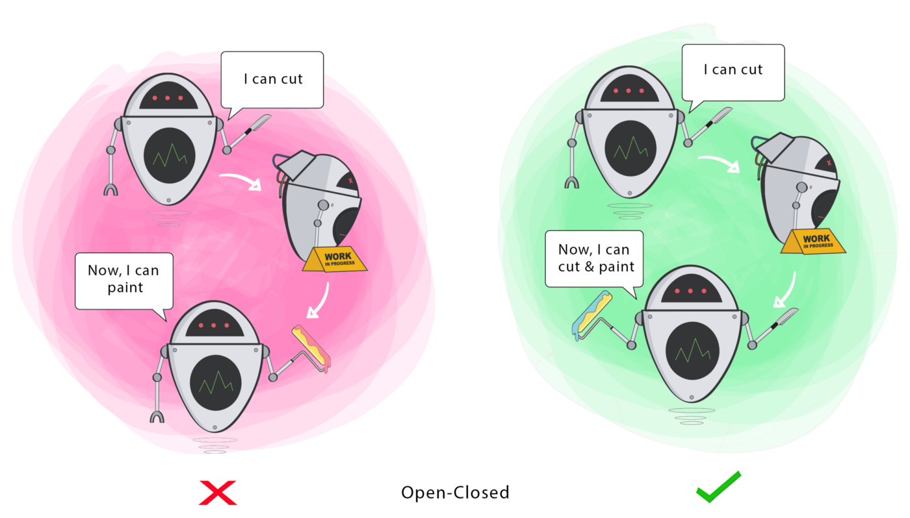

Slide 5
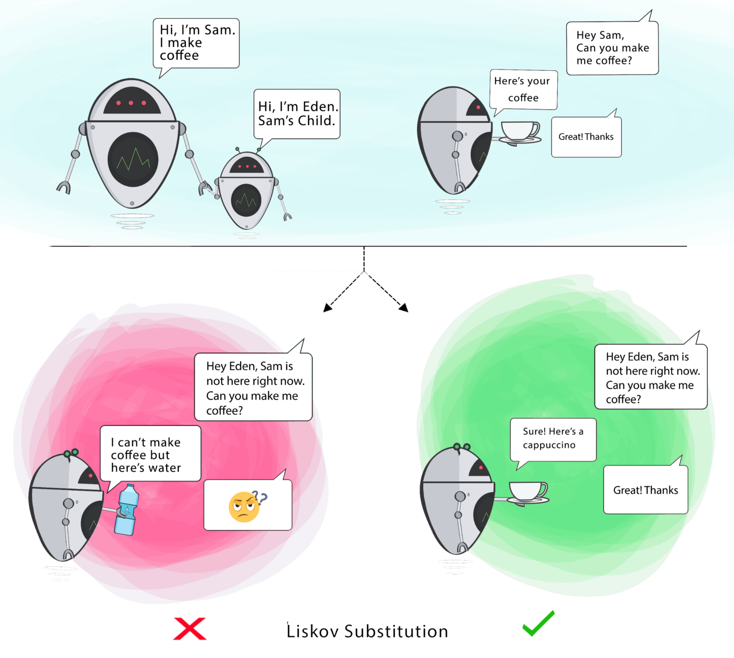

Slide 6
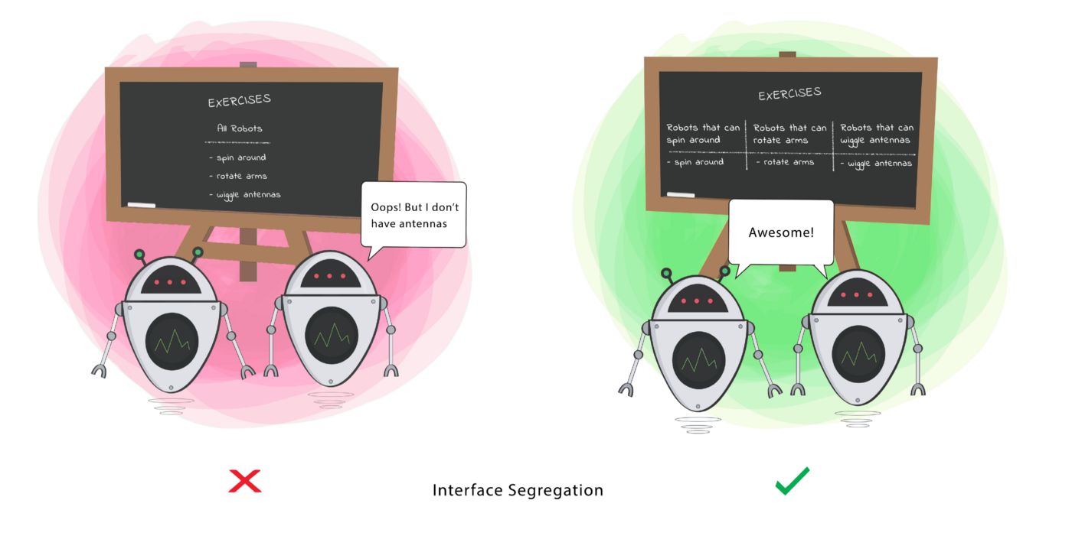

Slide 7
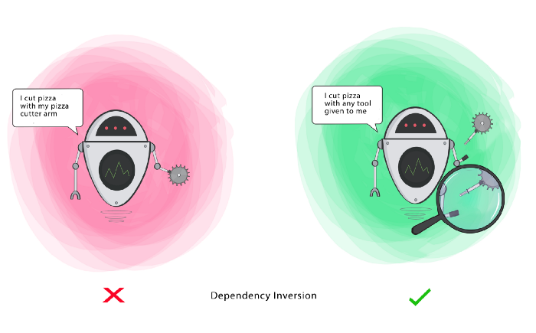

Slide 8

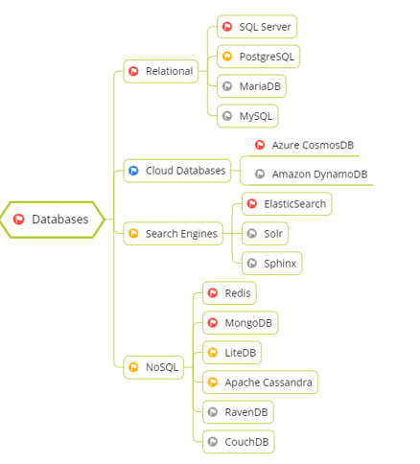
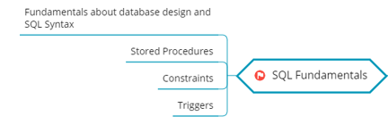

Slide 9



Slide 10
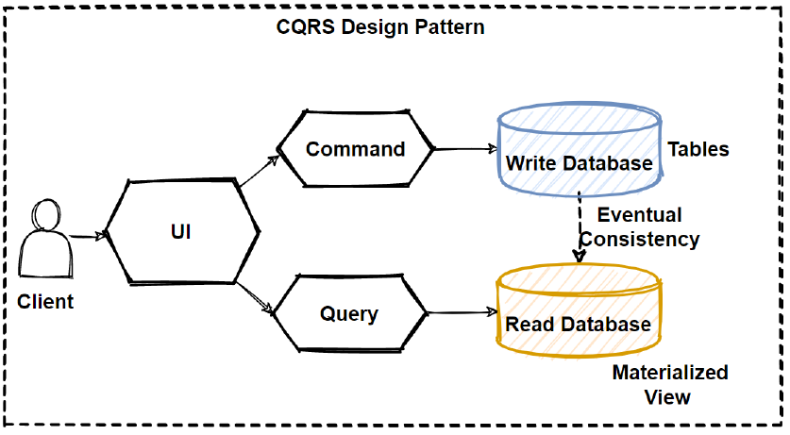

Slide 11
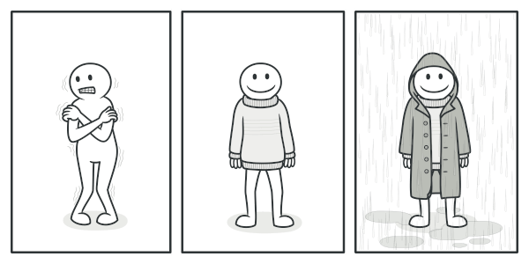


Slide 12

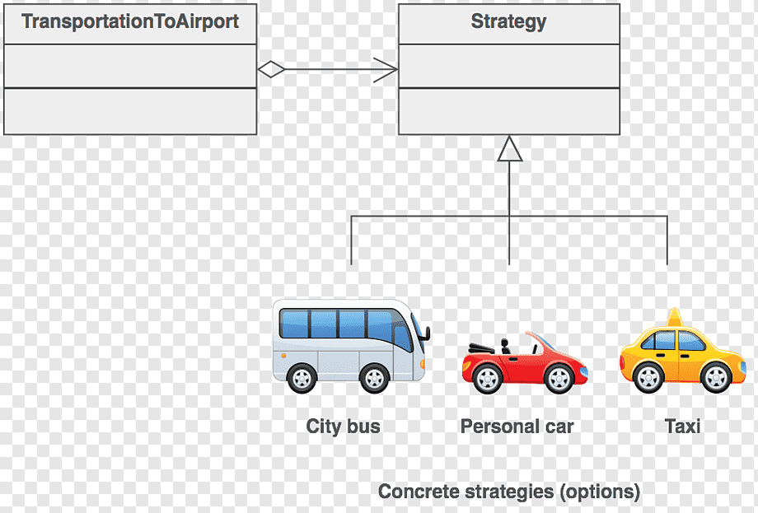

Slide 13
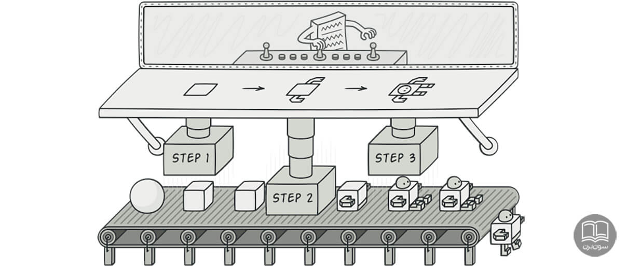



Slide 14
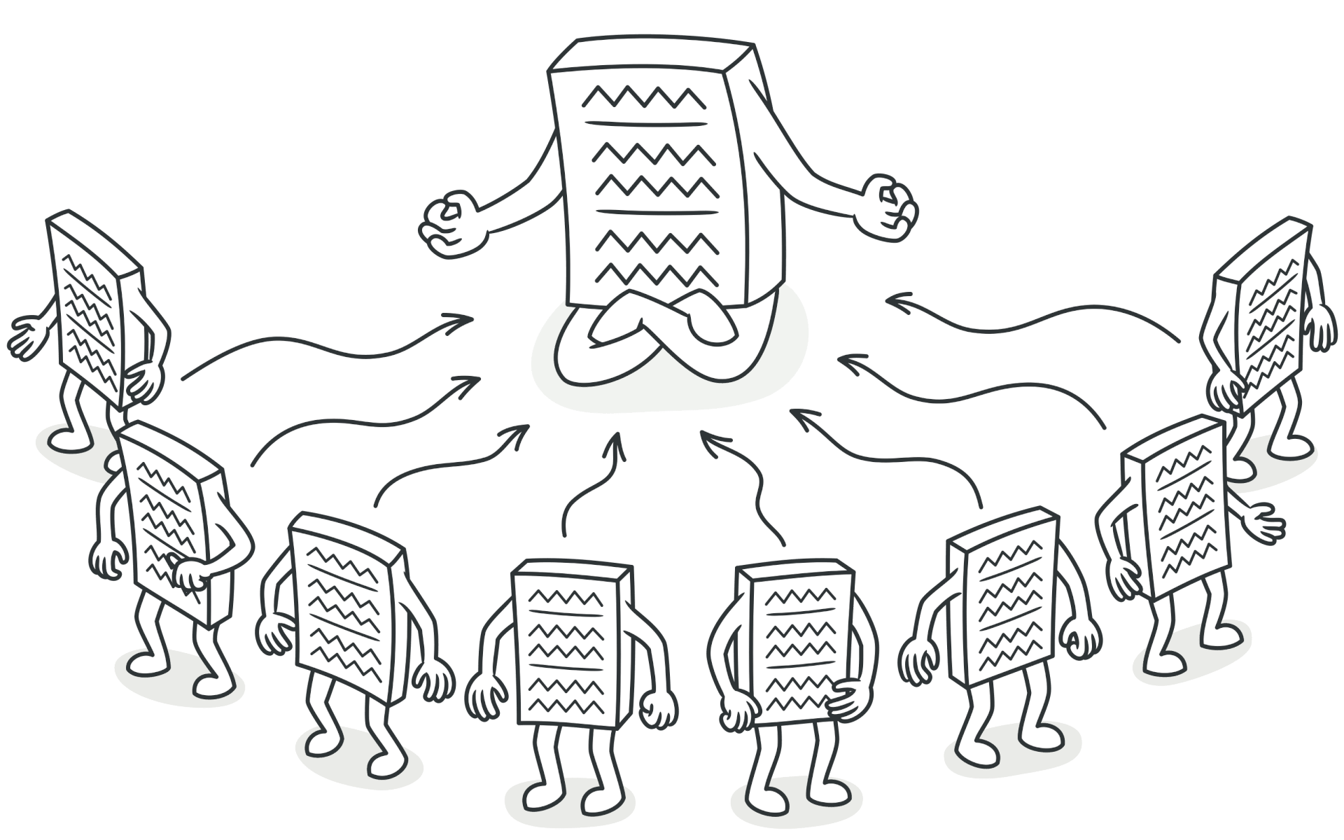


Slide 15
