Slide 1
Machine Learning and Data Science Portfolio
Iurii Guliev (2020)
Fanshawe College
Moscow State University

Slide 2
Contents
Face Key Dots Neural Network (s. 3)
Sunglasses Detector (s. 4)
Traffic Sign Classifier (s. 5)
University Data Science Projects (s. 6)
Metro network vulnerability analysis model (s. 7)

Slide 3

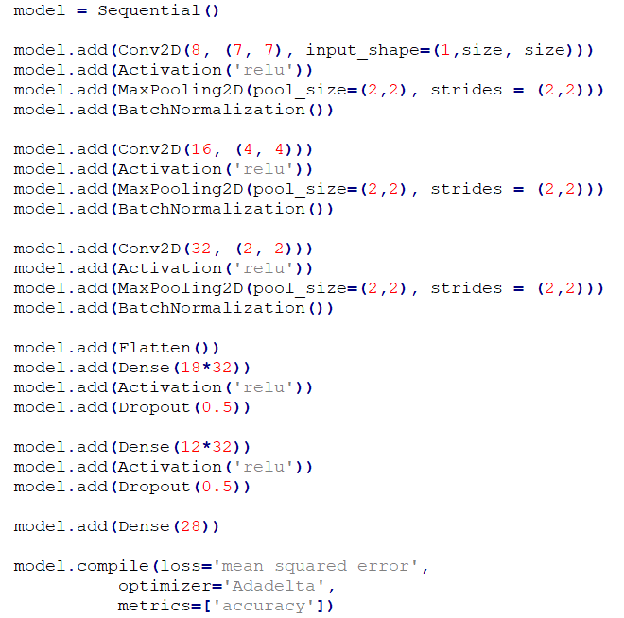
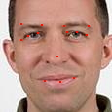
Face Key Dots Neural Network
For this project I was given a set of 6000 images on which I had to train my own convolutional neural network.
Used techniques and tools:
Python 3
Keras library
Data augmentation with numpy and skimage
Result:
8.3099 error on 100 new images using MSE metric
Network
Result

Slide 4
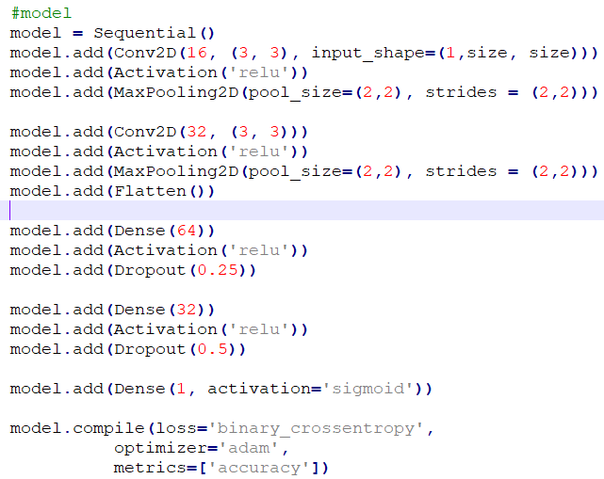
Sunglasses Detector
I was asked to create a convolutional neural network and train it on 300 images
Used techniques and tools:
Python 3
Keras library
Data augmentation with numpy and skimage
Result:
Accuracy on 22000 new images is 89%
Network
True
False

Slide 5
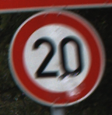
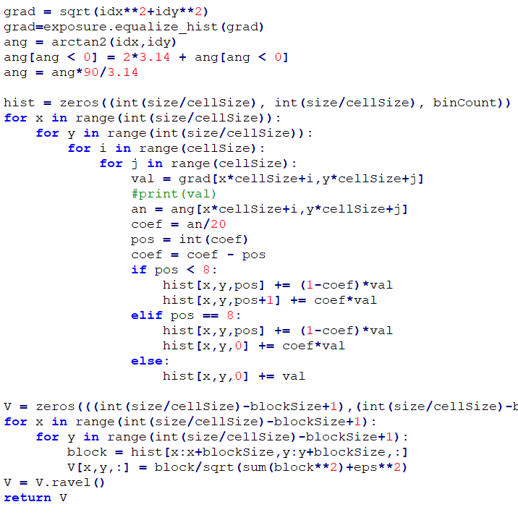

Traffic Sign Classifier
I had to train a traffic sign classifier using SVM model on vectors of specific dots from the images
Used techniques and tools:
Python 3
sklearn library and numpy
Histogram of oriented gradients (HOG)
Support vector machine
Result:
Accuracy on a 1000 new signs - 93%
HOG detection
Class 0
Class 42

Slide 6
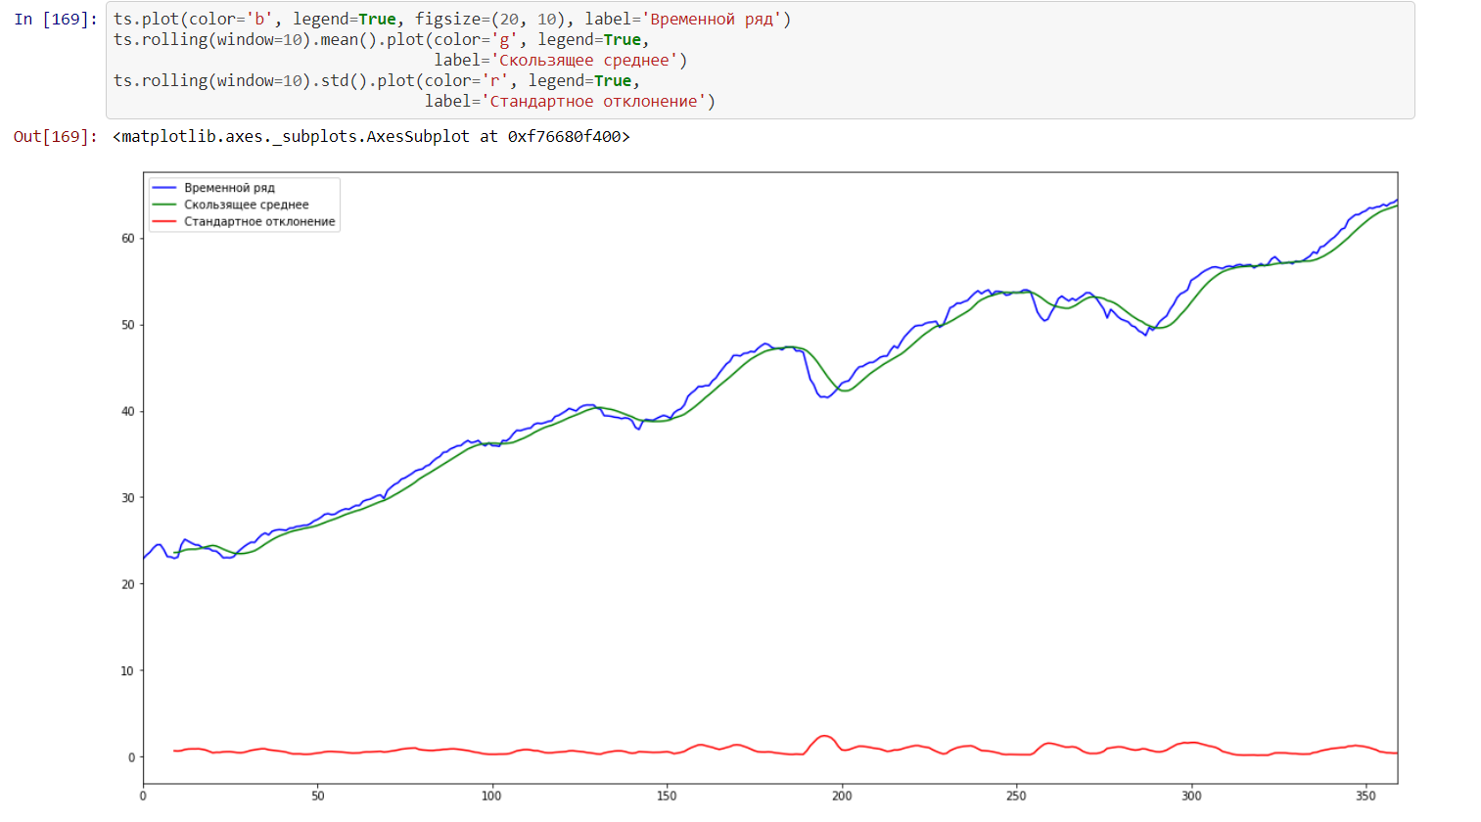
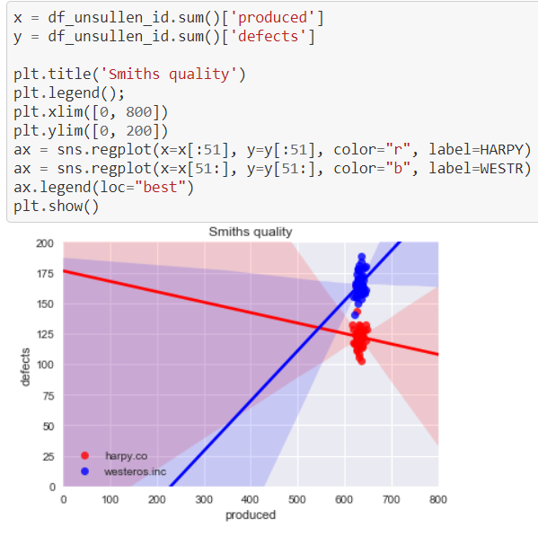
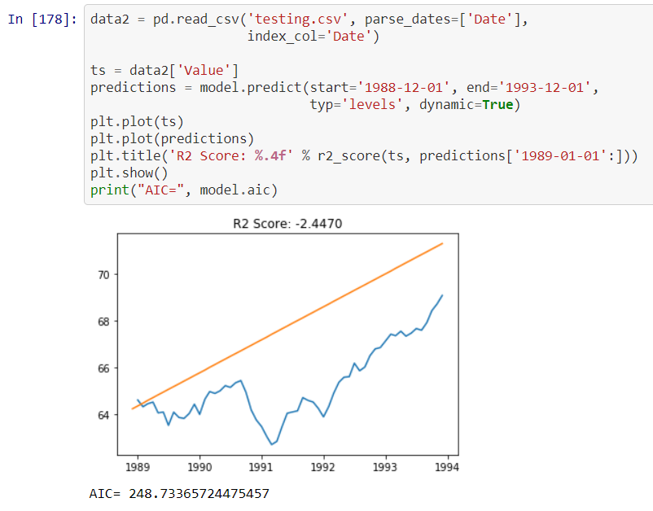
University Data Science Projects
Projects from my university program include time series analysis, prediction models and data aggregation
Used techniques and tools:
Python 3, Jupyter Notebook
Pandas, statsmodels, numpy, seaborn
ARIMA, SARIMAX models
Result:
2 years of experience with python libraries for Time Series analysis
Time Series Analysis
Data Analysis
Prediction

Slide 7
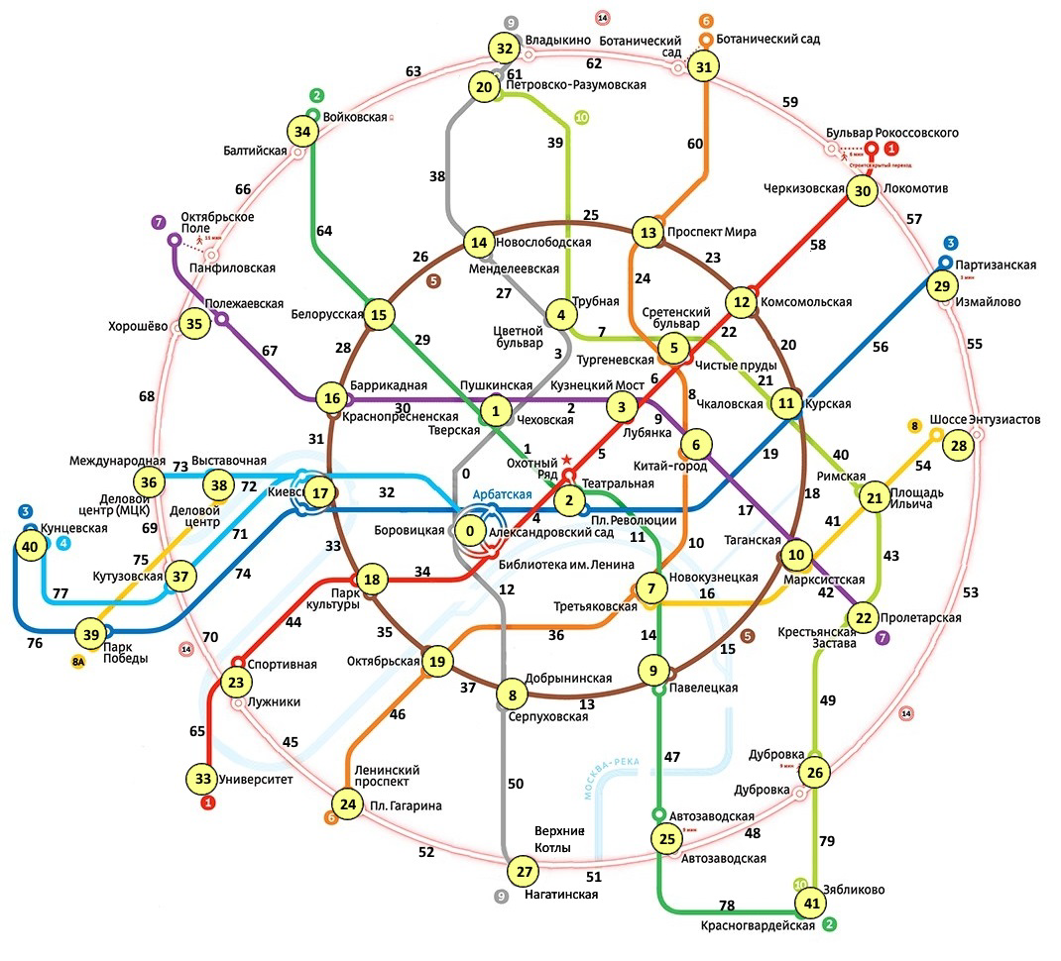
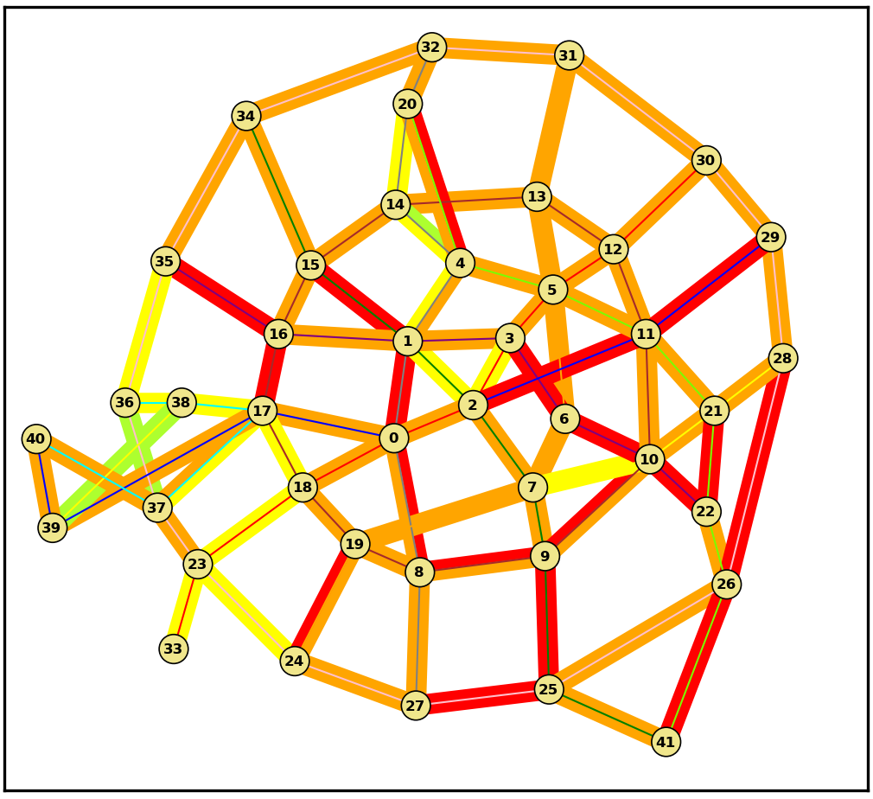
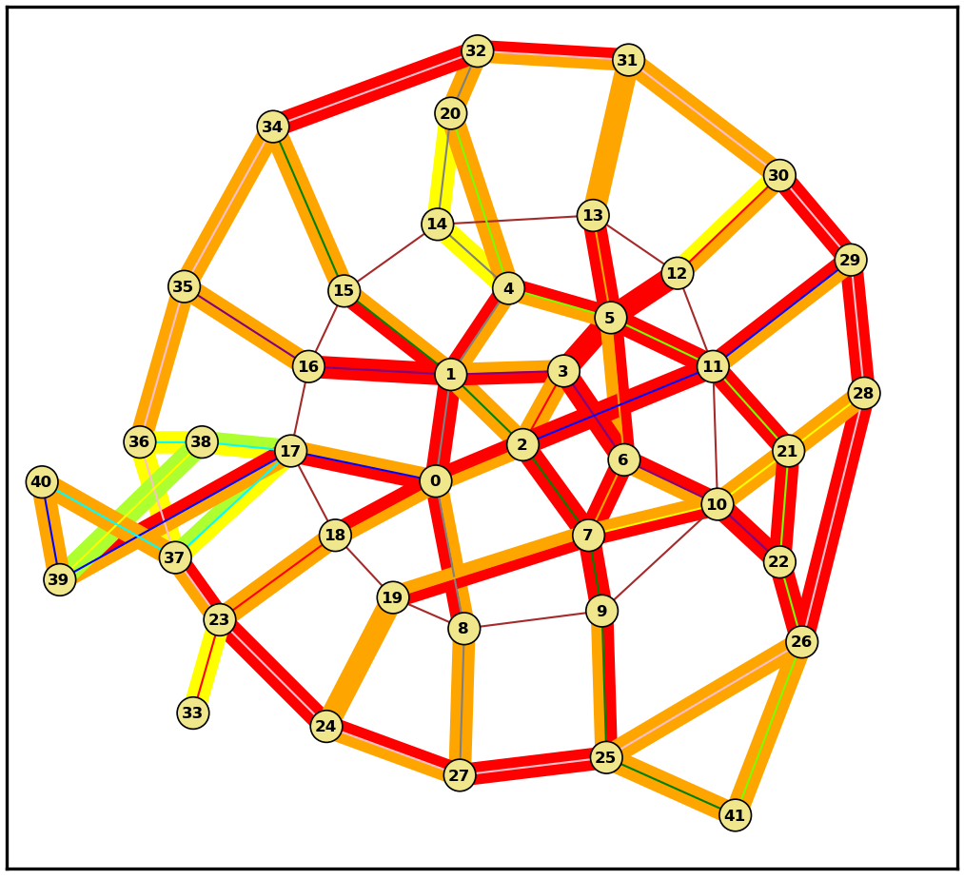
Metro network vulnerability analysis model
This is my university diploma. My research was based on open based information about Moscow metro passenger flow and capacity. I had to built a simulation model that would tell how the network would react to changes
Used techniques and tools:
Python 3
gurobipy library
Numpy and matplotlib
Network flow programming
Result:
Working model to analyze Moscow metro stability
Normal
Built model of Moscow metro
Main Circle is out of service

