Slide 1
TaskFlow:
A Personal Productivity Hub
STUDENT NAME: Shivansh Yashi
E-Mail ID: shivanshyashi016@gmail.com
COLLEGE / UNIVERSITY: Graphic Era University

Slide 2
Problem Statement
Individuals and students struggle to manage multiple responsibilities, leading to stress and reduced productivity.
A task manager app provides a structured way to plan, prioritize, and complete tasks.

Slide 3
Project Overview
TaskFlow is a powerful frontend web application crafted to help users take control of their daily lives. The app is a central hub for all your tasks, providing a seamless and intuitive experience for tracking your to-do lists.
One of the core features of TaskFlow is its ability to add and track tasks. You can easily create new tasks, set deadlines, and organize them into different categories or projects. The app also lets you mark tasks as complete, giving you a clear sense of accomplishment as you work through your to-do list.

Slide 4
Project Overview
Beyond just tracking tasks, TaskFlow helps you monitor your progress visually. The app provides a visual representation of your completed and pending tasks, allowing you to quickly see how far you’ve come and what’s still left to do. This visual feedback is a great motivator and helps you stay on top of your workload.
Ultimately, the goal of TaskFlow is to promote better time management and organization. By providing a single, organized platform for all your tasks, the app reduces mental clutter and helps you prioritize what's most important. This leads to increased productivity and a more structured approach to your daily and long-term goals.

Slide 5
End Users
Students: Students can leverage TaskFlow to effortlessly manage their academic lives. The app provides a single place to manage assignments, track due dates, and organize class schedules. This helps reduce the stress of juggling multiple deadlines and different subjects.
Professionals: Professionals can use TaskFlow to stay on top of their fast-paced work environment. It's the perfect tool to organize tasks, schedule meetings, and manage project deadlines. By centralizing work-related items, professionals can stay focused on their goals and ensure nothing falls through the cracks.

Slide 6
End Users
Freelancers: For freelancers managing multiple clients, TaskFlow is a crucial tool for success. The app makes it simple to track client projects, monitor progress, and manage invoices, ensuring every project stays on schedule and is completed efficiently.
Anyone needing a centralized daily to-do system: At its core, TaskFlow is for anyone who wants to bring order to their daily life. It provides a clean, centralized system to track everything from chores to personal goals. If you've ever felt overwhelmed by your to-do list, TaskFlow can help you regain control and work more effectively.

Slide 7
Tech Stack
HTML (HyperText Markup Language)
HTML serves as the structure of the application. It provides the skeletal framework for every element you see on the screen, from the input fields for adding new tasks to the lists that display them. Without HTML, there would be no content for the other technologies to interact with, making it the essential starting point for building the user interface.
CSS (Cascading Style Sheets)
CSS is responsible for the styling of TaskFlow, giving it its polished and professional appearance. It goes beyond basic colors and fonts to create a visually engaging experience. This includes using gradients for backgrounds and buttons to add depth and a modern aesthetic. The focus on a clean UI (User Interface) ensures that the app is not only visually appealing but also easy to navigate, reducing clutter and allowing users to focus on their tasks.

Slide 8
Tech Stack
JavaScript
JavaScript is the engine that drives TaskFlow's interactivity. It handles all the dynamic actions within the app, making it responsive and functional. This includes:
Task Handling: JavaScript manages the creation, editing, and deletion of tasks. When a user clicks "Add Task," JavaScript takes that input and adds it to the list.
Progress Tracking: The visual monitoring of progress, a key feature of TaskFlow, is powered by JavaScript. It tracks the status of each task and updates the visual display (like a progress bar or a count of completed tasks) in real-time.

Slide 9
Design and Layout
Clean, Minimal Interface
The app features a clean, minimal interface that reduces visual clutter and helps users focus on their tasks. By stripping away unnecessary elements, the design ensures a straightforward user experience. This simplicity isn't just for aesthetics; it’s a functional choice that promotes better concentration and reduces cognitive load, making task management feel less daunting.
Header with Project Title
At the top of the interface, a prominent header with the project title provides immediate context. This title can be customized, allowing users to name their to-do lists based on different projects, days, or goals (e.g., "Monday's Tasks," "Client Project A," "Gym Routine"). This simple feature helps users stay organized and easily switch between different task lists.

Slide 10
Design and Layout
Task Input Area
The task input area is where the magic begins. This is a dedicated space where users can quickly add new tasks to their list. It’s designed for efficiency, often featuring a simple text field and an "Add" button, allowing for rapid entry of new items. The ease of adding a task is crucial for ensuring that users can capture ideas and to-dos as soon as they come to mind.
Task List with Completion Controls
The task list is the core of the application, visually presenting all pending and completed tasks. Each task within the list is accompanied by completion controls, typically a checkbox or a button. When a user completes a task, they simply check the box, and the app updates the status. This interactive element provides a satisfying sense of accomplishment and keeps the list current.

Slide 11
Design and Layout
Progress Dashboard with Real-Time Updates
The progress dashboard is a key feature that provides a comprehensive overview of a user's productivity. This section offers real-time updates on their progress, showing metrics like the number of completed tasks, a percentage of completion, or a visual progress bar. This dynamic feedback loop motivates users and helps them see their achievements at a glance, reinforcing the habit of staying organized and productive.
Responsive Design for All Devices
TaskFlow's user-centric design extends to its adaptability across different screens. It is built to be fully responsive for all devices, ensuring a seamless and consistent experience whether you're on a desktop computer, a tablet, or a smartphone. This is achieved by using a flexible layout and CSS media queries that automatically adjust the interface to fit the screen size. For example, on a mobile device, the layout might stack elements vertically to be more finger-friendly, while on a desktop, the same elements could be arranged horizontally for better use of screen real estate. This commitment to responsiveness ensures that you can manage your tasks anywhere, at any time, without compromising on usability.

Slide 12
Features
Add, Complete, and Delete Tasks
At the heart of TaskFlow is its fundamental task management functionality. The application makes it incredibly easy to add new tasks, providing a seamless input field that allows users to capture to-dos the moment they think of them. Once a task is underway, users can easily mark it as complete with a single click, providing a satisfying sense of accomplishment. For tasks that are no longer relevant, the option to delete them keeps the task list clean and focused. This intuitive, three-part system ensures that the task list remains an accurate reflection of a user's current goals.
Dynamic Progress Tracking
TaskFlow offers more than just a static list; it provides dynamic progress tracking that gives users a real-time overview of their productivity. As you add or complete tasks, a visual progress dashboard updates instantly. This feature might include a progress bar that fills up, a numerical count of completed tasks versus total tasks, or a percentage display. This real-time feedback helps users visualize their progress, providing a clear and motivating picture of how much they have accomplished and what is left to do.

Slide 13
Features
Motivational Interactive Messages
To keep users engaged and encourage them to stay on track, TaskFlow includes motivational interactive messages. These are small, encouraging phrases or celebratory animations that appear at key moments, such as when a user completes their first task of the day, finishes a challenging project, or clears their entire to-do list. These messages are designed to be positive reinforcement, celebrating small victories and making the process of task management feel more rewarding. This unique feature helps build a positive relationship between the user and the application, turning a simple tool into a powerful source of motivation.

Slide 14
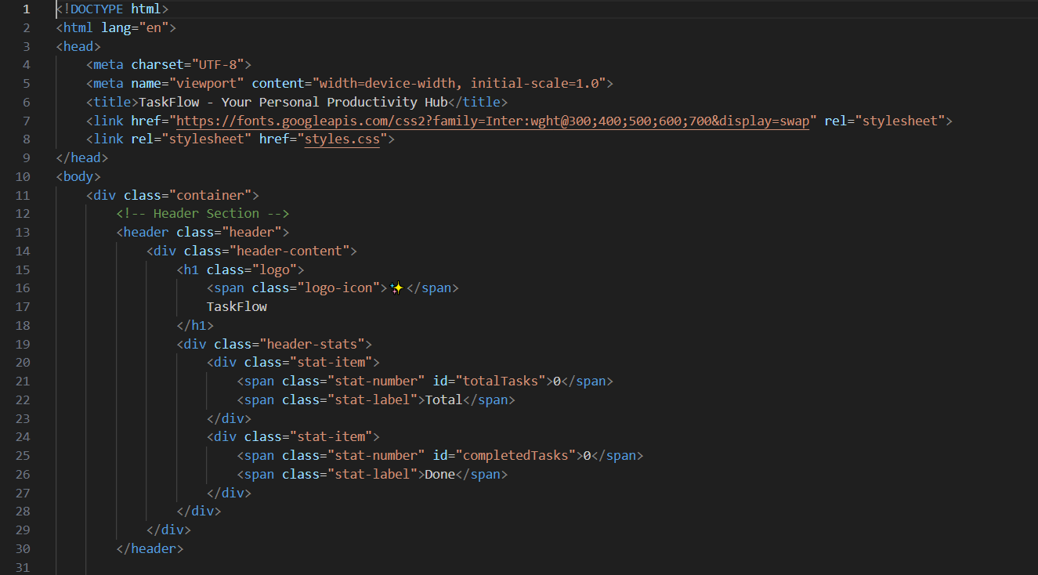
Coding: HTML

Slide 15
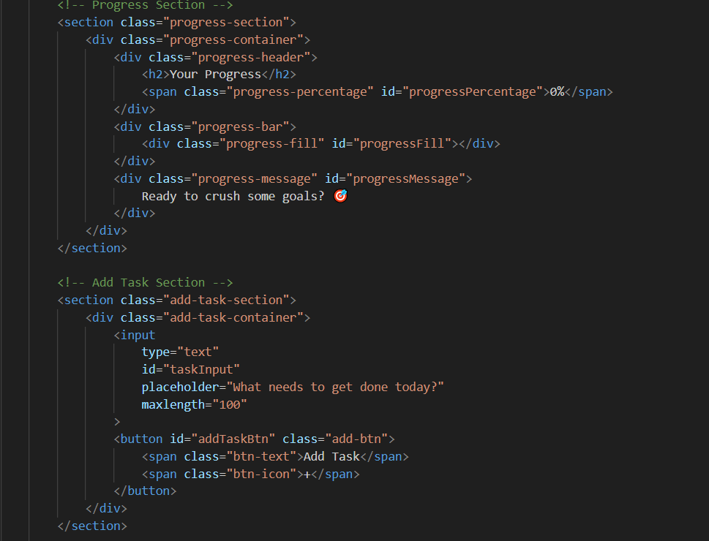
Coding: HTML

Slide 16
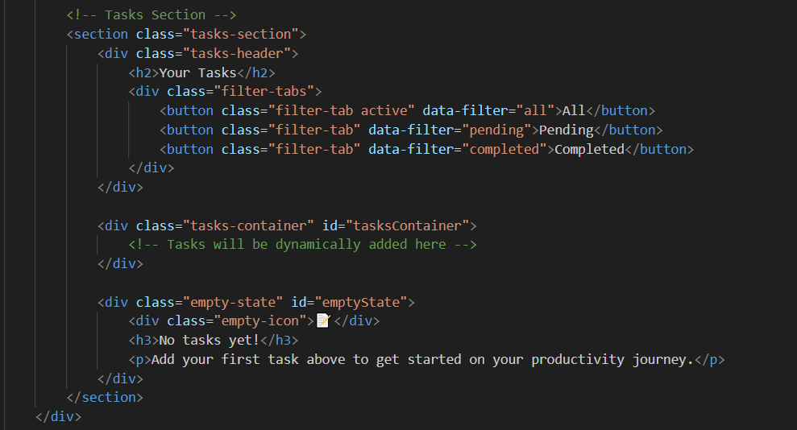
Coding: HTML

Slide 17
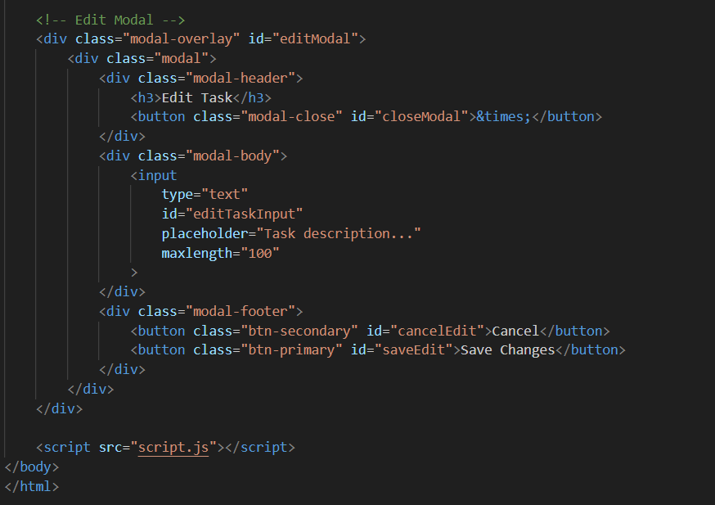
Coding: HTML

Slide 18
Explanation
This HTML code defines the front-end structure of a simple task management web application called TaskFlow.
It sets up the skeleton of the user interface, and styling is done by CSS, and the actual behavior is controlled by JavaScript.
Everything is wrapped inside a main <div class="container"> for structured layout.
Header section displays the logo of TaskFlow and also shows the task statistics (Total Tasks and Completed Tasks)
Progress Section displays overall progress toward task completion. It also shows a progress bar that visually fills as tasks are completed.
Add Task Section aids us in adding new tasks. The ‘+’ icon triggers JavaScript to add new task.

Slide 19
Explanation
Tasks Section displays all tasks in a task list container. It provides filtering tabs (Completed, Pending, All) to sort tasks. It includes an empty state message that appears when no tasks exist.
Edit Modal helps us to edit the existing tasks. It contains an input field to change the task text, and cancel and save buttons. This modal is hidden by default and is toggled by JavaScript.

Slide 20
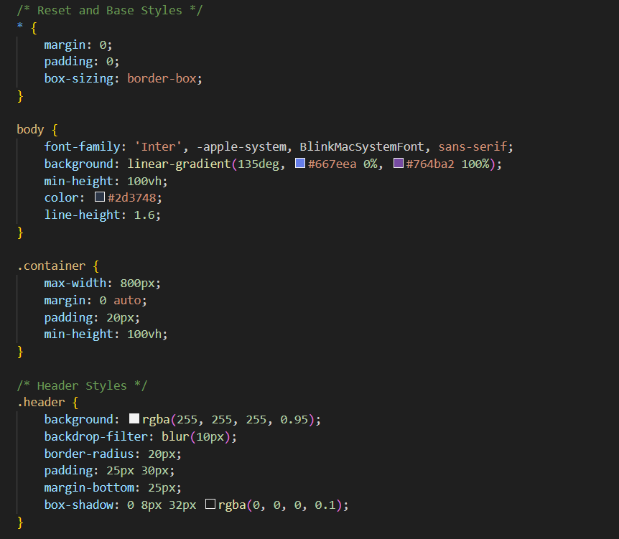
Coding: CSS

Slide 21
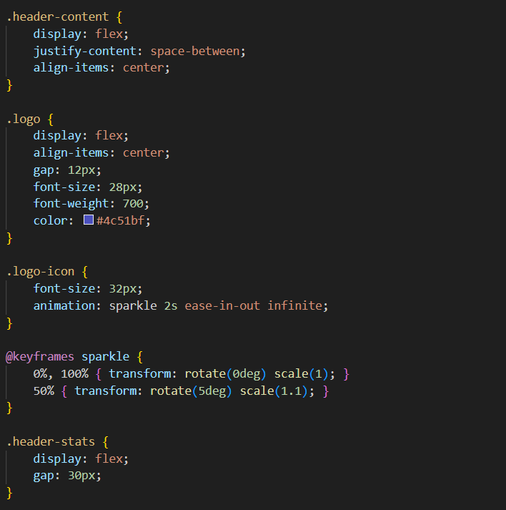
Coding: CSS

Slide 22
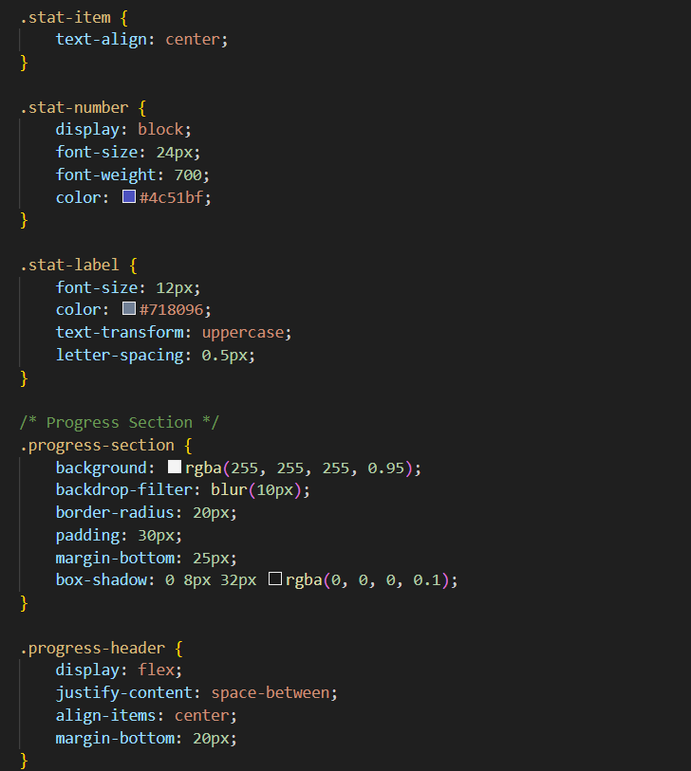
Coding: CSS

Slide 23
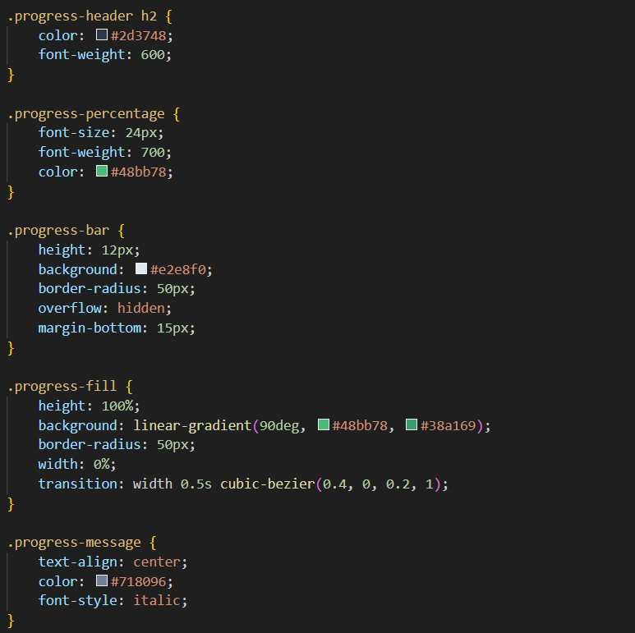
Coding: CSS

Slide 24
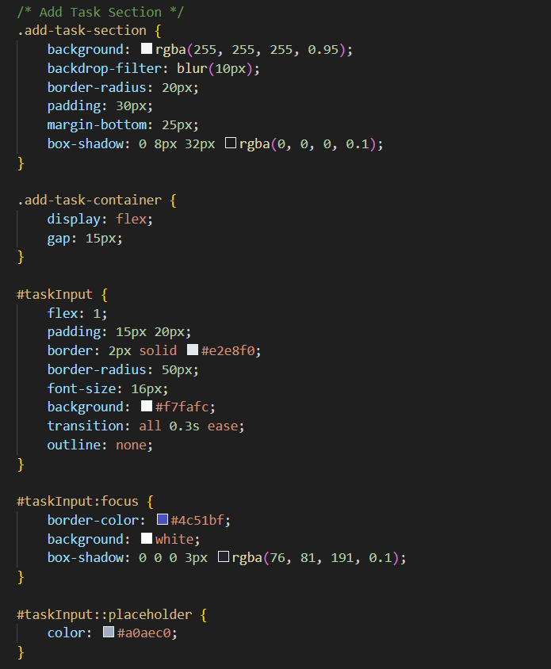
Coding: CSS

Slide 25
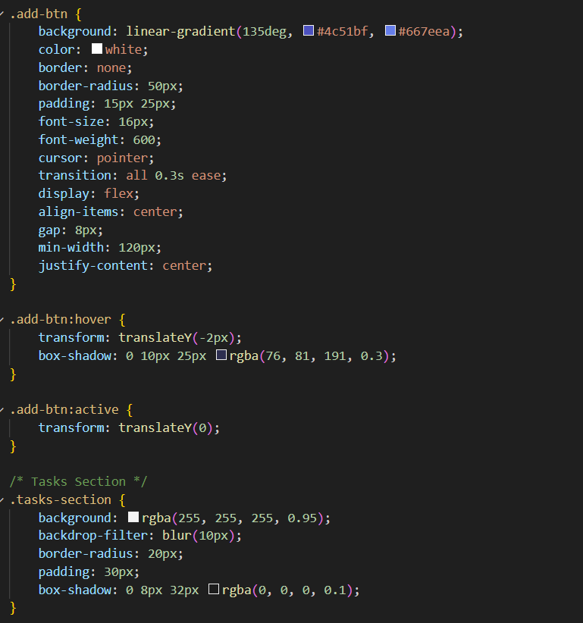
Coding: CSS

Slide 26
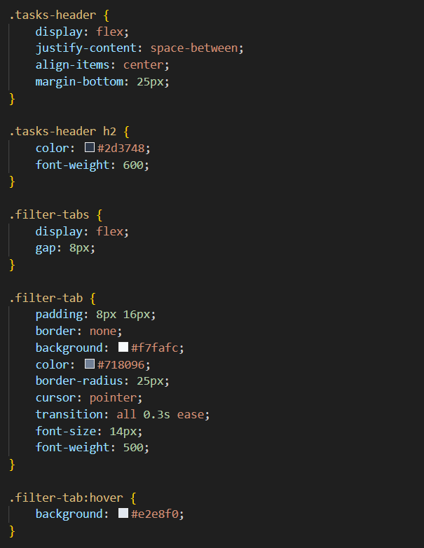
Coding: CSS

Slide 27
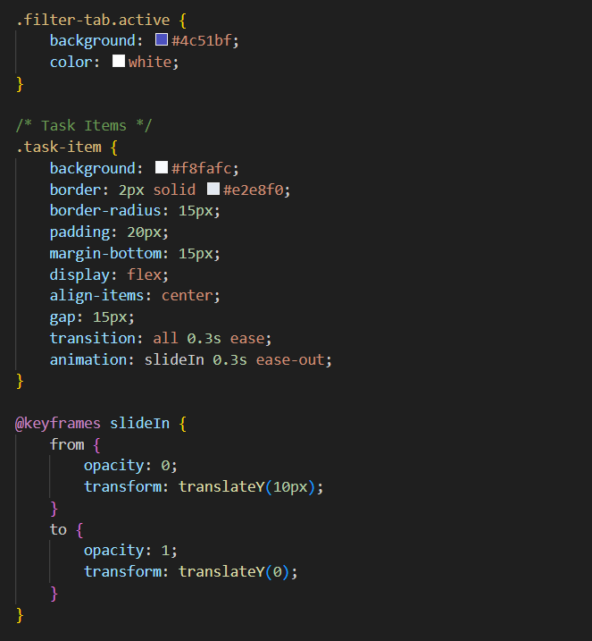
Coding: CSS

Slide 28
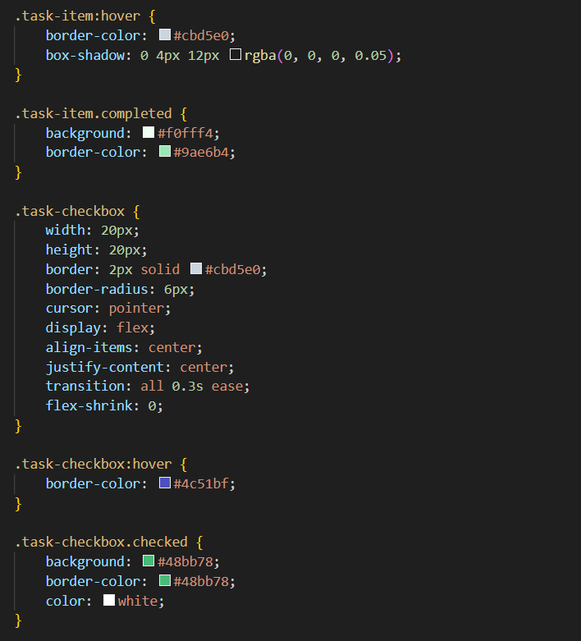
Coding: CSS

Slide 29
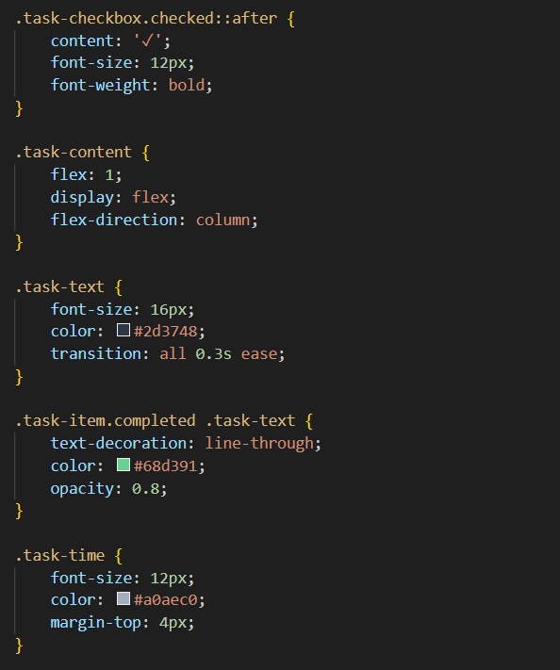
Coding: CSS

Slide 30
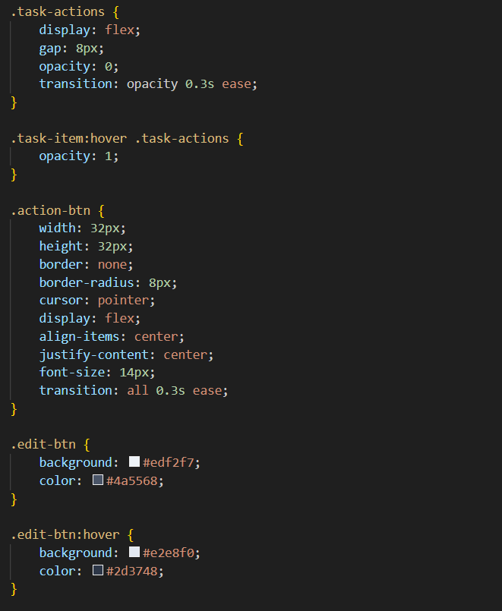
Coding: CSS

Slide 31
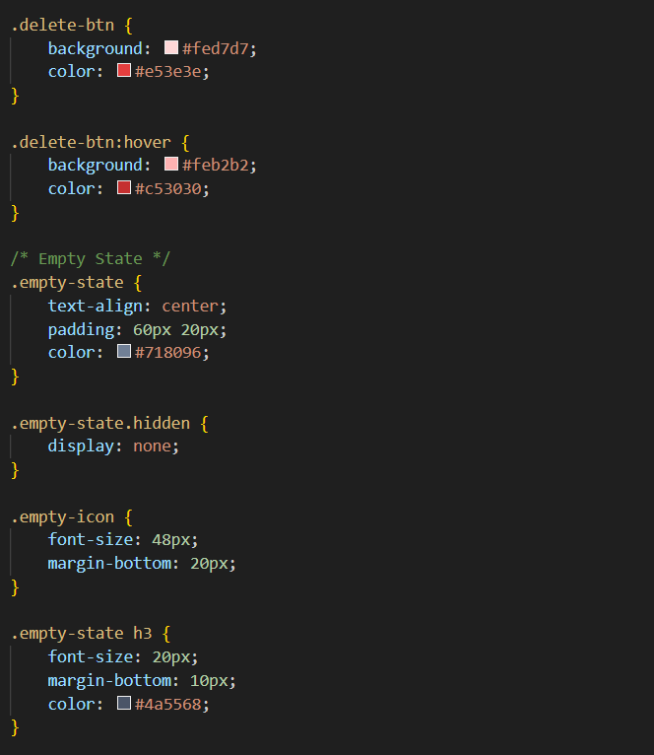
Coding: CSS

Slide 32
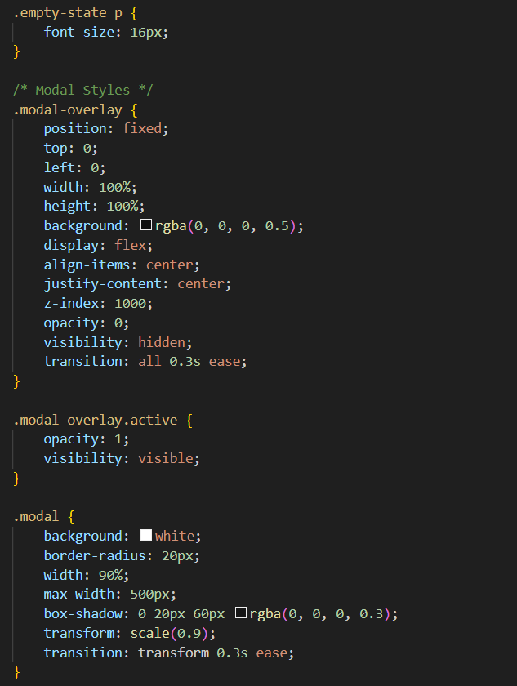
Coding: CSS

Slide 33
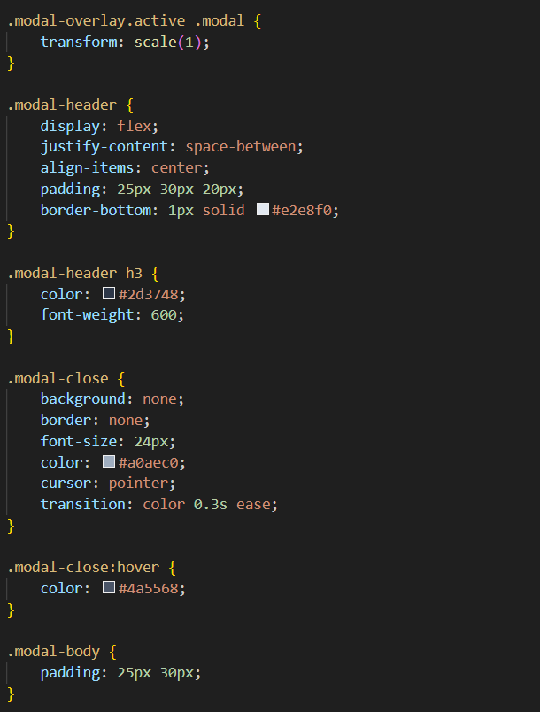
Coding: CSS

Slide 34
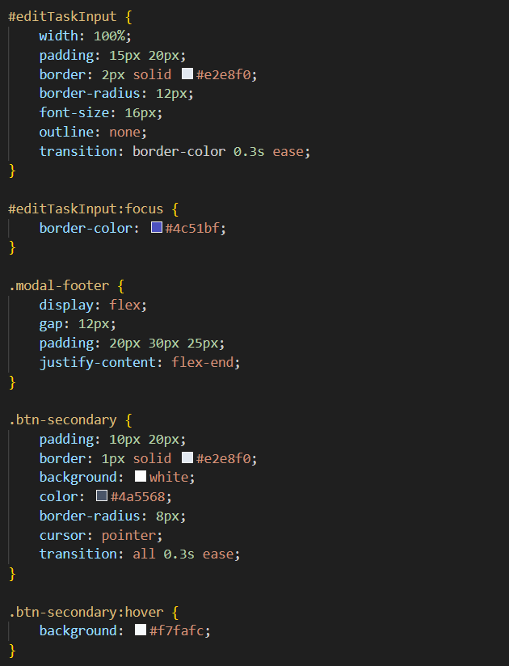
Coding: CSS

Slide 35
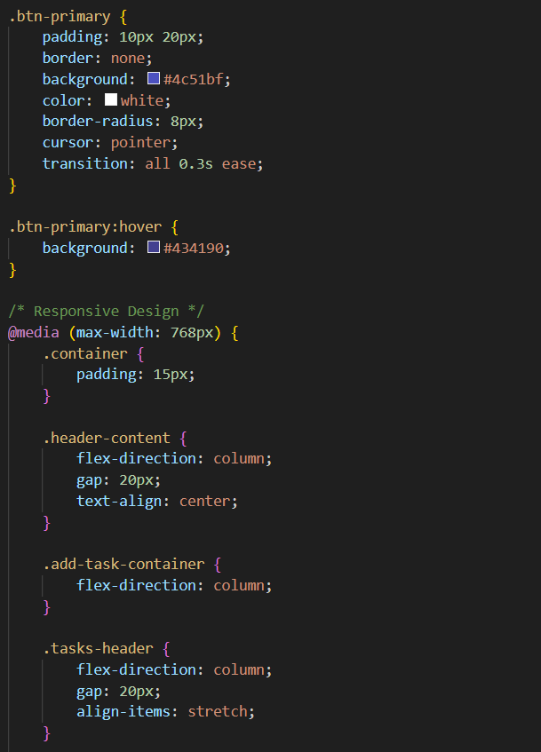
Coding: CSS

Slide 36
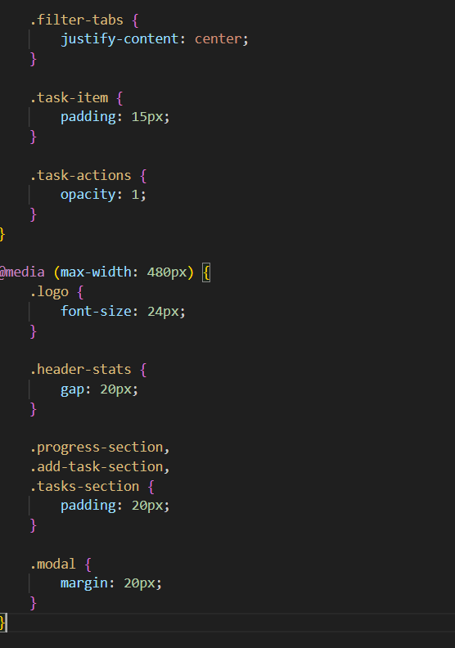
Coding: CSS

Slide 37
Explanation
Base Reset & Layout
Removes default margins/paddings (* { margin:0; padding:0; }), applies box-sizing: border-box, sets a gradient background on body, and defines a clean font (Inter) with modern spacing.
Container Setup
A centered .container with max-width 800px, padding, and full viewport height ensures content stays neatly aligned and readable across screens.
Header Design
.header is styled with a glassmorphism effect (rgba white + blur), rounded corners, shadow, and padding. Inside, .header-content uses flexbox to arrange the logo and stats.

Slide 38
Explanation
Logo & Animation
.logo is bold and purple (#4c51bf). The .logo-icon has a sparkle animation (slight rotation + scaling loop).
Progress Section
Displays task completion percentage with a progress-bar. The .progress-fill animates width smoothly to show progress. The percentage text is green (#48bb78) for positivity.
Add Task Section
A task input (#taskInput) with rounded pill shape, soft shadows, and focus glow. The .add-btn has a gradient background, hover lift effect, and responsive sizing.

Slide 39
Explanation
Tasks Section
Lists tasks inside .task-item cards with borders, hover shadows, and animations (slideIn). Completed tasks turn greenish with strike-through text.
Task Interactions
Custom checkboxes (.task-checkbox) toggle a checkmark when active. Action buttons (edit, delete) appear on hover for task management.
Modal Styling
Fullscreen .modal-overlay for editing tasks with smooth fade/scale transition. The modal box itself is white, rounded, shadowed, and neatly structured with header, body, and footer.

Slide 40
Explanation
Responsive Design
Adjusts layouts for tablets/mobiles (@media). Stacks header and add-task inputs vertically, shrinks padding/fonts, and ensures usability on smaller screens.
This CSS creates a modern, Material-You–inspired to-do app UI with glassmorphism, smooth animations, and mobile responsiveness.

Slide 41
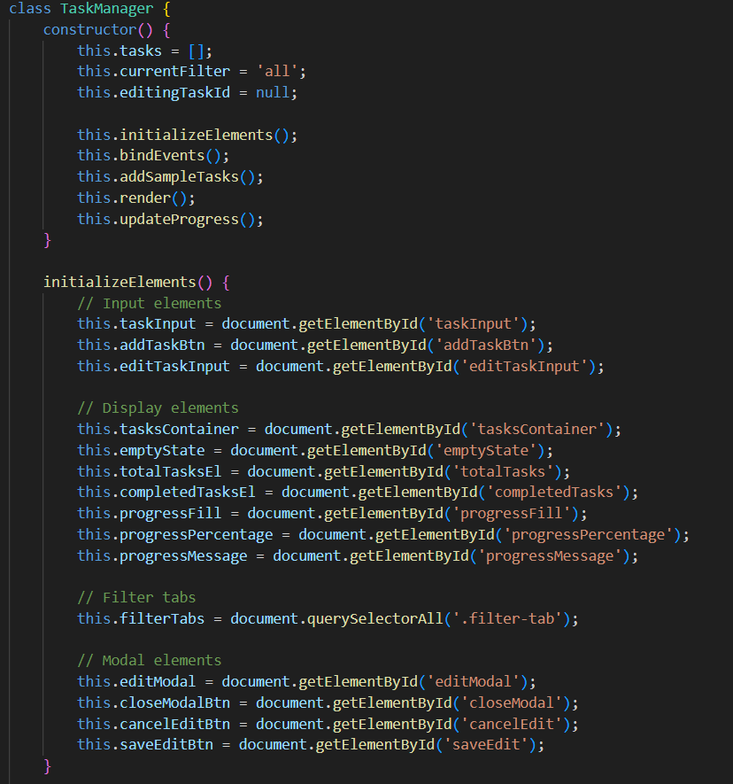
Coding: JavaScript

Slide 42
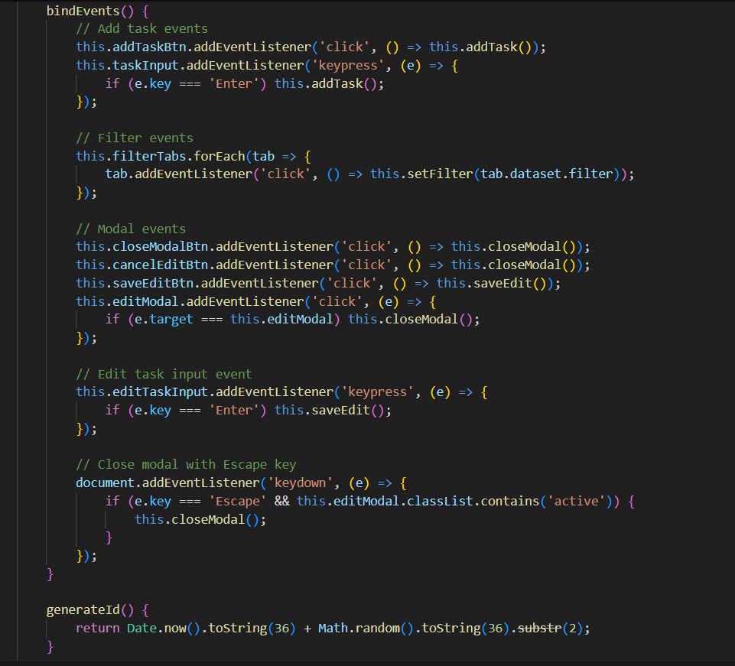
Coding: JavaScript

Slide 43
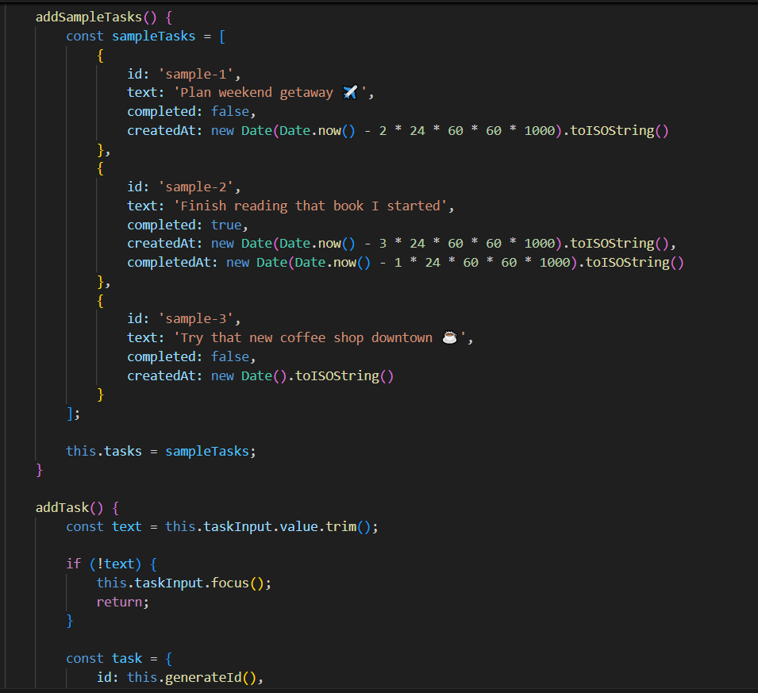
Coding: JavaScript

Slide 44
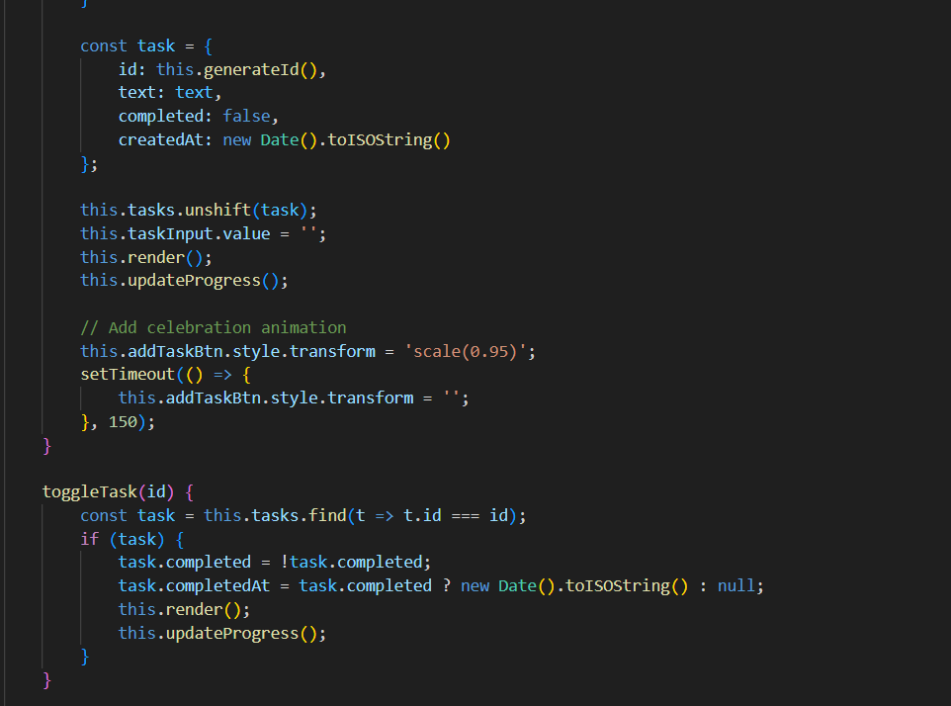
Coding: JavaScript

Slide 45
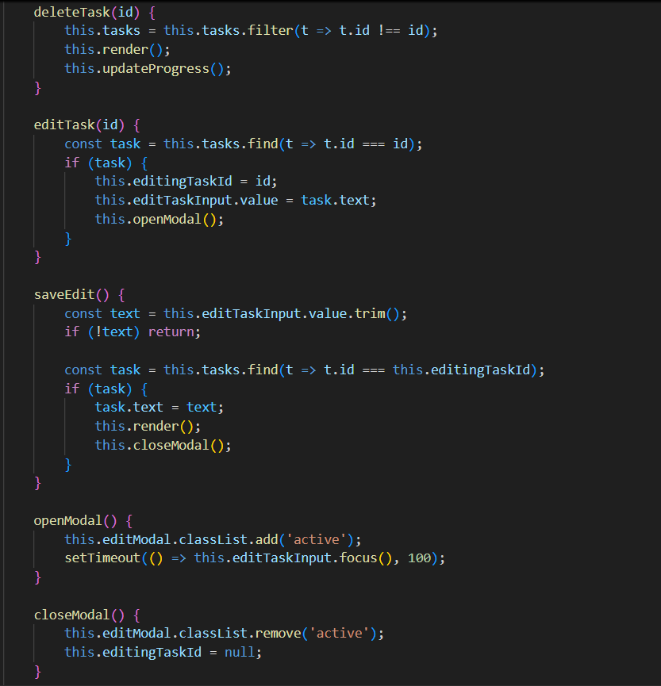
Coding: JavaScript

Slide 46
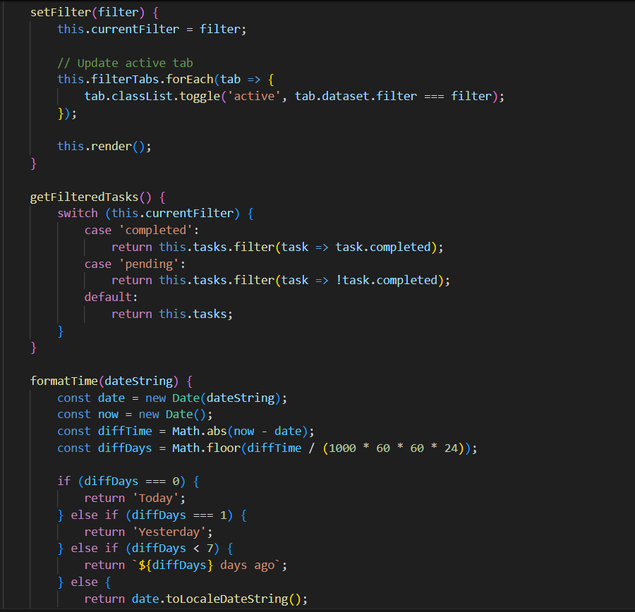
Coding: JavaScript

Slide 47
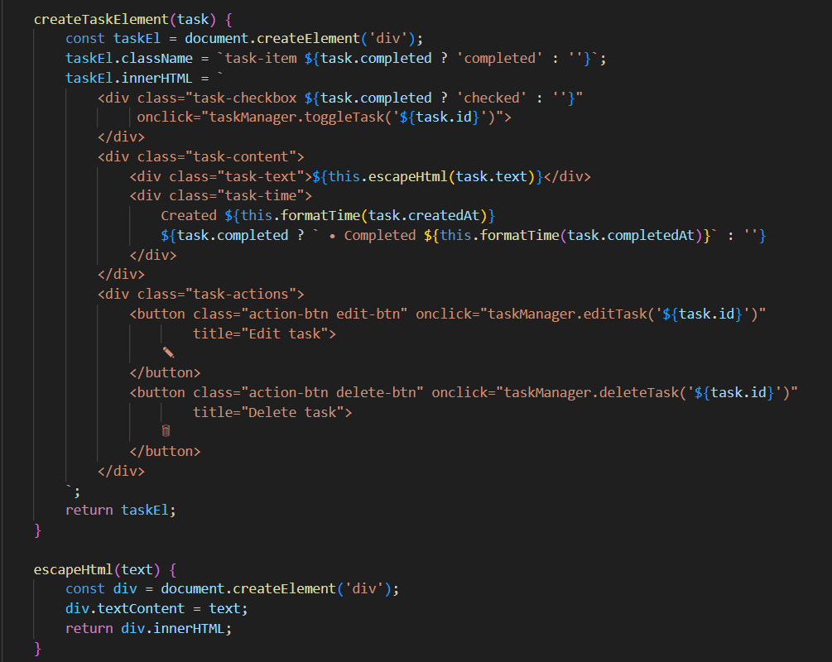
Coding: JavaScript

Slide 48
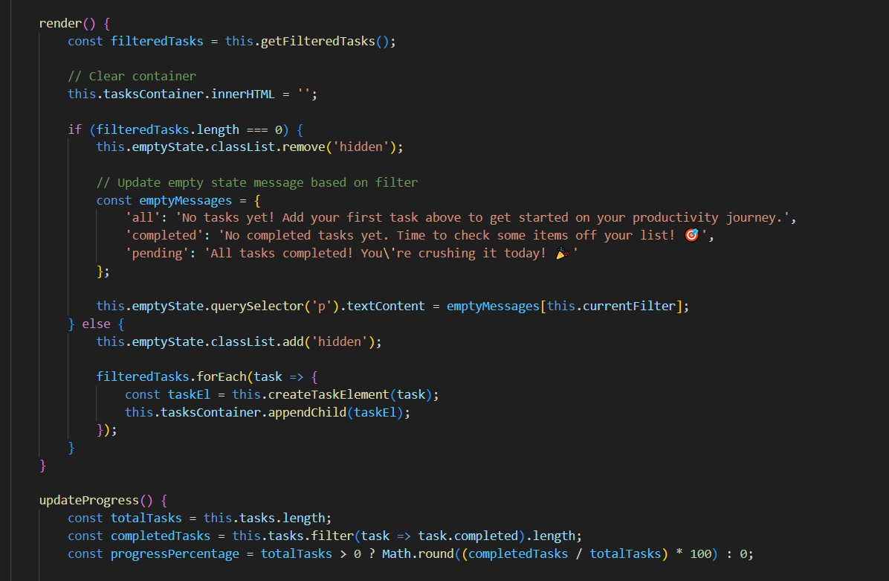
Coding: JavaScript

Slide 49
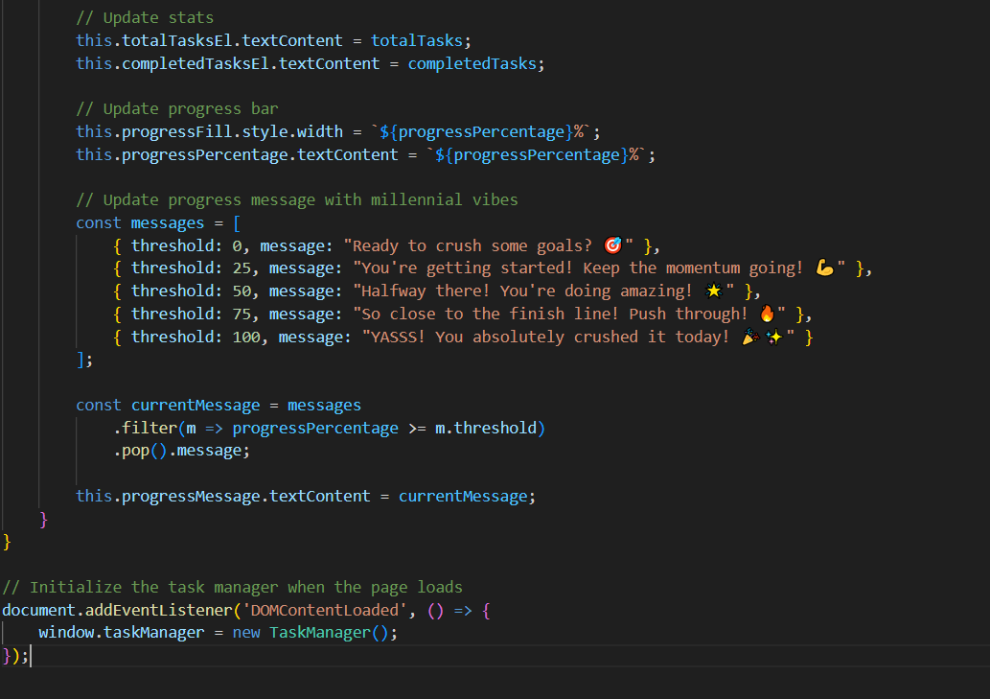
Coding: JavaScript

Slide 50
Explanation
The JavaScript code defines a TaskManager class to handle all logic for a to-do app (adding, editing, deleting, filtering tasks, and tracking progress).
In the constructor, it initializes state (tasks, currentFilter, etc.), grabs DOM elements, binds events, loads sample tasks, and renders UI.
The code provides methods to add tasks (addTask), toggle completion (toggleTask), edit text (editTask, saveEdit), and delete (deleteTask).
It uses a modal popup for editing tasks with open/close handling and keyboard shortcuts (Escape, Enter).
It also supports filters (all, completed, pending) via setFilter and getFilteredTasks.

Slide 51
Explanation
It also displays time info (Today, Yesterday, n days ago) for when tasks were created or completed (formatTime).
It also dynamically builds DOM nodes for each task (createTaskElement) with safe text rendering (escapeHtml).
It render function updates the task list display and shows an appropriate empty state message if no tasks match the filter.
The Progress tracker updates stats, progress bar width, percentage, and motivational messages based on completion ratio.
Finally, when the page loads (DOMContentLoaded), it creates a global taskManager instance and makes the app interactive.

Slide 52
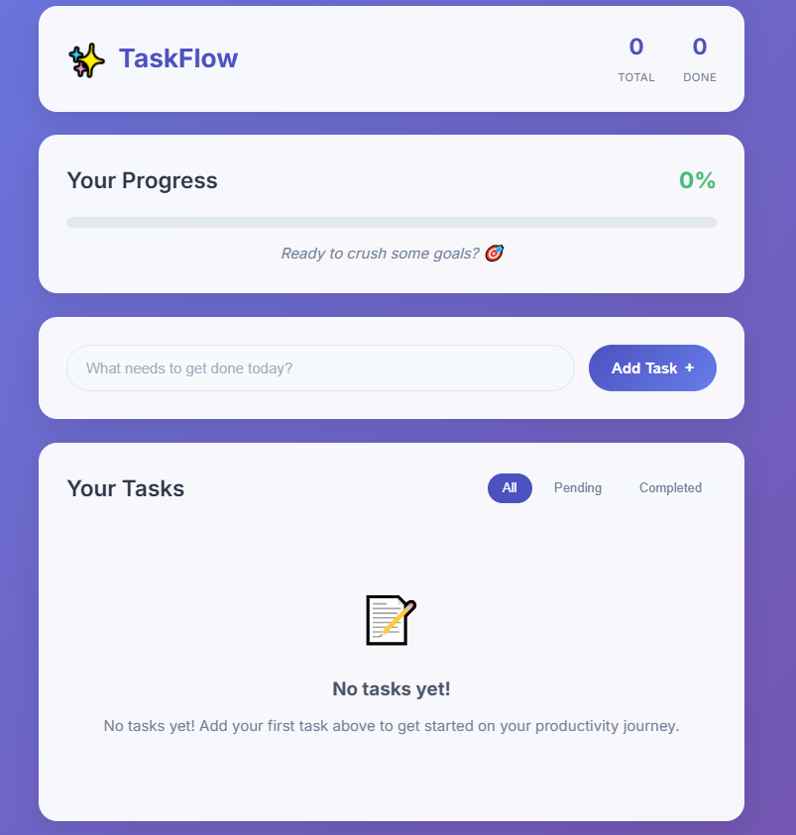
Results and Screenshots
No Task Added.

Slide 53
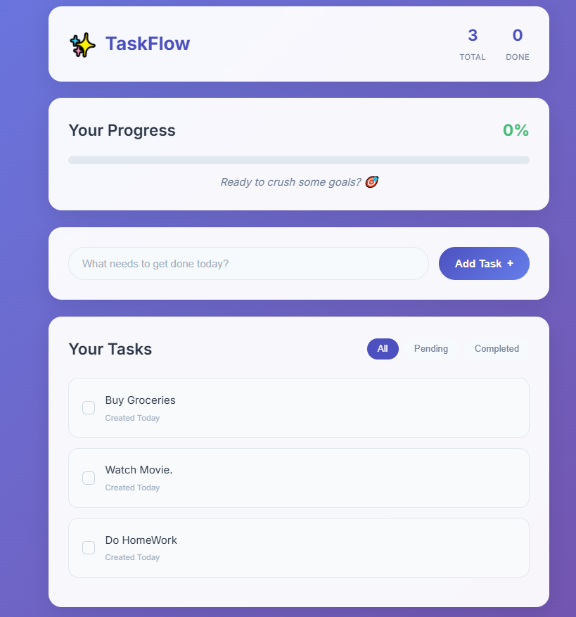
Results and Screenshots
Few Tasks Added.

Slide 54
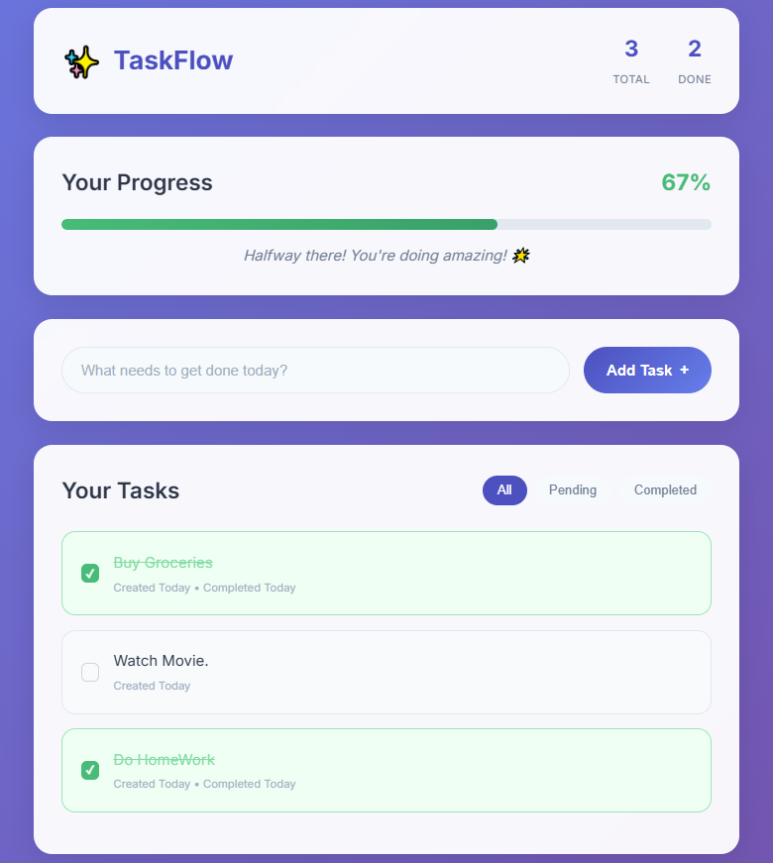
Results and Screenshots
Few Tasks Completed.

Slide 55
Conclusion
TaskFlow shows how frontend tech solves productivity challenges.
• Simple, visually appealing
• User-centric design
• Enhances productivity and organization

Slide 56
GitHub and Deployment Link
Github Link : HostileGenius/IBM-SkillBuild
Deployment Link: TaskFlow - Your Personal Productivity Hub

Slide 57
Thank You !!!

