Slide 1
DECISION MODELS

Slide 2
Theory of decision-making
Games against the nature
Model of conflict
  Conflict of intelligent (rational) and nonintelligent (irational) players
  Rational player is interesting in outcom
Selection of the best decision influenced by states of nature - events
Generaly unrepeatable situations

Slide 3
Decision model elements
Model elements
  Decision alternatives
  States of nature
  Decision matrix (table) – payoffs associated with each combination of alternatives and events
Decision criterion
Certainty, risk, uncertainty

Slide 4
Certainty, risk, uncertainty
Decision-making under certainty
  Decision maker knows for certain which state of nature will occur
  Probability of certain state of nature is 1, probabilities of others are 0
Decision-making under risk
  Probabilities for the occurrence of the different states of nature are known or estimated
Decision-making under uncertainty
  No estimates of the probabilities for the occurrence of the different states of nature are available

Slide 5
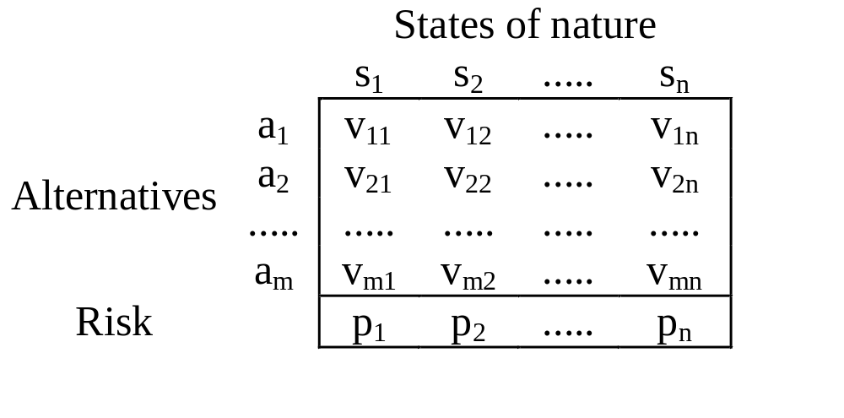
Decision table

Slide 6
Decision tree
Event 1
Payoff 1
E
Event 2
Payoff 2
Variant 1
Event 3
Payoff 3
Event 1
D
Variant 2
E
Event 2
Payoff
Variant 3
Event 3
Event 1
E
Event 2
Payoff
Event 3
Decision variants
States of nature
Payoffs

Slide 7
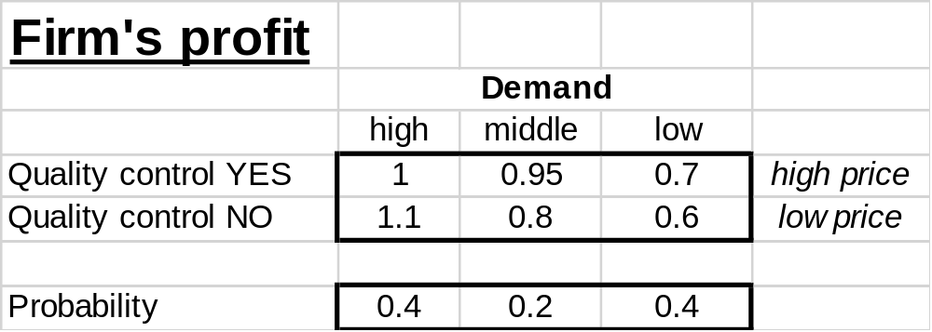
The best firm strategy

Slide 8
Solving of decision problems
Selection of the dominating alternative
Selection of the best alternative
  different methods (criteria) according to the nature of the decision-maker and the decision-making situation
Selection of the alternative according to the highest utility

Slide 9
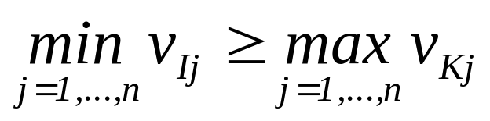
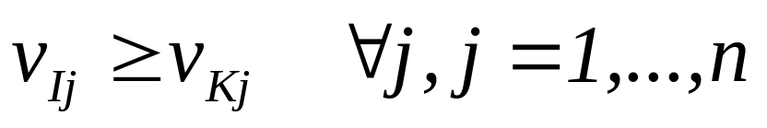
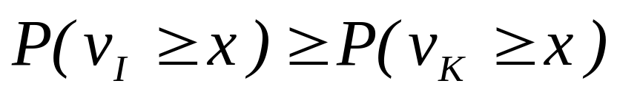
Selection of the dominating alternative
Outcome dominance: a_{I} dominates a_{K}
Event dominance: a_{I} dominates a_{K}
Probabilistic dominance: a_{I} dominates a_{K}

Slide 10
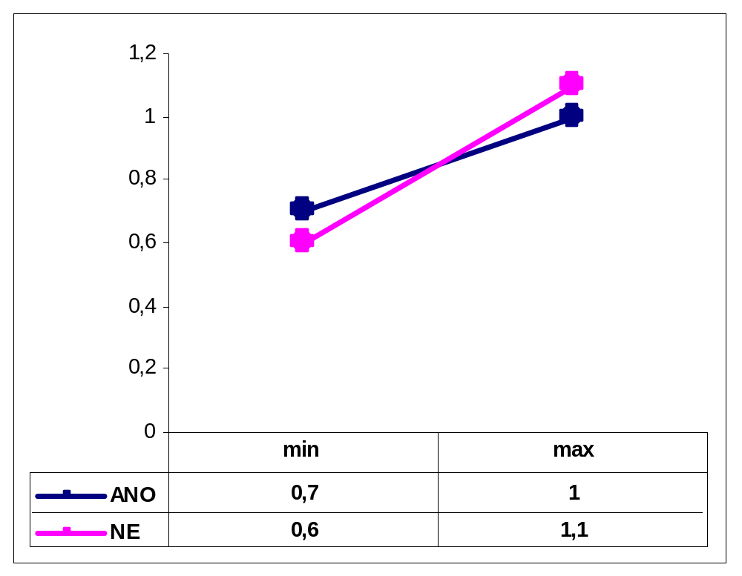
Outcome dominance
1 0.95 0.7
1.1 0.8 0.6
YES
NO

Slide 11
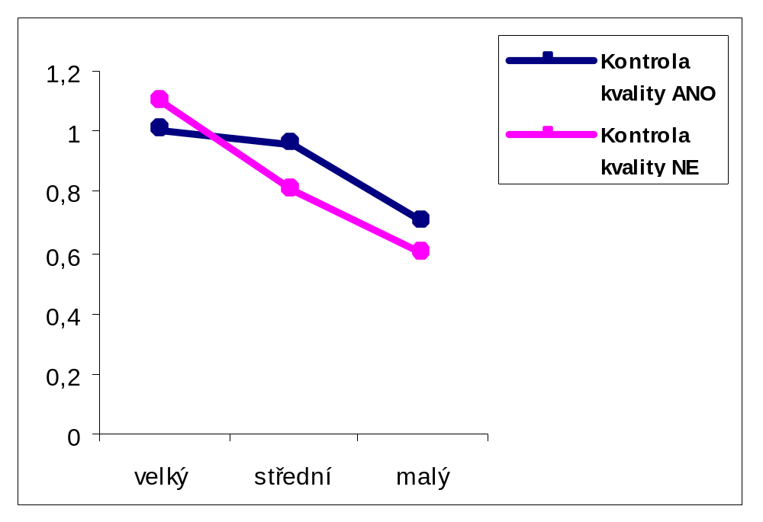
Event dominance
1 0.95 0.7
1.1 0.8 0.6
Quality control YES
Quality control NO
High Middle Low

Slide 12
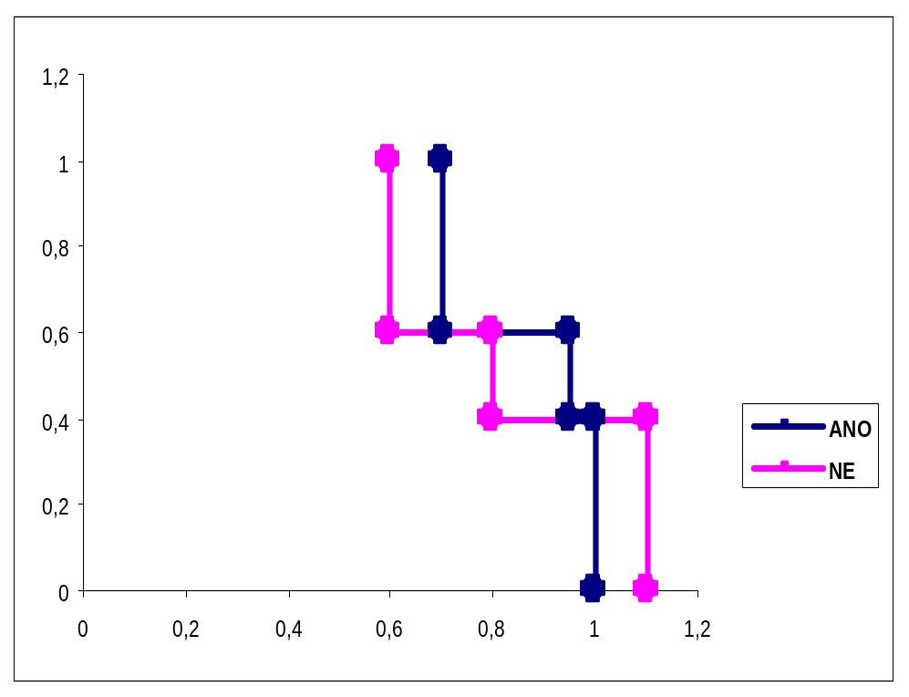
Probabilistic dominance
Risk profil
1 0.95 0.7
1.1 0.8 0.6
YES
NO

Slide 13
Selection of the best alternative
Decision-making under certainty
Decision-making under uncertainty
  Maximax rule
  Wald criterion - maximin rule
  Savage criterion - minimax regret rule
  Laplace criterion - principle of insufficient reason
  Hurwicz criterion
Decision-making under risk
  EMV criterion - expected monetary value criterion
  EOL criterion - expected opportunity loss criterion

Slide 14
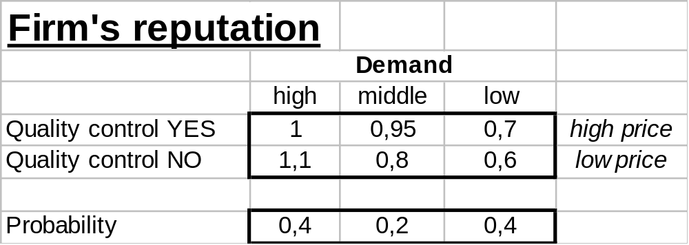
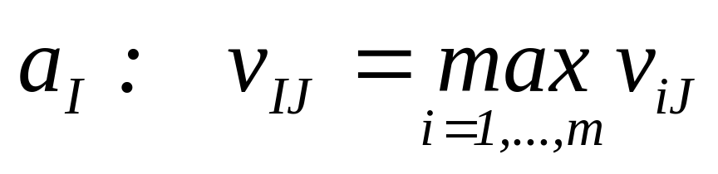
The best alternative under certainty

Slide 15
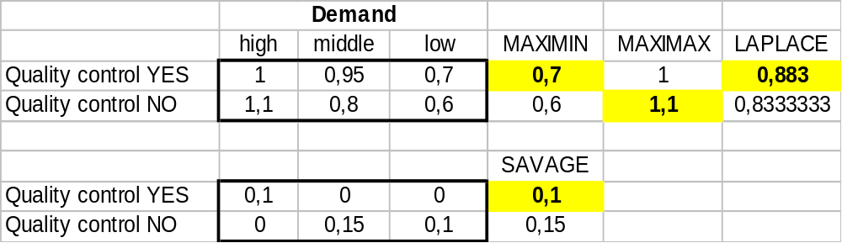
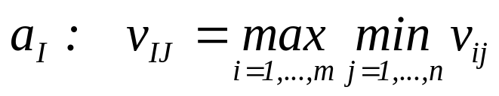
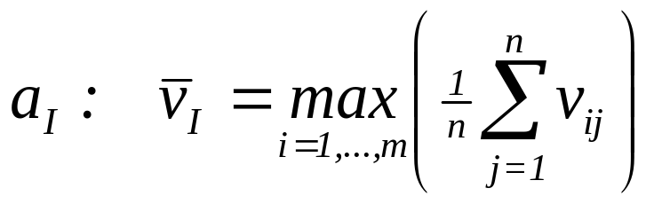
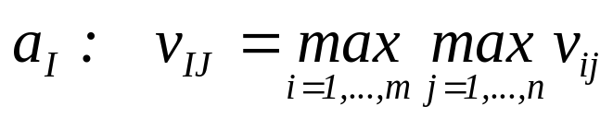
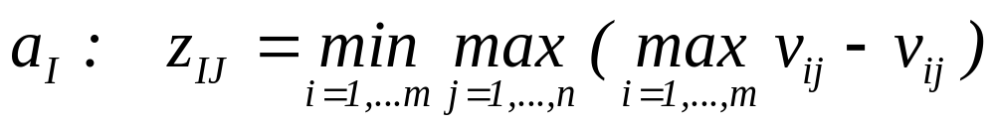
The best alternative under uncertainty

Slide 16
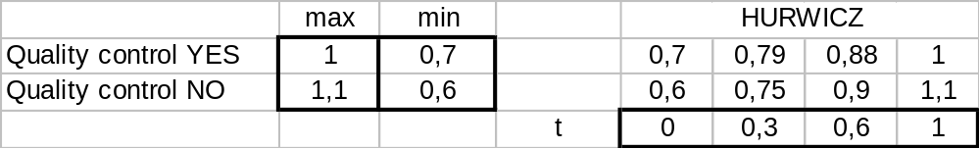
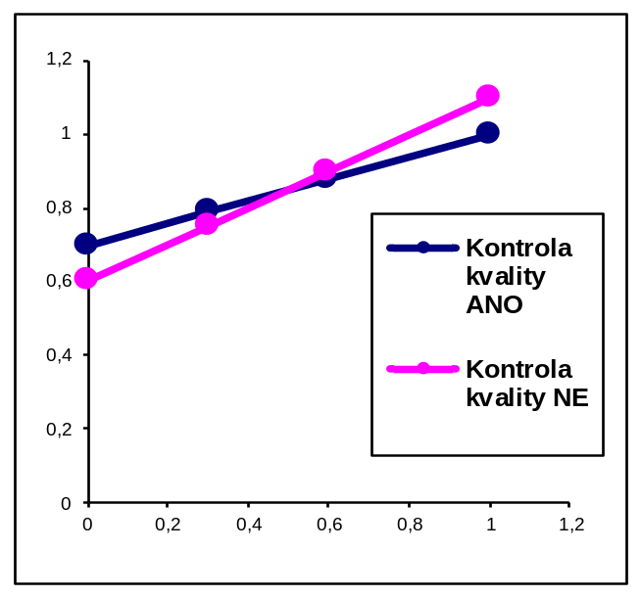
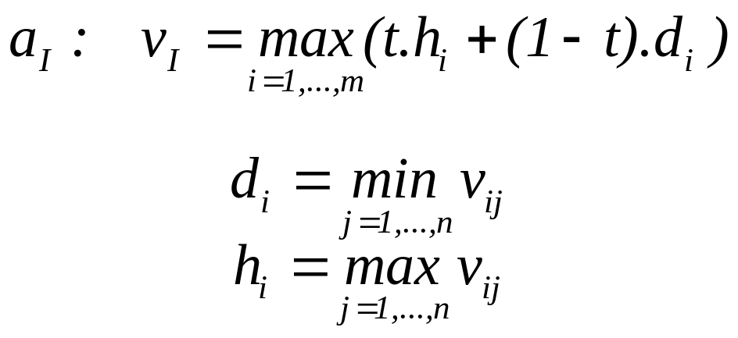
The best alternative under uncertainty

Slide 17
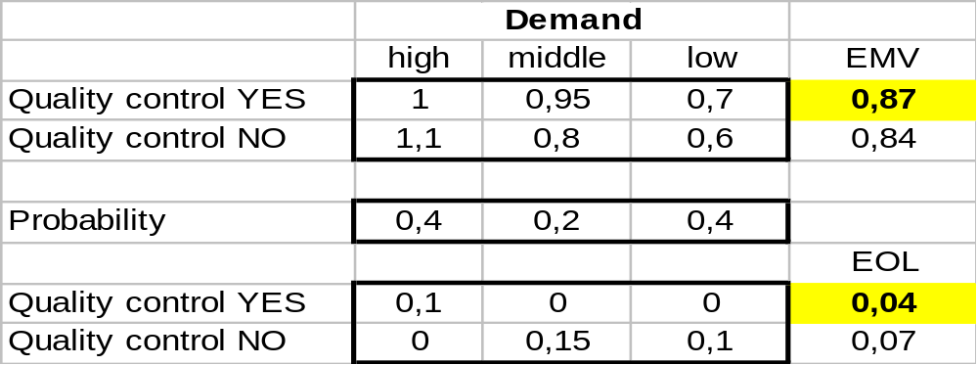
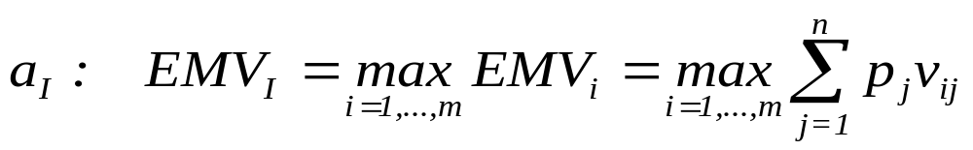
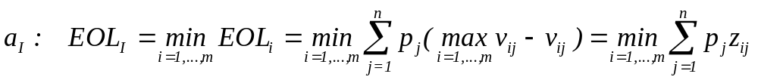
The best alternative under risk

Slide 18
Decision tree
Demand high
Demand middle
M
Quality control YES
Demand low
R
Demand high
Quality control
NO
Demand middle
M
Demand low

Slide 19
Decision model result
The best decision alternative
  Chosen decision – decision-making alternative to implementation

