Slide 1
MULTIPLE ATTRIBUTES EVALUATION OF VARIANTS
Conflict among criteria

Slide 2
Two kinds of models
Multiple Objective Decision Making
  Infinite Number of Alternatives
Multiple Attribute Decision Making
  Finite Number of Alternatives

Slide 3
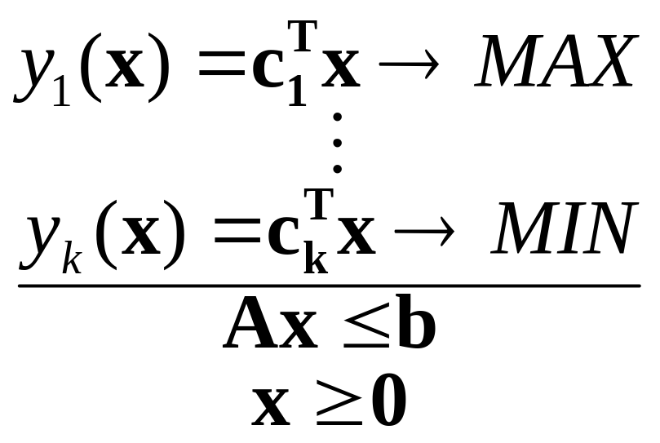
Multiple Objective Decision Making
Infinite Number of Alternatives
At least two criteria
Example – Linear multi criteria programming

Slide 4
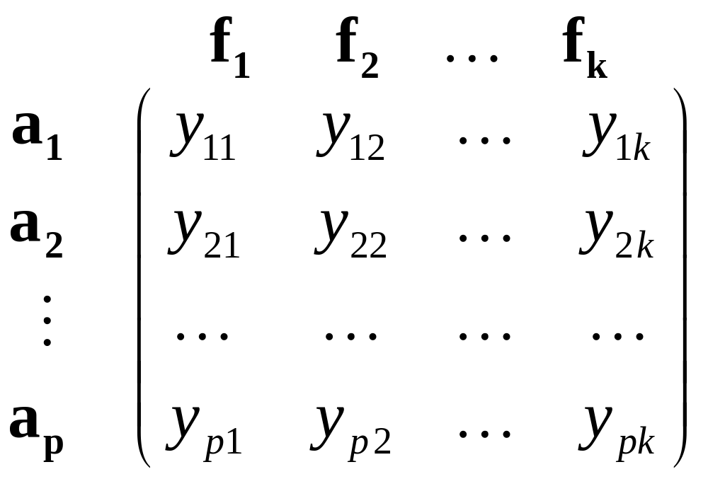
Multiple Attribute Decision Making
Finite Number of Alternatives
Evaluation of all alternatives with respect to all attributes

Slide 5
Basic terms
Ideal alternative
Nadir alternative
Dominating and dominated alternative
The best alternative – preferred alternative – compromise alternative
Pareto efficient alternative

Slide 6
Ideal and nadir variant
Ideal variant – Hypothetical or real variant that is best in all criteria (or as good as the best variant).
  variant H - evaluation (h₁, ..., h_{k})
Nadir variant – Hypothetical or real variant that is worst in all criteria.
  variant D - evaluation (d₁, ..., d_{k}).

Slide 7
Dominance among alternatives
Maximization criteria
Alternative a_{i} is dominating alternative a_{j} , if
(y_{i1}, y_{i2} ,…, y_{ik}) ≥ (y_{j1}, y_{j2},…, y_{jk})
and for at least one criterion f_{l} holds y_{il} > y_{jl} .
Nondominated alternative
  Alternative a_{i} is nondominated if the decision set of alternatives doesn’t contain alternative that dominates a_{i}.
  Pareto efficiency – Pareto efficient alternative

Slide 8
The best (preferred, compromise) alternative
The best alternative is close to the ideal alternative.
  The best alternative has the smallest distance from ideal alternative according to the proper metrics.
Compromise among criteria
  Compensation of criteria
  Some criteria omitted

Slide 9
The aim of MADM
Selection of the best alternatives (one or more)
Dichotomizing into the efficient and non efficient alternatives
Ranking of all alternatives
Noncompensatory model
  Not permit trade-offs between attributes
Compensatory Model
  Permit trade-offs between attributes

Slide 10
Utility, utility function
Utility is a measure of satisfaction
All attribute values can be expresed by utility value
Partial utility values can be combined into global utility value

Slide 11
Utility function
A utility function represents a preference relation
Mapping of attribute values into interval ⟨0, 1⟩
Risk seeking
1
0
Risk neutral
Risk aversion

Slide 12
Graphical representation I
f₂
a₁
H
a₂
a₃
D
a₄
f₁

Slide 13
Graphical representation II
Radial graphs
a₁
a₂
a₁
a₂
S
S

Slide 14
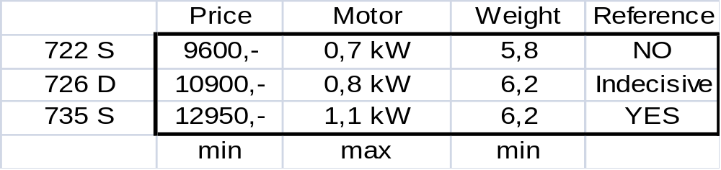
The lawn mower problem
Selection of the best lawn mower according to the price, motor, weight and reference

Slide 15
Informations
Inter and intra attribute comparisons
  Criteria preferences
  Alternatives preferences
    Not necessary in numerical form
  No preference information given
  Nominal information - standard levels of attributes
  Ordinal information - qualitative - ordering
  Cardinal information - quantitative

Slide 16
Methods for quantifying information
Sequence Method
  Criteria/alternatives are arranged according their importance to a sequence from most to least important.
Scoring Method
  Each criterion/alternative is evaluated by certain number of points from chosen scale.
Pairwise comparison
  The judgement of the relative importance of each pair of criteria/alternatives.

Slide 17
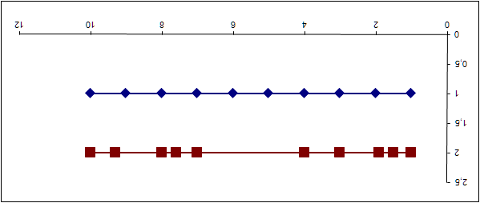
Quantification of information
Sequencing method
Scoring method
Pairwise comparison
  Consistency
 | Rank | Points
Price
Motor
Weight
Reference

Slide 18
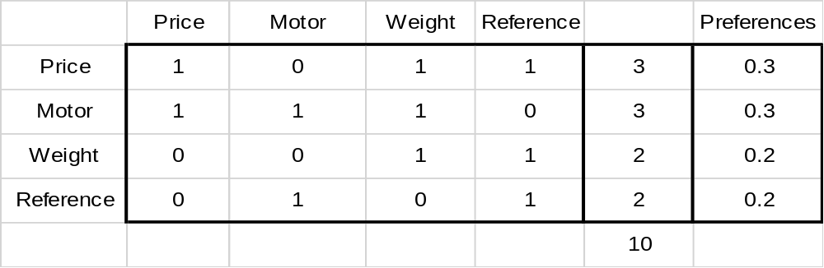
The lawn mower problem
Pairwise comparison
Expression of preference
    yes – no (1 – 0)
    Ordinal and cardinal preferences
      Fuller method
      Saaty method

Slide 19
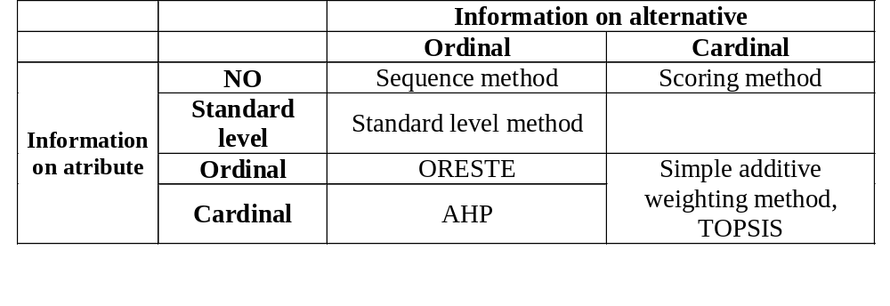
Taxonomy of MADM methods

Slide 20
MADM methods
Attributes must be measured in the same scale
Sequence or scoring methods
Standard level methods
Simple additive weighting method

Slide 21
Scoring or sequence methods
Alternatives are arranged to a sequence and are evaluated by their order from 1
OR
Alternatives are evaluated by certain number of points from chosen scale for inst. from 1 to 10
Sequence numbers or scores are added
Both methods can be extended by criteria weights

Slide 22
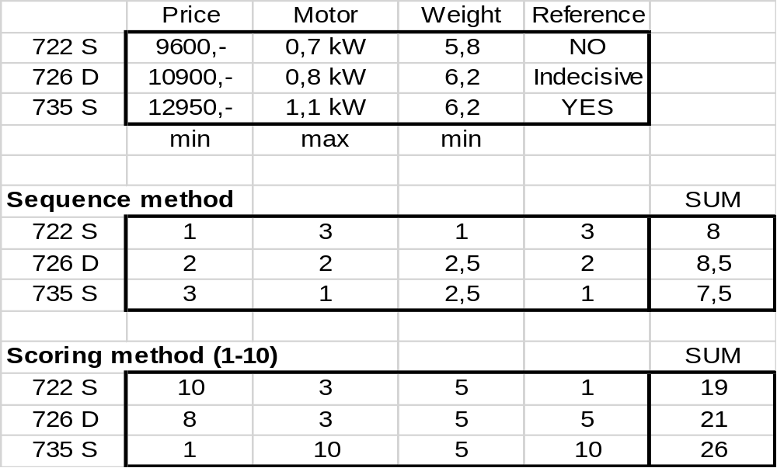
The lawn mower problem

Slide 23
Standard level methods
Conjunctive method
  Elimination of alternatives not satisficing all standard levels
Disjunctive method
  Accepted alternatives satisficing at least one standard level
Iterative approach
  Change of some standard levels to receive exact number of preferred alternatives

Slide 24
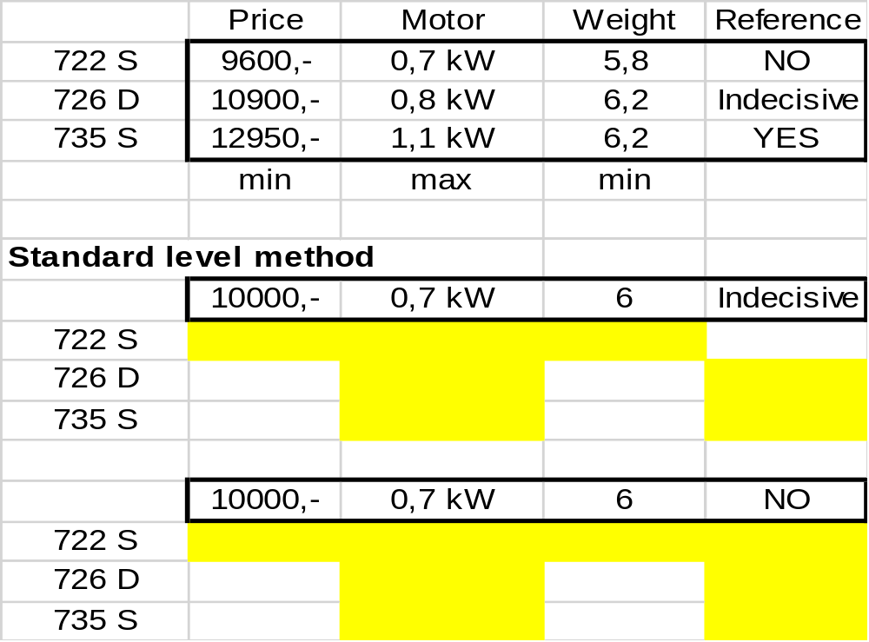
The lawn mower problem

Slide 25
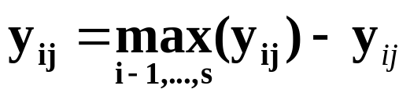
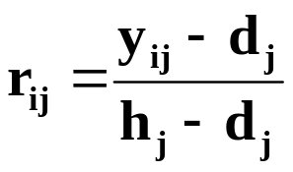
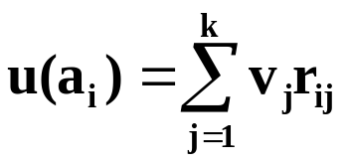
Simple additive weighting method
Transforming all attribute evaluation into maximization criteria
Setting ideal alternative H with evaluation (h₁, ..., h_{k}) and nadir alternative D with evaluation (d₁, ..., d_{k}).
Calculation of standardized criterial matrix R (partial utility values)
Calculation of aggregate utility of all alternatives
Ranking od alternatives according to the utility u(a_{i}).

Slide 26
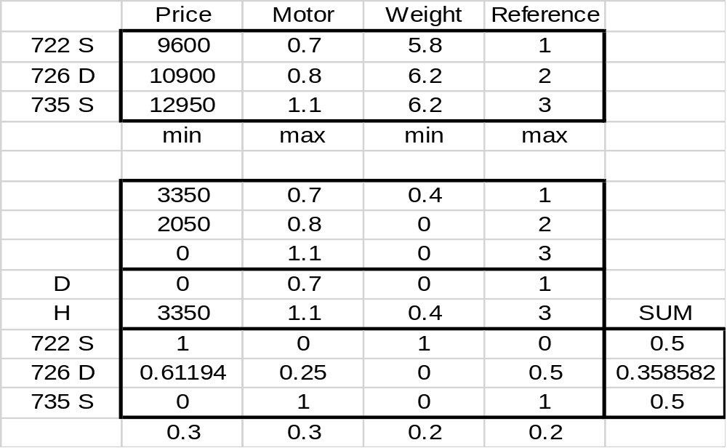
The lawn mower problem

