Slide 1
GAME THEORY

Slide 2
Aim of the Game theory model
Finding of optimal strategy in hazardous games
Economic behaviour – selection of strategy
Model of conflict or competition
Intelligent (rational) player
Non intelligent (irrational) player
John von Neumann, Oscar Morgenstern – 1928
John Forbes Nash – Nobel prize 1994

Slide 3
Game
Model of conflict or competition
Cooperative, non-cooperative games
Antagonistic – non-antagonistic game
Time – simultaneous and sequential game
Repetition
Game - play - strategy - move

Slide 4
Players
Number of players
Intelligent (rational) and non-intelligent (irrational) players
Form of cooperation

Slide 5
Strategy
Player‘s behaviour
Game – play - strategy - move
Finite, infinite games
Discrete, continuous games

Slide 6
Payoff
Players‘ results, outcomes
Depends on the choice of the strategies of all players
Payoff functions
Maximization of profit
Constant-sum, non-constant-sum games

Slide 7
Game theory model elements
Players
Strategies
Payoffs for each combination of players' strategies
sometimes conditions for these values

Slide 8
Game theory model result
Equilibrium strategy
The strategy of each player that gives him the best possible outcome, i.e. in which he and the other players achieve their best possible outcomes
The payoff of the game is the gain of the individual players

Slide 9
Solution of game
Each player tries to maximize his welfare, profit, outcome at the expense of the others.
Result – The best (optimal) strategies which gives to each player the best outcome related to the other players and their strategies
Maximal possible win of each player
Value of game – players‘ gain, expected payoffs

Slide 10
Model of game
Tree (extensive) form of model
Game tree (decision tree - moves)
Normal form of model
List of players, list of strategy spaces, and list of payoff functions
Payoff matrix (decision matrix)
Characteristic function form of model
Payoffs of all coalitions

Slide 11
Matrix game
Two-person game
Finite number of strategies for each player
Zero-sum game
Sum of payoffs for both players is equal to zero
Outcom of one player is a loss of the other player
Matrix form of game model

Slide 12
Matrix game in normal form
Payoff matrix

Slide 13
Matrix game in tree form
Game tree
Move 2
A
Move n
H2
payoff
Move 1
B
Move n
H2
payoff
Move 2
A
Move 1
A
……….
Strategy A
Strategy B
Move n
H2
payoff
Move2
A
Move 1
B
Move n
H2
payoff
Move2
A

Slide 14
Pure and mixed strategy
Pure strategy
One best strategy
Mixed strategy
Probabilities of strategies realization or frequencies of strategies usage
If player A has m pure strategies R₁, R₂,…, R_{m}, then his mixed strategy is a probability distribution over m points
(r₁, r₂,…, r_{m})

Slide 15
Optimal pure strategy
Player A
Lower value of the game
Player B
Upper value of the game
Opponent view
Player view

Slide 16
Saddle point
Strategies (R_{k}, S_{h}) represent saddle point of matrix game, if
Lower value of game is equal to upper value of game
(Maximin is equal to minimax)
For saddle point and other strategies i=1, ... ,m a j=1,...,n is true, that
Wrong (non optimal) strategy means smaller outcom.

Slide 17
Matrix game solution
Theorem
The optimal pure strategies exist in the matrix game, if and only if the game has the saddle point.

Slide 18
Matrix game – Firms competition
Game with saddle point

Slide 19
Matrix game – Firms competition
Game without saddle point

Slide 20
Mixed strategies
Mixed strategy of player A
r = (r₁, r₂, ... , r_{m})^{T}, and Σ r_{i} = 1
Mixed strategy of player B
s = (s₁, s₂, ... , s_{n})^{T} , and Σ s_{j} = 1

Slide 21
Seeking of optimal mixed strategy
Player A wants at least outcome w (maximin)
r^{T}a_{j} ≥ w for all j=1,...,n
Σ r_{i} = 1
r ≥ 0
w → max
Player B wants at most loss w (minimax)
a_{i}s ≤ w for all i=1,...,m
Σ s_{j} = 1
r ≥ 0
w → min

Slide 22
Seeking of optimal mixed strategy
Player A
r^{T}a_{j} ≥ w for all j=1,...,n
Σ r_{i} = 1
r ≥ 0
w → max
Player A (transformation x_{i} = r_{i}/w)
x^{T}a_{j} ≥ 1 for all j=1,...,n
Σ x_{i} = 1/w
x ≥ 0
1/w = Σ x_{i} → min

Slide 23
Seeking of optimal mixed strategy
Theory of duality
Player A
x^{T}a_{j} ≥ 1 for all j=1,...,n
x ≥ 0
Σ x_{i} → min
Player B
a_{j}y ≤ 1 for all i=1,...,m
y ≥ 0
Σ y_{j} → max

Slide 24
Seeking of optimal mixed strategy
Transformation of models is possible only in the case of positive payoffs, because value of game w has to be positive
Non negative elements of payoff matrix
Addition of proper value to each pay-off
Selection of value at least as
Do not forget do carry back this transformation !!!!!!!!!

Slide 25
Matrix game solution
The Minimax Theorem.
For every finite two-person zero-sum game,
(1) there is a number w, called the value of the game,
(2) there is a mixed strategy for Player A such that his average gain is at least w no matter what B does, and
(3) there is a mixed strategy for Player B such that his average loss is at most w no matter what A does.
Fundamental theorem of game theory says, that optimal mixed strategy exists

Slide 26



Matrix game – Firms competition
Pay-off matrix – negative element
Min a_{ij} = -0,1 … proper value for instance 0,6
Player A
0,5r₁ + 0,7r₂ ≥ w 0,5x₁ + 0,7x₂ ≥ 1
0,8r₁ + 0,4r₂ ≥ w 0,8x₁ + 0,4x₂ ≥ 1
r₁ + r₂ = 1 (x₁ + x₂ = ¹/_{w})
r₁ , r₂ ≥ 0 x₁ , x₂ ≥ 0
w → max x₁ + x₂ → min
$$\left(\begin{matrix}−0,1 & 0,2 \\ 0,1 & −0,2\end{matrix}\right)$$
$$\left(\begin{matrix}−0,1+0,6 & 0,3+0,6 \\ 0,1+0,6 & −0,2+0,6\end{matrix}\right)$$
$$\left(\begin{matrix}0,5 & 0,8 \\ 0,7 & 0,4\end{matrix}\right)$$

Slide 27
Matrix game – Firms competition
Player B
0,5s₁ + 0,8s₂ ≤ w 0,5y₁ + 0,8y₂ ≤ 1
0,7s₁ + 0,4s₂ ≤ w 0,7y₁ + 0,4y₂ ≤ 1
s₁ + s₂ = 1 (y₁ + y₂ = ¹/_{w})
s₁ , s₂ ≥ 0 y₁ , y₂ ≥ 0
w → min y₁ + y₂ → max

Slide 28
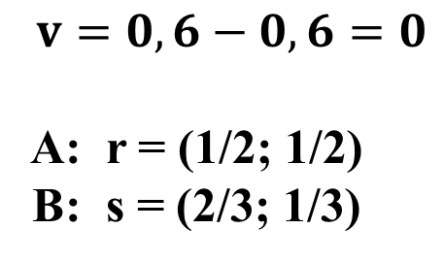
Matrix game – Firms competition
Optimal mixed strategies
$$v=0,6−0,6=0$$
A: r = (1/2; 1/2)
B: s = (2/3; 1/3)

Slide 29
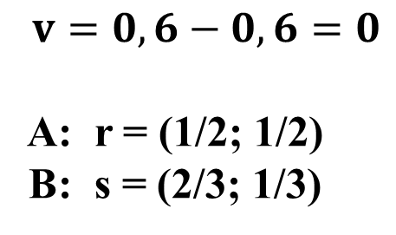
Matrix game – Firms competition
Optimal mixed strategies
Firm A has to check the quality of half of its products.
Firm B has to control the quality of two thirds of its products.
They will have the same amount of profit.
$$v=0,6−0,6=0$$
A: r = (1/2; 1/2)
B: s = (2/3; 1/3)

Slide 30
Methods of solving the matrix game
maximin and minimax
searching for a saddle or equilibrium point
searching for pure or mixed strategies
simplex algorithm

Slide 31
Game against nature
Non-intelligent (irational) player – nature
Decision models

